Slide 1
General overview:
atomic coordinates and charges
generate .sdf file
generate .xyz and .key file
generate .mfj file
run mobcal
OpenBabel
sdf2tinkerxyz
xyztomfj_mmff_mmffcharge.py
vdw.prm
mass.prm

Slide 2
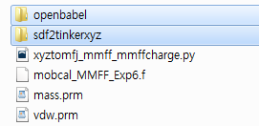
Necessary files:
OpenBabel: converts a coordinate file into an .sdf file. Needs to be pre-installed on the system
(http://openbabel.org/wiki/Main_Page)
sdf2tinkerxyz: generates the .xyz and .key file with MMFF atom types and charges. Needs to be pre-installed on the system (http://sdf2xyz2sdf.sourceforge.net/?Description:sdf2tinkerxyz)
xyztomfj_mmff_mmffcharge.py: generates .mfj file from atomtype and charge information from the .xyz and .key file, and the parameters from mass.prm and vdw.prm.
mass.prm: summary of mass and atomtype information from Tinker (https://dasher.wustl.edu/tinker/distribution/params/mmff.prm)
vdw.prm: summary of vdw parameters from the original publication for MMFF
(ftp://ftp.wiley.com/public/journals/jcc/suppmat/17/490/MMFF-I_AppendixB.ascii)

Slide 3
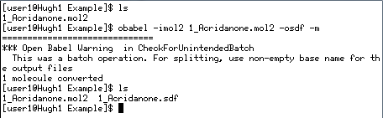
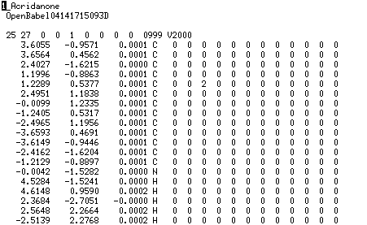
1. Convert a coordinate file to an .sdf file using OpenBabel
# obabel –imol2 1_Acridanone.mol2 -osdf -m
.sdf file is a type of coordinate files
a .sdf file

Slide 4

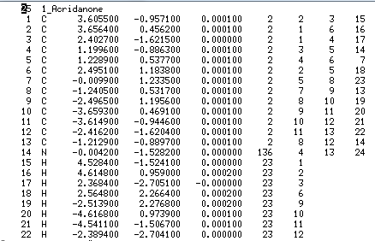
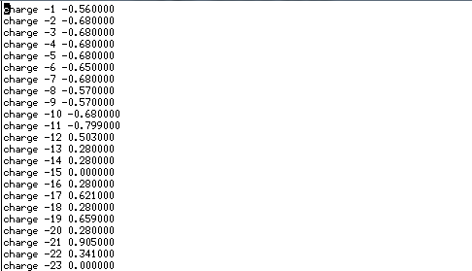
2. Generate .xyz and .key file from the .sdf file using the sdf2tinkerxyz software
# sdf2tinkerxyz < 1_Acridanone.sdf
a .xyz file
a .key file
The generated .xyz file has the information on atom types automatically assigned by the sdf2tinkerxyz software. It is recommended to check the assigned atom types.
The generated .key file has the information on MMFF charges automatically assigned by the sdf2tinkerxyz software. Note that charges are sometimes improperly assigned, especially when multiple/uncommon protonation sites are present within a molecule.

Slide 5
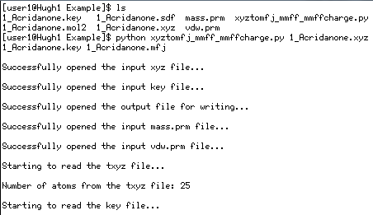
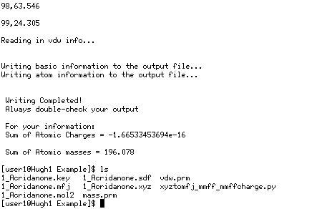
3. Generate the .mfj file for calculations using the xyztomfj python code. Note that mass.prm and vdw.prm must be located in the same directory beforehand.
# python xyztomfj_mmff_mmffcharge.py 1_Acridanone.xyz 1_Acridanone.key 1_Acridanone.mfj
Verify that the sum of atomic charges and atomic masses are proper. Note that the sum of atomic charges in this example is ~0 (e⁻¹⁶), although the molecule is a singly protonated ion. This means that the charges were not correctly assigned by the sdf2tinkerxyz software, and this is because the protonation site was at an oxygen atom. In this case, alternative charges must be used by providing proper charge information to the .mfj file.

Slide 6
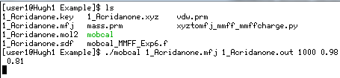

4. Compile Mobcal and run. The Mobcal code has been modified to accept input file name, output file name, random seed number, and scaling factors from the command line.
#f95 mobcal_MMFF_Exp6.f –o mobcal
# ./mobcal 1_Acridanone.mfj 1_Acridanone.out 1000 0.98 0.81 (for helium)
or ./mobcal 1_Acridanone.mfj 1_Acridanone.out 1000 0.76 0.86 (for nitrogen)
The scaling factors, 0.98 and 0.81, are from Table S9 of the helium publication (Exp-6 with optimized MMFF parameters). The scaling factor 0.76 and 0.86 is from Table S2 of the nitrogen publication.
It is recommended to repeat the calculations at least three times using different scaling factors (1000 in the example above) and average the results.
An imp value of 100 for calculations gives high precision (<1% relative deviation) for most systems, but can be reduced or increased if necessary.

Slide 7
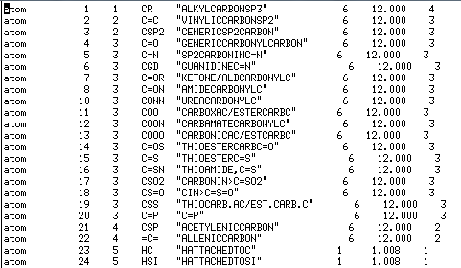
@ “Atom type” and “atom type group” (arbitrary terminology in this PPT file)
mass.prm
.xyz file
“atom type”
“atom type group”
“atom type”
A number of atoms with different atom types can belong to the same atom type group. For example, in the mass.prm file, it can be seen that “H attached to C” and “H attached to Si” are assigned atom types of 23 and 24, respectively, although they belong to the same atom type group (“5”). Vdw parameters are assigned following atom type group.
Note that the .xyz file from the sdf2tinkerxyz software has the “atom type” information rather than “atom type group” information. Therefore, the xyztomfj.py code reads the mass.prm file to assign atom type groups, and assigns vdw parameters based on the information.

Slide 8
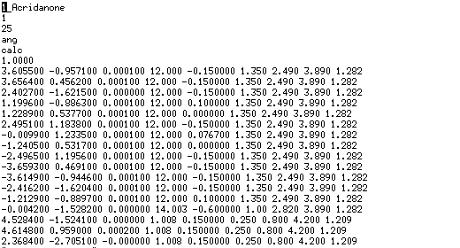
@ the .mfj file
MMFF vdw parameters
The original Mobcal code requires five information for an atom, which are: x coordinate, y coordinate, z coordinate, mass, and charge. In the modified code, four additional vdw parameters (α_{i}, N_{i}, A_{i}, and G_{i}) need to be provided for each atom. This is done by the xyztomfj code, but manual verification is always recommended.

Slide 9
@ Partial charges
In case charge is incorrectly assigned by the xyztomfj software, proper charges need to be supplied by the user. See related publications.
@ Multiple coordinates
Be cautious when using an .mfj file with multiple coordinates inside, because verification has not been performed extensively for such use.

Slide 10
Summary of commands:
# obabel –imol2 1_Acridanone.mol2 -osdf –m
# sdf2tinkerxyz < 1_Acridanone.sdf
# python xyztomfj_mmff_mmffcharge.py 1_Acridanone.xyz 1_Acridanone.key 1_Acridanone.mfj
# f95 mobcal_MMFF_Exp6.f –o mobcal
# ./mobcal 1_Acridanone.mfj 1_Acridanone.out 1000 0.98 0.81
Jong Wha Lee, Mar 15 2018

