Slide 1

Indexed
Files.

Slide 2
Creating an Indexed File
$ SET SOURCEFORMAT"FREE"
IDENTIFICATION DIVISION.
PROGRAM-ID. CreateIndexedFromSeq.
* Creates an indexed file from a sequential file.
ENVIRONMENT DIVISION.
INPUT-OUTPUT SECTION.
FILE-CONTROL.
SELECT VideoFile ASSIGN TO "VIDEO.DAT"
ORGANIZATION IS INDEXED
ACCESS MODE IS RANDOM
RECORD KEY IS VideoCode
ALTERNATE RECORD KEY IS VideoTitle
WITH DUPLICATES
FILE STATUS IS VideoStatus.
SELECT SeqVideoFile ASSIGN TO "INVIDEO.DAT".
DATA DIVISION.
FILE SECTION.
FD VideoFile.
01 VideoRecord.
02 VideoCode PIC 9(5).
02 VideoTitle PIC X(40).
02 VideoSupplierCode PIC 99.
FD SeqVideoFile.
01 SeqVideoRecord.
88 EndOfFile VALUE HIGH-VALUES.
02 SeqVideoCode PIC 9(5).
02 SeqVideoTitle PIC X(40).
02 SeqVideoSupplierCode PIC 99.
WORKING-STORAGE SECTION.
01 VideoStatus PIC X(2).

Slide 3
Creating an Indexed File
PROCEDURE DIVISION.
Begin.
OPEN INPUT SeqVideoFile.
OPEN OUTPUT VideoFile.
READ SeqVideoFile
AT END SET EndOfFile TO TRUE
END-READ.
PERFORM UNTIL EndOfFile
WRITE VideoRecord FROM SeqVideoRecord
INVALID KEY DISPLAY "VIDEO STATUS :- ", VideoStatus
END-WRITE
READ SeqVideoFile
AT END SET EndOfFile TO TRUE
END-READ
END-PERFORM.
CLOSE VideoFile, SeqVideoFile.
STOP RUN.

Slide 4
Reading an Indexed File - Sequentially.
$ SET SOURCEFORMAT"FREE"
IDENTIFICATION DIVISION.
PROGRAM-ID. ReadingIndexedFile.
* Sequential reading of an indexed file
ENVIRONMENT DIVISION.
INPUT-OUTPUT SECTION.
FILE-CONTROL.
SELECT VideoFile ASSIGN TO "VIDEO.DAT"
ORGANIZATION IS INDEXED
ACCESS MODE IS DYNAMIC
RECORD KEY IS VideoCode
ALTERNATE RECORD KEY IS VideoTitle
WITH DUPLICATES
FILE STATUS IS VideoStatus.
DATA DIVISION.
FILE SECTION.
FD VideoFile
01 VideoRecord.
88 EndOfFile VALUE HIGH-VALUE.
02 VideoCode PIC 9(5).
02 VideoTitle PIC X(40).
02 SupplierCode PIC 99.
WORKING-STORAGE SECTION.
01 VideoStatus PIC X(2).
01 RequiredSequence PIC 9.
88 VideoCodeSequence VALUE 1.
88 VideoTitleSequence VALUE 2.
01 PrnVideoRecord.
02 PrnVideoCode PIC 9(5).
02 PrnVideoTitle PIC BBBBX(40).
02 PrnSupplierCode PIC BBBB99.

Slide 5
Reading an Indexed File - Sequentially.
PROCEDURE DIVISION.
Begin.
OPEN INPUT VideoFile.
DISPLAY "Enter key : 1=VideoCode, 2=VideoTitle ->"
WITH NO ADVANCING.
ACCEPT RequiredSequence.
IF VideoTitleSequence
MOVE SPACES TO VideoTitle
START VideoFile KEY IS GREATER THAN VideoTitle
INVALID KEY DISPLAY "VIDEO STATUS :- ", VideoStatus
END-START
END-IF
READ VideoFile NEXT RECORD
AT END SET EndOfFile TO TRUE
END-READ.
PERFORM UNTIL EndOfFile
MOVE VideoCode TO PrnVideoCode
MOVE VideoTitle TO PrnVideoTitle
MOVE SupplierCode TO PrnSupplierCode
DISPLAY PrnVideoRecord
READ VideoFile NEXT RECORD
AT END SET EndOfFile TO TRUE
END-READ
END-PERFORM.
CLOSE VideoFile.
STOP RUN.

Slide 6
Reading an Indexed File - Sequentially.
RUN OF INDEX-EG2.EXE USING VIDEOCODE KEY
Enter key : 1=VideoCode, 2=VideoTitle ->1
00121 FLIGHT OF THE CONDOR, THE 03
00333 PREDATOR 02
00444 LIVING EARTH, THE 03
01001 COMMANDO 02
01100 ROBOCOP 01
02001 LEOPARD HUNTS IN DARKNESS, A 03
02121 DIRTY DANCING 04
03031 COMPETENT CREW 05
03032 YACHT MASTER 05
04041 OPEN OCEAN SAILING 05
04042 PRINCESS BRIDE, THE 06
04444 LIFE ON EARTH 03
05051 OVERBOARD 01
06061 HOPE AND GLORY 07
07071 AMONG THE WILD CHIMPANZEES 03
08081 WHALE NATION 03
09091 BESTSELLER 07
10001 WICKED WALTZING 04
11111 TERMINATOR, THE 02
13301 MASSACRE AT MASAI MARA 03
14032 KNOTTY PROBLEMS FOR SAILORS 05
17001 ALIEN 07
17002 ALIENS 07
17041 GARFIELD TAKES A HIKE 06
18001 SURVIVING THE STORM 05
19444 PINOCCIO 02
RUN OF INDEX-EG2 USING VIDEOTITLE KEY
Enter key : 1=VideoCode, 2=VideoTitle ->2
17001 ALIEN 07
17002 ALIENS 07
07071 AMONG THE WILD CHIMPANZEES 03
09091 BESTSELLER 07
01001 COMMANDO 02
03031 COMPETENT CREW 05
02121 DIRTY DANCING 04
00121 FLIGHT OF THE CONDOR, THE 03
17041 GARFIELD TAKES A HIKE 06
06061 HOPE AND GLORY 07
14032 KNOTTY PROBLEMS FOR SAILORS 05
02001 LEOPARD HUNTS IN DARKNESS, A 03
04444 LIFE ON EARTH 03
00444 LIVING EARTH, THE 03
13301 MASSACRE AT MASAI MARA 03
04041 OPEN OCEAN SAILING 05
05051 OVERBOARD 01
19444 PINOCCIO 02
00333 PREDATOR 02
04042 PRINCESS BRIDE, THE 06
01100 ROBOCOP 01
18001 SURVIVING THE STORM 05
11111 TERMINATOR, THE 02
08081 WHALE NATION 03
10001 WICKED WALTZING 04
03032 YACHT MASTER 05

Slide 7
Reading an Indexed File - Directly.
IDENTIFICATION DIVISION.
PROGRAM-ID. ReadingIndexedFile.
* Illustrates direct read on an indexed file by any key
ENVIRONMENT DIVISION.
INPUT-OUTPUT SECTION.
FILE-CONTROL.
SELECT VideoFile ASSIGN TO "VIDEO.DAT"
ORGANIZATION IS INDEXED
ACCESS MODE IS DYNAMIC
RECORD KEY IS VideoCode
ALTERNATE RECORD KEY IS VideoTitle
WITH DUPLICATES
FILE STATUS IS VideoStatus.
DATA DIVISION.
FILE SECTION.
FD VideoFile.
01 VideoRecord.
02 VideoCode PIC 9(5).
02 VideoTitle PIC X(40).
02 SupplierCode PIC 99.
WORKING-STORAGE SECTION.
01 VideoStatus PIC X(2).
88 RecordFound VALUE "00".
01 RequiredKey PIC 9.
88 VideoCodeKey VALUE 1.
88 VideoTitleKey VALUE 2.
01 PrnVideoRecord.
02 PrnVideoCode PIC 9(5).
02 PrnVideoTitle PIC BBBBX(40).
02 PrnSupplierCode PIC BBBB99.

Slide 8
Reading an Indexed File - Directly.
PROCEDURE DIVISION.
Begin.
OPEN INPUT VideoFile.
DISPLAY "Chose key VideoCode = 1, VideoTitle = 2 -> "
WITH NO ADVANCING.
ACCEPT RequiredKey.
IF VideoCodeKey
DISPLAY "Enter Video Code (5 digits) -> " WITH NO ADVANCING
ACCEPT VideoCode
READ VideoFile
KEY IS VideoCode
INVALID KEY DISPLAY "VIDEO STATUS :- ", VideoStatus
END-READ
END-IF
IF VideoTitleKey
DISPLAY "Enter Video Title (40 chars) -> " WITH NO ADVANCING
ACCEPT VideoTitle
READ VideoFile
KEY IS VideoTitle
INVALID KEY DISPLAY "VIDEO STATUS :- ", VideoStatus
END-READ
END-IF
IF RecordFound
MOVE VideoCode TO PrnVideoCode
MOVE VideoTitle TO PrnVideoTitle
MOVE SupplierCode TO PrnSupplierCode
DISPLAY PrnVideoRecord
END-IF.
CLOSE VideoFile.
STOP RUN.

Slide 9
Reading an Indexed File - Directly.
RUN OF INDEX-EG3.EXE USING VIDEOCODE
Chose key VideoCode = 1, VideoTitle = 2 -> 1
Enter Video Code (5 digits) -> 02121
02121 DIRTY DANCING 04
RUN OF INDEX-EG3.EXE USING VIDEOCODE
Chose key VideoCode = 1, VideoTitle = 2 -> 1
Enter Video Code (5 digits) -> 05051
05051 OVERBOARD 01
RUN OF INDEX-EG3.EXE USING VIDEOTITLE
Chose key VideoCode = 1, VideoTitle = 2 -> 2
Enter Video Title (40 chars) -> OVERBOARD
05051 OVERBOARD 01
RUN OF INDEX-EG3.EXE USING VIDEOTITLE
Chose key VideoCode = 1, VideoTitle = 2 -> 2
Enter Video Title (40 chars) -> DIRTY DANCING
02121 DIRTY DANCING 04
RUN OF INDEX-EG3.EXE USING NON EXISTANT VIDEOCODE
Chose key VideoCode = 1, VideoTitle = 2 -> 1
Enter Video Code (5 digits) -> 44444
VIDEO STATUS :- 23

Slide 10
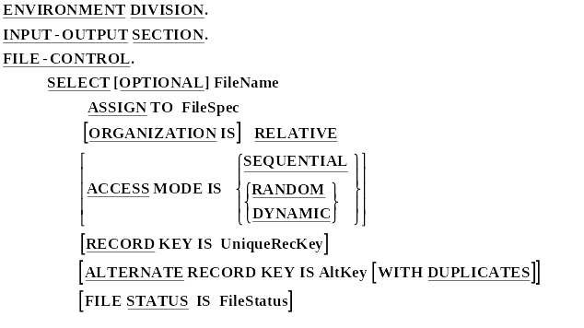
Select and Assign for Indexed Files

Slide 11
Indexed Files - Primary Key
30 60 99
Level 2
Index
Buckets
10 20 30
40 50 60
70 80 99
Level 1
Level 0
41 43 44 45 46 49
Data Buckets

Slide 12
Indexed Files - Alternate Key
H R Z
Level 2
Index
Buckets
C F H
L O R
T W Z
Level 1
Level 0
Mi Nf Ni Nt Oi Ot
Base Buckets
50 51 54 55 56 59
Ii Ef Bi Nt Jt At
Data Buckets

Slide 13
Indexed Files - Alternate Key
H R Z
Level 2
Index
Buckets
C F H
L O R
T W Z
Level 1
Level 0
Mi Nf Ni Nt Oi Ot
Base Buckets
50 51 54 55 56 59
Ii Ef Bi Nt Jt At
Ot
45
Nf
65
Mi
71
Data Buckets

Slide 14
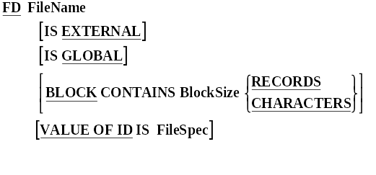
FDs for Indexed Files

Slide 15
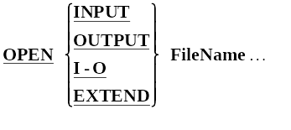
Indexed File Verbs - OPEN

Slide 16
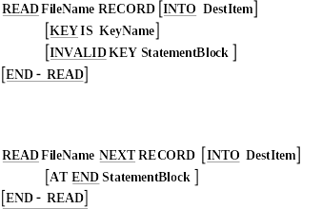
Indexed File Verbs - READ

Slide 17


Indexed File Verbs - Write and Rewrite

Slide 18
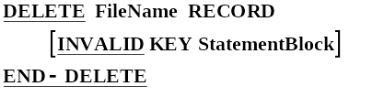
Indexed File Verbs - DELETE

Slide 19
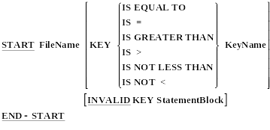
Indexed File Verbs - START

