Slide 1

Relative
Files.

Slide 2
Creating a Relative File
$ SET SOURCEFORMAT"FREE"
IDENTIFICATION DIVISION.
PROGRAM-ID. CreateRelativeFromSeq.
* Creates a Relative file from a sequential file.
ENVIRONMENT DIVISION.
INPUT-OUTPUT SECTION.
FILE-CONTROL.
SELECT SupplierFile ASSIGN TO "SUPP.DAT"
ORGANIZATION IS RELATIVE
ACCESS MODE IS RANDOM
RELATIVE KEY IS SupplierKey
FILE STATUS IS SupplierStatus.
SELECT SupplierFileSeq ASSIGN TO "INSUPP.DAT".
DATA DIVISION.
FILE SECTION.
FD SupplierFile.
01 SupplierRecord.
02 SupplierCode PIC 99.
02 SupplierName PIC X(20).
02 SupplierAddress PIC X(60).
FD SupplierFileSeq.
01 SupplierRecordSeq.
88 EndOfFile VALUE HIGH-VALUES.
02 SupplierCodeSeq PIC 99.
02 SupplierNameSeq PIC X(20).
02 SupplierAddressSeq PIC X(60).
WORKING-STORAGE SECTION.
01 SupplierStatus PIC X(2).
01 SupplierKey PIC 99.

Slide 3
Creating a Relative File
$ SET SOURCEFORMAT"FREE"
IDENTIFICATION DIVISION.
PROGRAM-ID. CreateRelativeFromSeq.
* Creates a Relative file from a sequential file.
ENVIRONMENT DIVISION.
INPUT-OUTPUT SECTION.
FILE-CONTROL.
SELECT SupplierFile ASSIGN TO "SUPP.DAT"
ORGANIZATION IS RELATIVE
ACCESS MODE IS RANDOM
RELATIVE KEY IS SupplierKey
FILE STATUS IS SupplierStatus.
SELECT SupplierFileSeq ASSIGN TO "INSUPP.DAT".
DATA DIVISION.
FILE SECTION.
FD SupplierFile.
01 SupplierRecord.
02 SupplierCode PIC 99.
02 SupplierName PIC X(20).
02 SupplierAddress PIC X(60).
FD SupplierFileSeq.
01 SupplierRecordSeq.
88 EndOfFile VALUE HIGH-VALUES.
02 SupplierCodeSeq PIC 99.
02 SupplierNameSeq PIC X(20).
02 SupplierAddressSeq PIC X(60).
WORKING-STORAGE SECTION.
01 SupplierStatus PIC X(2).
01 SupplierKey PIC 99.

Slide 4
Creating a Relative File
PROCEDURE DIVISION.
Begin.
OPEN OUTPUT SupplierFile.
OPEN INPUT SupplierFileSeq.
READ SupplierFileSeq
AT END SET EndOfFile TO TRUE
END-READ
PERFORM UNTIL EndOfFile
MOVE SupplierCodeSeq TO SupplierKey
MOVE SupplierRecordSeq TO SupplierRecord
WRITE SupplierRecord
INVALID KEY DISPLAY "SUPP STATUS :-", SupplierStatus
END-WRITE
READ SupplierFileSeq
AT END SET EndOfFile TO TRUE
END-READ
END-PERFORM.
CLOSE SupplierFile, SupplierFileSeq.
STOP RUN.

Slide 5
Reading a Relative File.
$ SET SOURCEFORMAT"FREE"
IDENTIFICATION DIVISION.
PROGRAM-ID. ReadRelative.
* Reads a Relative file directly or in sequence
ENVIRONMENT DIVISION.
INPUT-OUTPUT SECTION.
FILE-CONTROL.
SELECT SupplierFile ASSIGN TO "SUPP.DAT"
ORGANIZATION IS RELATIVE
ACCESS MODE IS DYNAMIC
RELATIVE KEY IS SupplierKey
FILE STATUS IS SupplierStatus.
DATA DIVISION.
FILE SECTION.
FD SupplierFile.
01 SupplierRecord.
88 EndOfFile VALUE HIGH-VALUES.
02 SupplierCode PIC 99.
02 SupplierName PIC X(20).
02 SupplierAddress PIC X(60).
WORKING-STORAGE SECTION.
01 SupplierStatus PIC X(2).
88 RecordFound VALUE "00".
01 SupplierKey PIC 99.
01 PrnSupplierRecord.
02 PrnSupplierCode PIC BB99.
02 PrnSupplierName PIC BBX(20).
02 PrnSupplierAddress PIC BBX(50).
01 ReadType PIC 9.
88 DirectRead VALUE 1.
88 SequentialRead VALUE 2.

Slide 6
Reading a Relative File.
PROCEDURE DIVISION.
BEGIN.
OPEN INPUT SupplierFile.
DISPLAY "Enter Read type (Direct=1, Seq=2)-> " WITH NO ADVANCING.
ACCEPT ReadType.
IF DirectRead
DISPLAY "Enter supplier key (2 digits)-> " WITH NO ADVANCING
ACCEPT SupplierKey
READ SupplierFile
INVALID KEY DISPLAY "SUPP STATUS :-", SupplierStatus
END-READ
PERFORM DisplayRecord
END-IF
IF SequentialRead
READ SupplierFile NEXT RECORD
AT END SET EndOfFile TO TRUE
END-READ
PERFORM UNTIL EndOfFile
PERFORM DisplayRecord
READ SupplierFile NEXT RECORD
AT END SET EndOfFile TO TRUE
END-READ
END-PERFORM
END-IF
CLOSE SupplierFile.
STOP RUN.
DisplayRecord.
IF RecordFound
MOVE SupplierCode TO PrnSupplierCode
MOVE SupplierName TO PrnSupplierName
MOVE SupplierAddress TO PrnSupplierAddress
DISPLAY PrnSupplierRecord
END-IF.

Slide 7
Reading a Relative File.
RUN OF REL-EG2.EXE USING SEQUENTIAL READING
Enter Read type (Direct=1, Seq=2)-> 2
01 VESTRON VIDEOS OVER THE SEA SOMEWHERE IN LONDON
02 EMI STUDIOS HOLLYWOOD, CALIFORNIA, USA
03 BBC WILDLIFE BUSH HOUSE, LONDON, ENGLAND
04 CBS STUDIOS HOLLYWOOD, CALIFORNIA, USA
05 YACHTING MONTHLY TREE HOUSE, LONDON, ENGLAND
06 VIRGIN VIDEOS IS THIS ONE ALSO LOCATED IN ENGLAND
07 CIC VIDEOS NEW YORK PLAZZA, NEW YORK, USA
RUN OF REL-EG2.EXE USING DIRECT READ
Enter Read type (Direct=1, Seq=2)-> 1
Enter supplier key (2 digits)-> 05
05 YACHTING MONTHLY TREE HOUSE, LONDON, ENGLAND

Slide 8
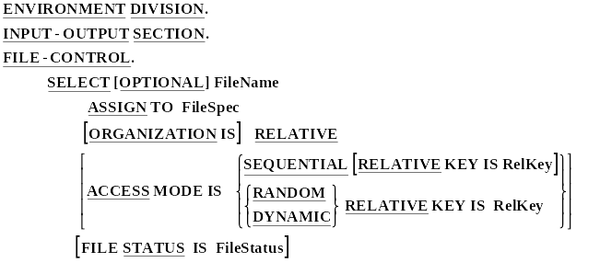
Select and Assign for Relative Files

Slide 9
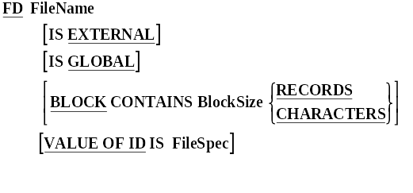
FDs for Relative Files

Slide 10
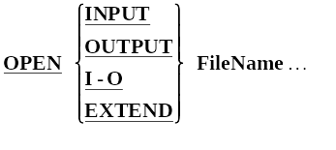
Relative File Verbs - OPEN

Slide 11
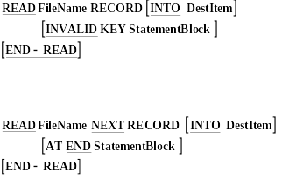
Relative File Verbs - READ

Slide 12


Relative File Verbs - Write and Rewrite

Slide 13
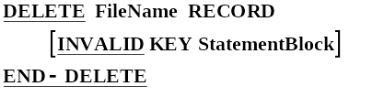
Relative File Verbs - DELETE

Slide 14
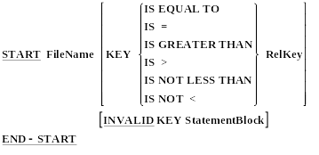
Relative File Verbs - START

Slide 15
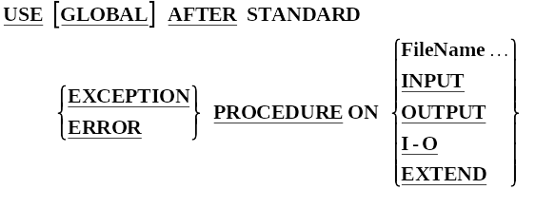
Error Handling Using Declaratives.
PROCEDURE DIVISION.
DECLARATIVES.
SectionOne SECTION.
USE clause for this section.
ParOne1.
????????????????
????????????????
ParOne2.
????????????????
????????????????
SectionTwo SECTION.
USE clause for this section.
ParTwo1.
????????????????
????????????????
ParTwo2.
????????????????
????????????????
END-DECLARATIVES.
Main SECTION.
Begin.

Slide 16
Error Handling Using Declaratives.
PROCEDURE DIVISION.
DECLARATIVES.
FileError SECTION.
USE AFTER ERROR PROCEDURE ON RelativeFile.
CheckFileStatus.
EVALUATE TRUE
WHEN RecordDoesNotExist
DISPLAY "Record does not exist"
WHEN RecordAlreadyExists
DISPLAY "Record already exists"
WHEN FileNotOpen OPEN I-O RelativeFile
END-EVALUATE.
END-DECLARATIVES.
Main SECTION.
Begin.

