Slide 1

COPY Verb
Notes:
1

Slide 2
The COPY Verb
The COPY verb is very different from other COBOL verbs.
While other COBOL statements are executed at run time the COPY is executed at compile time.
The COPY statement allows programs to include frequently used source code text from a copy file or copy library.
The COPY can include source code text without change or it can change the text as it is copied into the client program.
Notes:
2

Slide 3
The COPY verb2
The COPY verb is generally used when creating large software systems.
It allows item descriptions to be kept and updated centrally in a copy Library, often under the control of a copy librarian.
A copy library contains COBOL elements that can be reference using a textname.
Each client program which wants to use items described in the copy library uses the COPY verb to include the descriptions it requires.
When more than one copy library is used the OF or IN qualifier is used to indicate which library is being referenced.
Notes:
2

Slide 4
Why use the COPY verb?
Using the COPY verb makes implementation simpler by reducing the amount of coding required and eliminating transcription errors.
Using the COPY verb makes some maintenance tasks easier and safer.
The text in the copy library is updated and the affected programs are recompiled.
Using copy libraries makes it more difficult for programmers to make ad hoc changes to file and record formats.
Changes generally have to be approved by the COPY librarian.
Notes:
2

Slide 5
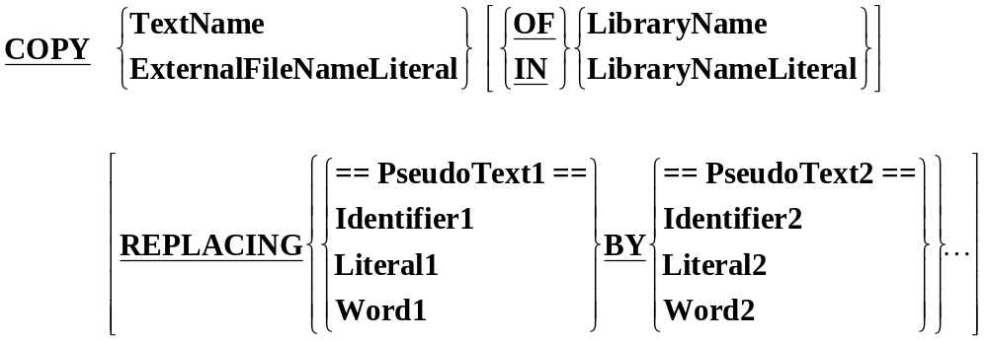
COPY format
Example COPY statements.
COPY "CopyFile2.CBL" REPLACING XYZ BY 120.
COPY Copyfile3 IN "d:\visocd\examples\EGLIB".
COPY "CopyFile3.CBL" IN "d:\visocd\examples\EGLIB".
ExternalFileNameLiteral
TextName
LibraryNameLiteral
ExternalFileNameLiteral
LibraryNameLiteral
Notes:
2

Slide 6
How the COPY works
If the REPLACING phrase is not used then the compiler simply copies the text into the client program without change.
If the COPY does use the REPLACING phrase then the text is copied and each properly matched occurrence of Pseudo-Text-1, Identifier-1, Literal-1 and Word-1 in the library text is replaced by the corresponding Pseudo-Text-2, Identifier-2, Literal-2 or Word-2 in the REPLACING phrase.
Pseudo-Text is any COBOL text encloded in double equal signs (e.g. ==ADD 1==).
It allows us to replace a series of words or characters as opposed to an individual identifier, literal or word.
Notes:
2

Slide 7
How the REPLACING works
The REPLACING phrase tries to match text-words in the library text with text-words before the BY in the REPLACING phase.
If a match is achived then as text is copied from the library it is replaced by the matching REPLACING phrase text.
For purposes of matching, each occurrence of a
separator comma
semicolon
space
in pseudo-text-1 or in the library text is considered to be a single space.
Each sequence of one or more space separators is considered to be a single space.
Comment lines in either the library or REPLACING phrase text are treated as a single space.
Notes:
2

Slide 8
Text-Words
The matching procedure in the REPLACING phrase operates on text-words.
A text word is ;
    A literal including opening and closing quotes
    A seperator other than;
    A Space
    A Pseudo-Text delimiter
    A Comma
    Opening and closing parentheses
    Any other sequence of contiguous characters, bounded by separators.
Notes:
2

Slide 9
Text-Word Examples
MOVE
    1 Text Word
MOVE Total TO Print-Total
    4 Text Words - MOVE Total TO Print-Total
MOVE Total TO Print-Total.
    5 Text Words - MOVE Total TO Print-Total .
PIC S9(4)V9(6)
    9 Text words - PIC S9 ( 4 ) V9 ( 6 )
“PIC S9(4)V9(6)”
    1 Text word - “PIC S9(4)V9(6)”
Notes:
10

Slide 10
COPY Example 1
IDENTIFICATION DIVISION.
PROGRAM-ID. COPYEG1.
AUTHOR. Michael Coughlan.
ENVIRONMENT DIVISION.
FILE-CONTROL.
SELECT StudentFile ASSIGN TO "STUDENTS.DAT"
ORGANIZATION IS LINE SEQUENTIAL.
DATA DIVISION.
FILE SECTION.
FD StudentFile.
COPY COPYFILE1.
PROCEDURE DIVISION.
BeginProg.
OPEN INPUT StudentFile
READ StudentFile
AT END SET EndOfSF TO TRUE
END-READ
PERFORM UNTIL EndOfSF
DISPLAY StudentNumber SPACE StudentName SPACE
CourseCode SPACE FeesOwed SPACE AmountPaid
READ StudentFile
AT END SET EndOfSF TO TRUE
END-READ
END-PERFORM
STOP RUN.
01 StudentRec.
88 EndOfSF VALUE HIGH-VALUES.
02 StudentNumber PIC 9(7).
02 StudentName PIC X(60).
02 CourseCode PIC X(4).
02 FeesOwed PIC 9(4).
02 AmountPaid PIC 9(4)V99.
Notes:
16

Slide 11
COPY Example 2
Copyfile2.cbl
02 StudName PIC X(20) OCCURS XYZ TIMES.
01 NameTable2.
COPY "CopyFile2.CBL" REPLACING XYZ BY 120.
01 NameTable2.
02 StudName PIC X(20) OCCURS 120 TIMES.
Notes:
10

Slide 12
COPY Example 3
Copyfile3.cbl
02 CustOrder PIC 9(R).
01 CopyData.
COPY Copyfile3 REPLACING ==R== BY ==4==.
01 CopyData.
02 CustOrder PIC 9(4).
Notes:
10

Slide 13
COPY Example 4
Copyfile4.cbl
02 CustOrder2 PIC 9(6)V99.
01 CopyData.
COPY CopyFile4 REPLACING ==V99== BY ====.
01 CopyData.
02 CustOrder2 PIC 9(6).
Notes:
10

Slide 14
COPY Example 5
Copyfile5.cbl
02 CustKey PIC X(3) VALUE "KEY".
01 CopyData.
COPY CopyFile5 REPLACING "KEY" BY "ABC".
01 CopyData.
02 CustKey PIC X(3) VALUE "ABC".
Notes:
10

Slide 15
COPY Example 6
Copyfile5.cbl
02 CustKey PIC X(3) VALUE "KEY".
01 CopyData.
COPY CopyFile5 REPLACING "CustKey" BY "Cust".
01 CopyData.
02 CustKey PIC X(3) VALUE "KEY".
No Replacement
Notes:
10

Slide 16
COPY Example 7
Copyfile5.cbl
02 CustKey PIC X(3) VALUE "KEY".
01 CopyData.
COPY CopyFile5 REPLACING "KEY" BY =="ABC".
02 CustNum PIC 9(8)==.
01 CopyData.
02 CustKey PIC X(3) VALUE "ABC".
02 CustNum PIC 9(8).
Notes:
10

Slide 17
COPY Example 8
Copyfile5.cbl
02 CustKey PIC X(3) VALUE "KEY".
* the ( is a textword replaced by @
COPY copyfile5 REPLACING ( BY @.
* the 3 between ( and ) is a textword replaced by the textword "three"
COPY copyfile5 REPLACING 3 BY three.
* the ) is a textword replaced by &
COPY copyfile5 REPLACING ) BY &.
02 CustKey PIC X@3) VALUE "KEY".
02 CustKey PIC X(three) VALUE "KEY".
02 CustKey PIC X(3& VALUE "KEY".
Notes:
10

Slide 18
COPY Example 9
Copyfile5.cbl
02 CustKey PIC X(3) VALUE "KEY".
* the X before (3) is a textword replaced by pseudotext "Replace the X"
COPY copyfile5 REPLACING X
BY ==Replace the X==.
* the pseudotext X(3) is replaced by X(19)
COPY copyfile5 REPLACING ==X(3)==
BY ==X(19)==.
* the series of textwords X ( 3 ) is replaced by the series X ( 19 )
COPY copyfile5 REPLACING X(3) BY X(19).
02 CustKey PIC Replace the X(3) VALUE KEY".
02 CustKey PIC X(19) VALUE "KEY".
02 CustKey PIC X(19) VALUE "KEY".
Notes:
10

Slide 19
COPY Example 10
Copyfile5.cbl
02 CustKey PIC X(3) VALUE "KEY".
* the textword PIC is replaced by the pseudotext Pic is Replaced
COPY copyfile5 REPLACING PIC
BY ==Pic is Replaced==.
* The P in PIC is not a textword by itself and so is not replaced
COPY copyfile5 REPLACING P BY
==But P in PIC not replaced==.
02 CustKey Pic is Replaced X(3) VALUE "KEY".
02 CustKey PIC X(3) VALUE "KEY".
No Replacement
Notes:
10

