Slide 1

Searching Tables.

Slide 2
Creating Pre-filled Tables
A B C D E F G H I J K L
01 LetterTable.
02 TableValues.
03 FILLER PIC X(13)
VALUE "ABCDEFGHIJKLM".
03 FILLER PIC X(13)
VALUE "NOPQRSTUVWXYZ".

Slide 3
Creating Pre-filled Tables
A B C D E F G H I J K L
01 LetterTable.
02 TableValues.
03 FILLER PIC X(13)
VALUE "ABCDEFGHIJKLM".
03 FILLER PIC X(13)
VALUE "NOPQRSTUVWXYZ".
02 FILLER REDEFINES TableValues.
03 Letter PIC X OCCURS 26 TIMES.

Slide 4
Searching a Table
A B C D E F G H I J K L
1 2 3 4 5 6 7 8 9 10 11 12
01 LetterTable.
02 TableValues.
03 FILLER PIC X(13)
VALUE "ABCDEFGHIJKLM".
03 FILLER PIC X(13)
VALUE "NOPQRSTUVWXYZ".
02 FILLER REDEFINES TableValues.
03 Letter PIC X OCCURS 26 TIMES.
PERFORM VARYING Idx FROM 1 BY 1 UNTIL
LetterIn EQUAL TO Letter(Idx)
END-PERFORM.
DISPLAY LetterIn, "is in position ", Idx.

Slide 5
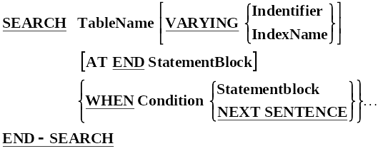
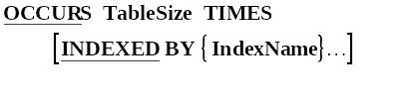
Search Syntax

Slide 6
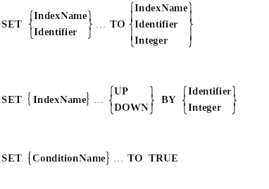
SET Syntax

Slide 7
Searching a Table
A B C D E F G H I J K L
1 2 3 4 5 6 7 8 9 10 11 12
01 LetterTable.
02 TableValues.
03 FILLER PIC X(13)
VALUE "ABCDEFGHIJKLM".
03 FILLER PIC X(13)
VALUE "NOPQRSTUVWXYZ".
02 FILLER REDEFINES TableValues.
03 Letter PIC X OCCURS 26 TIMES
INDEXED BY LetterIdx.
SET LetterIdx TO 1.
SEARCH Letter
AT END DISPLAY "Letter not found!"
WHEN Letter(LetterIdx) = LetterIn
DISPLAY LetterIn, "is in position ", Idx
END-SEARCH.

Slide 8
Searching a Two Dimension Table.
1 2 3 4
1 2 3 4 5 6 7 8 1 2 3 4 5 6 7 8 1 2 3 4 5 6 7 8 1 2 3 4
01 TimeTable.
02 Day OCCURS 5 TIMES INDEXED BY DayIdx.
03 Hours OCCURS 8 TIMES INDEXED BY HourIdx.
04 Item PIC X(10).
04 Location PIC X(10).
SET DayIdx TO 0.
PERFORM UNTIL MeetingFound OR DayIdx > 5
SET DayIdx UP BY 1
SET HourIdx TO 1
SEARCH Hours WHEN MeetingType = Item(DayIdx, HourIdx)
SET MeetingFound TO TRUE
DISPLAY MeetingType " on " DayIdx " at " HourIdx
END-SEARCH
END-PERFORM.

Slide 9
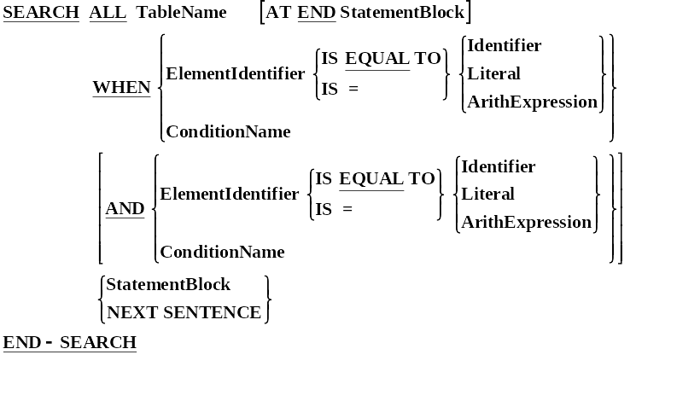
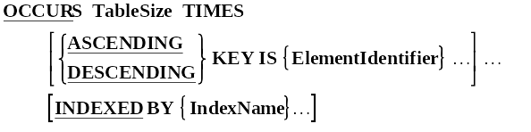
Search All Syntax.

Slide 10
Using the Search All
A B C D E F G H I J K L
1 2 3 4 5 6 7 8 9 10 11 12
01 LetterTable.
02 TableValues.
03 FILLER PIC X(13)
VALUE "ABCDEFGHIJKLM".
03 FILLER PIC X(13)
VALUE "NOPQRSTUVWXYZ".
02 FILLER REDEFINES TableValues.
03 Letter PIC X OCCURS 26 TIMES
ASCENDING KEY IS Letter
INDEXED BY LetterIdx.
SEARCH ALL Letter
WHEN Letter(LetterIdx) = LetterIn
DISPLAY LetterIn, "is in position ", Idx
END-SEARCH.

Slide 11
How the Search All works.
A B C D E F G H I J K L M N O P Q R S T U V W X Y Z
1 2 3 4 5 6 7 8 9 10 11 12 13 14 15 16 17 18 19 20 21 22 23 24 25 26
Lower
Upper
Middle
Letter(Middle)
1
26
13
M
=
ALGORITHM.
Middle = (Lower + Upper) / 2
CASE TRUE
WHEN Letter(Middle) < "Q" THEN Lower = Middle + 1
WHEN Letter(Middle) > "Q" THEN Upper = Middle -1
WHEN Letter(Middle) = "Q" THEN SET ItemFound TO TRUE
WHEN Lower > Upper THEN ItemNotInTable TO TRUE

Slide 12
How the Search All works.
A B C D E F G H I J K L M N O P Q R S T U V W X Y Z
1 2 3 4 5 6 7 8 9 10 11 12 13 14 15 16 17 18 19 20 21 22 23 24 25 26
Lower
Upper
Middle
Letter(Middle)
14
26
13
M
=
ALGORITHM.
Middle = (Lower + Upper) / 2
CASE TRUE
WHEN Letter(Middle) < "Q" THEN Lower = Middle + 1
WHEN Letter(Middle) > "Q" THEN Upper = Middle -1
WHEN Letter(Middle) = "Q" THEN SET ItemFound TO TRUE
WHEN Lower > Upper THEN ItemNotInTable TO TRUE

Slide 13
How the Search All works.
A B C D E F G H I J K L M N O P Q R S T U V W X Y Z
1 2 3 4 5 6 7 8 9 10 11 12 13 14 15 16 17 18 19 20 21 22 23 24 25 26
Lower
Upper
Middle
Letter(Middle)
14
26
20
T
=
ALGORITHM.
Middle = (Lower + Upper) / 2
CASE TRUE
WHEN Letter(Middle) < "Q" THEN Lower = Middle + 1
WHEN Letter(Middle) > "Q" THEN Upper = Middle -1
WHEN Letter(Middle) = "Q" THEN SET ItemFound TO TRUE
WHEN Lower > Upper THEN ItemNotInTable TO TRUE

Slide 14
How the Search All works.
A B C D E F G H I J K L M N O P Q R S T U V W X Y Z
1 2 3 4 5 6 7 8 9 10 11 12 13 14 15 16 17 18 19 20 21 22 23 24 25 26
Lower
Upper
Middle
Letter(Middle)
14
19
20
T
=
ALGORITHM.
Middle = (Lower + Upper) / 2
CASE TRUE
WHEN Letter(Middle) < "Q" THEN Lower = Middle + 1
WHEN Letter(Middle) > "Q" THEN Upper = Middle -1
WHEN Letter(Middle) = "Q" THEN SET ItemFound TO TRUE
WHEN Lower > Upper THEN ItemNotInTable TO TRUE

Slide 15
How the Search All works.
A B C D E F G H I J K L M N O P Q R S T U V W X Y Z
1 2 3 4 5 6 7 8 9 10 11 12 13 14 15 16 17 18 19 20 21 22 23 24 25 26
Lower
Upper
Middle
Letter(Middle)
14
19
16
P
=
ALGORITHM.
Middle = (Lower + Upper) / 2
CASE TRUE
WHEN Letter(Middle) < "Q" THEN Lower = Middle + 1
WHEN Letter(Middle) > "Q" THEN Upper = Middle -1
WHEN Letter(Middle) = "Q" THEN SET ItemFound TO TRUE
WHEN Lower > Upper THEN ItemNotInTable TO TRUE

Slide 16
How the Search All works.
A B C D E F G H I J K L M N O P Q R S T U V W X Y Z
1 2 3 4 5 6 7 8 9 10 11 12 13 14 15 16 17 18 19 20 21 22 23 24 25 26
Lower
Upper
Middle
Letter(Middle)
17
19
16
P
=
ALGORITHM.
Middle = (Lower + Upper) / 2
CASE TRUE
WHEN Letter(Middle) < "Q" THEN Lower = Middle + 1
WHEN Letter(Middle) > "Q" THEN Upper = Middle -1
WHEN Letter(Middle) = "Q" THEN SET ItemFound TO TRUE
WHEN Lower > Upper THEN ItemNotInTable TO TRUE

Slide 17
How the Search All works.
A B C D E F G H I J K L M N O P Q R S T U V W X Y Z
1 2 3 4 5 6 7 8 9 10 11 12 13 14 15 16 17 18 19 20 21 22 23 24 25 26
Lower
Upper
Middle
Letter(Middle)
17
19
18
R
=
ALGORITHM.
Middle = (Lower + Upper) / 2
CASE TRUE
WHEN Letter(Middle) < "Q" THEN Lower = Middle + 1
WHEN Letter(Middle) > "Q" THEN Upper = Middle -1
WHEN Letter(Middle) = "Q" THEN SET ItemFound TO TRUE
WHEN Lower > Upper THEN ItemNotInTable TO TRUE

Slide 18
How the Search All works.
A B C D E F G H I J K L M N O P Q R S T U V W X Y Z
1 2 3 4 5 6 7 8 9 10 11 12 13 14 15 16 17 18 19 20 21 22 23 24 25 26
Lower
Upper
Middle
Letter(Middle)
17
17
18
R
=
ALGORITHM.
Middle = (Lower + Upper) / 2
CASE TRUE
WHEN Letter(Middle) < "Q" THEN Lower = Middle + 1
WHEN Letter(Middle) > "Q" THEN Upper = Middle -1
WHEN Letter(Middle) = "Q" THEN SET ItemFound TO TRUE
WHEN Lower > Upper THEN ItemNotInTable TO TRUE

Slide 19
How the Search All works.
A B C D E F G H I J K L M N O P Q R S T U V W X Y Z
1 2 3 4 5 6 7 8 9 10 11 12 13 14 15 16 17 18 19 20 21 22 23 24 25 26
Lower
Upper
Middle
Letter(Middle)
17
17
18
Q
=
ALGORITHM.
Middle = (Lower + Upper) / 2
CASE TRUE
WHEN Letter(Middle) < "Q" THEN Lower = Middle + 1
WHEN Letter(Middle) > "Q" THEN Upper = Middle -1
WHEN Letter(Middle) = "Q" THEN SET ItemFound TO TRUE
WHEN Lower > Upper THEN ItemNotInTable TO TRUE

Slide 20
How the Search All works.
A B C D E F G H I J K L M N O P Q R S T U V W X Y Z
1 2 3 4 5 6 7 8 9 10 11 12 13 14 15 16 17 18 19 20 21 22 23 24 25 26
Lower
Upper
Middle
Letter(Middle)
17
17
18
Q
=
ALGORITHM.
Middle = (Lower + Upper) / 2
CASE TRUE
WHEN Letter(Middle) < "Q" THEN Lower = Middle + 1
WHEN Letter(Middle) > "Q" THEN Upper = Middle -1
WHEN Letter(Middle) = "Q" THEN SET ItemFound TO TRUE
WHEN Lower > Upper THEN ItemNotInTable TO TRUE

Slide 21
Search All Example.
01 StateTable.
02 StateValues.
03 FILLER PIC X(20) VALUE ??????????????
Post Codes and Names
03 FILLER PIC X(20) VALUE ??????????????
02 FILLER REDEFINES StateValues.
03 States OCCURS 50 TIMES
ASCENDING KEY IS StateName
INDEXED BY StateIdx.
04 PostCode PIC X(6).
04 StateName PIC X(14).
SEARCH ALL States
AT END DISPLAY "State not found"
WHEN StateName(StateIdx) = InputName
MOVE PostCode(StateIdx) TO PrintPostCode
END-SEARCH.

