Slide 1

Introduction to MATLAB
https://moodle.ucl.ac.uk/course/view.php?id=22765

Slide 2
Introduction to MATLAB
1. What is MATLAB?
MATLAB is a numerical computation package, optimised for matrix operations
A matrix is just a rectangular array of numbers
Effectively, it is a very powerful, programmable calculator
2. Why use MATLAB?
It has a huge library of built in numerical functions (for data analysis etc.)
It has a large number of freely available toolboxes (for statistics etc.)
It has powerful built in graphics functions (for plotting graphs)
It has built in script writing (i.e. programming) with interactive debugging
It is very easy to use and very widely used, so there is a lot of support available

Slide 3
Computing a Sum in the Command Window
The first thing we need to do is start MATLAB
You will then be confronted with the MATLAB ‘desktop’
This has several different windows
The most important is the command window
This is used to enter commands into MATLAB and display the results
For example, you can immediately compute sums here, just like a calculator
Just type in the desired operation, hit return, and the answer is displayed
MATLAB does not care about spaces in these expressions

Slide 4
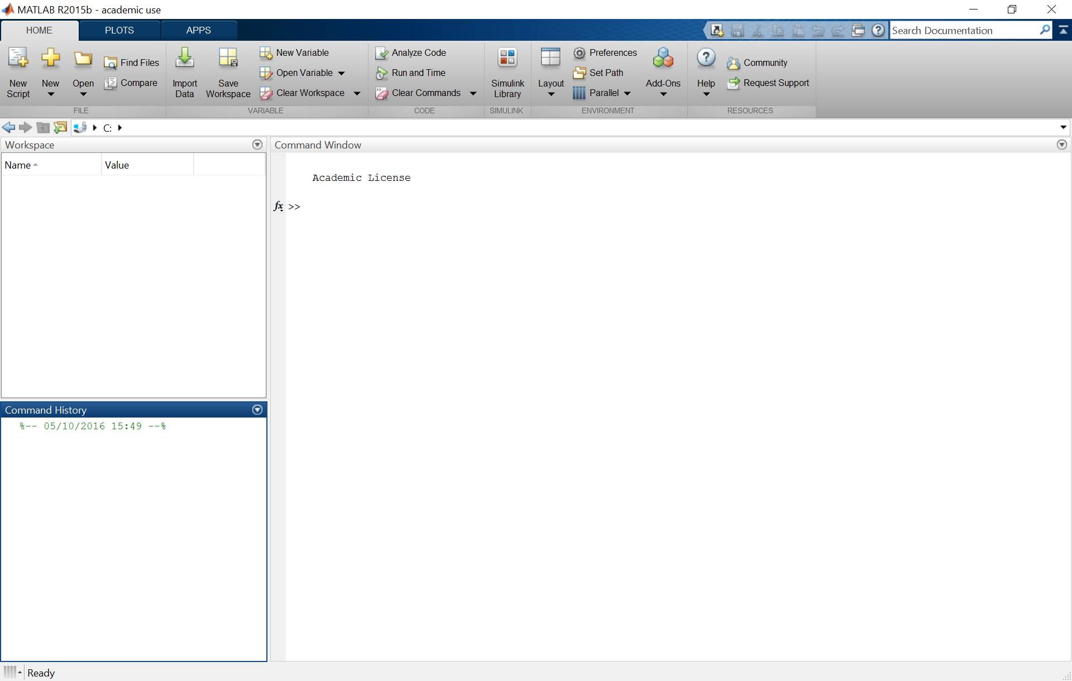
Computing a Sum in the Command Window
The command window
The exact layout can differ from machine to machine, but the windows are always labelled!

Slide 5
Using Variables
In MATLAB, you can also assign values to variables
Mathematical operations can then be performed on those variables in the same way
All variables in the current ‘stack’ (i.e. in memory) appear in the workspace
Unassigned output is automatically placed in the variable ‘ans’ (i.e. answer)
Output to the command window can be suppressed with a semi-colon ‘;’…
…but the value of the variable in the workspace will still be updated
You can display the value of any variable by typing its name and pressing return
The list of all variables in the workspace can be displayed by typing who
You can clear all variables from the workspace by typing clear
You can clear individual variables by typing clear variable_name

Slide 6
Using Variables
The workspace
The exact layout can differ from machine to machine, but the windows are always labelled!

Slide 7
Using Variables II
Variable names are case sensitive
Variable names cannot start with a number, contain spaces or punctuation (except ‘_’)
There are also some ‘reserved words’ that cannot be used as variable names
MATLAB will tell you if you attempt to use any of these
MATLAB also has several ‘built in’ constants that do not appear in the workspace
These include ‘pi’, ‘i’ / ‘j’, ‘inf’, ‘nan’ / ‘NaN’ and ‘eps’
‘pi’ is the transcendental number relating the circumference of a circle to its diameter
‘i’ and ‘j’ refer to the square root of minus one
‘nan’ and ‘NaN’ refer to Not-a-Number, which is used by MATLAB for undefined results
‘eps’ is the smallest precision number that MATLAB can handle

Slide 8
Vectors and Matrices
MATLAB is specifically designed to perform operations on matrices or vectors
Matrices and vectors are assigned with square brackets
Rows are separated by semi-colons within square brackets
Numerical sequences can be assigned with colons (i.e. start_value : finish_value)
In this case, the step between consecutive numbers will always be 1
The step size can also be defined (i.e. start_value : step_size : finish_value)

Slide 9
Vectors and Matrices
To perform ‘element-wise’ operations on a matrix, you must use the ‘.’ prefix
This means the operation is performed on each element individually
To perform matrix operations you do not need this prefix
Elements of a matrix can be indexed using matrix_name(n) or matrix_name(row, col)
The row index always comes first, then column (a handy mnemonic: Roman Catholic!)
One entire row of a matrix can be accessed using matrix_name(row , :)
Similarly, one entire column of a matrix can be accessed using matrix_name(: , col)
Matrices can be collapsed into vectors using matrix_name(:)

Slide 10
Strings, Cells, Structures and Logical Arrays
MATLAB deals with many different types of variable
So far we have only considered single numbers and matrices or vectors
MATLAB can also operate on strings, which are just text variables
Strings are entered using single quotation marks
Strings can be treated much the same as numeric variables
They can be concatenated, but follow standard rules
A cell array can contain variables of different sizes in each element
Cell arrays are created and accessed with curly brackets { }
Elements within cell arrays are accessed with curly and then normal brackets
Cell arrays are useful for holding strings of different length

Slide 11
Strings, Cells, Structures and Logical Arrays
Variables of all types can also be subsumed as fields within a structure
This allows you to group related data of different types within one overall variable
Structures are useful for storing all participant data
i.e. they can hold both name (as a string) and test data (as a numeric matrix)
Structures can also contain multiple sub-structures, accessed with normal brackets
Logical arrays are a special form of numeric variable that are useful for programming
Entries in a logical array can only be true (1) or false (0)
Otherwise, logical arrays can be treated much the same as numeric variables

Slide 12
The Variable Editor
Variable values can be inspected by double-clicking on their name in the workspace
This opens the ‘Variable Editor’ window
You can directly modify variables within this window
Just click on an element, and then type the new value you require
Note, however, that there is no record of these changes in the command window

Slide 13
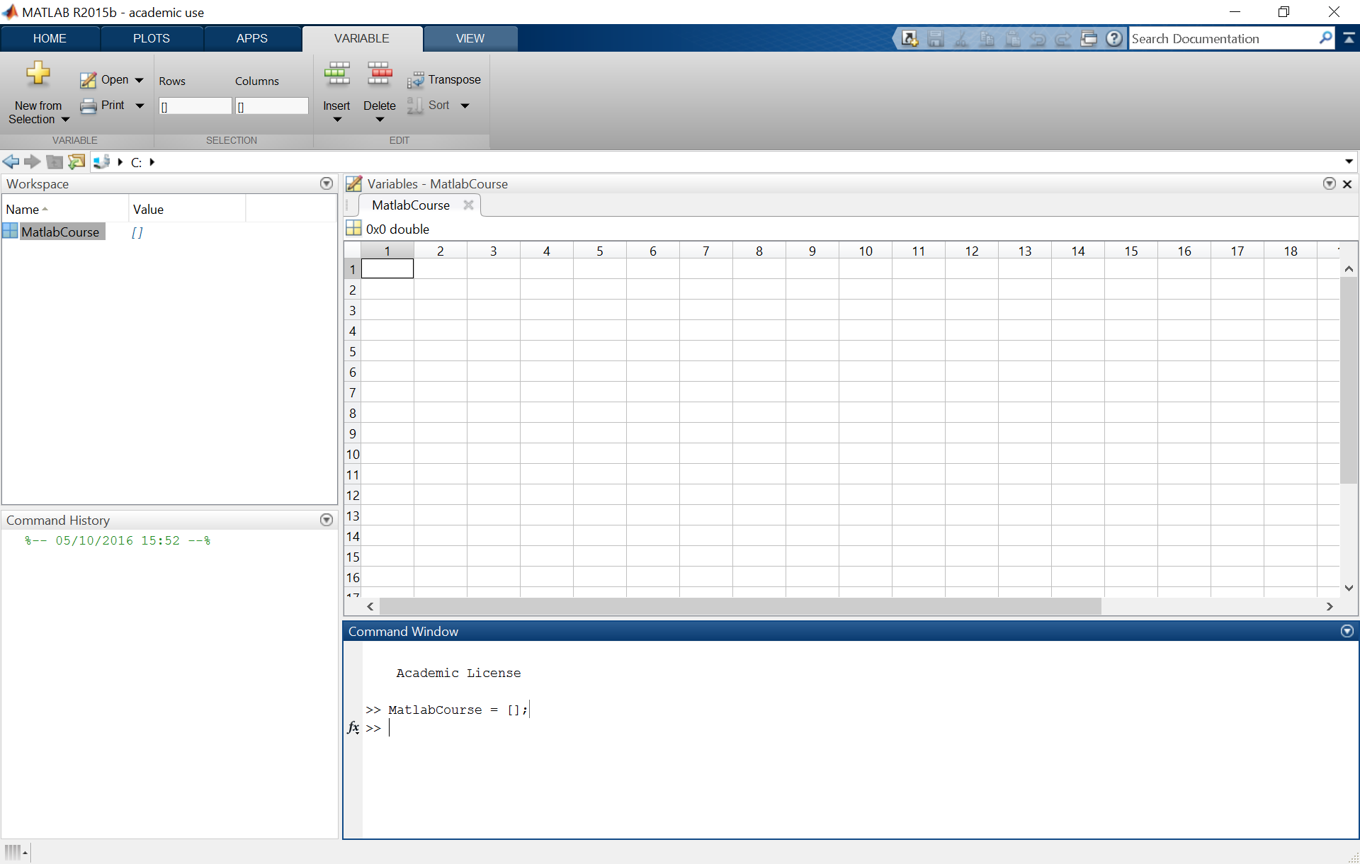
The Variable Editor
The variable editor
The exact layout can differ from machine to machine, but the windows are always labelled!

Slide 14
The Command History
MATLAB automatically stores a history of all the commands entered
This appears in the command history
Double clicking on those calculations performs them again
But beware! Variable values may have changed…
Previously entered commands can also be accessed by pressing ‘up’
This search can be refined by starting to enter the command, then pressing ‘up’
The command window can be cleared by typing ‘clc’ and pressing return
But this does not clear the command history

Slide 15
The Command History
The command history
The exact layout can differ from machine to machine, but the windows are always labelled!

Slide 16
Built-in Functions
MATLAB has a huge number of built in functions
These range from very simple, general functions like ‘mean’…
…to very specific, complex functions like ‘guide’
The real trick to MATLAB is learning which functions exist and how to use them
If you want to perform some operation, just Google it – a function will exist!
The standard syntax for all functions is:
[output1 output2 …] = function(input1, input2, …)
Again, if you do not assign the output to a particular variable, it will go into ‘ans’

Slide 17
Built-in Functions
We will now have a look at some commonly used functions
‘mean’: compute the mean of a set of numbers
‘std’: compute the standard deviation of a set of numbers
‘min’ and ‘max’: extract the minimum and maximum values of a vector or matrix
‘rand’, ‘randn’: generate a uniform or normally distributed random number
‘size’: output the size of a matrix
‘randperm’: randomly permute a set of numbers
‘sqrt’: compute the square root of a set of numbers
‘int2str’ and ‘num2str’: convert numbers to strings, for display reasons
‘disp’: displays a string in the MATLAB command window

Slide 18
Getting Help
MATLAB is very widely used, so there is plenty of help and support available
Built in help can be accessed from the toolbar (Help -> Product Help)
Help for specific functions can be accessed from the command line (help function)
The online help is excellent: http://www.mathworks.co.uk/help/matlab/
There are built in demo videos – just type ‘demo’ in the command window
For any specific MATLAB problems, just use Google!

Slide 19
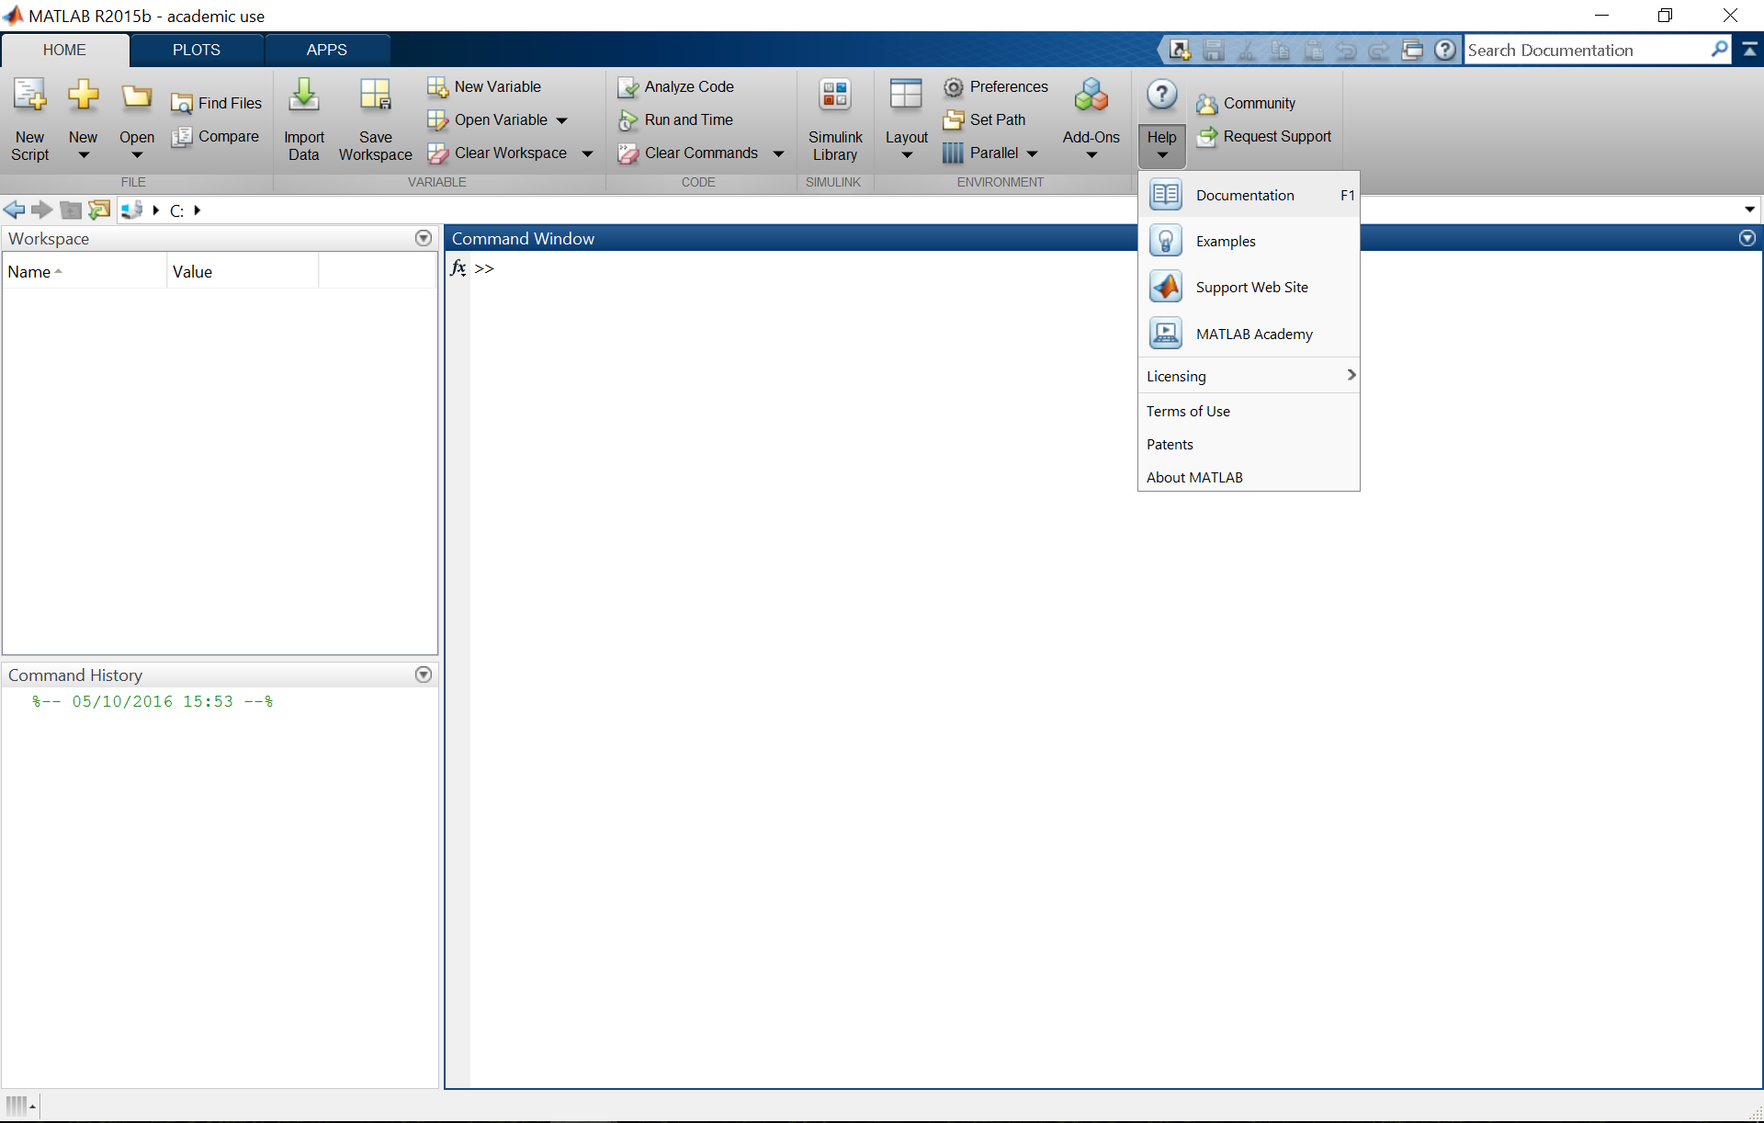
Getting Help
How to access the built in help files
The exact layout can differ from machine to machine, but the windows are always labelled!

Slide 20
Any Questions?
d.bush@ucl.ac.uk

