Slide 1
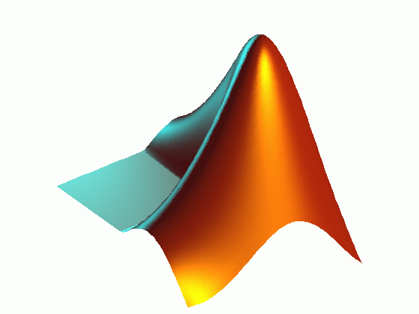
Visualisation and Plotting
https://moodle.ucl.ac.uk/course/view.php?id=22765

Slide 2
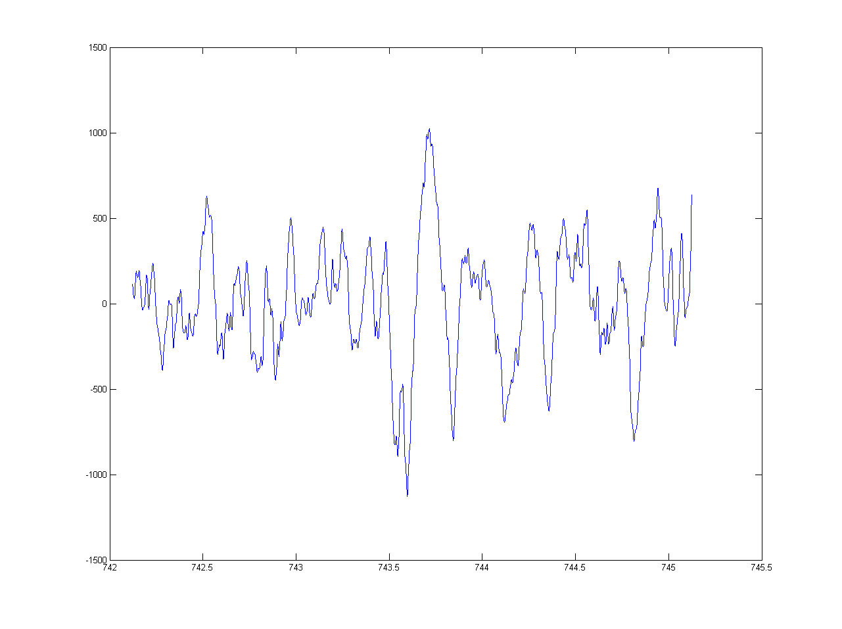
Basic Plotting
You can create a basic line graph in MATLAB using the function ‘plot’
‘plot(y)’ will plot your data (y) against an arbitrary (numbered) x-axis
‘plot(x, y)’ will plot your data (y) against the corresponding x-axis locations in x
If y is a matrix, the ‘plot’ function will display all columns of y as separate lines
For data arranged in rows, use the apostrophe shortcut to transpose the matrix

Slide 3
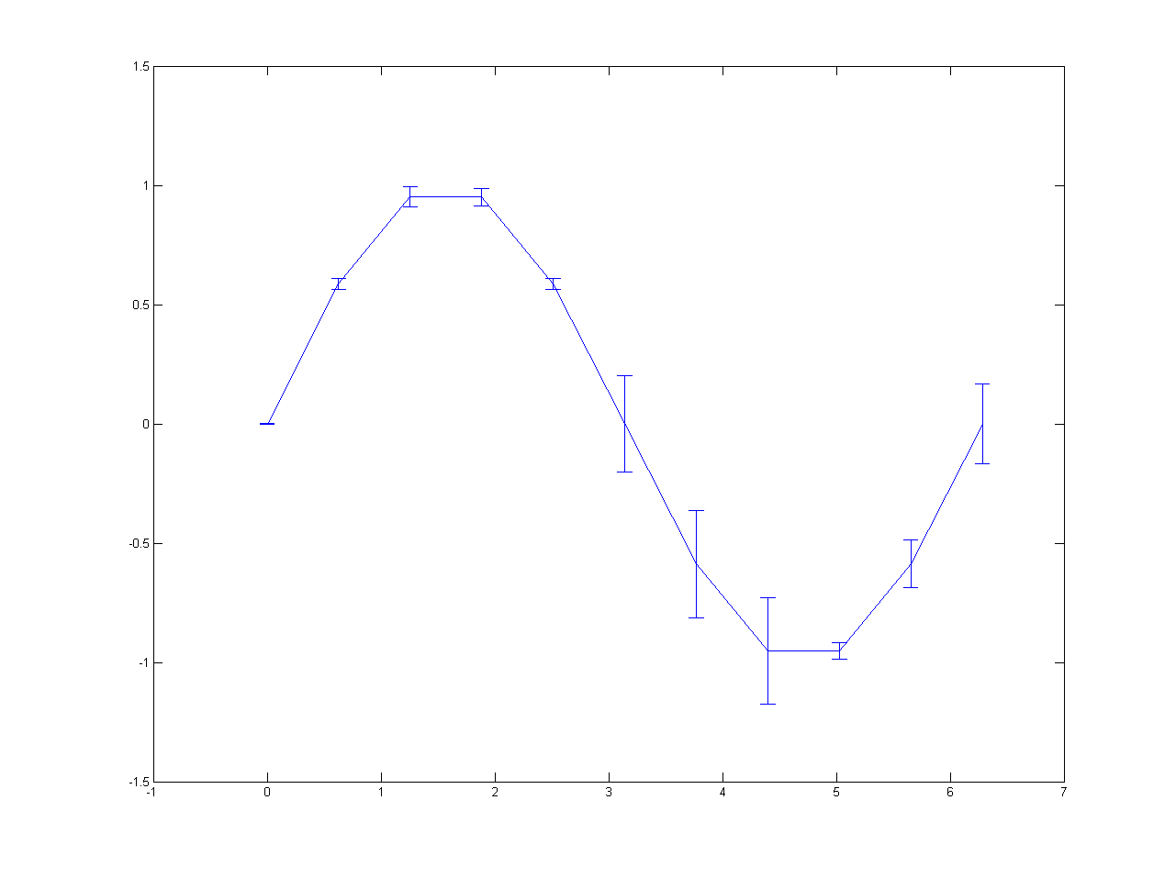
Error Bars and Scatter Plots
You can create a basic line graph with error bars using the function ‘errorbar’
‘errorbar(x, y, SE)’ will plot data with error bars whose length is specified by SE
Scatter plots can be created in MATLAB using the ‘scatter’ function
The ‘scatter’ function requires a minimum of two inputs (i.e. both x and y data)

Slide 4
Basic Figure Handling
Plotting functions automatically generate a new figure window, if one is not open
Plotting functions automatically overwrite an existing figure window, if one is open
To open an additional figure window, use the ‘figure’ command
To add more plots to an existing figure, use the ‘hold on’ / ‘hold off’ commands
You can close figures individually with the ‘close’ command
Note that this will close the most recently active figure
You can close all figures with the ‘close all’ command

Slide 5
Axis Limits
MATLAB automatically scales figure axes to accommodate the data being plotted
Axes limits can be manually controlled using ‘xlim([min max])’ and ‘ylim([min max])’
The ‘axis’ function can also be used adjust axes in several different ways
‘axis tight’ fits the axes limits to the data exactly
‘axis square’ makes the figure axes square, for display purposes
‘axis off’ removes the axes, labels and background, for display purposes
Each of these axis limit commands can be used on any MATLAB plot
You can also add and remove grid lines from your plots with ‘grid on’ / ‘grid off’...
...and add and remove the secondary x and y axes with ‘box on’ / ‘box off’

Slide 6
Figure Text
There are several functions for adding labels, titles and text to figures
Axes can be labelled using the functions ‘xlabel(‘string’)’ and ‘ylabel(‘string’)’
Titles can be added to a figure using the function ‘title(‘string’)’
A legend can be added to a figure using the function ‘legend(‘string1’, ’string2’ …)
Text can be added to a figure using the function ‘text(x_position, y_position, ‘string’)’
Text added by these functions can also be formatted directly from the command line
This is achieved by passing additional name / value pairs to the function
For example: title(‘string’, ’FontSize’, 24) or title(‘string’, ’FontName’, ‘Times’)

Slide 7
Editing Figure Properties I
There are two ways to edit the properties of a figure
The first is through the figure window toolbar, by clicking Edit -> Figure Properties…
This brings up an additional panel at the bottom of the figure window
Clicking on various parts of the figure then allows you to edit properties directly
For example, click on or near the axes, and you can edit the labels, font and limits
Clicking on the plotted line allows you to edit the colour, line style and marker style

Slide 8
Editing Figure Properties II
The second way to edit a figure is directly from the command line
Basic properties can be defined when first creating the plot
These include LineWidth, LineStyle, and Color for lines…
…and Marker, MarkerEdgeColor, MarkerFaceColor and MarkerSize for markers
For example: plot(x, y, ‘LineWidth’, 3, ‘Color’, ‘r’, ‘LineStyle’, ‘--’)
The colour, line and marker style alone can be defined in a single set of apostrophes
For example: plot(x, y, ‘r--*’)

Slide 9
Editing Figure Properties II
MATLAB ‘Color’ Code
‘b’ = Blue (default)
‘g’ = Green
‘r’ = Red
‘k’ = Black
‘y’ = Yellow
‘w’ = White
‘c’ = Cyan
‘m’ = Magenta
MATLAB ‘LineStyle’ Code
‘-’ = Solid line (default for plot)
‘--’ = Dashed line
‘-.’ = Dash-dot line
‘:’ = Dotted line
‘none’ = No line
MATLAB ‘Marker’ Code
‘o’ = Circle (default for scatter)
‘.’ = Point
‘x’ = Cross
‘+’ = Plus sign
‘*’ = Asterisk
‘s’ = Square
‘d’ = Diamond
‘v’ = Down triangle
‘^’ = Up triangle
‘>’ = Right triangle
‘<’ = Left triangle
‘p’ = Pentagram
‘h’ = Hexagram
‘none’ = No marker (default for plot)

Slide 10
Editing Figure Properties III
More complex properties can be adjusted using the ‘set’ function
The general syntax for this is ‘set (FigureHandle, ‘PropertyName’, Value)’
For example: set(gca, ‘TickDir’, ‘out’, ‘Xscale’, ‘log’)
There are a number of different properties that can be changed in this way
These can be viewed by searching for ‘Axes Properties’ in MATLAB help
The ‘figure handle’ identifies the figure that we wish to edit
The shortcut ‘gca’, or ‘get current axes’, specifies the ‘current’ figure axes...
...but to edit the properties of your plot, you must obtain a figure handle when you first call the plotting function, i.e. figure_handle = plot(x,y)

Slide 11
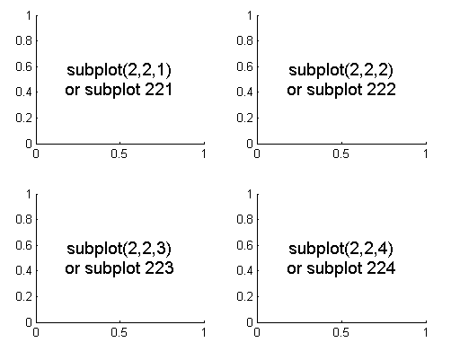
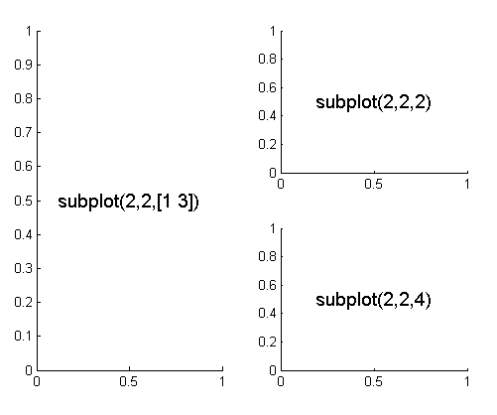
Subplots
Several different panels can be plotted within a single figure using ‘subplot’
The syntax is: subplot(nRows, nColumns, Panels_to_be_used)
Panels are numbered along each row
For example, subplot(2,2,1) sets up a 2 x 2 square of panels, and plots in the first
Plots can also be spread across multiple panels

Slide 12
Advanced Figure Handling
When drawing subplots, figure handles can be used to control each panel separately
This means assigning a variable to each panel
This is achieved by providing the ‘subplot’ function with an output variable
For example, ‘h1 = subplot(2,2,1)’
Properties of that specific panel can then be controlled using ‘set(h1, …)’ etc.

Slide 13
Bar Charts
Vertical and horizontal bar charts can be created using the ‘bar’ and ‘barh’ functions
Like plot, ‘bar(y)’ plots the data in y on an arbitrary x-axis of 1 to length(y)…
…while ‘bar(x, y)’ plots the data in y at the x-axis positions defined in x
The width of the bars can be defined by a third input, i.e. ‘bar(x, y, width)’
Other properties can be defined using name / value pairs
For example: bar(x, y, ‘FaceColor’, ‘r’, ‘EdgeColor’, ‘k’)
A list of bar chart properties can be found by searching for ‘Barseries properties’

Slide 14
Histograms
Histograms can be created using the ‘histogram’ function
Providing a single input will plot a histogram with an arbitrary set of bins, i.e. ‘hist(y)’
The second input can be used to define the edges of the x-axis bins, i.e. ‘hist(y,x)’
…or to define the total number of evenly spaced bins, i.e. ‘hist(y,n)’
Note that the syntax differs from ‘plot’ – input the data first, x-axis positions second

Slide 15
Contour Plots and Images
Two dimensional plots can be created using ‘contourf’ and ‘imagesc’
Passing a single (matrix) input defines the colour of each point on the graph
For example, ‘contourf(c)’ or ‘imagesc(c)’
Alternatively, x and y axis locations for each colour point can be provided
For example, ‘contourf(x, y, c)’ or ‘imagesc(x, y, c)’
The ‘contourf’ function also allows you to specify how many z contours are plotted
For example, ‘contourf(x, y, c, nContours)’
Note that the ‘imagesc’ function automatically inverts the y-axis
This can be corrected using set(gca, ‘Ydir’, ‘normal’) or axis xy

Slide 16
Other Useful Plotting Functions
There are many different plotting functions within MATLAB
Each of these can be controlled using the general syntax discussed above
Information on the specific syntax used for each function can be found in the ‘Help’ file
Some examples include:
‘plotyy’ – allows you to plot multiple lines on one figure with different y-axes
‘pie’ – allows you to plot a pie chart (with one emerging segment!)
‘loglog’, ‘semilogx’, ‘semilogy’ – allows you plot one or more logarithmic axes
‘rose’ – allows you to plot a circular histogram
‘surf’ – allows you to plot a 3D surface (like the MATLAB logo!)

Slide 17
Other Useful Plotting Tools
There are several buttons at the top of the Figure window that may be useful
The ‘Data Cursor’ returns the x and y co-ordinates of any point clicked on
The ‘Insert Legend’ button inserts an editable legend to annotate your figure
The ‘Insert Colorbar’ button adds a ‘colorbar’ (i.e. z-axis scale) to your figure
There are also buttons for zooming in and out of your figure
Finally, it is important to note that you can save figures in several formats
These include *.bmp, *.jpg, and *.svg
*.svg files can be subsequently be imported into Adobe Illustrator, Inkscape etc.
Figures saved in the native MATLAB *.fig format can be re-opened and edited

Slide 18
Any Questions?
d.bush@ucl.ac.uk

