Slide 1

Debugging
https://moodle.ucl.ac.uk/course/view.php?id=22765

Slide 2
Good Practices for Programming
There are a number of simple practices that make programming easier
These practices facilitate the sharing of code, and revisiting / re-using old code
These practices also make it easier to identify bugs in your code
Many of these practices are obvious, and may seem trivial at this stage…
…but will become increasingly important when you start writing complex code
You will have seen many of these in the sample code from previous lectures!

Slide 3
Organising your Code
Include a high-level description of your code at the start of the script
This will be displayed in the command window as the help information for that script
Then add an annotated ‘high-level’ framework, before inserting the ‘low-level’ code
Use blank lines or code ‘cells’ to separate distinct sections of your code
You can begin a new code cell or section using two percent symbols: %%
Use meaningful / intuitive variable names where possible
Indent your code to reflect loops and conditional arguments
You can apply ‘smart indentation’ by highlighting the code and pressing ctrl+I
Clear unneeded variables as you go along

Slide 4
Assigning Variables and Memory
Assign any constant values used throughout your script as variables at the start…
…like the quantity of each ingredient is defined at the start of a recipe
Then assign memory for the outputs of your script – this makes code run faster
Some useful functions for assigning variables and memory:
zeros: generate a vector or matrix of zeros
nan: generate a vector or matrix of NaNs (not-a-number)
ones: generate a matrix of ones (which can be multiplied by any constant)
true / false: generate a logical array where all entries are true or false
cell: generate a cell array of specific dimensions
repmat / repelem: repeat a specific matrix or vector a specified number of times

Slide 5
Organising your Code
Every piece of code you write should therefore start with the same high-level outline:
%% High-level description / help information
% Assign constant variables
% Assign memory for the output
% Specific body of code (unique to each script)
% Organise / generate required output
% Clear variables that are not needed as output

Slide 6
Debugging: The Code Analyser
MATLAB has very powerful built-in debugging tools for scripts and functions
One useful feature is the Code Analyser, which is built into the Editor window
This automatically detects potential issues in your code and suggests solutions
Locations of all warnings and potential errors are indicated on the right hand border
Warnings are highlighted in orange, and potential errors are highlighted in red
Corresponding code within the Editor window is also be underlined in orange or red
Hover your mouse over either to view details of the potential issue
This feedback is clearer and more intuitive than command window error messages
MATLAB will also suggest solutions – but these are not always appropriate or correct!

Slide 7
Debugging in the Editor Window
You can also make use of debugging mode within the Editor window
This is initiated by creating a breakpoint at a certain line of code
Breakpoints are created by clicking on the left hand border (by the line number)
When you do so, a red dot will appear, indicating that a breakpoint has been set
Your code will subsequently run up to that line and then pause
A small green arrow will indicate current position within the code being executed
You can subsequently ‘step through’ your code one line at a time
This allows you to identify the location and source of any issues with your code
Clicking on the breakpoint again will remove it

Slide 8
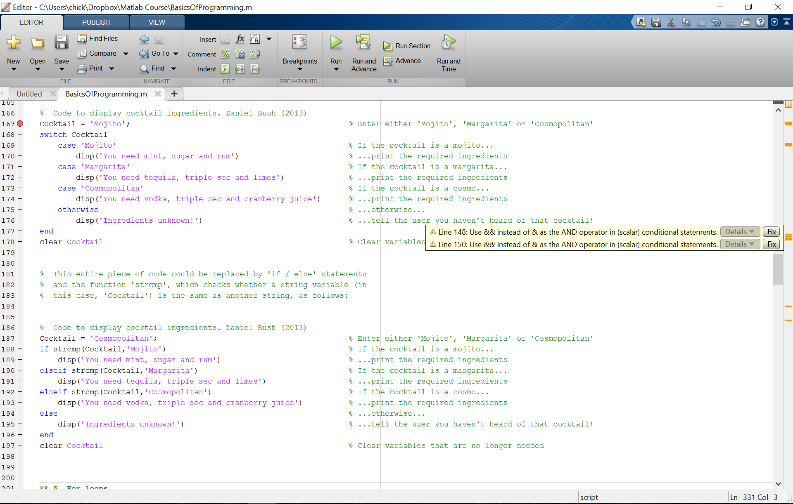
Debugging Features
Hover over these marks to view
any warnings or errors
Click here to enter a ‘breakpoint’

Slide 9
Debugging from the Command Line
You can also generate a conditional breakpoint from the command window
This is achieved by entering the command dbstop if error
After that, you will only enter debugging mode if an error occurs, where the error occurs
This allows you to inspect the variables and workspace that generated the error
Once the issue has been resolved, the conditional breakpoint can be removed
This is achieved using the command dbclear if error

Slide 10
Backup and Test your Code!
It is generally a good idea to save a new version of your code after each change
It is also useful to write a brief description of the changes made at the top of the code
It is imperative to run through your code with a worked example
Code can run without generating an error, and still contain mistakes
Debugging mode is a useful way of working through your code one step at a time
Simply add a ‘breakpoint’ at the start of your code, then proceed one line at a time
At each step, you can inspect or plot variables in the workspace
This way, you can make sure your code is doing what it is supposed to!

Slide 11
Any Questions?
d.bush@ucl.ac.uk

