Slide 1
Review of the paper,
Distributed deep learning for big
data time series analysis [1]
By
23366010 Bushra Rafia Chowdhury
ST - Mehnaz Ara Fazal
RA - Md Sabbir Hossain
Submitted To
Mr. Annajiat Alim Rasel
Senior Lecturer, Department of CSE
BRAC University

Slide 2
Overview
Motivation and Challenges
Overview of the Proposed Method
Proposed TCN model
Distributed Deep Learning Training and Testing
Experiment Results
Conclusion and Future Work Areas

Slide 3
Motivation and Challenges
Applications of deep learning is increasing
Data is the core for models because of the volume and variety
Models for time series problems are often more complex
Challenges for traffic flow prediction in large scale
Requires lots of computation
To achieve a good accuracy
Large amount of training data

Slide 4
Overview of the Proposed Method
Proposed a big data time series analysis system using distributed deep learning
System runs on Apache Spark big data framework
A Temporal Convolutional Networks (TCN) model is proposed to achieve high accuracy
Model trained on a huge amount of training data using BigDL

Slide 5
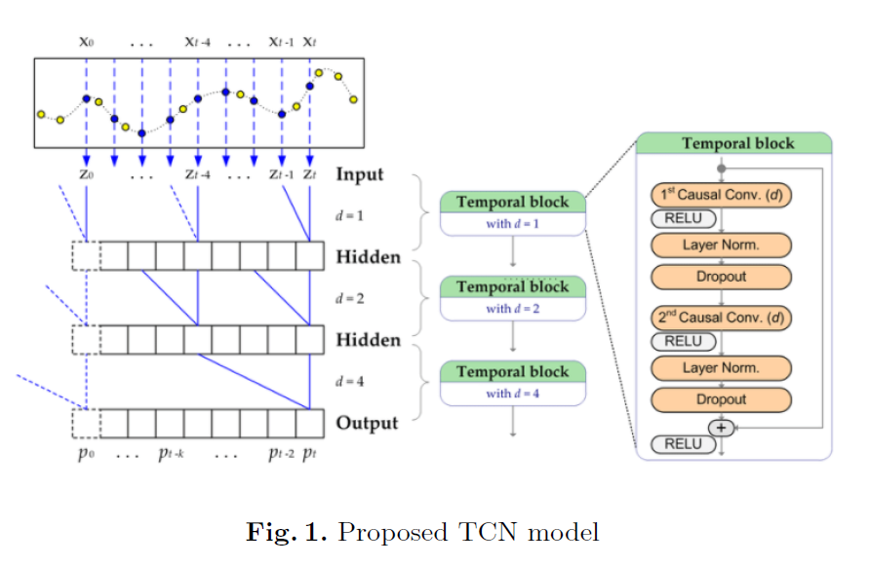
Proposed TCN model

Slide 6
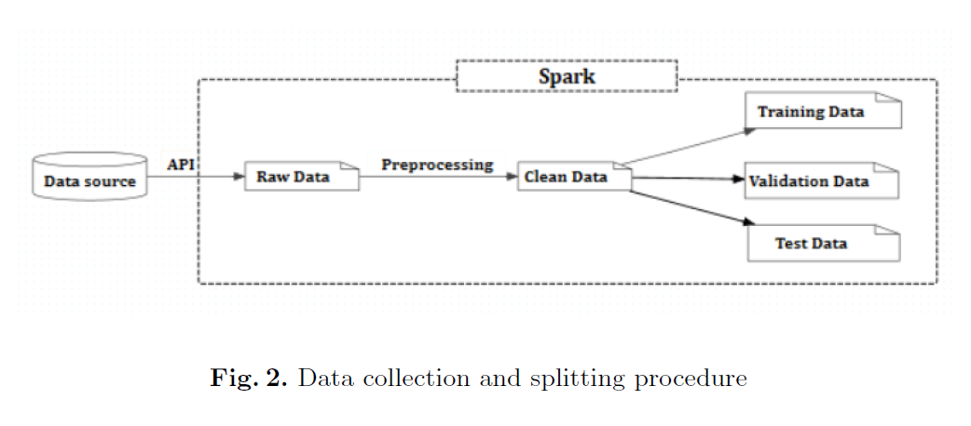
Distributed deep learning

Slide 7
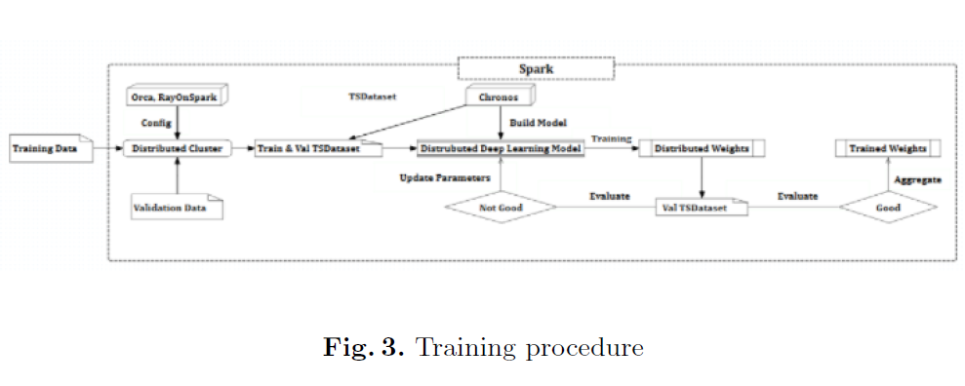
Distributed deep learning: Training Procedure

Slide 8
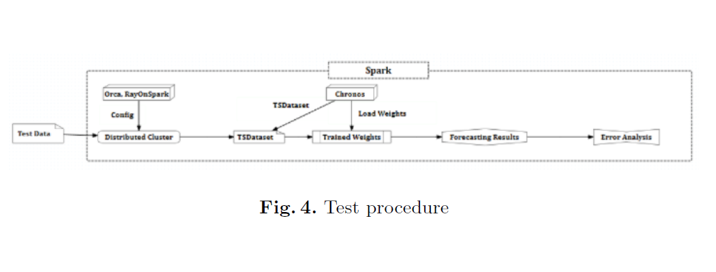
Distributed deep learning: Test Procedure

Slide 9
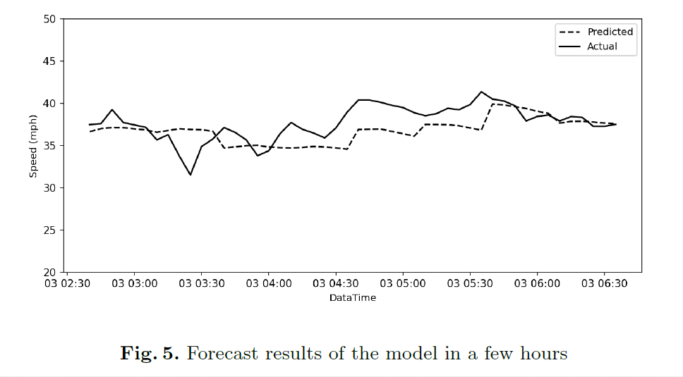
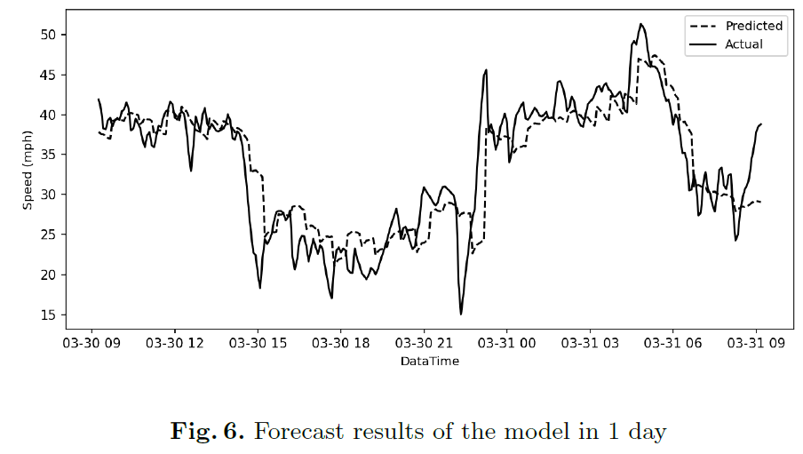
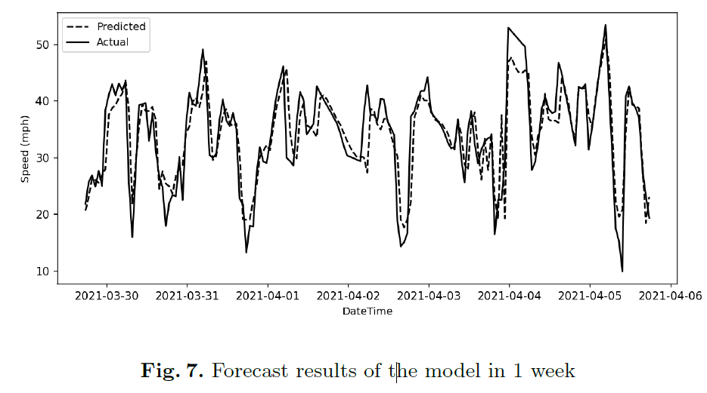
Experiment results - forecast results of the model

Slide 10
Conclusion and Future Work Areas
TCN Model achieve very high performance compared with traditional ML model
It can predict the traffic flow at very high accuracy in large scale
The work can extend for real-time traffic flow predictions and the implementation of security measures for the data

Slide 11
References
https://link.springer.com/chapter/10.1007/978-3-031-15063-0_31

Slide 12
Thank You

