Slide 1
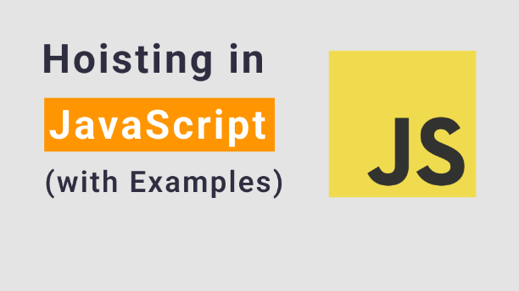

Slide 2
What is hoisting in java script?
Hoisting is the process of moving the variables and functions to the top of their scope before the code is executed. It allows us to access the variables and functions anywhere in their scope, no matter where they are declared.
We can hoist variables and functions. Let us understand them with examples.

Slide 3
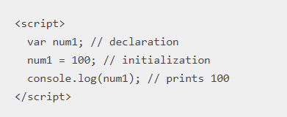
Variable Hoisting: Generally, we declare and initialize variables like this:

Slide 4
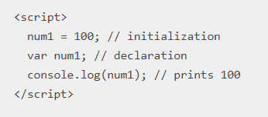
In JS, we can do the initialization before the declaration.

Slide 5
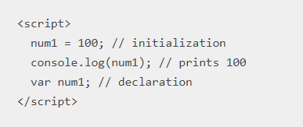
We can even move the declaration to the end.
This is called hoisting. We can access a variable before it has been declared.

Slide 6
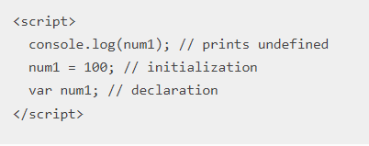
In the case of var variables, you need to remember 3 things.
1. By default, the var variables are initialized with the undefined value.
It prints undefined (initial value) because we are accessing the variable before initialization and declaration.

Slide 7
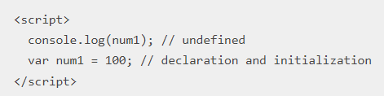
2. We can declare and initialize a var variable in a single statement. If we try to access it before the statement, it prints undefined.

Slide 8
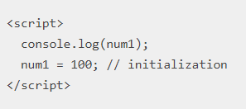
3. If we don’t declare a variable and initialize it with a value, it becomes a global variable. It is not hoisted. We get a Reference Error.
Output:
Uncaught Reference Error: num1 is not defined

Slide 9


