Slide 1


ANZ Bank Analytics Challenge
Team 3
Angela Frecklington
Bushra Khan
Perpetual Rodrigues
Urvashi Patel
Predicting Loan Status
Notes:
Image source: Microsoft 365 content library

Slide 2
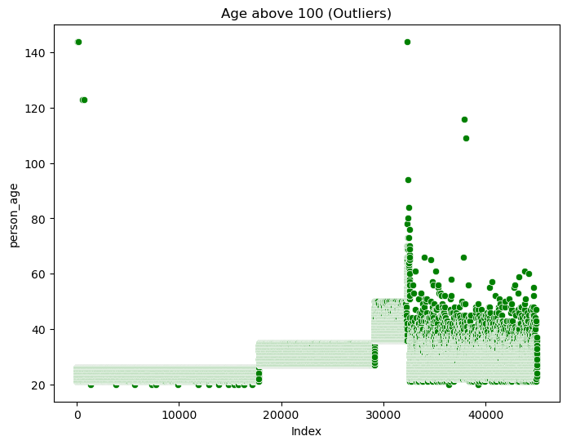
Problem Statement & Dataset Overview
Business objective
Predict loan default risk to help ANZ Bank minimise financial losses while maintaining efficient and fair approvals—distinguishing repayable loans from higher-risk defaults.
Dataset overview
~45,000 loan records with demographic features (age, gender, education) and financial/credit attributes (income, employment experience, loan amount, interest rate, loan-to-income ratio, credit score, credit history length).
Target & data quality
loan_status is binary (0 = approved, 1 = defaulted).
Seven records with implausible ages (109–144 years) were identified as outliers from the summary statistics and scatterplot and were removed to prevent unrealistic values from influencing the analysis.
Initial checks found no missing values, enabling focus on exploration and modelling; dataset structure guided feature selection, model choice, and interpretation.
Notes:
The core objective of this project was to predict loan default risk in order to help ANZ Bank minimise financial losses while maintaining efficient and fair loan approval processes. The business problem focuses on distinguishing between loans that are likely to be approved and successfully repaid versus those that are at higher risk of default. The dataset used for this analysis contained approximately 45,000 loan records, making it sufficiently large to support robust statistical analysis and machine learning modelling. Each record included a mix of demographic variables, such as age, gender, and education level, as well as financial and credit-related attributes including income, employment experience, loan amount, interest rate, loan-to-income ratio, credit score, and credit history length. The target variable, loan_status, was binary, where 0 represented approved loans and 1 represented defaulted loans. Initial data quality checks confirmed that the dataset had no missing values, allowing the team to focus on exploratory analysis and modelling rather than extensive imputation. Understanding the structure and purpose of this dataset was critical, as it informed feature selection, model choice, and the interpretation of results. This slide establishes the analytical foundation by clearly defining the problem scope, the business relevance, and the data used to derive insights.

Slide 3
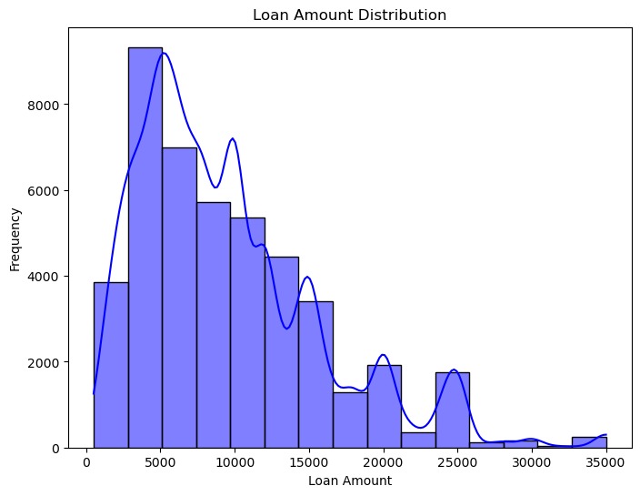
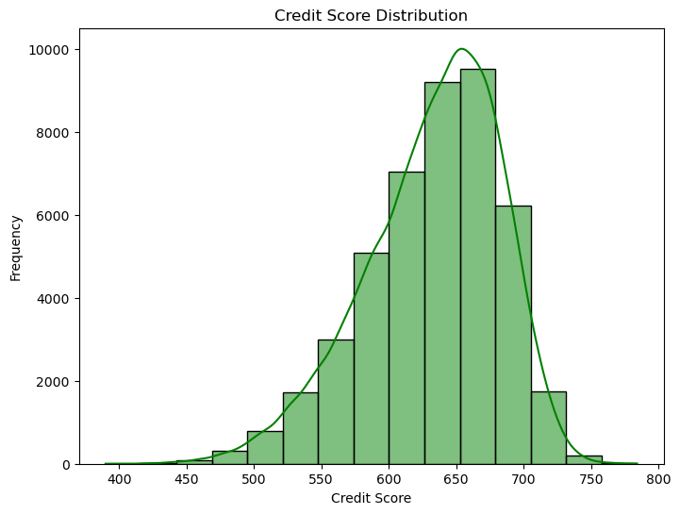
Exploratory Data Insights
Key EDA signals shaping the model
Loan Amount Distribution:
Loan amounts clustered in lower ranges; large loans were rare, indicating conservative borrowing behavior.
Credit Score Distribution:
Credit scores were approximately normal and centered in the mid-600s, suggesting moderate applicant creditworthiness.
Notes:
Exploratory data analysis revealed several important characteristics of the loan dataset that directly influenced model development and interpretation. One of the most notable findings was a strong class imbalance in the target variable, with the majority of loans being approved and a much smaller proportion resulting in default. This imbalance is typical in real-world banking data but poses challenges for predictive modelling, particularly in correctly identifying high-risk borrowers. Distribution analysis showed that most loan amounts were concentrated in the lower ranges, while larger loans were relatively rare, indicating conservative borrowing behaviour among most applicants. Credit scores followed an approximately normal distribution, centred around the mid-600 range, suggesting that most applicants had moderate creditworthiness. Correlation analysis highlighted that loan_percent_income and loan interest rate had the strongest relationships with loan default, indicating that borrowers taking loans that consume a higher proportion of their income or attract higher interest rates are more likely to default. Additionally, a small number of extreme age values were identified as outliers and removed to prevent distortion of results. These insights provided valuable context for selecting features and understanding the underlying risk patterns in the data. Image source: Microsoft 365 content library

Slide 4
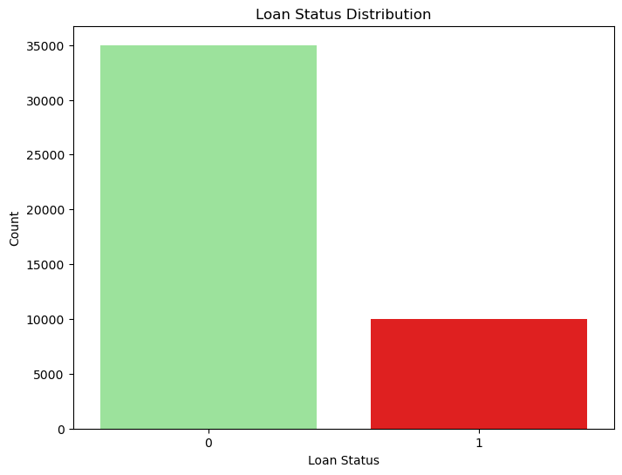
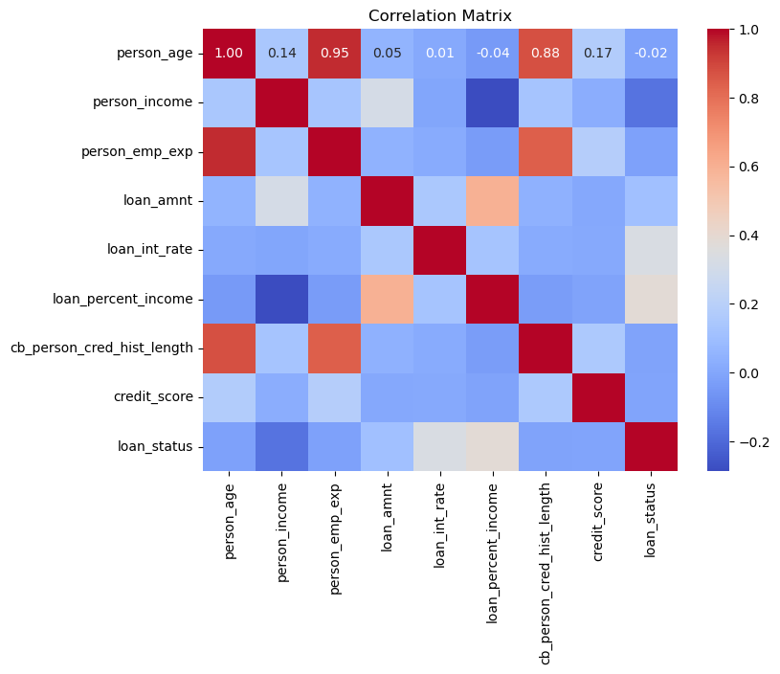
Exploratory Data Insights
continued
Loan Distribution:
Strong class imbalance: most loans were approved, with relatively few defaults—making high-risk detection harder.
Correlation Matrix:
Feature Relationships: Strong positive correlations exist between person_age, person_income, and person_emp_exp, as well as among loan_amnt, loan_int_rate, and loan_percent_income, reflecting expected relationships between borrower profiles and loan characteristics.
Loan Status (Default Risk): Correlations with loan_status are generally weak, with the strongest being loan_percent_income (~0.38) and loan_int_rate (~0.33), indicating higher default risk for borrowers with higher repayment burden and interest rates.
Notes:
Exploratory data analysis revealed several important characteristics of the loan dataset that directly influenced model development and interpretation. One of the most notable findings was a strong class imbalance in the target variable, with the majority of loans being approved and a much smaller proportion resulting in default. This imbalance is typical in real-world banking data but poses challenges for predictive modelling, particularly in correctly identifying high-risk borrowers. Distribution analysis showed that most loan amounts were concentrated in the lower ranges, while larger loans were relatively rare, indicating conservative borrowing behaviour among most applicants. Credit scores followed an approximately normal distribution, centred around the mid-600 range, suggesting that most applicants had moderate creditworthiness. Correlation analysis highlighted that loan_percent_income and loan interest rate had the strongest relationships with loan default, indicating that borrowers taking loans that consume a higher proportion of their income or attract higher interest rates are more likely to default. Additionally, a small number of extreme age values were identified as outliers and removed to prevent distortion of results. These insights provided valuable context for selecting features and understanding the underlying risk patterns in the data. Image source: Microsoft 365 content library

Slide 5
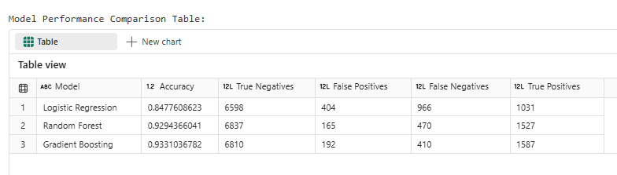
Model Performance Evaluation
Training the Models
The dataset was split into 80% training data (35,994 rows) and 20% testing data (8,999 rows) using train_test_split, allowing the model to learn patterns from the training set and be evaluated on unseen test data.
Why confusion matrices matter
Accuracy alone can mask risk, so confusion matrices were used to distinguish false negatives (risky borrowers incorrectly approved) from false positives (safe borrowers incorrectly rejected), providing a more meaningful evaluation of credit risk.
Best model for deployment
Three models were trained—Logistic Regression, Random Forest, and Gradient Boosting—with Gradient Boosting achieving the best performance at ~93.3% accuracy and the fewest false negatives, effectively balancing loan approvals with strong defaulter detection for credit risk management.
Notes:
Multiple machine learning models were evaluated to determine the most effective approach for predicting loan default, including Logistic Regression, Random Forest, and Gradient Boosting. Model performance was assessed using accuracy and, more importantly, confusion matrix analysis to understand the trade-off between false positives and false negatives. While Logistic Regression provided a baseline, it produced a relatively high number of false negatives, meaning many risky loans were incorrectly approved. Random Forest significantly improved overall accuracy and reduced false positives but still missed a notable number of defaulters. Gradient Boosting emerged as the best-performing model, achieving an accuracy of approximately 93.3% and the lowest number of false negatives among all models tested. This is particularly important from a banking perspective, as false negatives represent high-risk borrowers who are mistakenly approved, leading to potential financial losses. The confusion matrix visually demonstrates the model’s ability to correctly identify both approved loans and defaulters, reinforcing confidence in its predictive strength and suitability for deployment in a real-world lending environment. The confusion matrix visualisation illustrates the balance achieved by the Gradient Boosting model between correctly approving low-risk loans and accurately flagging high-risk applicants, highlighting its practical value for credit risk management.

Slide 6
Key findings
• Gradient Boosting consistently outperformed Logistic Regression and Random Forest across evaluation metrics. • loan_percent_income and loan interest rate were the most influential predictors, highlighting affordability and pricing effects. • Confusion matrix results indicate false negatives should be reduced to avoid approving high-risk loans.
Business recommendations
• Adopt Gradient Boosting in the credit assessment pipeline as the preferred default model. • Use model outputs to flag high-risk applications for manual review while fast-tracking low-risk approvals. • Prioritise risk controls that minimise costly false negatives to reduce default exposure.
Future work
• Threshold tuning and cost-sensitive learning to better align decisions with ANZ’s business objectives.
Key Findings & Recommendations
Actionable insights for ANZ credit risk decisions
Notes:
The analysis led to several clear and actionable findings for ANZ Bank. First, Gradient Boosting consistently outperformed Logistic Regression and Random Forest models across all key evaluation metrics, making it the preferred solution for loan default prediction. Second, features such as loan_percent_income and loan interest rate were identified as the most influential predictors of default risk, suggesting that affordability and pricing play a critical role in borrower behaviour. Third, confusion matrix analysis showed that reducing false negatives should be prioritised, as approving high-risk loans has a greater financial impact than incorrectly rejecting low-risk applicants. Based on these insights, it is recommended that ANZ Bank adopt the Gradient Boosting model as part of its credit assessment pipeline. The model can be used to flag high-risk applications for further review while allowing low-risk loans to be approved more efficiently. This approach supports improved risk management, reduced default rates, and a better overall customer experience by streamlining decisions for reliable borrowers. Future work could focus on threshold tuning and cost-sensitive learning to further align model outputs with business objectives.

