Slide 1

People Finder

Slide 2
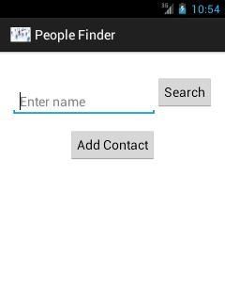

Slide 3
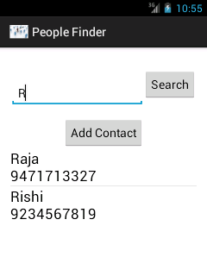

Slide 4
Using the Amazon SimpleDb
Requests to SimpleDb are made through a client
Contact details are stored as items in a SimpleDb domain
An item is a collection of attribute/value pair
Select request uses a simple query language to determine which items to match and what data to return or how

Slide 5
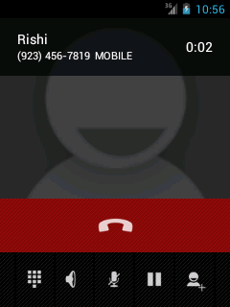

Slide 6
Making a call
The INTENT, ACTION_CALL is used
The phone number to be dialed is set as the data
The activity is then started
This feature can be used by swiping the list item from left to right

Slide 7
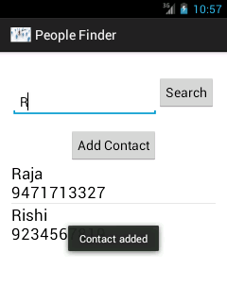

Slide 8
Adding to Contacts
ContactsContract defines an extensible database of contact-related information
Batch method is used to insert the raw contact and its constituent data rows in a single database transaction and causes at most one aggregation pass
This feature can be used by swiping the list item from right to left
After the contact has been successfully added, a toast notifies the same

