Slide 1
Cloud Computing

Slide 2
INTRODUCTION
Cloud Computing provides us a means by which we can access the applications as utilities, over the Internet. It allows us to create, configure, and customize applications online.
With Cloud Computing users can access database resources via the internet from anywhere for as long as they need without worrying about any maintenance or management of actual resources.

Slide 3
What is Cloud?
The term Cloud refers to a Network or Internet. In other words, we can say that Cloud is something, which is present at remote location.
Cloud can provide services over network, i.e., on public networks or on private networks, i.e., WAN, LAN or VPN.
Applications such as e-mail, web conferencing, customer relationship management (CRM), all run in cloud.

Slide 4
What is Cloud Computing?
Cloud Computing refers to manipulating, configuring, and accessing the applications online.
It offers online data storage, infrastructure and application.
Cloud Computing is both a combination of software and hardware based computing resources delivered as a network service.

Slide 5
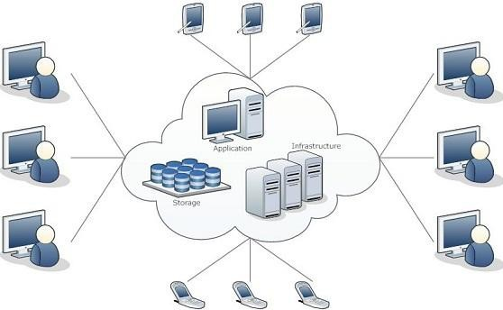
Cloud Computing Architecture

Slide 6
Basic Concepts
There are certain services and models working behind the scene making the cloud computing feasible and accessible to end users. Following are the working models for cloud computing:
Deployment Models
Service Models

Slide 7
Deployment Models
Deployment models define the type of access to the cloud, i.e., how the cloud is located? Cloud can have any of the four types of access: Public, Private, Hybrid and Community.

Slide 8
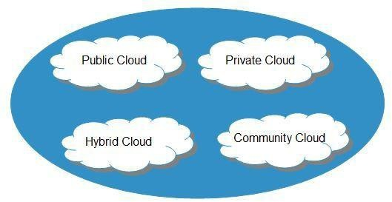

Slide 9
PUBLIC CLOUD : The Public Cloud allows systems and services to be easily accessible to the general public. Public cloud may be less secure because of its openness, e.g., e-mail.
PRIVATE CLOUD : The Private Cloud allows systems and services to be accessible within an organization. It offers increased security because of its private nature.
COMMUNITY CLOUD : The Community Cloud allows systems and services to be accessible by group of organizations.
HYBRID CLOUD : The Hybrid Cloud is mixture of public and private cloud. However, the critical activities are performed using private cloud while the non-critical activities are performed using public cloud.

Slide 10
Service Models
Service Models are the reference models on which the Cloud Computing is based. These can be categorized into three basic service models as listed below:

Slide 11
Infrastructure as a Service (IaaS)
Platform as a Service (PaaS)
Software as a Service (SaaS)

Slide 12
Infrastructure as a Service (IaaS)
IaaS is the delivery of technology infrastructure as an on demand scalable service.
IaaS provides access to fundamental resources such as physical machines, virtual machines, virtual storage, etc.
Usually billed based on usage
Usually multi tenant virtualized environment
Can be coupled with Managed Services for OS and application support

Slide 13






IaaS Examples

Slide 14
Platform as a Service (PaaS)
PaaS provides the runtime environment for applications, development & deployment tools, etc.
PaaS provides all of the facilities required to support the complete life cycle of building and delivering web applications and services entirely from the Internet.
Typically applications must be developed with a particular platform in mind
Multi tenant environments
Highly scalable multi tier architecture

Slide 15


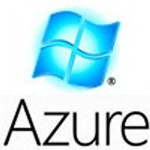



PaaS Examples

Slide 16
Software as a Service (SaaS)
SaaS model allows to use software applications as a service to end users.
SaaS is a software delivery methodology that provides licensed multi-tenant access to software and its functions remotely as a Web-based service.
•
•
•
Usually billed based on usage Usually multi tenant environment Highly scalable architecture

Slide 17

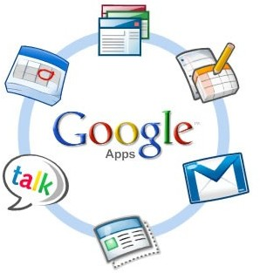

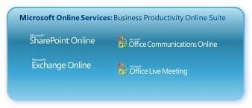

SaaS Examples

Slide 18
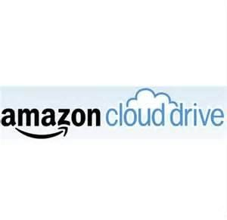
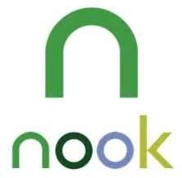

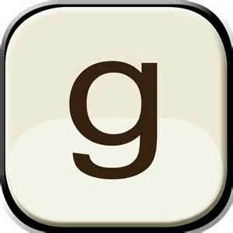
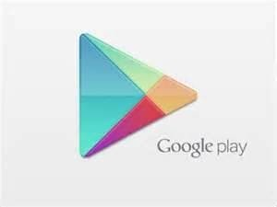

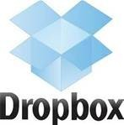





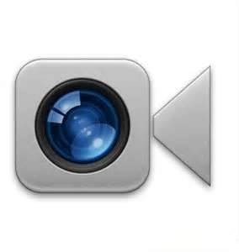



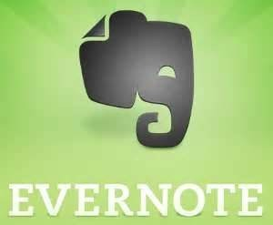

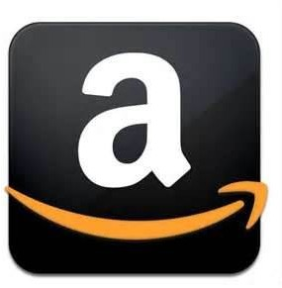
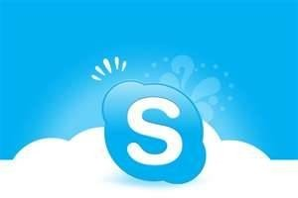

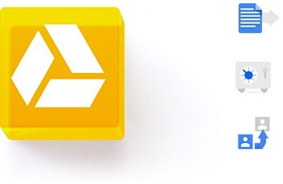
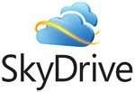

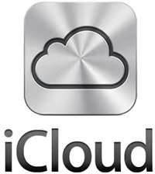
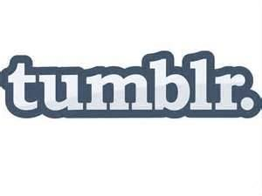








Do you Use the Cloud?

Slide 19
Advantages
•
•
•
•
•
•
•
•
•
•
•
Lower computer costs Improved performance: Reduced software costs Instant software updates
Improved document format compatibility Unlimited storage capacity
Increased data reliability Universal document access Latest version availability Easier group collaboration Device independence

Slide 20
Disadvantages
•
•
•
•
•
•
Requires a constant Internet connection
Does not work well with low-speed connections Features might be limited
Can be slow
Stored data can be lost
Stored data might not be secure

Slide 21
Cloud Storage
•
Create an Account User name and password.
•
Content lives with the account in the cloud.
•
Log onto any computer with Wi-Fi to find your content

Slide 22

Download For Storage
•
•
•
•
•
Download a cloud based app to on your computer
The app lives on your Computer Save files to the app
When connected to the Internet it will sync with the cloud The Cloud can be accessed from any Internet connection

Slide 23
Thank
you…
Question…?

