Slide 1
Advanced Statistical Modeling
4/25/2022
Ridge, Lasso, and
Elastic Net Regression
Ryan Miller and
Ryan Henderson

Slide 2
Contents
Ordinary Least Squares
Regularization General Principle
Ridge Regression
Lasso Regression
Elastic Net Regression
Simple Example
Glmnet Regression Models Example
CARET Training Best Tuned Model Example
Conclusion

Slide 3
Introduction
Ridge, Lasso, and Elastic Net are regularization methods that can be used in regression analysis in an attempt to improve the accuracy and prediction ability of a regression model.
The main concept behind these regularization methods is to sacrifice some amount of bias in the model to reduce the variance of predicted values.

Slide 4
Introduction
The Ordinary Least Squares method of obtaining a simple linear model has widely acknowledged problems in prediction and interpretation, so regularization methods have been used to solve these issues.
Ridge, Lasso, and Elastic Net impose their own penalties to a regression model based on the β values obtained in the model.

Slide 5
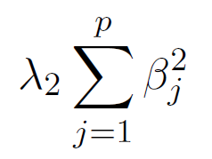
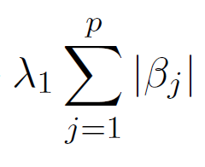
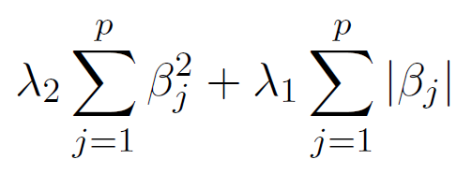
Introduction
Ridge Penalty -
Lasso Penalty -
Elastic Net Penalty -
Where λ are tuning parameters, p is the number of predictors, and β are the regression coefficients

Slide 6
Ordinary Least Squares
Basic Linear Regression Model:
where Y is the response variable, X are the predictor variables, β are the regression coefficients, ϵ is the error term, and p is the number of predictors.

Slide 7

Ordinary Least Squares
We can make predictions based on the following formula by determining the estimated regression coefficients.

Slide 8
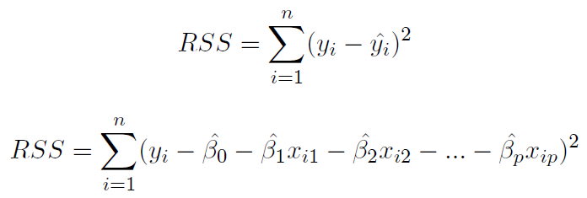
Ordinary Least Squares
The regression coefficients can be solved by minimizing the following residual sum of squares equations.

Slide 9
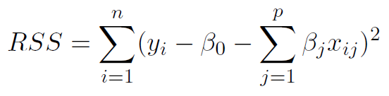
Ordinary Least Squares
The calculated β values that minimize the RSS become the regression coefficients. The residual sum of squares with the regression coefficients shown below will be used in the following methods.

Slide 10
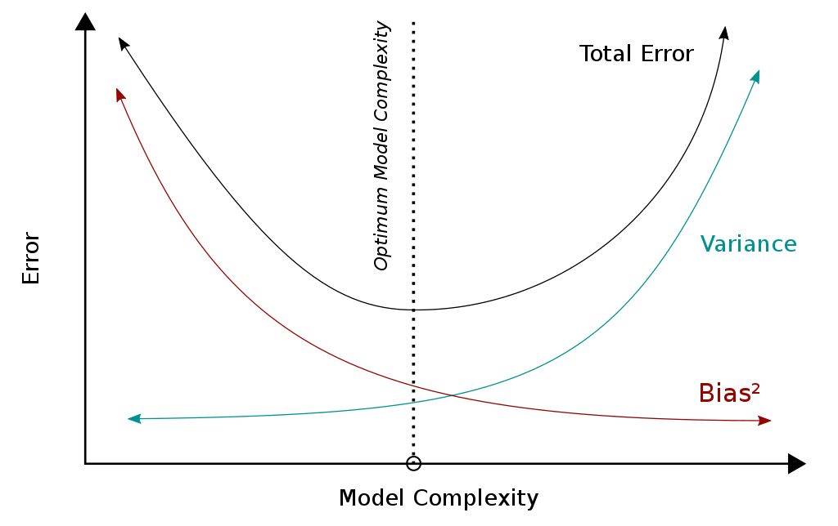
Bias Variance Trade-Off

Slide 11
Regularization General Principle
The goal is to mitigate variance for out-of-sample predictions.
We introduce a bias term to the loss/deviance function [for any EDM] and solve for the minimum.
λ × sum of squared coefficients,
λ × sum of coefficient absolute values,
λ × some mixture of the two above treatments
λ and the best mixture are found via cross-validation. λ ranges from 0 to +∞.

Slide 12
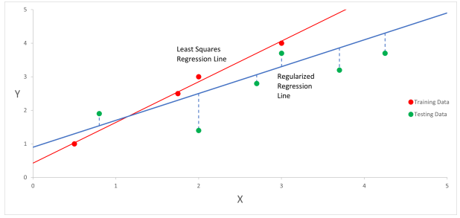
Regularization General Principle (cont.)

Slide 13
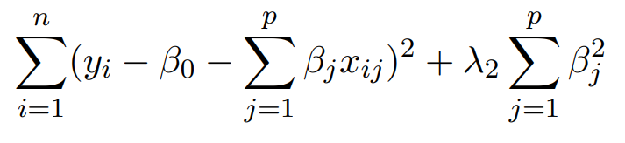


Ridge Regression
Loss Function:
Variance:
OLS Variance for comparison:
Key Points:
Coefficients will only reach 0 if λ is at +∞. (doesn’t do variable selection)
Only useful when all or nearly all coefficients are significant due to low outlier tolerance and tolerance for irrelevant features.
Used to approximate Lasso’s closed form: ∑ꞵ²/|ꞵ|

Slide 14
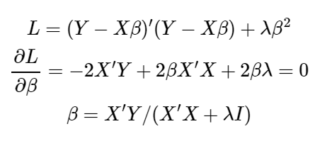
Ridge Regression
How loss is minimized:

Slide 15
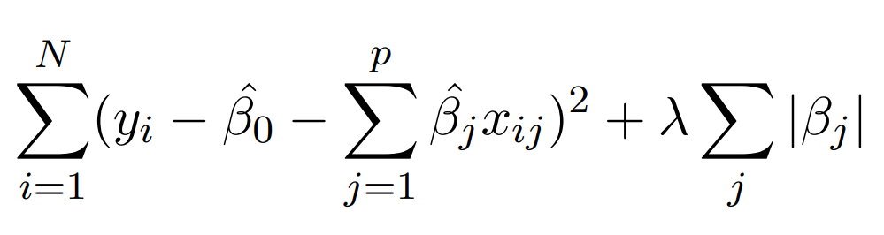
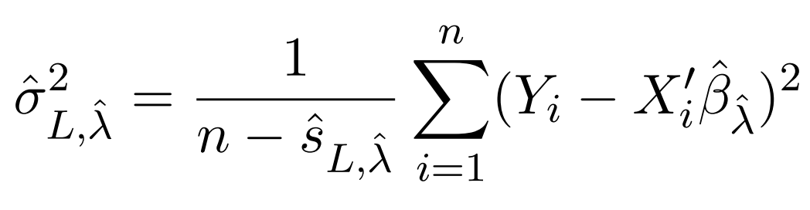
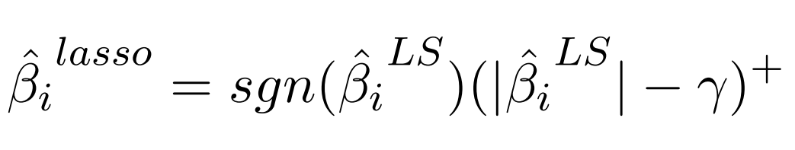
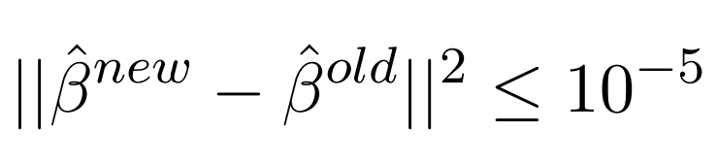
Lasso Regression
Loss Function:
Variance Estimate:
Optimization:
Soft-thresholding form:
Calculable Convergence:
Key Points:
Coefficients will reach 0 if λ is sufficiently large.
Performs variable selection
Absolute value gives non-linearity and no derivation
Significance tests are still being studied.
Notes:
Variance estimate from Fan Guo & Hao 2012. Cross-validated sum of squares where ˆsL,λˆ is the number of non-zero covariates. Mean RSS with more conservative estimates the more non-zero covariates.
Soft-thresholding form from Donoho and Johnstone 1994. In both cases where an OLS Beta is negative or positive, we must compare to the lasso case in terms of the loss function. https://stats.stackexchange.com/questions/17781/derivation-of-closed-form-lasso-solution/17786#17786

Slide 16
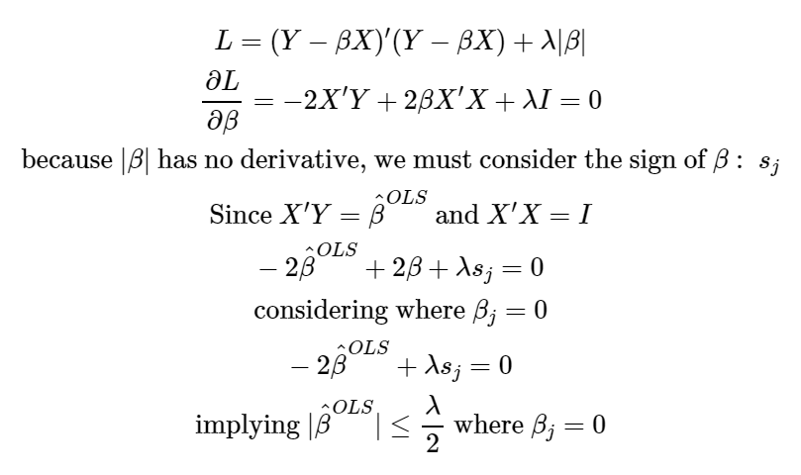
Lasso Regression
How it does variable selection:

Slide 17
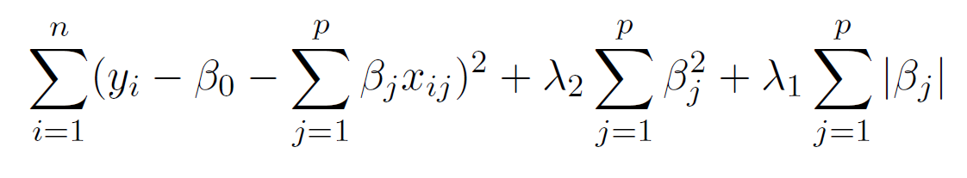
Elastic Net Regression
Loss Function:
Key Points:
Combines penalties of Ridge and Lasso by adding both to the residual sum of squares to be minimized
Method allows for possibility of both Ridge and Lasso: if λ2 = 0, the penalty is the Lasso penalty, and if λ1 = 0, the penalty is the Ridge penalty
Combination of these penalties allows for the strengths of Lasso, such as simultaneous automatic variable selection and continuous shrinkage, and the strengths of Ridge, the selection of correlated variables.

Slide 18

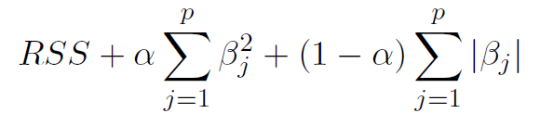
Elastic Net Regression
In the naive Elastic Net definition, the tuning parameters are set by the following equation:
With this α value, the naive Elastic Net penalized residual sum of squares to be minimized becomes the following loss function:

Slide 19

Elastic Net Regression
The naive Elastic Net regularization does not have great prediction performance unless it is very close to Ridge Regression or Lasso Regression. Because shrinkage occurs with both penalties, there is double shrinkage. To correct this problem, the naive Elastic Net regression coefficients are rescaled with the following equation:

Slide 20
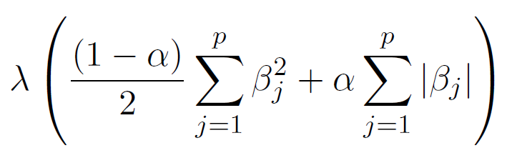
Glmnet Function
For applied use in R, the penalties for Ridge, Lasso, and Elastic Net can be simplified by using a single λ value shown in the following gaussian penalty equation used in the Glmnet function.

Slide 21
Simple Example
Load and Preprocess
Train-Test Split
Train the Models
Compare In-Sample RSS
Compare In-Sample R-Squared
Compare Coefficients
Compare Out-of-Sample R-Squared

Slide 22
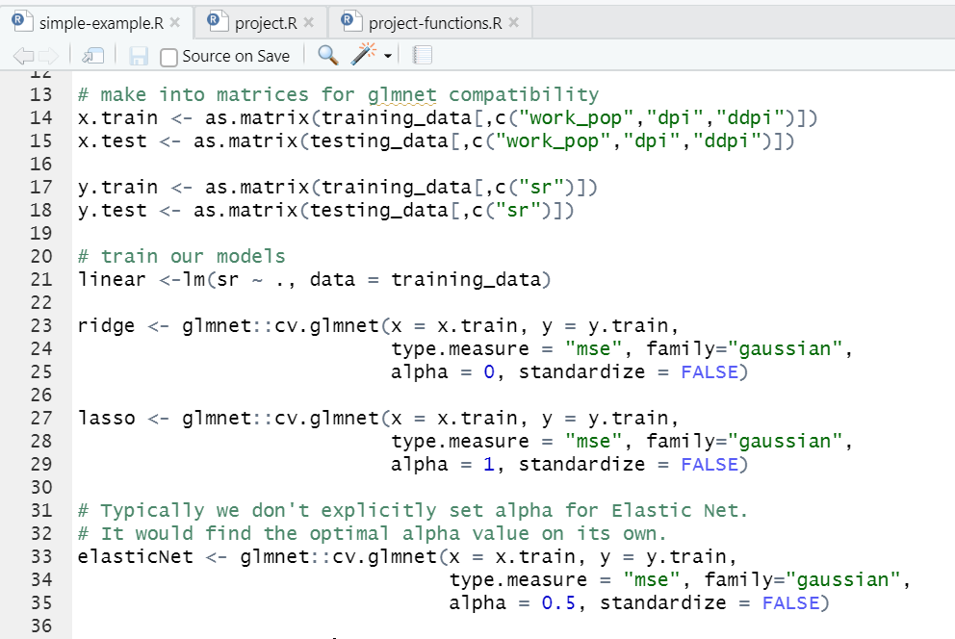
Simple Example Code

Slide 23
Gradient Analysis
I’m going to show a 3D example of each regression function’s loss gradients using Plotly. Then I will show the contour plots.

Slide 24
Glmnet
Load and Preprocess
Train-Test Split
Train the Models
View MSE Plot and Lambda Plot
Compare In-Sample RSS
Compare Coefficients
Compare Out-of-Sample R-Squared

Slide 25
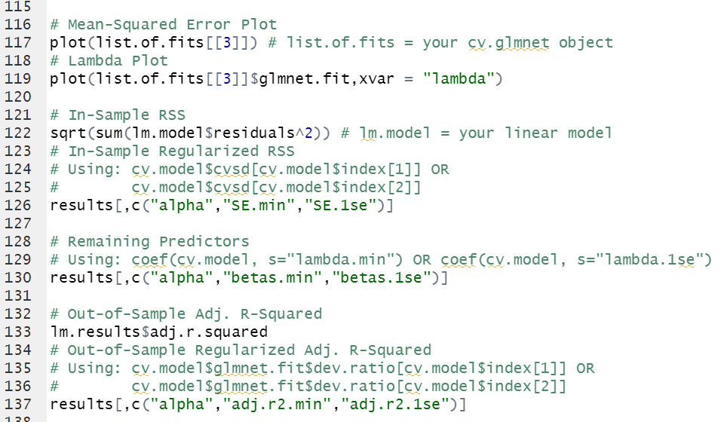
Glmnet Results

Slide 26
CARET Training
Using the CARET train function, we can fit predictive models over different tuning parameters.
We can specify the regression model as glmnet, set k-fold cross validation, and choose granularity settings within the function.
The best tuned model is selected by minimizing the RMSE by default.

Slide 27
Conclusion - Ridge Regression
Strengths:
Penalty allows for better parameter estimation in a regression model
Drawbacks:
Can never remove any parameters from the model

Slide 28
Conclusion - Lasso Regression
Strengths:
Penalty allows for better parameter estimation in a regression model
Has ability to remove parameters from model
Drawbacks:
Limited variable selection when the number of predictors is greater than the sample size
Has trouble selecting between highly correlated predictors

Slide 29
Conclusion - Elastic Net
Strengths:
Penalty allows for better parameter estimation in a regression model
Has ability to remove parameters from model
Permits a data set where the number of predictors is greater than the sample size
Drawbacks:
Higher processing demands
More complex model selection process

Slide 30
Conclusion - Examples
Similar results between models, flexibility of what model to use based on what metric you choose to base decision on
Possible advantage of less predictors being used depending on how model is used

Slide 31
Links
https://glmnet.stanford.edu/articles/glmnet.html#logistic-regression-family-binomial-
I added my files to my personal github:
https://github.com/business-ui/AdvStatsModeling

