Slide 1
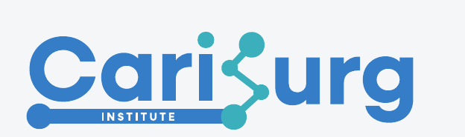
ML Classification
for Clinical Data
CariSurg MedTech Pathways · Week 6 · Tutorial 1
30-minute live tutorial
Tutor Name
Tutor Affiliation/Title

Slide 2

What is classification?
A classifier sorts each patient into one of a fixed set of labelled boxes.
Ours are the five ESI triage levels.
ESI 1
ESI 2
ESI 3
ESI 4
ESI 5
Resuscitate
Emergent
Urgent
Less urgent
Non-urgent
The model reads a patient's clues (age, vitals, chief complaints) and predicts which box they belong in.
Notes:
Anchor the whole week: classification = sorting into fixed labelled boxes. Our boxes are the 5 ESI levels. Contrast with regression (predicting a number). Keep it concrete — point at the five cards. Ask: 'what clues would YOU use to sort a patient?' to tee up features.

Slide 3

From Week 0 rules to a learned model
Week 0 — you wrote the rules
Week 6 — the model finds the rules
IF spo2 < 90 AND rr > 24:
level = 1
ELIF hr > 120:
level = 2
ELSE:
level = 3
You gave the thresholds by hand.
A model learns them from thousands of past patients.
It weighs many clues at once — not just one IF at a time.
Same goal as your pseudocode: output an ESI level.
Notes:
Bridge from the Week 0 triage pseudocode. The key mental shift: instead of a human hand-coding IF/ELSE thresholds, the model infers the decision boundaries from labelled data. Emphasise it is the SAME task (produce an ESI level) — only the source of the rules changes. This de-mystifies ML for non-coders.

Slide 4

The supervised learning pipeline
1
→
2
→
3
→
4
Features
Model
Prediction
Evaluation
the clues per patient
learns X → y
an ESI guess
how good is it?
Every model we build this term walks these four steps. Today is concept; Tutorials 2–3 are the code.
Notes:
The mental model students should carry all term: features → model → prediction → evaluation. Map it forward: Tutorial 2 does features→model→prediction; Tutorial 3 does evaluation. Everything else is detail hung on this spine.

Slide 5

Why ESI is the target
The Emergency Severity Index (ESI) is a 5-level triage scale used at the front door of an ED.
It is the one column we are trying to predict — the answer key the model learns from.
It is assigned by a trained nurse, so it is a defensible clinical ground truth — not something we invented.
1
Resuscitation — immediate, life-saving
2
Emergent — high risk, cannot wait
3
Urgent — needs several resources
4
Less urgent — one resource
5
Non-urgent — exam only
Notes:
Define ESI plainly: a 5-level scale a triage nurse assigns. Stress it is the label (y) and it is a legitimate clinical ground truth because a professional assigned it. Lower number = more urgent — students routinely get this backwards, so drill it now.

Slide 6

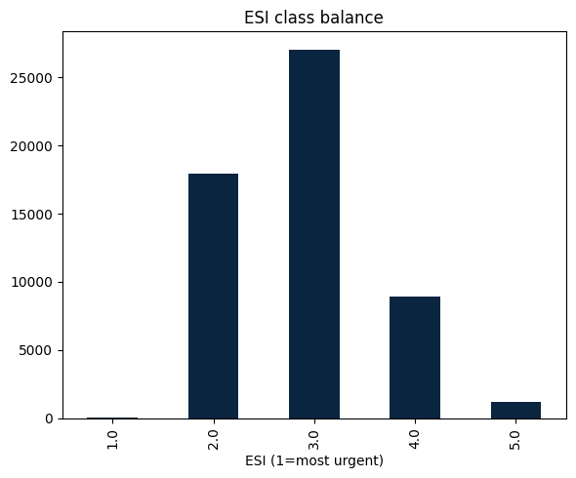
Triage is multi-class AND imbalanced
Why this matters
5 classes, not 2 (multi-class).
ESI 3 dominates; ESI 1 is rare.
A model can score 'well' by ignoring the rare, critical class.
That is the trap Tutorial 3 fixes.
Notes:
Two properties define the difficulty. Multi-class: 5 outcomes not 2. Imbalanced: ESI 3 is ~half the data, ESI 1 a few percent. Plant the seed: a lazy model that always says '3' looks decent on accuracy but is clinically dangerous. Numbers shown are illustrative of the cohort's cleaned set.

Slide 7


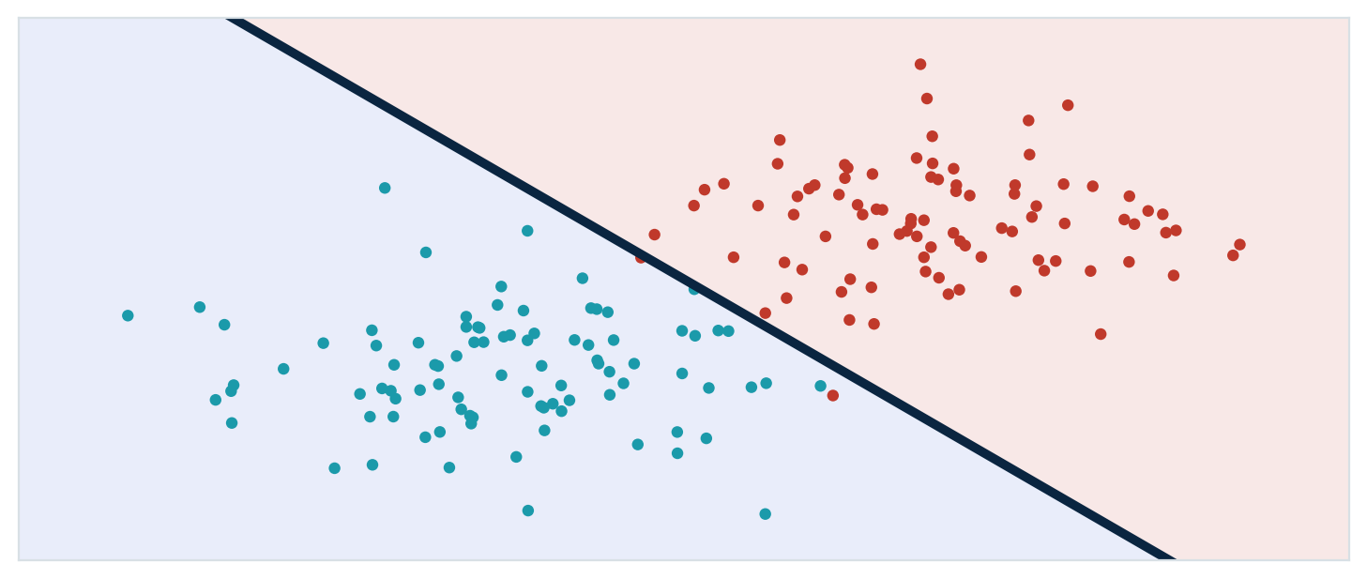
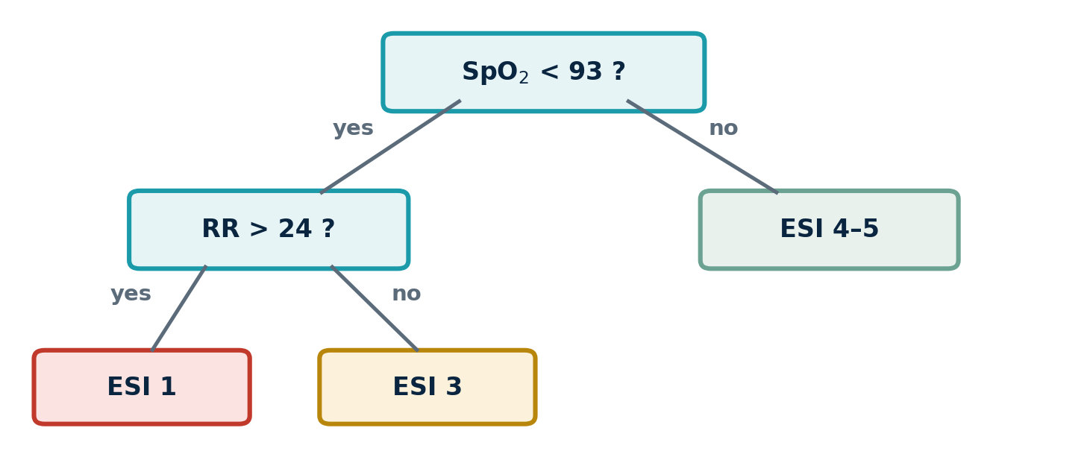
Your two Week 6 models
Logistic Regression
Decision Tree
One straight line between the classes. Needs feature scaling.
A flowchart of yes/no questions. No scaling; easy to read.
Notes:
Preview the two baselines without code — let the pictures do the work. Logistic regression lays down ONE straight boundary (it sums weighted features, so scaling matters); the tree is a branching flowchart of yes/no cuts (it compares one feature to a threshold, so scaling doesn't). Both output an ESI level. This exact contrast returns as a hands-on task in Tutorial 2.

Slide 8


Train / test split & data leakage
The 80 / 20 rule
Avoid leakage
TRAIN (80%)
TEST
Never feed the model a column it could only know AFTER triage — e.g. disposition (admitted / discharged). It inflates scores and collapses in real use.
stratify — keep the same ESI mix in both halves.
random_state — same split every run (reproducible).
The test set is a final exam the model never sees while training.
Notes:
Three disciplines: stratified split (protects the rare ESI 1), fixed random_state (reproducibility — a recurring theme), and leakage prevention. Give the leakage story concretely: 'disposition' is decided after triage; using it is cheating and the model dies in production. This sets up the FEATURES cell in Tutorial 2.

Slide 9
NEXT TUTORIAL
Summary
Tutorial 2
Implementing Logistic Regression & Decision Tree
01
Classification Models
These learn from data to sort patients into categories (in our case ESI boxes). There are many that exists.
02
Logistic Regression
Supervised machine learning technique used for classification problems by predicting a probability an input belongs to a specific class.
STUCK BEFORE THEN?
Post in #ask-a-tutor.
Include the command, the full error, and what you expected.
Decision Tree
03
Supervised learning algorithm that creates a tree-like structure were each node is a decision rule. By following a set of decisions the model can predict a classification for an input.
Week 6 · Tutorial 1 · Introduction to ML Classification
Notes:
⏱ TIME: 3 min 🎯 GOAL: Close the tutorial with crisp, non-negotiable pre-work. No "any questions?" — students leave with three specific things to do. 🗣 TALKING POINTS: • Walk through the three pre-work items. Each one must be done before Tutorial 2 or the next session is blocked for that student. • Repo public: this is portfolio-visible — that is the whole point of putting it on GitHub. • A commit on a branch (not main): this proves they internalised the branching rule. • A merged PR: this proves they did the whole loop end-to-end. • Posting the URL in #cohort-2026 is the soft check — tutors will scan the channel before Tutorial 2 to flag anyone who has not posted. • Tutorial 2 picks up directly from here: now that you have a repo, what should be in it and how should it be organised. ❓ ASK THE ROOM: • "Anything genuinely blocking you from finishing the pre-work in the next 24 hours?" • Listen for: laptop access, GitHub authentication issues, or any conceptual gap. Triage in Discord after the session — do not solve in the closing minutes. ⚠ WATCH FOR: • The student who nods through the close but has not actually opened a terminal all session. Catch them in Discord with a friendly check-in — better now than at Tutorial 2. • Do not end on "see you next time". End on the three deliverables. The deck closes on action, not pleasantries.

Slide 10
Today in one line
Classification sorts patients into the five ESI boxes.
A model learns the rules you used to hand-code in Week 0.
Triage is multi-class and imbalanced — accuracy alone will mislead.
Next: Tutorial 2 — build logistic regression and a decision tree.
CariSurg MedTech Pathways · Week 6 · Tutorial 1

