Slide 1
The Impacts of Weather on Tennis Player Performance
Bing-Hsun Wu
Motivation
A tennis fanatic, I want to utilize the power of data to identify key contributing factors to tennis professional player performances
Goal
Examine how weather condition, such as temperature, humidity, wind speed and pressure, comes into play with the matches results
Explore if there is indeed player-specific weather condition which might be favorable to one party

Slide 2
Data Sources and Methods
Tennis-data.co.uk website
  Winner, Loser, Wsets, Lsets, Location in CSV format
  Identify 3 top most frequently appeared players in the dataset as target players of interest in this project
OpenWeatherMap
  cityname, temperature, pressure, humidity, wind speed in JSON format
  Use GET request from the first dataset to get the corresponding weather data

Slide 3
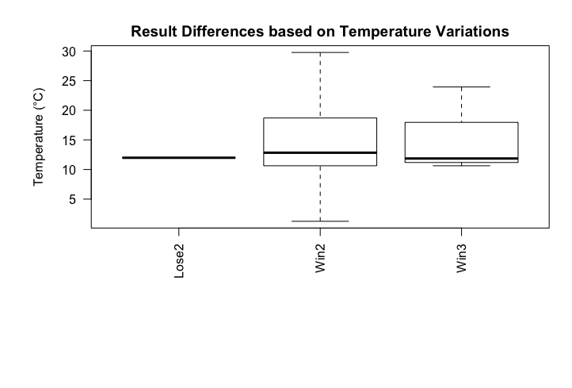
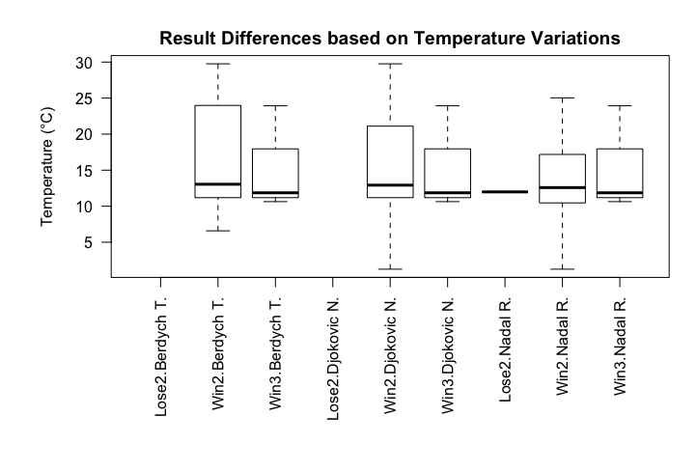
Analysis and Visualization
Wide range of temperature condition when win in 2 sets
There is indeed a player-specific condition when win in 2 sets. Djokovic has the widest temperature tolerance.

