Slide 1

INTRODUCTION to COMPUTATION & PROGRAMMING FOR IE
Assoc. Prof. Dr. Gürkan ÖZTÜRK & Assist. Prof. Dr. Emre ÇİMEN
Week 13

Slide 2
Functions as objects
﻿In Python, functions are first-class objects. That means that they can be treated like objects of any other type, e.g., int or list.
def applyToEach(L, f):
""" Assumes L is a list, f a function
Mutates L by replacing each element, e, of L by f(e) """
for i in range(len(L)):
L[i] = f(L[i])
L = [1, -2, 3.33]
print('L :', L)
print(50*"-")
print('Apply abs to each element of L')
applyToEach(L, abs)
print('L : ', L)
print(50*"-")
print('Apply int to each element of L')
applyToEach(L, int)
print('L : ', L)
L : [1, -2, 3.33]
--------------------------------------------------
Apply abs to each element of L
L : [1, 2, 3.33]
--------------------------------------------------
Apply int to each element of L
L : [1, 2, 3]
20/05/2020

Slide 3
Functions as objects
def applyToEach(L, f):
""" Assumes L is a list, f a function
Mutates L by replacing each element, e, of L by f(e) """
for i in range(len(L)):
L[i] = f(L[i])
def line(x):
a,b=2,3
y=a*x +b
return y
L = [1, 2, 3]
print('L :', L)
print(50*"-")
print('Apply line function to each element of L')
applyToEach(L, line)
print('L : ', L)
L : [1, 2, 3]
--------------------------------------------------
Apply line function to each element of L
L : [5, 7, 9]
20/05/2020

Slide 4
Functions as objects
﻿Python has a built-in higher-order function, map, that is similar to, but more general than, the applyToEach function
def inc(x):
return x+1
a = map(inc, [-1,2,-3,4,-5])
print(list(a))
L1 = [1, 28, 36]
L2 = [2, 57, 9]
print(list(map(min, L1, L2)))
[0, 3, -2, 5, -4]
[1, 28, 9]
20/05/2020

Slide 5
Strings, Tupples and Lists
Common operations of sequence types
Comparisons of the sequence types
seq[i] | returns the ith element in the sequence
Len(seq) | returns the length of the sequence
seq1 + seq2 | returns concatenation of the two sequence
n * seq | returns a sequence that repeats seq n times.
e in seq | is true if e is contained in the sequence and false otherwise
e not in seq | is true if e is not in the sequence and false otherwise
for e in seq | iterates over the elements of the sequence
Type | Type of elements | Examples of literals | Muttable
str | characters | ‘’,’a’, ‘abc’ | No
tupple | Any types | (), (3,) (’abc’, 4) | No
list | Any types | [], [3], [’abc’, 4] | Yes

Slide 6
Strings, Tupples and Lists
Some methonds on string
s.count(s1) | Counts how many times the string s1 occurs in s.
s.find(s1) | returns the index of the first occurrences of the substring s1 in s, and -1 if s1 is not in s
s.rfind(s1) | Same as fine, but starts from the end of s (the “r” in rfind stands for reverse)
s.index(s1) | Same as find, but raises an exception if s1 is not in s.
s.rindex(s1) | Same as index, but stats from the end of s.
s.replace(old, new) | Replaces all occurences of the string old in s with the string new
s.rstrip() | Removes trailing white spaces from s.
s.split(d) | Splits s using d as a delimiter. Returns a list of substrings of s.

Slide 7
Dictionaries
﻿Objects of type dict (short for dictionary) are like lists except that “indices” need not be integers—they can be values of any immutable type.
Since they are not ordered, we call them keys rather than indices.
Think of a dictionary as a set of key/value pairs.
Literals of type dict are enclosed in curly braces, and each element is written as a key followed by a colon followed by a value.
monthNumbers = {'Jan':1, 'Feb':2, 'Mar':3, 'Apr':4, 'May':5, 1:'Jan', 2:'Feb', 3:'Mar', 4:'Apr', 5:'May'}
print('The third month is ' + monthNumbers[3])
dist = monthNumbers['Apr'] - monthNumbers['Jan']
print('Apr and Jan are', dist, 'months apart')
The third month is Mar
Apr and Jan are 3 months apart

Slide 8
Dictionaries
plakaDosyaAdi = 'w13b- 22, 23 Apr/plakalar1.csv'
dosya = open(plakaDosyaAdi, 'r')
tumVeriler = dosya.read()
plakalar = tumVeriler.split('\n')
plakaD = {'key': 'value'}
for sehir in plakalar:
kod, sehirAdi = sehir.split(';’)
plakaD[sehirAdi]=kod
plakaD[kod]=sehirAdi
print(plakaD['Ardahan']) print(plakaD['34’])
print(plakaD[‘26'])
75
İstanbul
Eskişehir

Slide 9
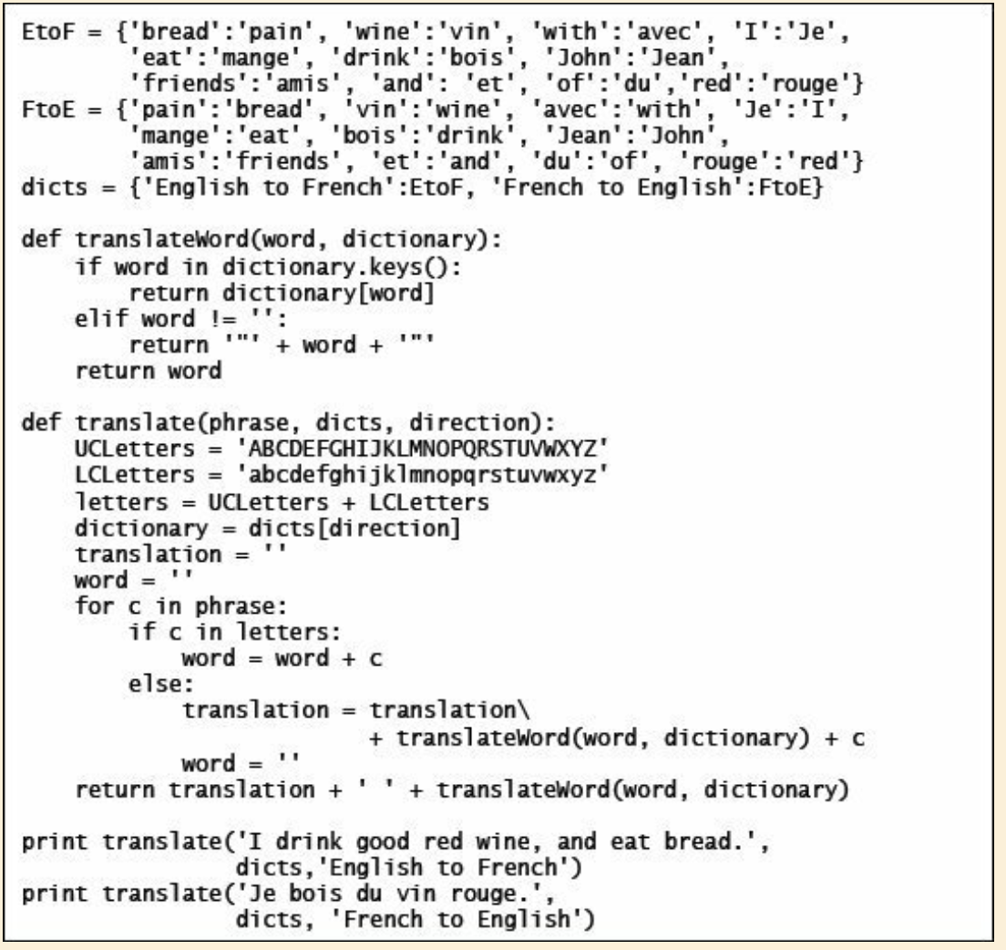
Dictionaries
﻿Je bois "good" rouge vin, et mange pain.
I drink of wine red.

Slide 10
Dictionaries
len(d) | Returns the number of items in d.
d.keys() | returns a list containing the keys in d.
d.values() | Returns a list containing the values in d.
k in d | Returns True if key k is in d.
d[k] | returns the item in d with key k.
d.get(k,v) | Returns d[k] if k is in d, and v otherwise.
d[k]=v | v associates the value v with the key k in d. If there is already a value associated with k, that value replaced.
del d[k] | Removes the key k from d.
For k in d | iterates over the keys in d.

Slide 11
File Examples - revisited
﻿TSP problem and solution reading from text file
…
def readProblem3(dosyaAdi):
dosyaProblem = open(dosyaAdi,'r’)
icerik = dosyaProblem.read()
aa = icerik.split("\n")
for a in aa[6:-2]:
bb=a.split(' ‘)
for b in bb:
print(b, end="\t")
print()
dosyaProblem.close
dosya1 = './w10b- 1,2 Apr/att48-2.tsp'
readProblem2(dosya1)
./w10b- 1,2 Apr/att48-2.tsp
NAME : att48\n
COMMENT : 48 capitals of the US (Padberg/Rinaldi)\n
TYPE : TSP\n
DIMENSION : 48\n
EDGE_WEIGHT_TYPE : ATT\n
NODE_COORD_SECTION\n
1 6734 1453\n
2 2233 10\n
3 5530 1424\n
…
47 5185 3258\n
48 3023 1942\n
EOF\n
0 | NAME : att48
1 | COMMENT : 48 capitals of the US (Padberg/Rinaldi)
2 | TYPE : TSP
3 | DIMENSION : 48
4 | EDGE_WEIGHT_TYPE : ATT
5 | NODE_COORD_SECTION
6 | 1 6734 1453
7 | 2 2233 10
8 | 3 5530 1424
… | …
52 | 47 5185 3258
53 | 48 3023 1942
54 | EOF
1 6734 1453
2 2233 10
3 5530 1424
4 401 841
5 3082 1644
6 7608 4458
7 7573 3716
…
39 3484 2829
40 6271 2135
41 4985 140
42 1916 1569
43 7280 4899
44 7509 3239
45 10 2676
46 6807 2993
47 5185 3258
48 3023 1942

Slide 12
File Examples - revisited
def readProblem(dosyaAdi):
dosyaProblem = open(dosyaAdi,'r’)
icerik = dosyaProblem.read()
aa = icerik.split("\n")
data = []
for a in aa[6:-2]:
bb=a.split(' ‘)
satir = []
for b in bb:
satir.append(int(b))
data.append(satir)
dosyaProblem.close
return data
dosya1 = 'w13b- 22, 23 Apr/att48-2.tsp' veriler = readProblem(dosya1)
verilerD = {}
for v in veriler:
verilerD[v[0]]=v[1:]
def uzaklik(a,b):
return ((a[0]-b[0])**2 + (a[1]-b[1])**2)**.5
print(verilerD[4])
print(uzaklik(verilerD[3], verilerD[4]))
rota = [1,5,2,4,7,1]
NAME : att48\n
COMMENT : 48 capitals of the US (Padberg/Rinaldi)\n
TYPE : TSP\n
DIMENSION : 48\n
EDGE_WEIGHT_TYPE : ATT\n
NODE_COORD_SECTION\n
1 6734 1453\n
2 2233 10\n
3 5530 1424\n
…
47 5185 3258\n
48 3023 1942\n
EOF\n
0 | NAME : att48
1 | COMMENT : 48 capitals of the US (Padberg/Rinaldi)
2 | TYPE : TSP
3 | DIMENSION : 48
4 | EDGE_WEIGHT_TYPE : ATT
5 | NODE_COORD_SECTION
6 | 1 6734 1453
7 | 2 2233 10
8 | 3 5530 1424
… | …
52 | 47 5185 3258
53 | 48 3023 1942
54 | EOF
1 6734 1453
2 2233 10
3 5530 1424
4 401 841
5 3082 1644
6 7608 4458
7 7573 3716
…
39 3484 2829
40 6271 2135
41 4985 140
42 1916 1569
43 7280 4899
44 7509 3239
45 10 2676
46 6807 2993
47 5185 3258
48 3023 1942

Slide 13
Refenrences
John V. Guttag, Introduction to Computation and Programming Using Python, The MIT Press Cambridge, Massachusetts London, England, 2013

Slide 14
INTRODUCTION to COMPUTATION & PROGRAMMING FOR IE
Assoc. Prof. Dr. Gürkan ÖZTÜRK & Assist. Prof. Dr. Emre ÇİMEN
Week 10

