Slide 1


BusRadar
Aleksandr Dobkin, Michael Choi, Christopher Mills
http://busradarapp.com/

Slide 2
How it started
BusRadar is a mobile application for the Android platform that will simplify your bus-riding experience in the Madison, WI area!
Class project for UW–Madison course
  Aleksandr Dobkin
  Michael Choi
  Christopher Mills
Timeline
  January 30, 2010: First Meeting
  March 6, 2020: Main project work begun
  May 11, 2010: First version published

Slide 3
When is the bus coming?
Problem: You're waiting for the bus.
  How long do you have to wait?
Data is available
  Thank-you Metro.
Data is not easily accessible for people at the bus stop
  Takes too long. Have to know where you are.
Make the data easily accessible using smartphone
  Use GPS to find location
  Answers in just one tap

Slide 4
Project Proposal
# app title: (Madison) Bus Radar
# group members: Michael Choi, Aleksandr Dobkin, Chris Mills
# What is Bus Radar?
This application is designed to help people to make use of the Madison Metro System by helping them quickly ascertain bus arrival times.
A major feature is to provide bus arrival times at the bus stops in the user's vicinity. The application will use the phone's onboard GPS to determine the user's current location and plot his location on the map along with a selection of nearby bus stops. The user will be able to choose one of the stops and the application will display, for each route that makes stops at that location, the estimated arrival time for the next three buses.
Actual project proposal from February 2010

Slide 5
Where does the data come from?
Bus arrival times
  Metro Transit Stop Tracker
  Real-Time
Bus coordinates
  Metro-Transit Map Tracker
  Real-Time
Bus Stop information & coordinates
  Bus Stop Departures webpage & Map Tracker
Route Shapes
  Metro-Transit Map Tracker

Slide 6
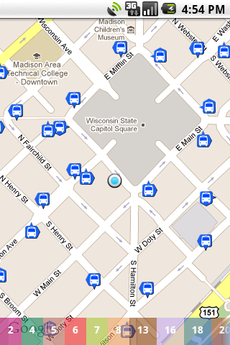

Main Screen
Map with user's location in the center
Bus stops shown on map
Route bar on the bottom (more on this later)
Your current location
Bus stop heading east
All available routes

Slide 7
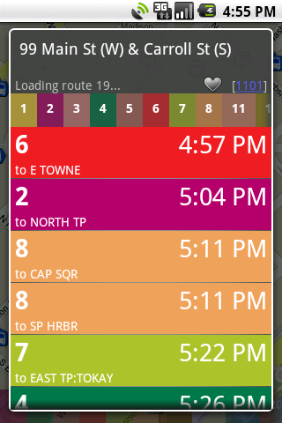
Arrival Times
Next three bus arrivals for every route passing through the stop
Listing color-coded in chronological order
Filterable by route

Slide 8
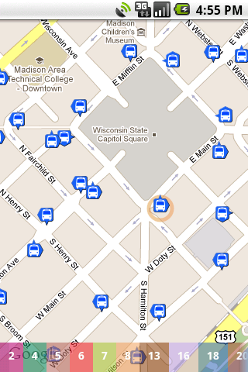

Route Bar
Display all available routes now running

Slide 9
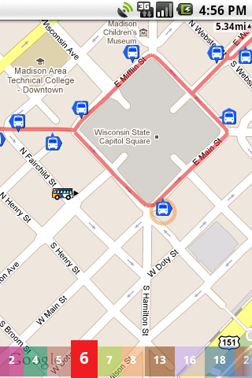
Route Bar
No. 6 bus 5.34 miles away
Display all available routes now running
Filter stops by route
Highlight route on map
Show bus positions
No. 6 bus here

Slide 10
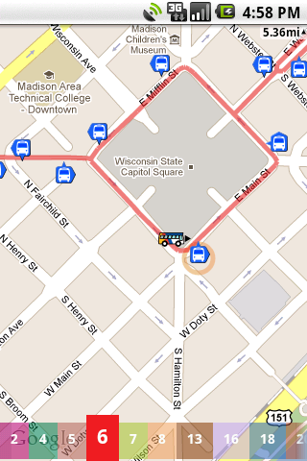
Route Bar
Display all available routes now running
Filter stops by route
Highlight route on map
Show bus positions

Slide 11
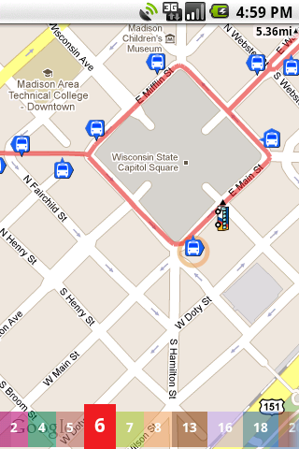
Route Bar
Display all available routes now running
Filter stops by route
Highlight route on map
Show bus positions

Slide 12
Availability
Available on Android Marketplace FREE
Over 4,000 downloads & over 2,000 active users in just over a year
Five stars & many positive comments

Slide 13
What's Next
iPhone version
HTML5 version
  Cross-Platform: iPhone, Windows Phone 7, Blackberry, etc
Other cities

Slide 14
Contact
Website: http://busradarapp.com/
Email: support@busradarapp.com
Twitter: http://twitter.com/BusRadar
Android Market
  https://market.android.com/details?id=busradar.madison

