Slide 1
Movie ratings ANALYSIS
BUSRA KURT

Slide 2
Introduction
Factors that impact ratings
Research Question:
Does the director of the movies impact ratings?
Answer:
In this research, findings suggest that the director of the movies impacts ratings.

Slide 3
Hypotheses
H₀ = There is no difference between Woody Allen movies ratings and average rating for all other directors’ movies.
H_{a} = There is difference between Woody Allen movies ratings and average rating for all other directors’ movies.

Slide 4
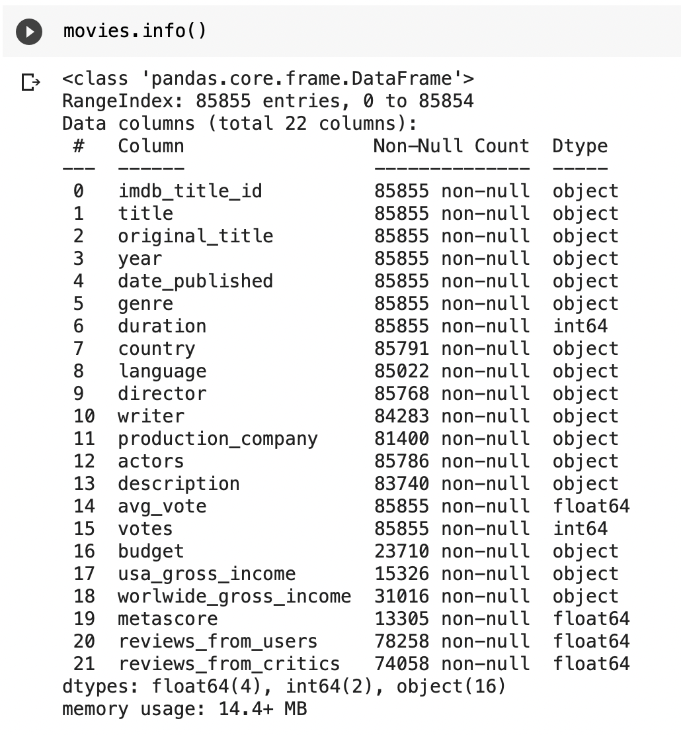
Data
Movies ratings
22 different feature of movies
85855 records
Collected between 1894-2020
Originally comes from Kaggle

Slide 5
Methods
A/A test for all movies
A/A test for Woody Allen movies
A/B test comparing average rating for all movies to Woody Allen movies

Slide 6
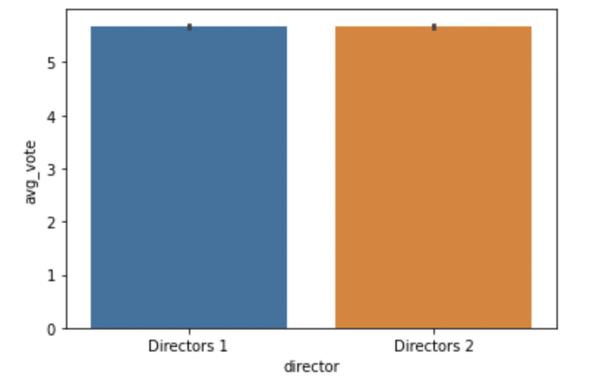
Results: A/A test for All Movies
Fail to reject the null that there is no significant difference between the means.
The p-value of 0.63 is not less than the .05 threshold we need to reject the null.
Conclusion: We conclude that confounding variables have been controlled for.

Slide 7
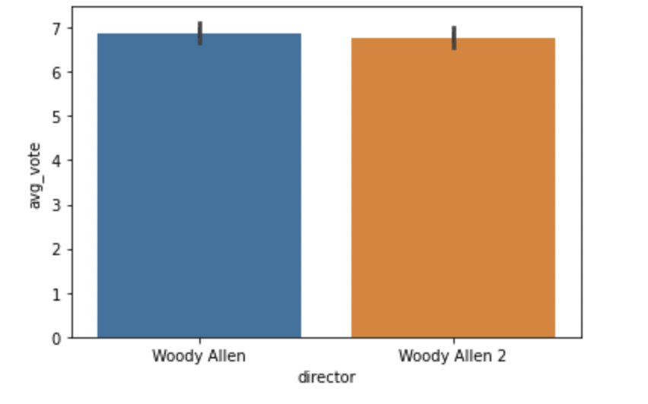
Results: A/A test for Woody Allen Movies
Fail to reject the null that there is no significant difference between the means.
The p-value of 0.58 is not less than the .05 threshold we need to reject the null.
Conclusion: We conclude that confounding variables have been controlled for.

Slide 8
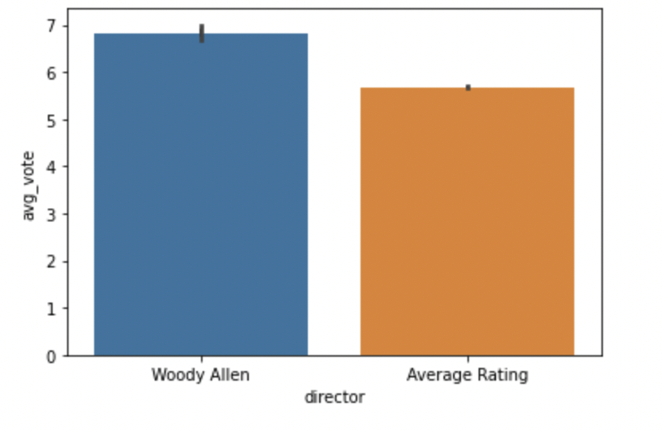
Results: A/B test of ratings
Reject the null that there is no difference between Woody Allen movies ratings and average rating for all other directors’ movies.
The p-value is less than the .05 threshold we need to reject the null.
Conclusion: We reject the null and accept the alternative hypothesis. The director of movies impacts the ratings.

Slide 9
Discussion & Recommendations
Test Woody Allen movies in different genres.
Get some more information and find out what qualities made Woody Allen movies better than the others.
Repeat the experiment comparing different director to average of all movies.

Slide 10
Q&A

