Slide 1
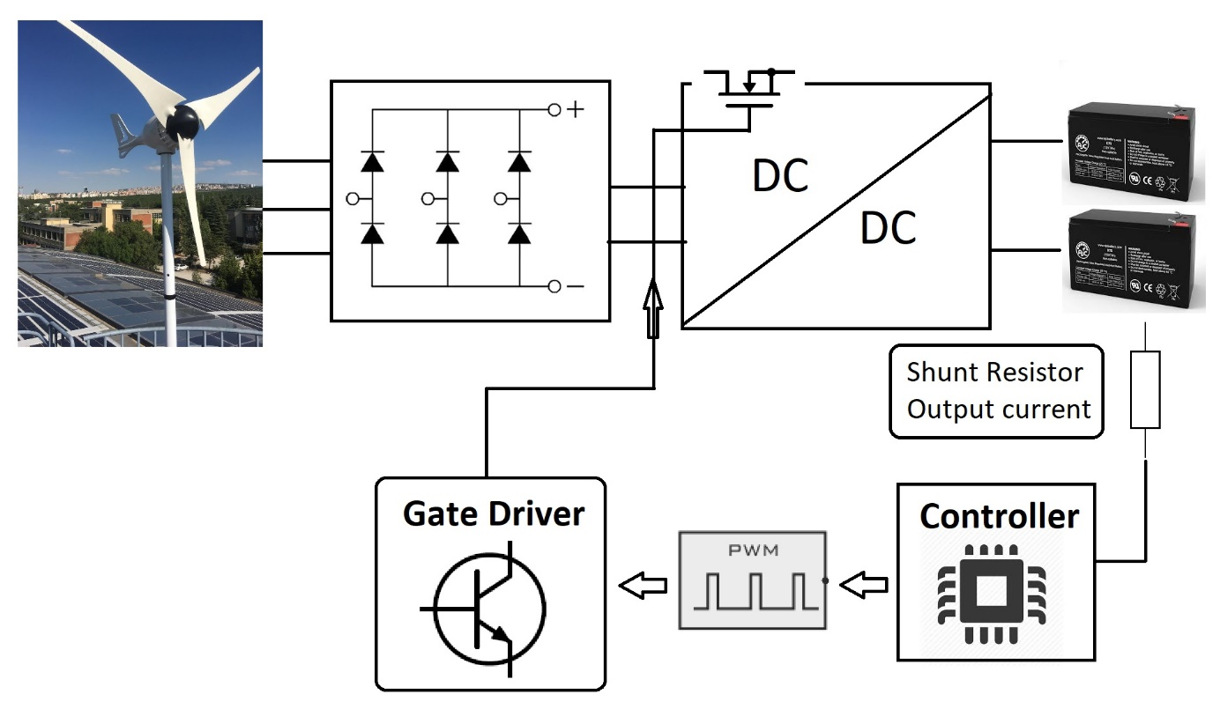
EE 463 Term Project
Eren ÖZKARA
Büşra Nur KOÇAK
Yunus ÇAY

Slide 2
ıNTRODUCTION
Topology Selection
Detailed Simulation
PCB Design
Component Selection
Conclusion

Slide 3
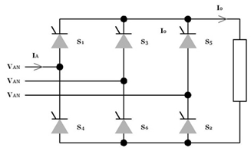

Topology sELECTION
Three Phase Thyristor Rectifier
+ Easy Topology Structure
+ Less Component
+ No Third Harmonics
Expensive Components
Six Gate Signals
Complex Synchronous Control

Slide 4
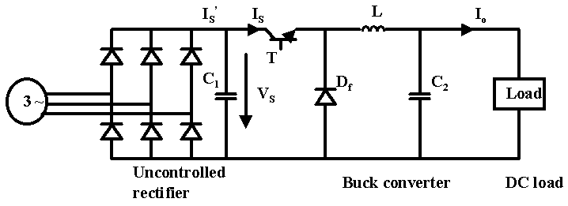

Three Phase Diode Rectifier with Buck Converter
+ One Gate Signal
+ Low Cost Compared to Controlled Rectifier
+ No Third Harmonics
- Theoretically Low Efficiency Compared to Controlled Rectifier
High Size Due to LC filter

Slide 5
Detaıled sımulatıon
Uncontrolled Three Phase Rectifier
Buck Converter
Battery
Controller
Completed Simulation Results

Slide 6
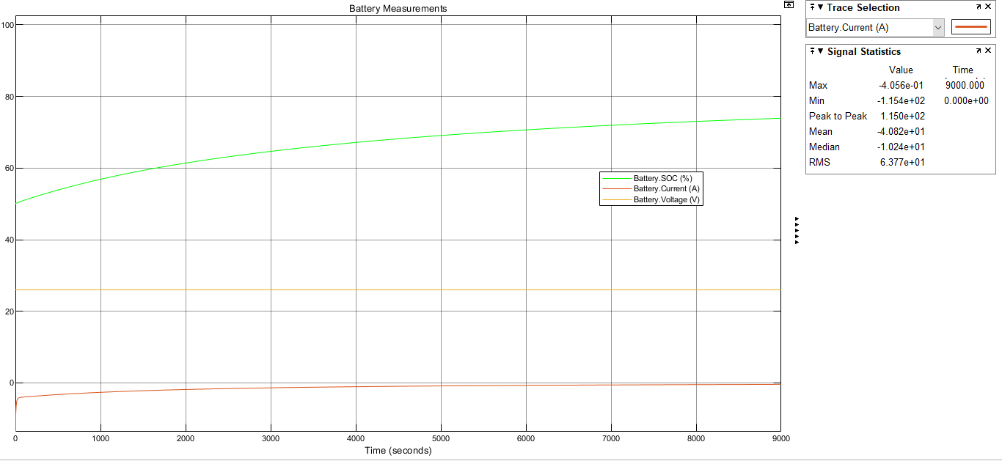

Battery
Constant Voltage Test

Slide 7
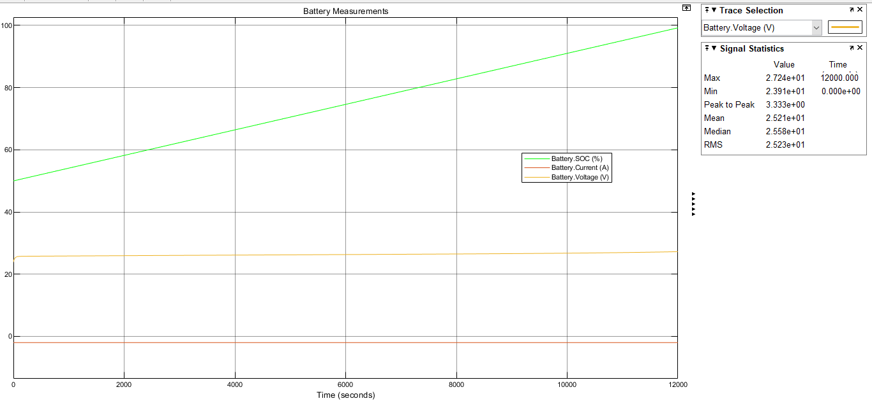
Constant Current Test

Slide 8
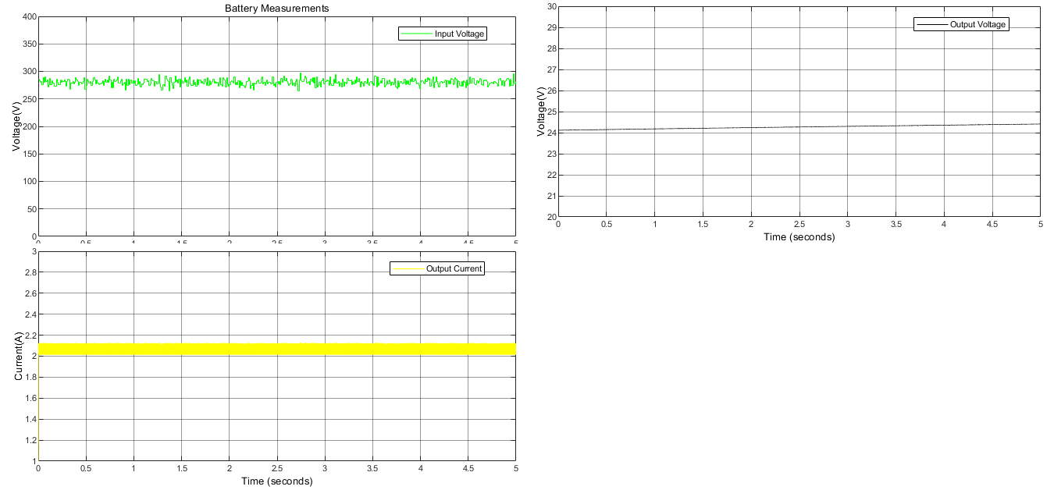
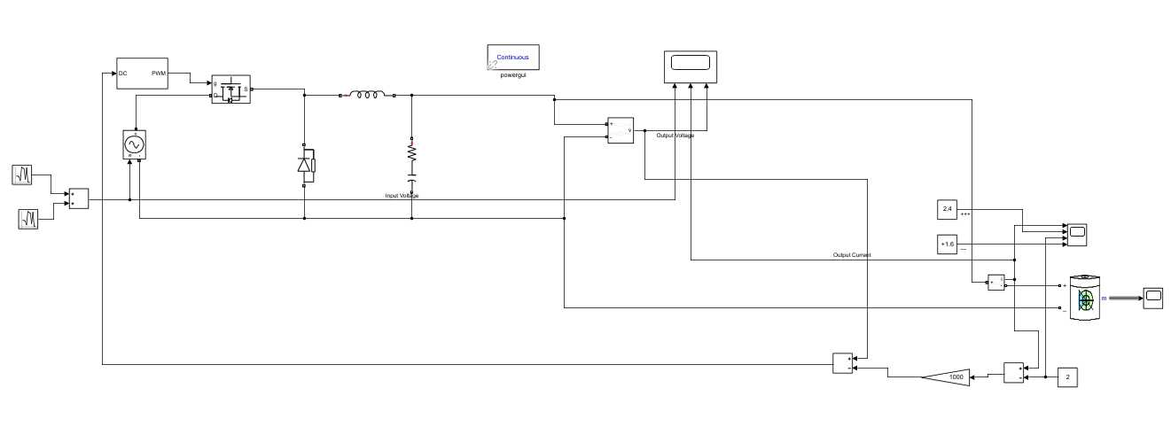
Battery with Buck Converter

Slide 9
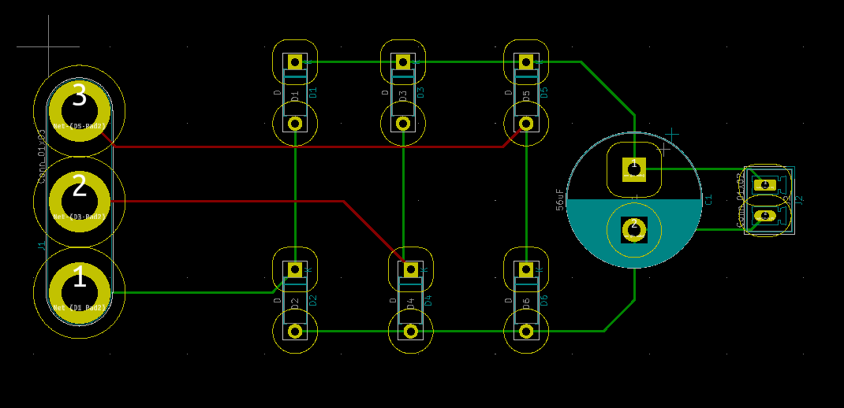
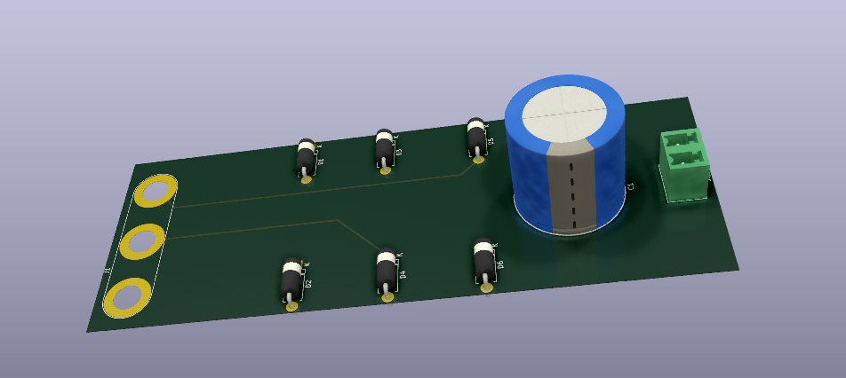
Pcb dESIGN

Slide 10
Pcb Desıgn consıderatıon
Footprints
Trace spacing with respect to IPC2221 standards
Track width with respect to IPC2221 standards
Space for heatsinks
PCB thickness with respect to used component datasheet.
Control traces in inner layer
Traces with 45 degree angles
Silk layer for more descriptive design
Nodes

Slide 11
Conclusıon
Inductor Core Design
Control Circuit Design
Thermal Calculations
Thermal Simulations
PCB Designs
Project Video

Slide 12
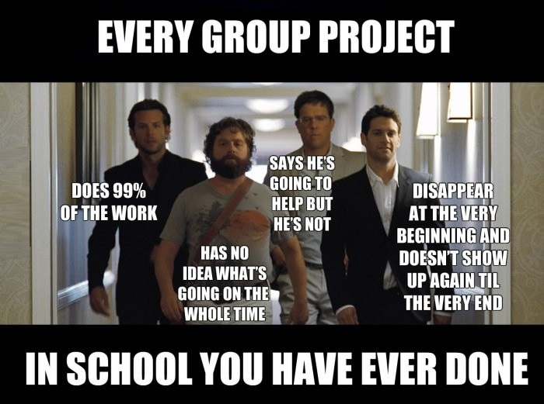
THANKS FOR LISTENING

