Slide 1
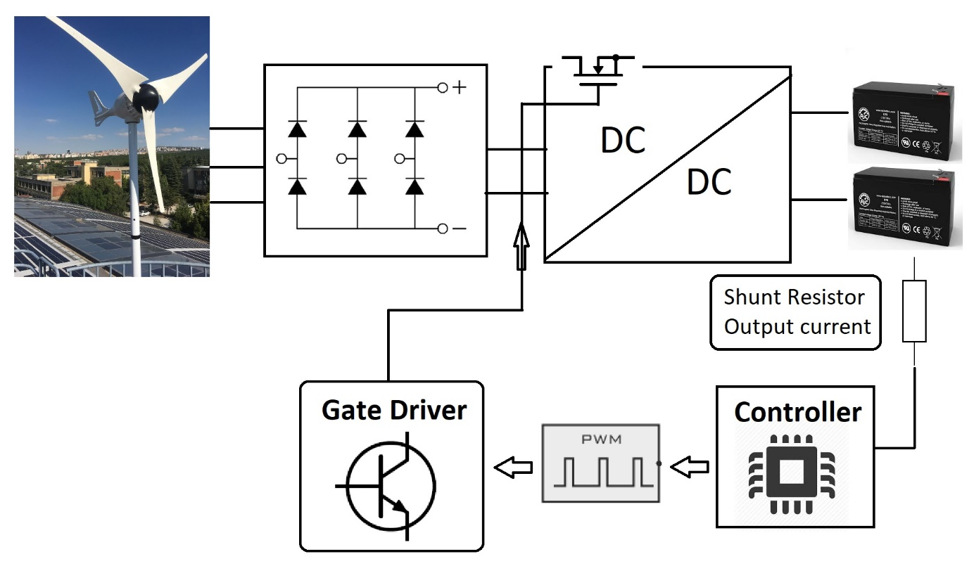
EE 463 Term Project Power guıde
Eren ÖZKARA
Büşra Nur KOÇAK
Yunus ÇAY

Slide 2
ıNTRODUCTION
Topology Selection
Detailed Simulation
PCB Design
Component Selection
Conclusion

Slide 3
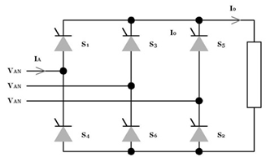

Topology sELECTION
Three Phase Thyristor Rectifier
+ Easy Topology Structure
+ Less Component
+ No Third Harmonics
Expensive Components
Six Gate Signals
Complex Synchronous Control

Slide 4
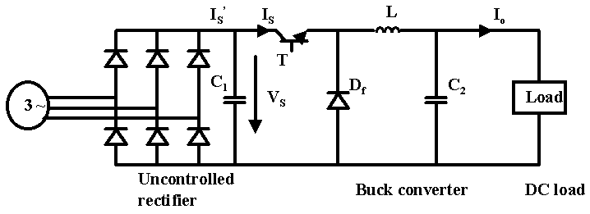

Three Phase Diode Rectifier with Buck Converter
+ One Gate Signal
+ Low Cost Compared to Controlled Rectifier
+ No Third Harmonics
- Theoretically Low Efficiency Compared to Controlled Rectifier
High Size Due to LC filter

Slide 5
Detaıled sımulatıon
Uncontrolled Three Phase Rectifier
Buck Converter
Battery
Controller
Completed Simulation Results

Slide 6
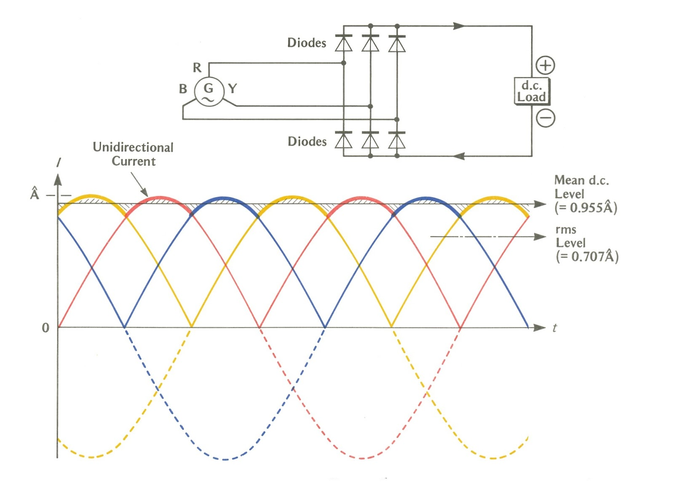
UnControllEd 3-Phase Rectıfıer
Low output voltage ripple
Simple
Cheap
Low conduction and switching losses

Slide 7
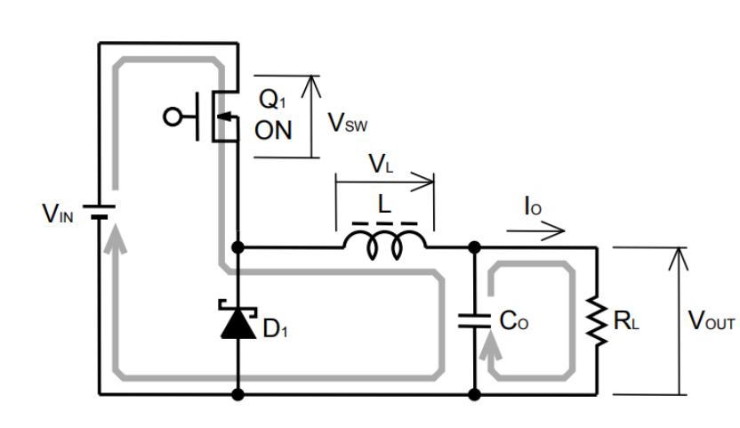
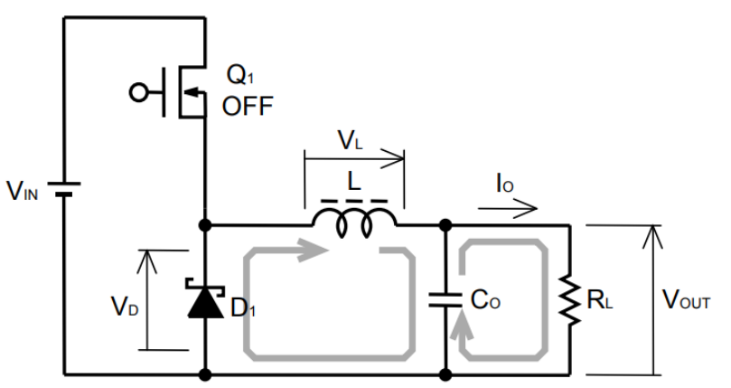

BUCK CONVERTER
$$L=\frac{(V_{IN}−V_{SW}−V_{OUT})×(V_{D}+V_{OUT})}{(V_{IN}−V_{SW}+V_{D})×f_{SW}×r×I_{OUT}}$$
$$C_{o}= \frac{1}{8∗f_{sw}∗(\frac{∆V}{∆I_{L}}−ESR)}$$

Slide 8
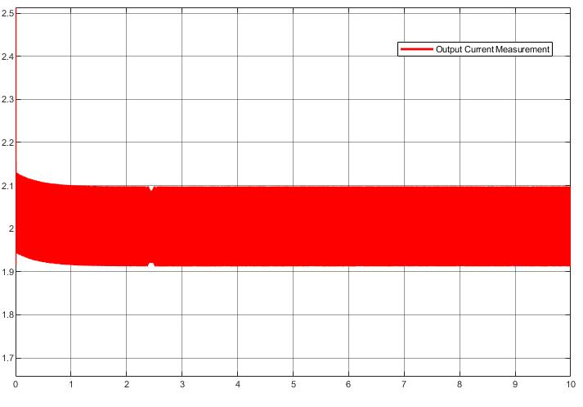
Output Current Ripple

Slide 9
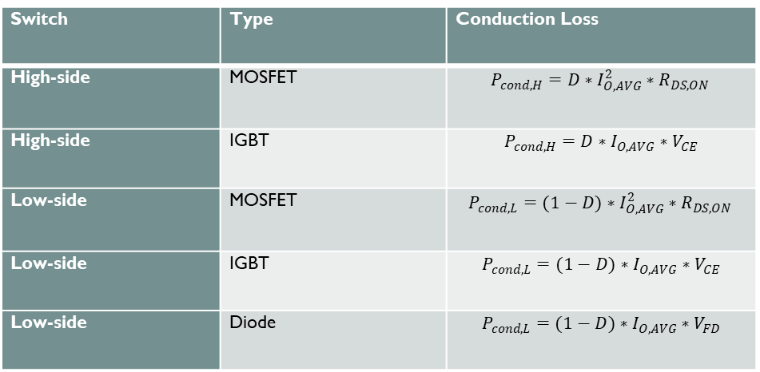
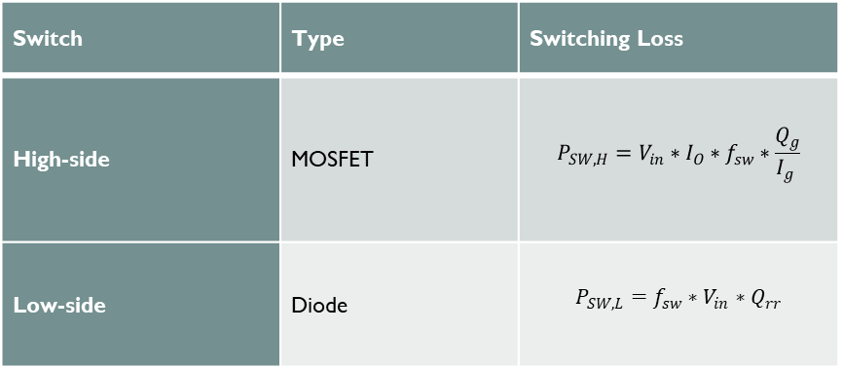
Non-Synchronous & Synchronous Buck Converter
Conduction losses
Switching losses
Switch | Type | Conduction Loss
High-side | MOSFET | $$P_{cond,H}=D∗I_{O,AVG}^{2}∗R_{DS,ON }$$
High-side | IGBT | $$P_{cond,H}=D∗I_{O,AVG}∗V_{CE}$$
Low-side | MOSFET | $$P_{cond,L}=(1−D)∗I_{O,AVG}^{2}∗R_{DS,ON }$$
Low-side | IGBT | $$P_{cond,L}=(1−D)∗I_{O,AVG}∗V_{CE}$$
Low-side | Diode | $$P_{cond,L}=(1−D)∗I_{O,AVG}∗V_{FD}$$
Switch | Type | Switching Loss
High-side | MOSFET | $$P_{SW,H}=V_{in}∗I_{O}∗f_{sw}∗\frac{Q_{g}}{I_{g} }$$
Low-side | Diode | $$P_{SW,L}=f_{sw}∗V_{in}∗Q_{rr}$$

Slide 10
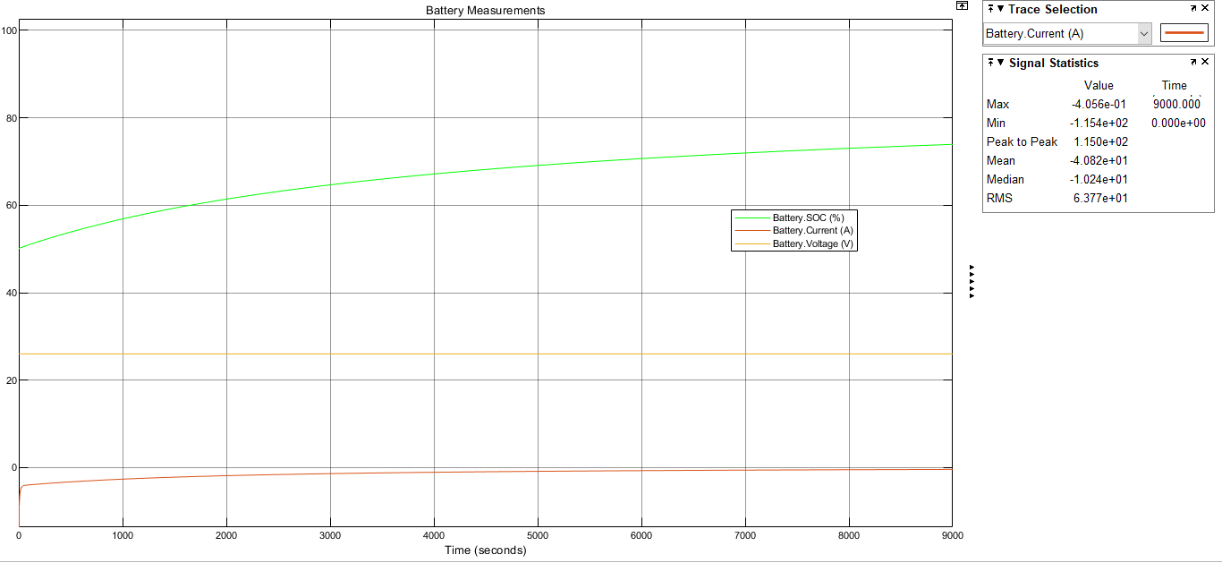

Battery
Constant Voltage Test

Slide 11
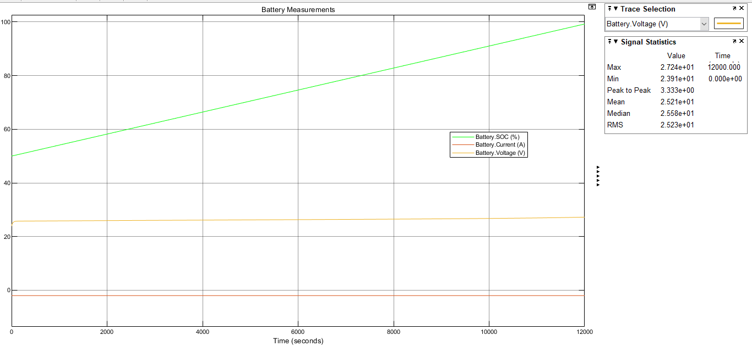
Constant Current Test

Slide 12
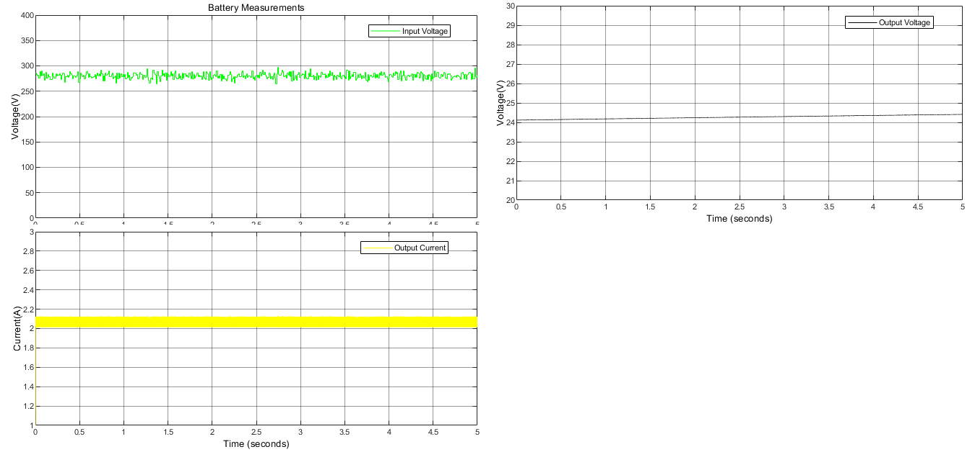
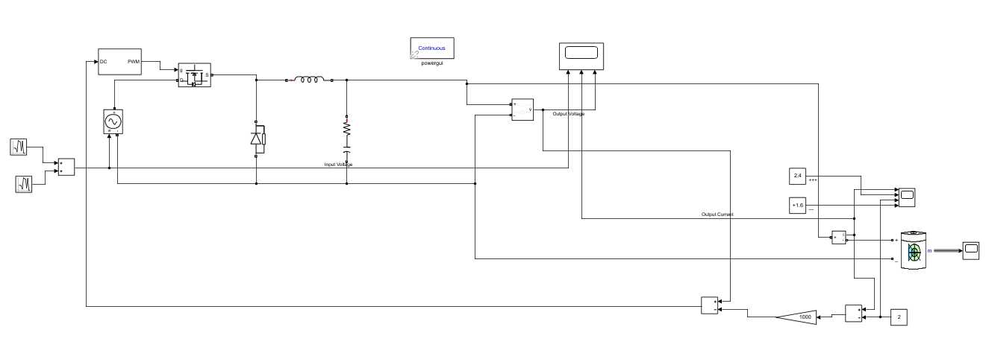
Battery with Buck Converter

Slide 13
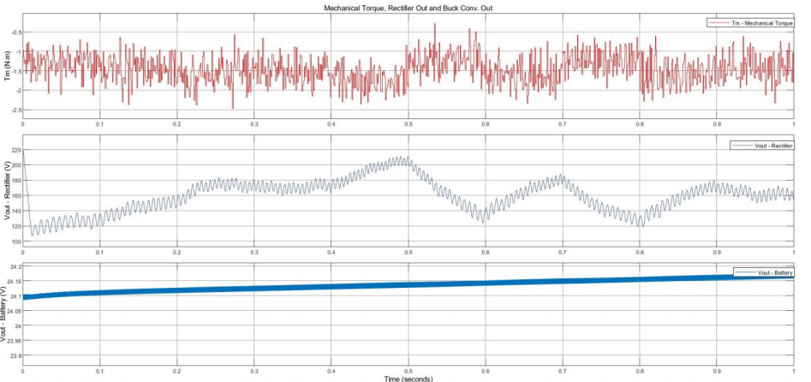
Completed sımulatıon

Slide 14
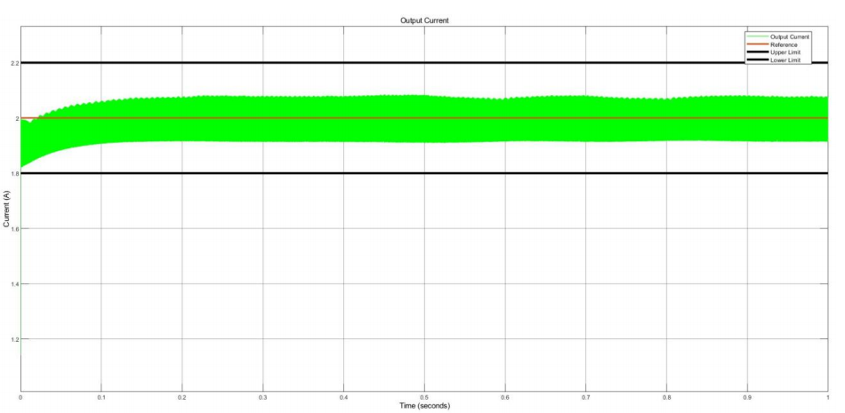
OUTPUT CURRENT OF THE COMPLETED SIMULATION

Slide 15
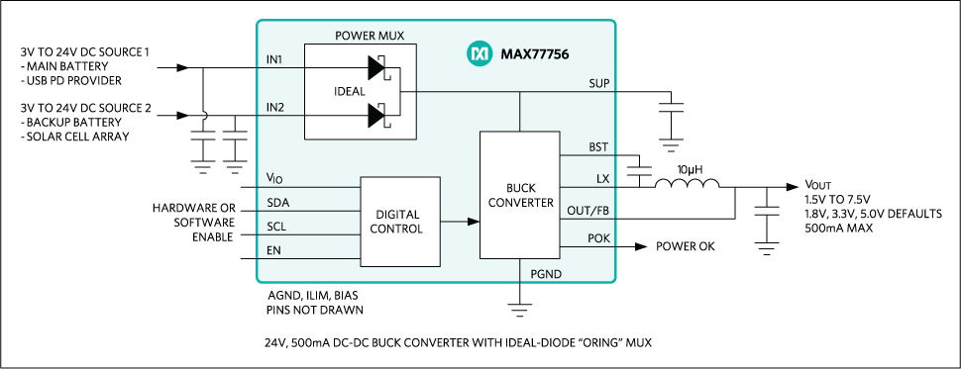
CONTROLLER
Switcher
Input voltage range
External regulator
MCU + Gate driver
Isolation
External supply

Slide 16
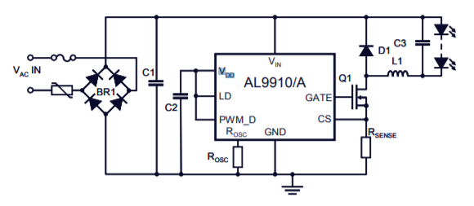
AL9910A LED DRIVER
Low cost
Simple application
Small volume
No isolation and external supply

Slide 17
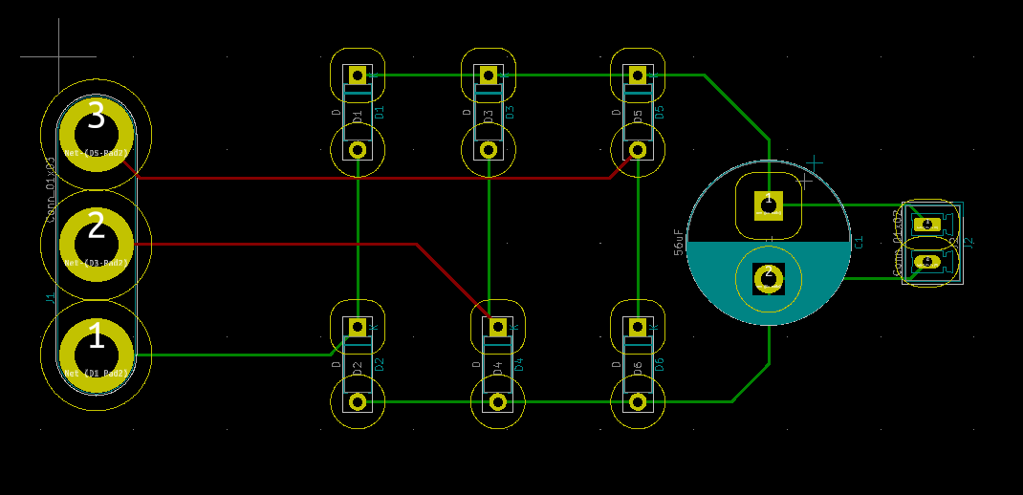
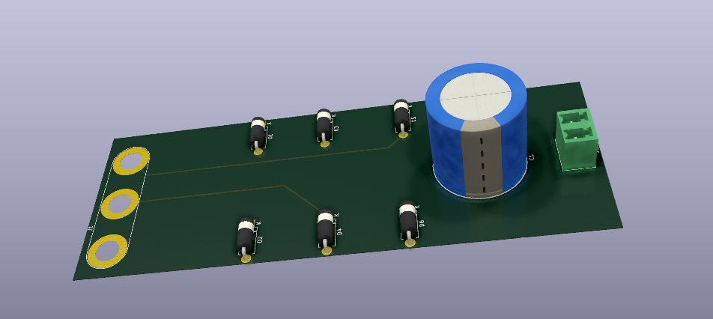
Pcb dESIGN

Slide 18
Pcb Desıgn consıderatıon
Footprints
Trace spacing with respect to IPC2221 standards
Trace width with respect to IPC2221 standards
Space for heatsinks
PCB thickness with respect to used component datasheet.
Control traces in inner layer
Traces with 45 degree angles
Silk layer for more descriptive design
Nodes

Slide 19
COMponent Selectıon
Rectifier Diode
Rectifier Capacitor
Rectifier Diode | Reverse Voltage | Forward Current | Cost
S1G | 400V | 1A | 6x0.22$ = 1.32$
Rectifier Capacitor | Capacitance (µF) | Voltage Rating (V) | ESR (mΩ) | Price
MAL219856569E3 | 56 | 400 | 1706 | 3.9 $

Slide 20
COMponent Selectıon
LC Capacitor
LC Inductor
Freewheeling Diode
Freewheeling Diode
 | Capacitance (µF) | Voltage Rating (V) | ESR (mΩ) | Price
ESC686M035AE3AA | 68 | 35 | 220 | 0.30 $
 | Inductance (mH) | Current Rating (A) | Saturation Current | Price
1140-272K-RC | 2.7 | 2.2 | 3.9 | 9.56 $
AIRD-03-152K | 1.5 | 2 | 3.4 | 5.52 $
Diode (Buck Conv) | V_{RRM} | I_{F(AV)} | V_{FD} | Q_{rr} | Cost
ES3G | 400V | 3A | 1.1V | 50nC | 0.18$
UF5404 | 400V | 3A | 1.0V | 8nC | 0.60$

Slide 21
COMponent Selectıon
MOSFET
Gate Driver
 | V_{DS} (V) | R_{DS(on)} (Ω) | I_{D} (A) | Price($)
SPN04N60S5 | 600 | 0.95 | 0.8 | 0.986
IPU60R1K4C6 | 650 | 1.4 | 3.2 | 0.75
IPS60R1K0PFD7S | 650 | 1.0 | 4.7 | 0.63
 | V_{IN} | F_{SW} | Cost
AL9910A | 520V | Up to 300kHz | 1.54€ = 1.88$

Slide 22

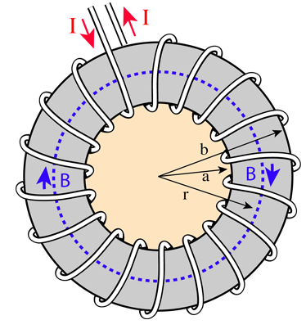
Toroıdal shape cores
Ferrite Cores
Iron Powder Cores
CABLE
22 AWG

Slide 23
Conclusıon
Inductor Core Design
Control Circuit Design
Thermal Calculations
Thermal Simulations
PCB Designs
Project Video

Slide 24

THANKS FOR LISTENING

