Slide 1


Slide 2
EE464- TERM PROJECT
Büşra Nur Koçak
Defne Nur Korkmaz
Mustafa Mert Sarıkaya
May 9, 2021

Slide 3
What should the presentation include?
Topology selection
Project design
How we selected critical components
Our plan for the design and manufacturing
Magnetic design
Controller selection
Our ideas about the design even if it is not completed
PCB design

Slide 4
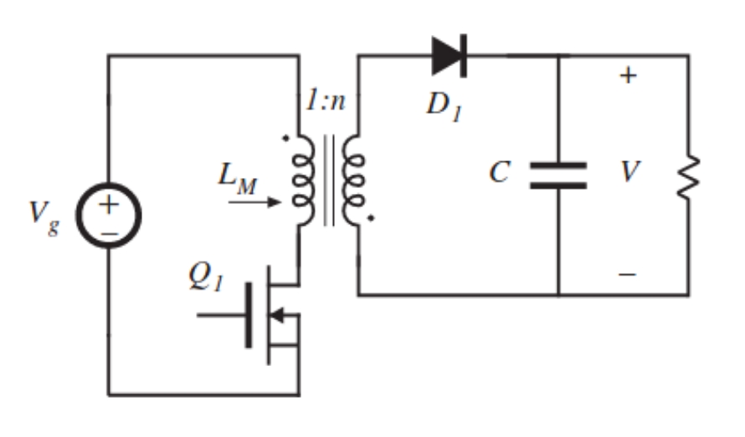
TOPOLOGY SELECTION
FLYBACK CONVERTER
Better utilization of transformer
Continuous output current
Easier to control
DCM operation
Smaller transformer
Reduce switching losses

