Slide 1


Slide 2
EE464- TERM PROJECT
Büşra Nur Koçak
Defne Nur Korkmaz
Mustafa Mert Sarıkaya
July 13, 2021

Slide 3
Topology Selection
Component Selection and Simulation Results
Losses and Thermal Results
PCB Design
Magnetic Design
Cost of the Design

Slide 4
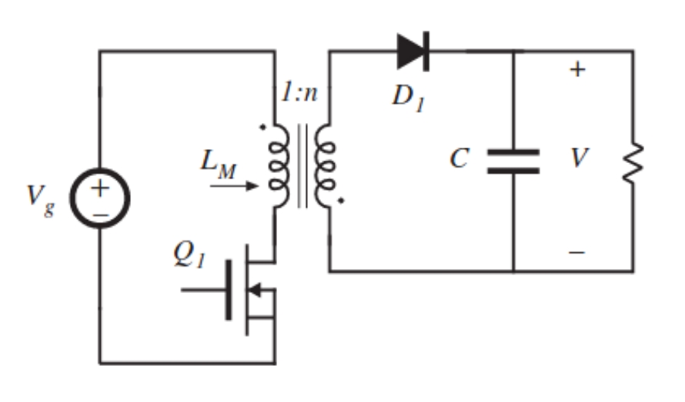
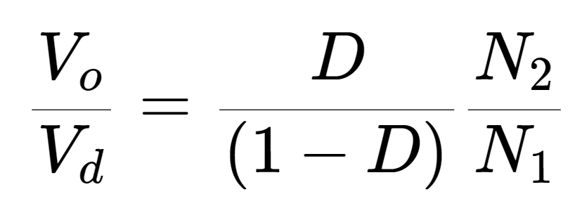
TOPOLOGY SELECTION
FLYBACK CONVERTER
Better utilization of transformer
Easier to control
DCM operation

Slide 5

Operating Values
DCM operation:
Limits flux density
Smaller core
Reduce switching losses
Smooth start
$D_{max}=0.$35
$D_{dweel}=0.1$
$f_{s} ≅100 kHz$

Slide 6
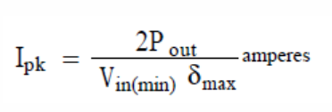
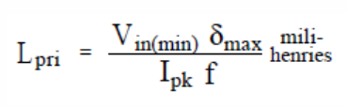
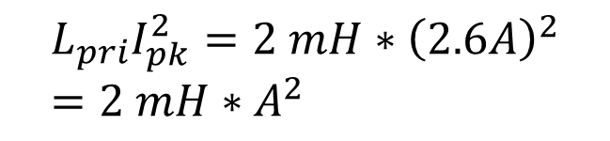
Magnetic Design
Iron Powder Core Selection
$$L_{pri}I_{pk}^{2}=2 mH∗{\left(2.6A\right)}^{2}=2 mH∗A^{2}$$

Slide 7
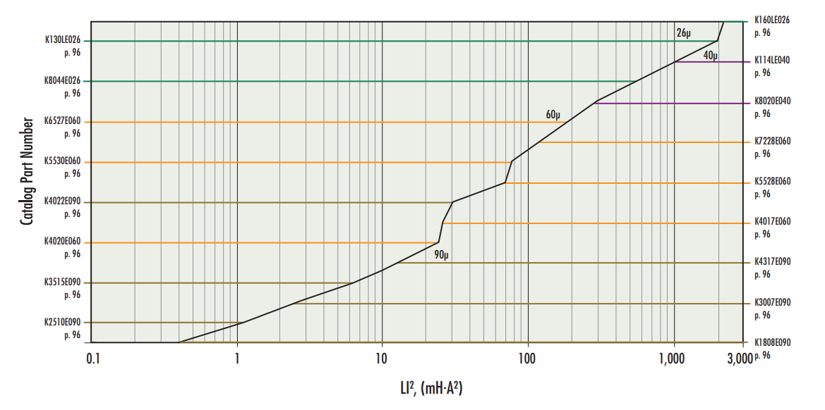
Iron Powder Core Selection
Kool Mµ E Core energy storage table

Slide 8
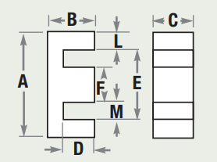
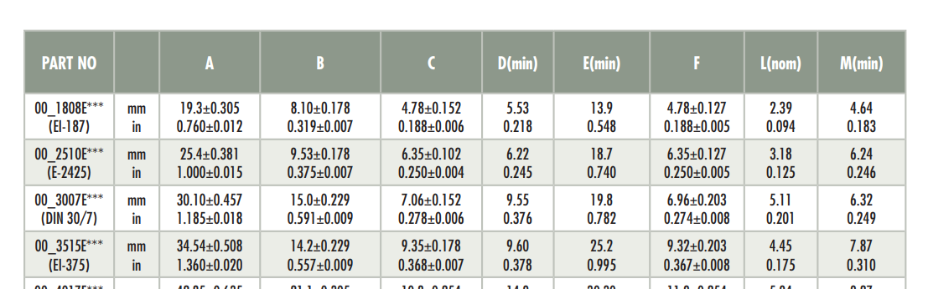

Slide 9
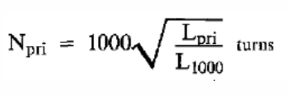
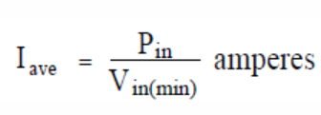
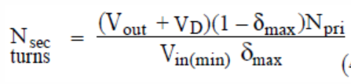
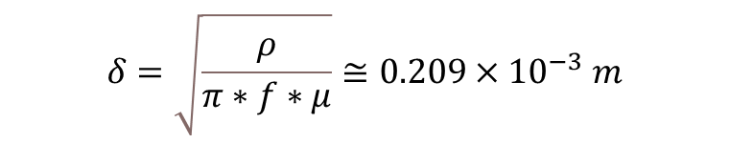
Selecting Turns and Wire Size
$$δ=\sqrt{\frac{ρ}{π∗f∗μ}}≅0.209×{10}^{−3} m$$

Slide 10
Selecting Turns and Wire Size
Property | Value
L | 92 nH
Npri | 57 turns
Nsec | 7 turns
Turns Ratio | 8
Cable | 26 AWG
Primary Parallel Cable | 2
Secondary Parallel Cable | 12
Kcu | 0.31

Slide 11
Component Selection and Simulations

Slide 12
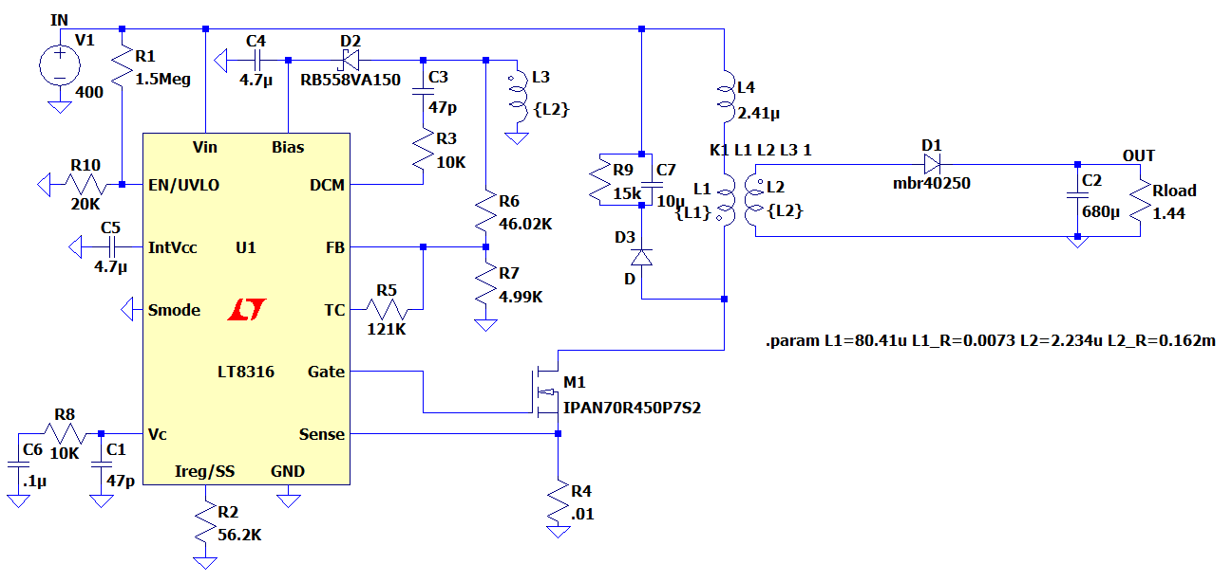
Controller
Parameter | Value - Description
V_{in} | 16V – 600V
F_{SW(Min)} | 3 kHz
F_{SW(Max)} | 140 kHz
Operating Junction Temperature | -40 – 125ºC
Price | $2.18 (1000+ order)

Slide 13
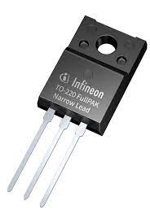
Mosfet (IPAN70R450P7S)
Parameter | Value - Description
V_{DS} , Breakdown voltage | 700V
I_{D}, Continuous current | 10A at T_{C} =20 ºC
I_{D,pulse} Pulsed Drain current | 25.9 A
R_{DS,ON} | 450mΩ
Q_{g} | 13.1nC
Price | $1.05

Slide 14
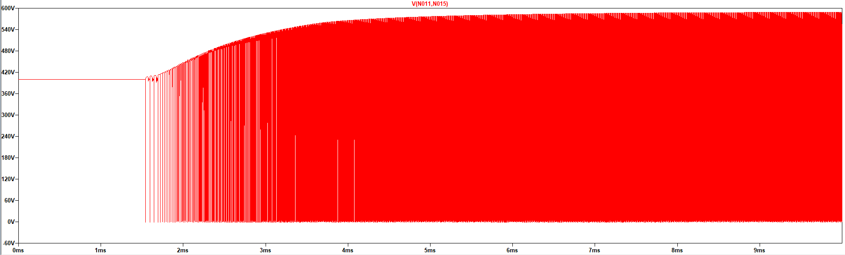
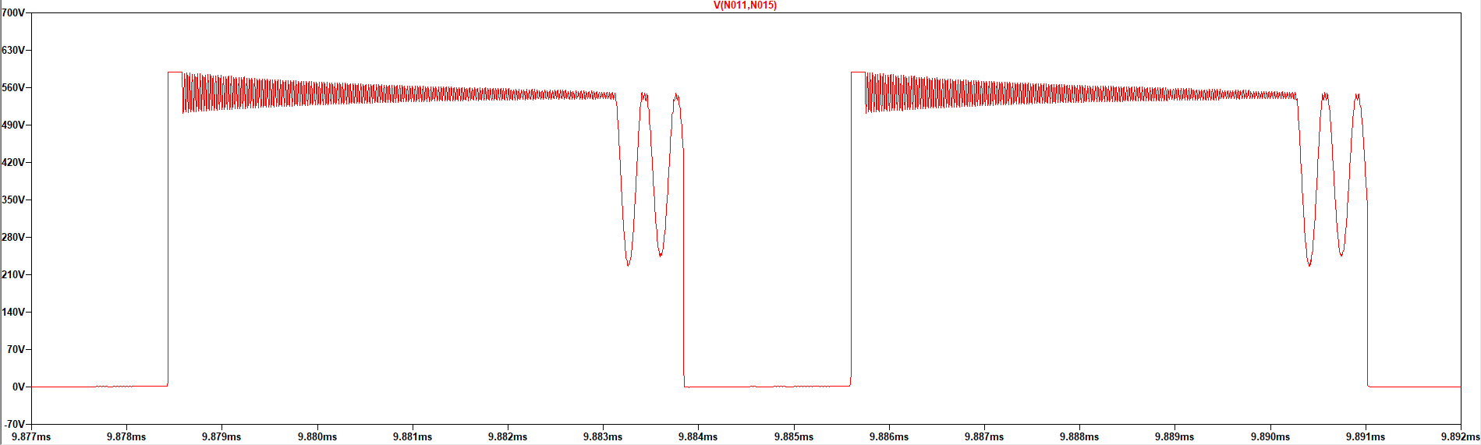
Mosfet Voltage Waveform

Slide 15
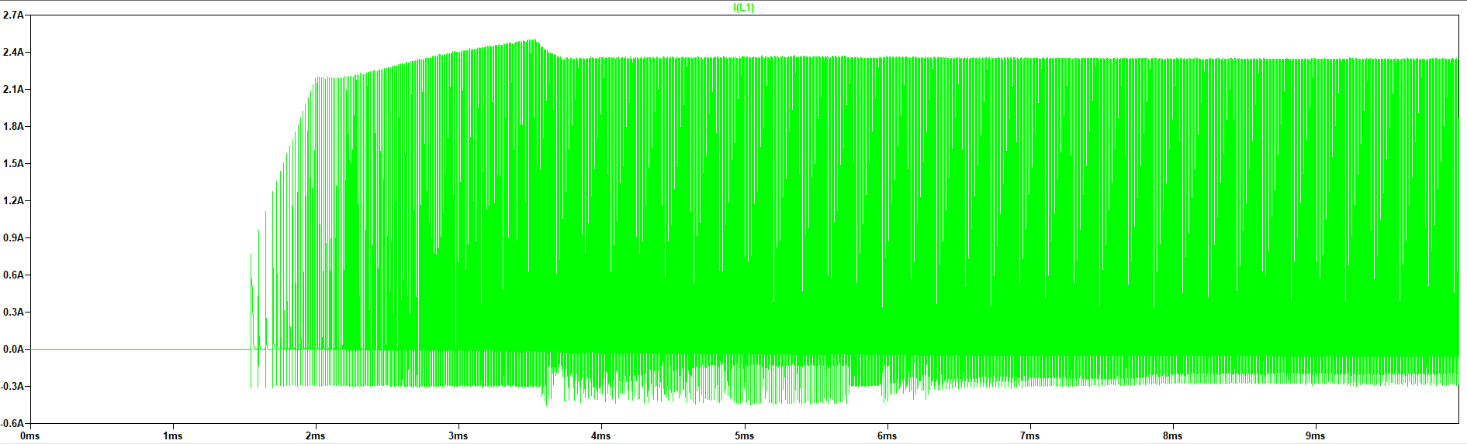
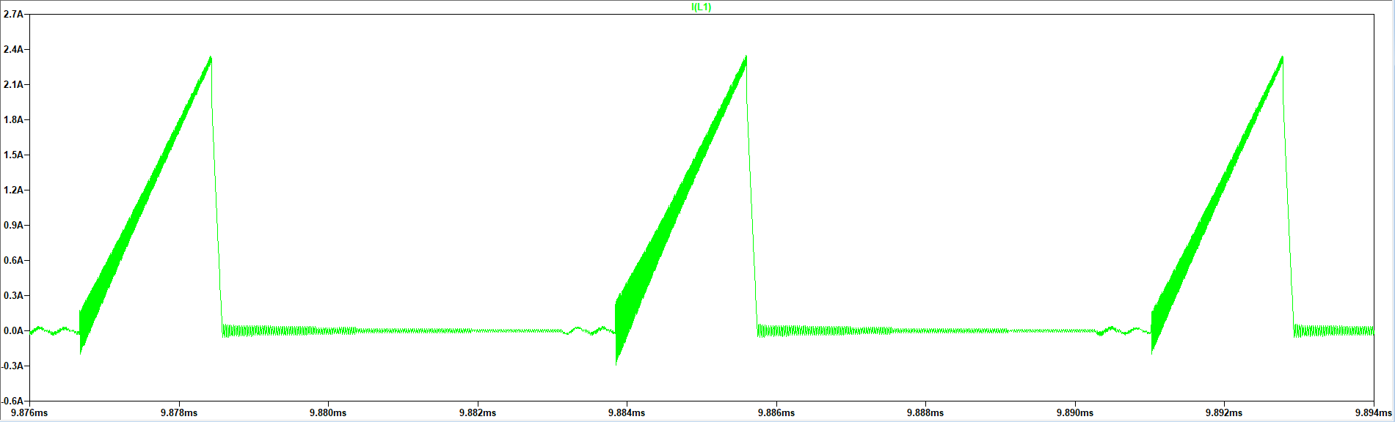
Mosfet Current Waveform

Slide 16
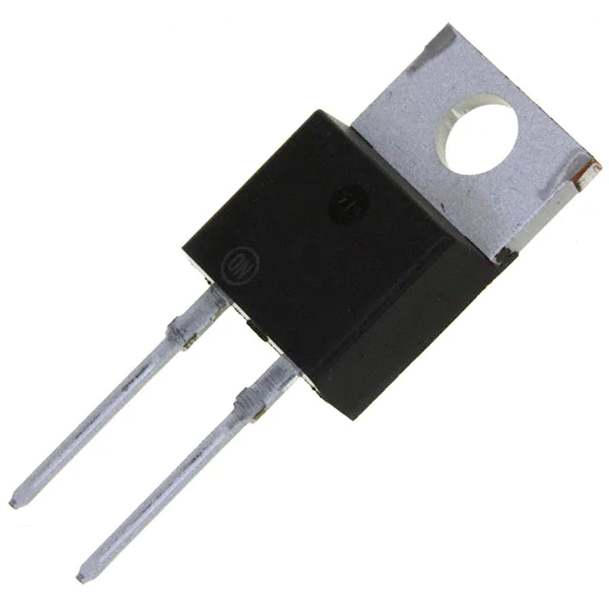
Diode(MBR40250G)
Parameter | Value - Description
V_{R} , Blocking voltage | 250V
I_{RMS}, Continuous current | 40A
I_{FRM}, Peak Repetitive Forward Current | 80A
V_{F} | 0.86V
Price | $1.82000

Slide 17
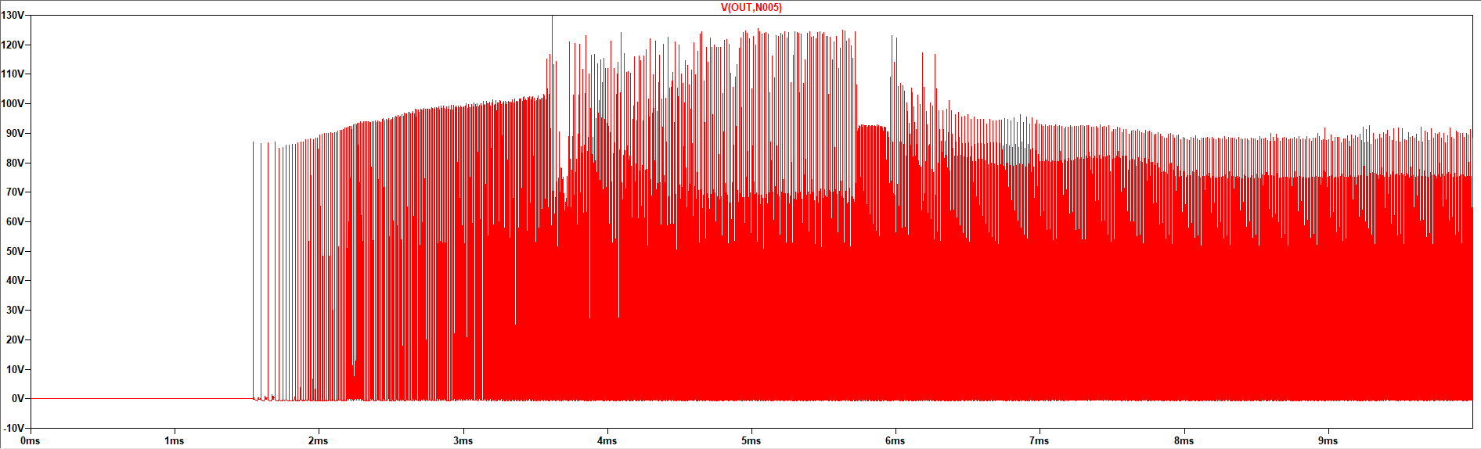
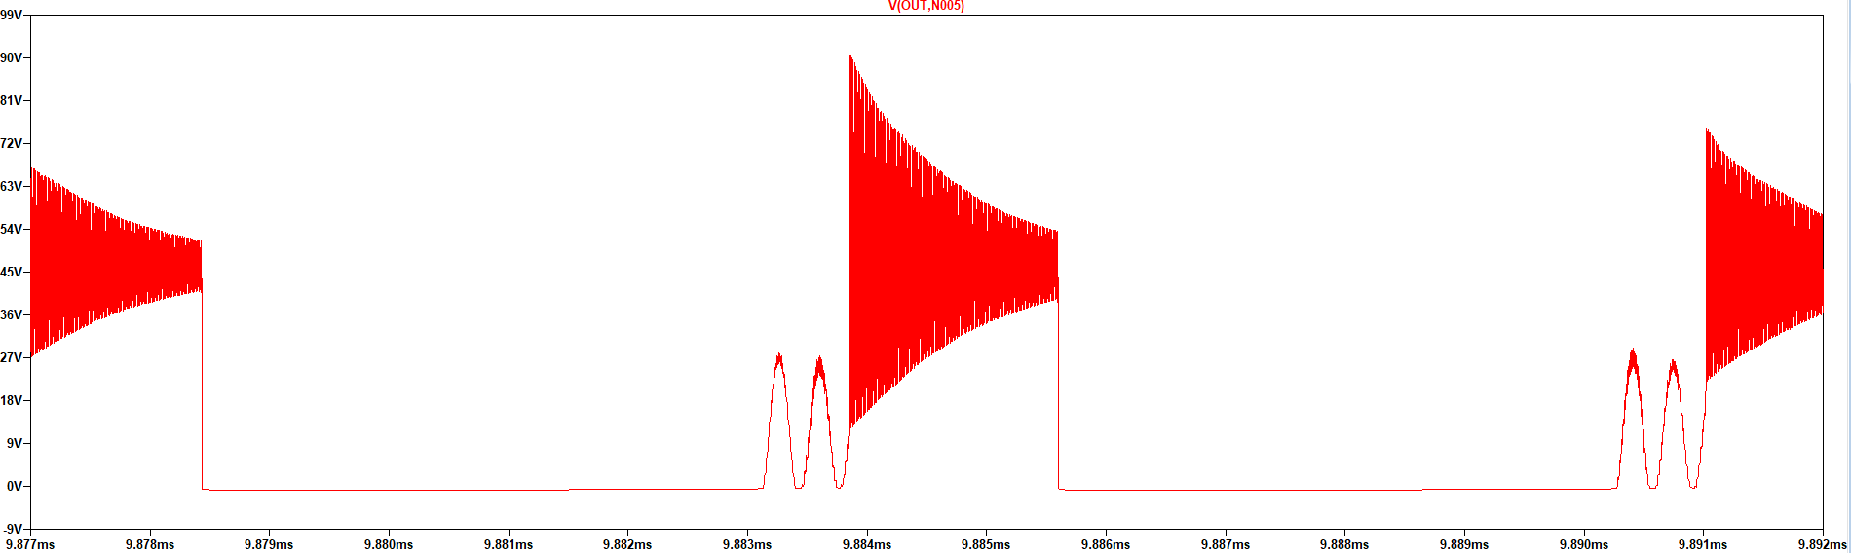
Diode Voltage Waveform

Slide 18
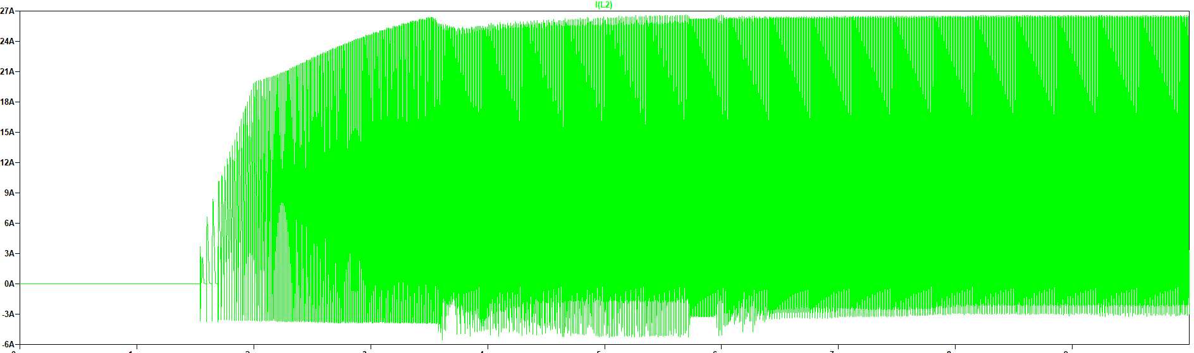
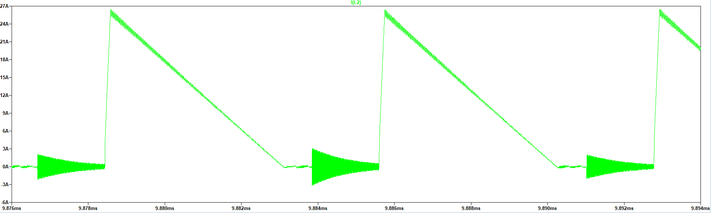
Diode Current Waveform

Slide 19
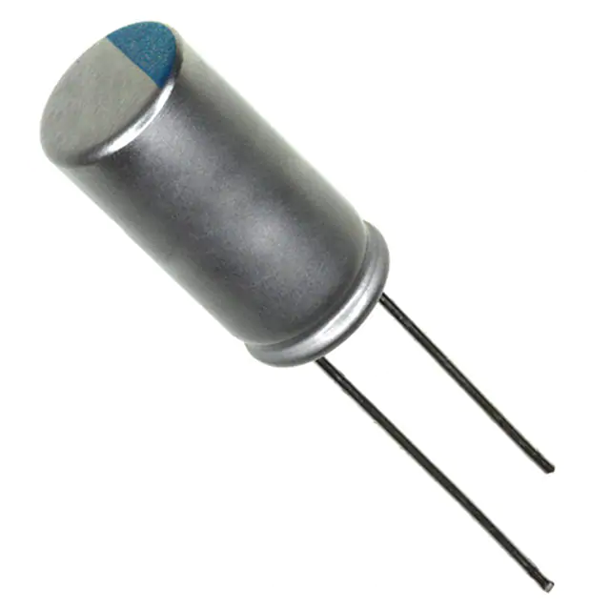
Output Capacitor(337ULR016MFF)
Parameter | Value - Description
C, Capacitance | 330 uF
V_{C,MAX} Rating | 16V
I_{C,ripple} | 4.3A
ESR | 13mΩ
Price | 0.2925$ x2

Slide 20
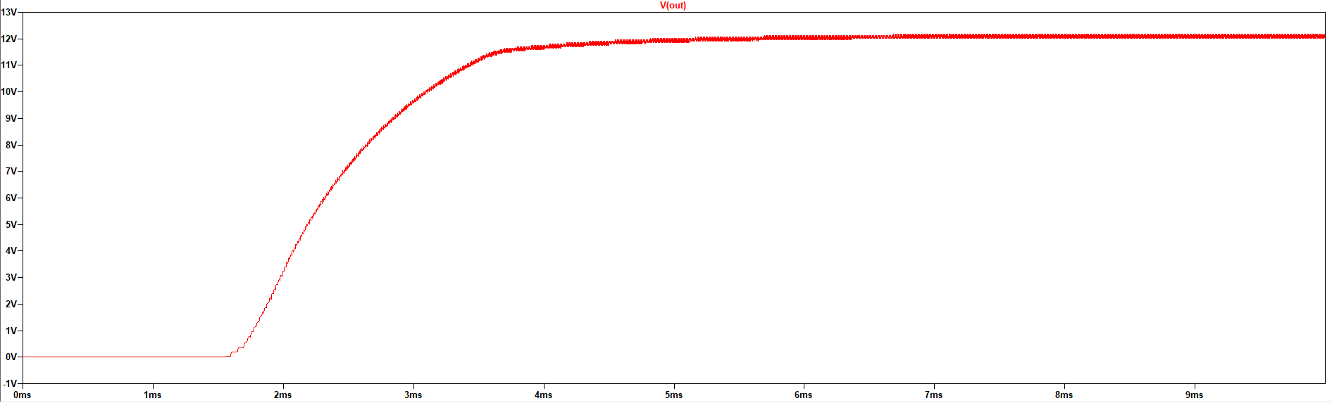
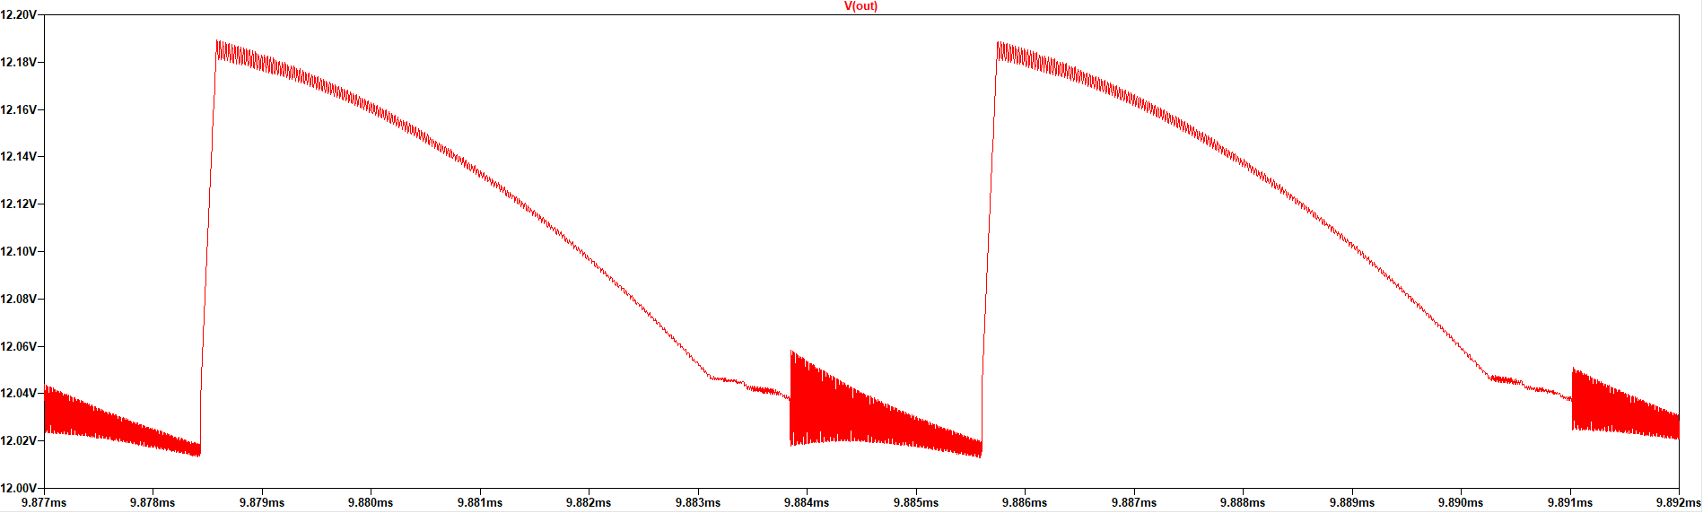
Output Voltage Waveform

Slide 21
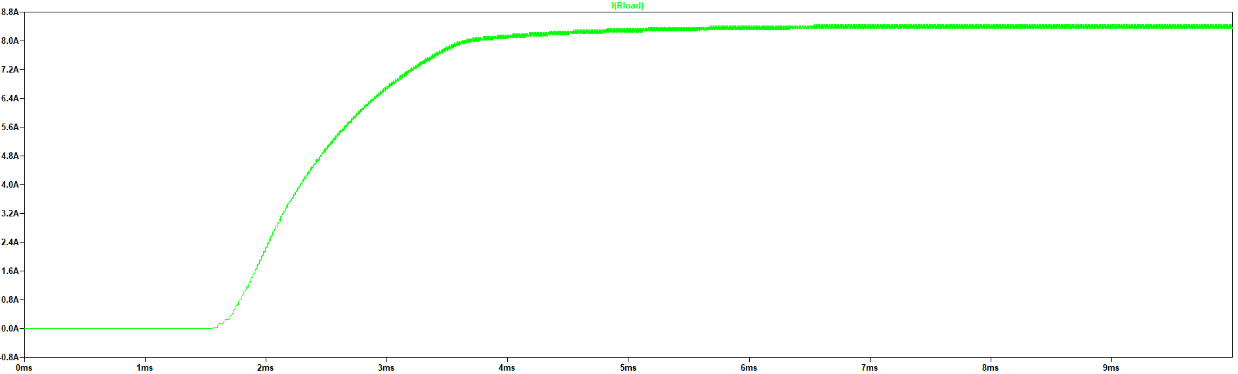
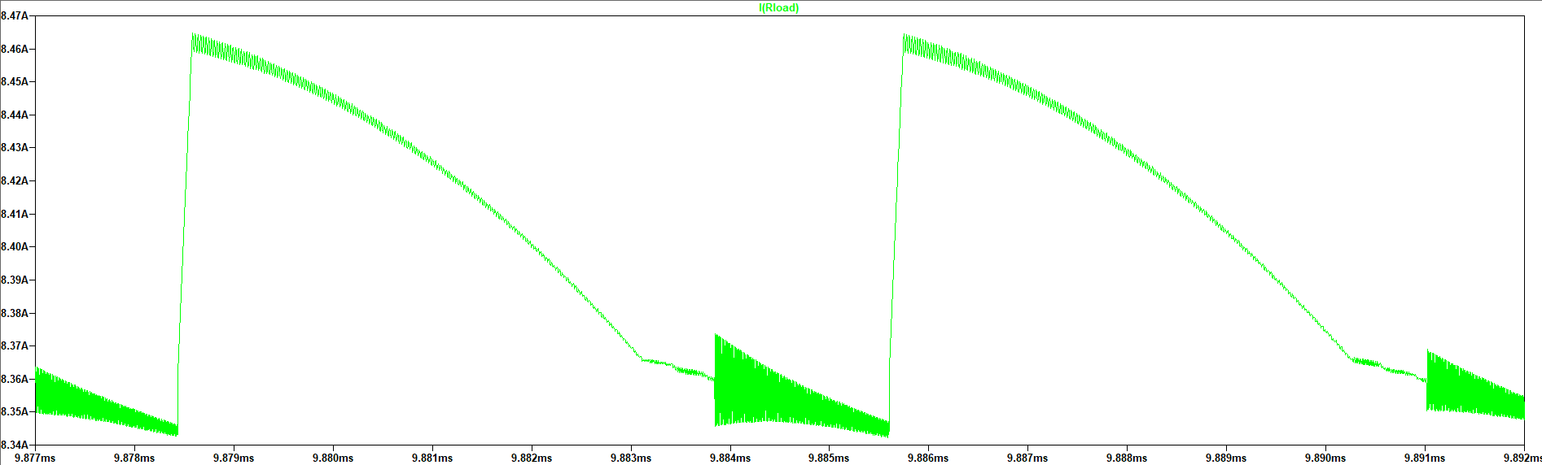
Output Current Waveform

Slide 22
Efficiency = 88.98 %
Losses
Type | Value
Mosfet Switching Loss | 0.8285 W
Mosfet Conduction Loss | 0.0157 W
Mosfet Total Loss | 0.8442 W
Diode Switching Loss | 0.0032 W
Diode Conduction Loss | 7.167 W
Diode Total Loss | 7.1702 W
Snubber Loss | 4 W
Transformer Core Loss | 0.124 W
Transformer Copper Losses | 0.2431 W
Transformer Total Loss | 0.3671 W
Total Loss | 12.3815 W

Slide 23
Thermal Results
Component | Temperature
Mosfet | 92.5 ºC
Diode (without Heatsink) | 338.5 ºC
Diode (with Heatsink) | 121.1 ºC
Transformer | 234 ºC

Slide 24
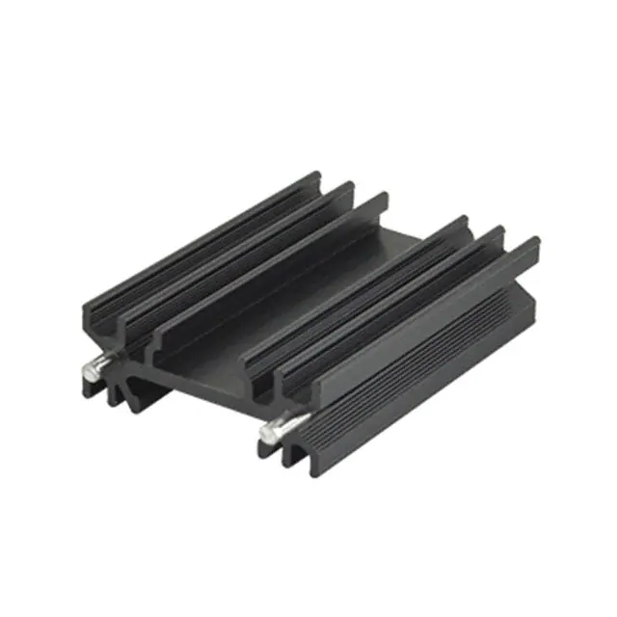
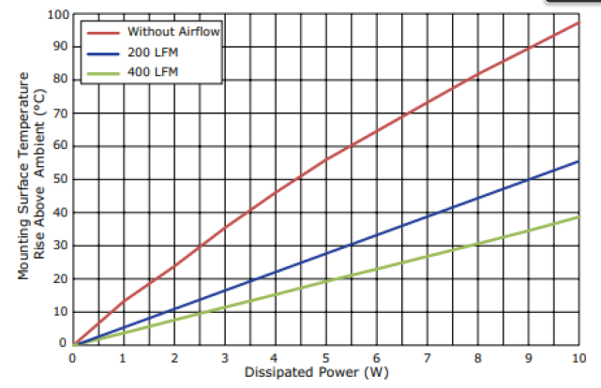
Heatsink(HSE-B20380-040H-01 )

Slide 25
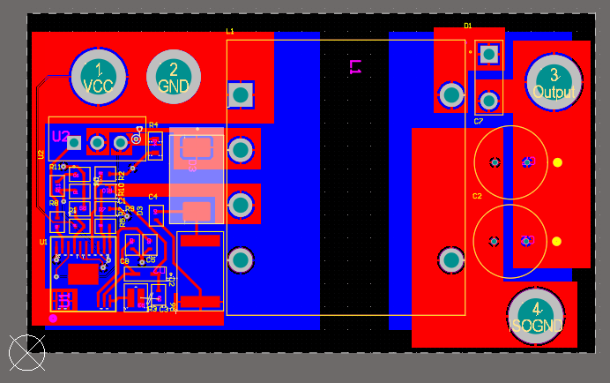
PCB Design
Overall PCB Design

Slide 26
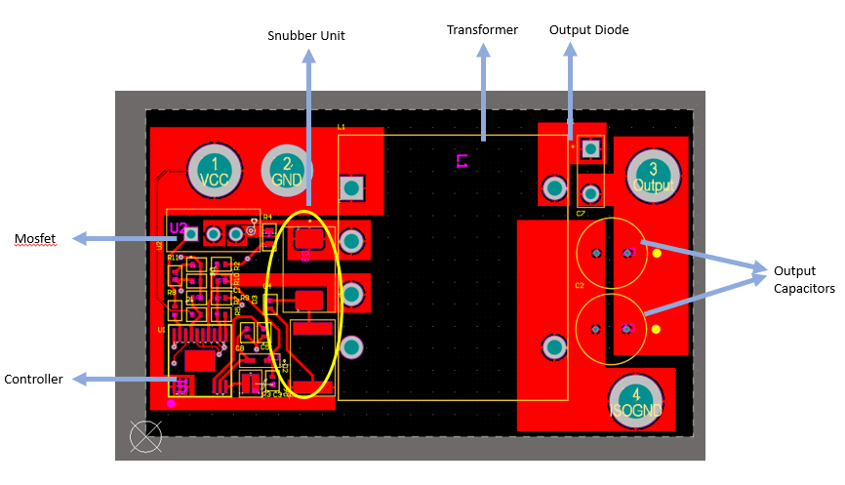
Top view of the PCB

Slide 27
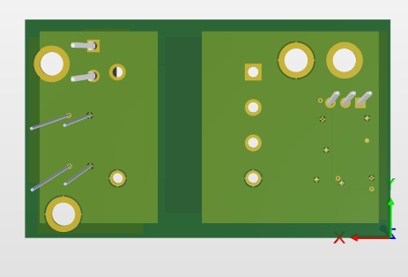
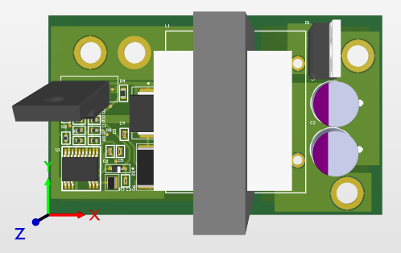
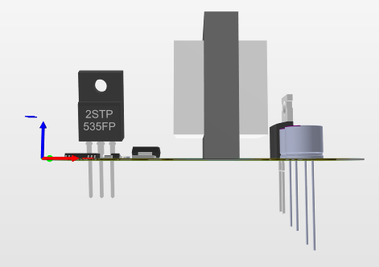
Dimensions:
3.7 x 6.2 x 4 = 91.76 cm^3
With the heat sink:
4.5 x 6.2 x 4 = 111.6 cm^3

Slide 28
Cost Analysis
Component | Price ($)
K3007E90 core | 0.78
B66232J1112T001 Bobbin | 0.82
Copper Cable (11 m) | 2.25
IPAN70R450P7S | 0.69
MBR40250G | 1.0178
337ULR016MFF (x2) | 0.2925 x 2
Resistors (1.5Mohm – 10Kohm) (x8) | 0.005 x 8
354010KFT Resistor | 0.468
ERJ-3BWFR033V Resistor | 0.0074
ERJ-2LWJR010X Resistor | 0.045
UVK105CG4R7JW-F Capacitor (x2) | 0.05 x 2
04026D105KAT4A Capacitor | 0.027
885012005078 Capacitor | 0.029
TMK105BJ104MV-F Capacitor | 0.006
BAS3010A03WE6327HTSA1 Diode | 0.125
S5KCTR Diode | 0.0966
HSE-B20380-040H-01 Heat Sink | 0.529
PCB | 0.679
Total | 8.298

