Slide 1


Slide 2
EE464- TERM PROJECT
Büşra Nur Koçak
Defne Nur Korkmaz
Mustafa Mert Sarıkaya
May 9, 2021

Slide 3
What should the presentation include?
Topology selection
Project design
How we selected critical components
Our plan for the design and manufacturing
Magnetic design
Controller selection
Our ideas about the design even if it is not completed
PCB design

Slide 4
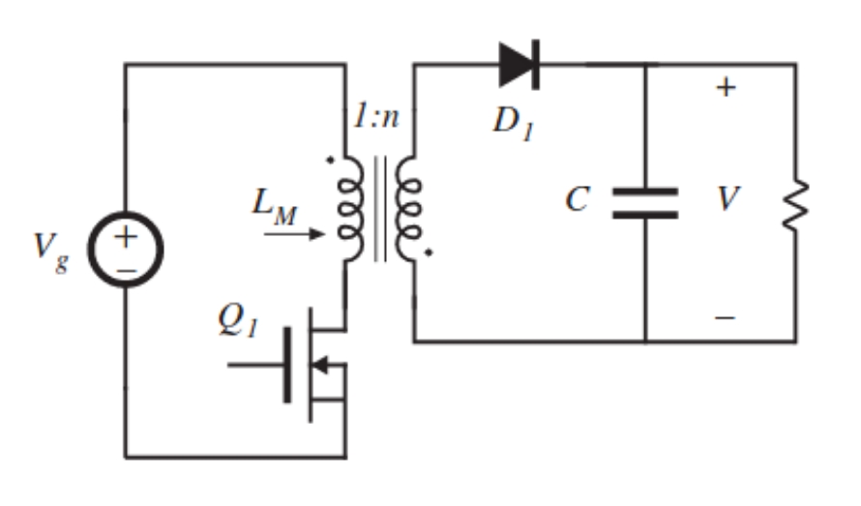
TOPOLOGY SELECTION
FLYBACK CONVERTER
Better utilization of transformer
Continuous output current
Easier to control
DCM operation
Smaller transformer
Reduce switching losses

Slide 8
EE464- TERM PROJECT
Büşra Nur Koçak
Defne Nur Korkmaz
Mustafa Mert Sarıkaya
May 9, 2021

Slide 9
Topology selection
Component selection
Simulation results
PCB design
Magnetic design

Slide 10
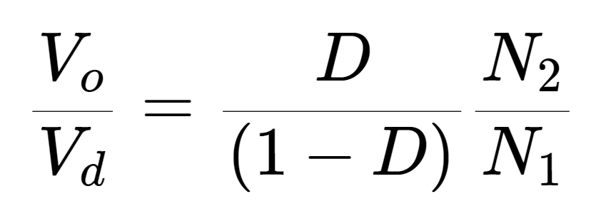
TOPOLOGY SELECTION
FLYBACK CONVERTER
Better utilization of transformer
Easier to control
DCM operation

Slide 11

Operating Values
$D_{max}=0.2$
$D_{dweel}=0.1$
$f_{s} ≅100 kHz$
AWG #26 (skin effect)
DCM operation:
Limits flux density
Smaller core
Reduce switching losses
Smooth start

Slide 12
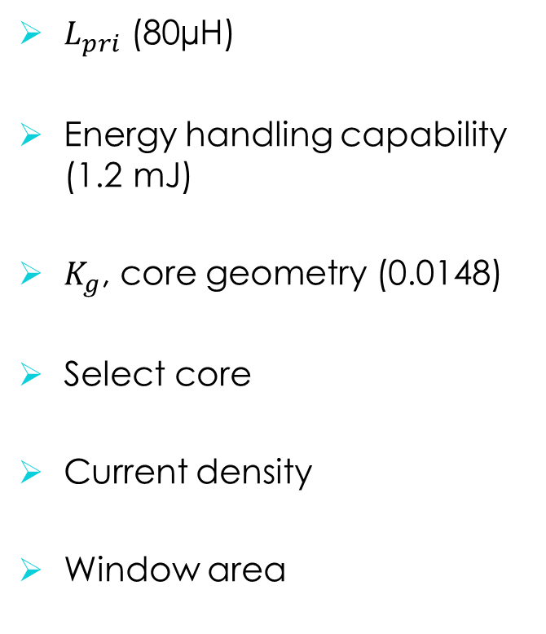

Magnetic Design
$K_{g}$ Method
$L_{pri}$ (80µH)
Energy handling capability (1.2 mJ)
$K_{g}$, core geometry (0.0148)
Select core
Current density
Window area
# of strands
# of turns
Air gap
Fringing flux
New # of turns
$B_{pk}$

Slide 13
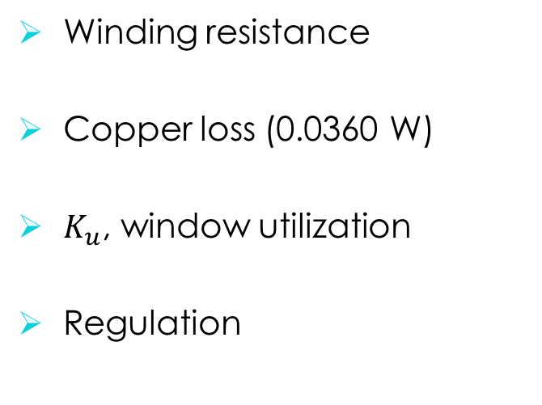
Magnetic Design
$K_{g}$ Method cont’
Winding resistance
Copper loss (0.0360 W)
$K_{u}$, window utilization
Regulation
Flux density
Core loss (5.38 W)
Temperature rise (61 ºC)

Slide 14
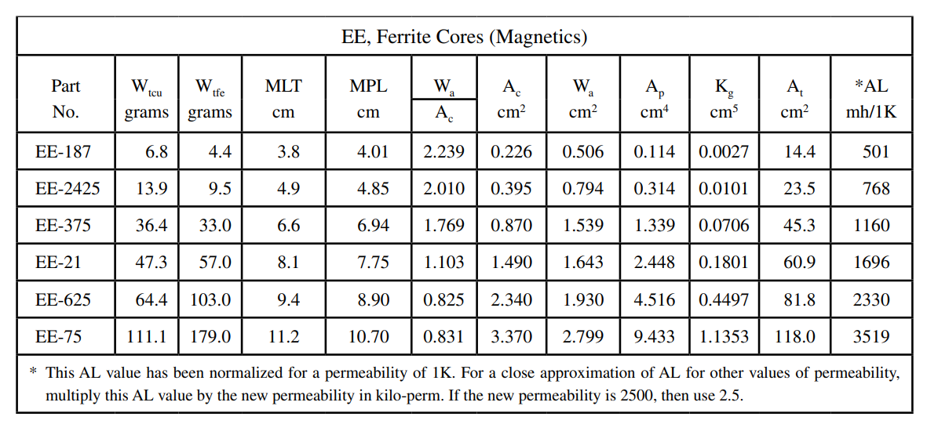

Slide 15
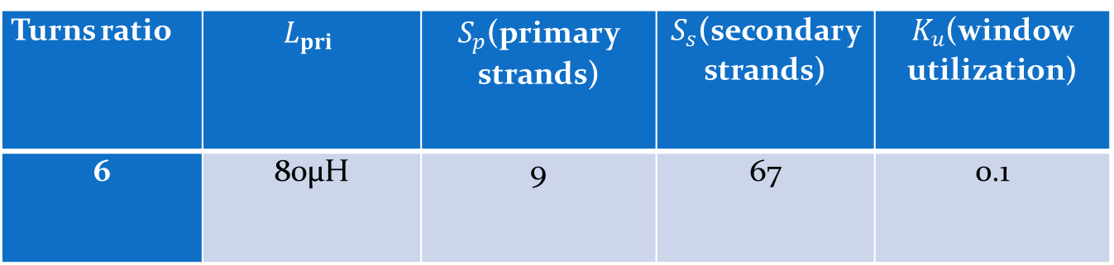
Turns ratio | $$L_{pri}$$ | $S_{p}$(primary strands) | $S_{s}$(secondary strands) | $K_{u}$(window utilization)
6 | 80µH | 9 | 67 | 0.1

