Slide 1


Slide 2
EE464- TERM PROJECT
Büşra Nur Koçak
Defne Nur Korkmaz
Mustafa Mert Sarıkaya
May 9, 2021

Slide 3
Topology selection
Component selection
Simulation results
PCB design
Magnetic design

Slide 4
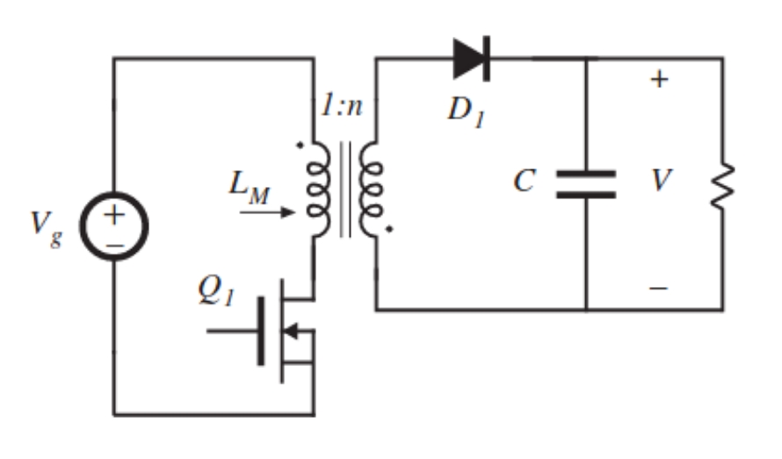
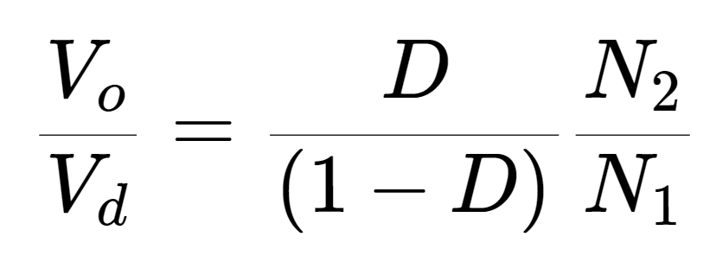
TOPOLOGY SELECTION
FLYBACK CONVERTER
Better utilization of transformer
Easier to control
DCM operation

Slide 5

Operating Values
$D_{max}=0.2$
$D_{dweel}=0.1$
$f_{s} ≅100 kHz$
AWG #26 (skin effect)
DCM operation:
Limits flux density
Smaller core
Reduce switching losses
Smooth start

Slide 6
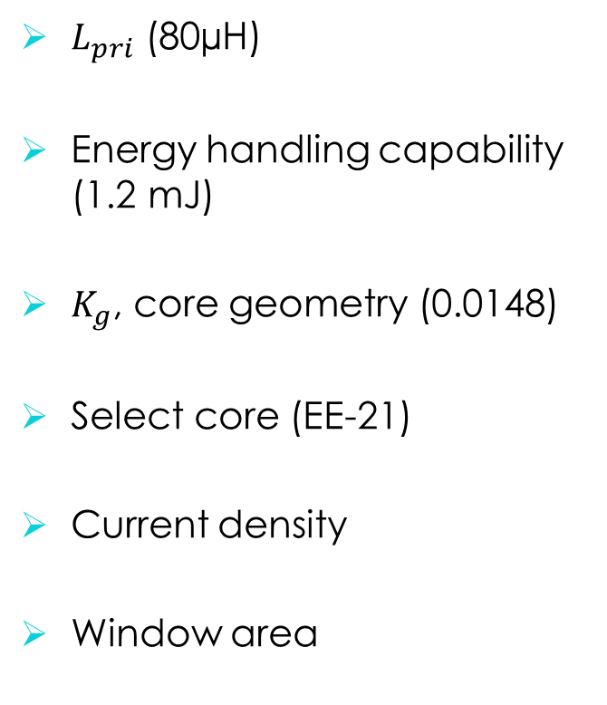
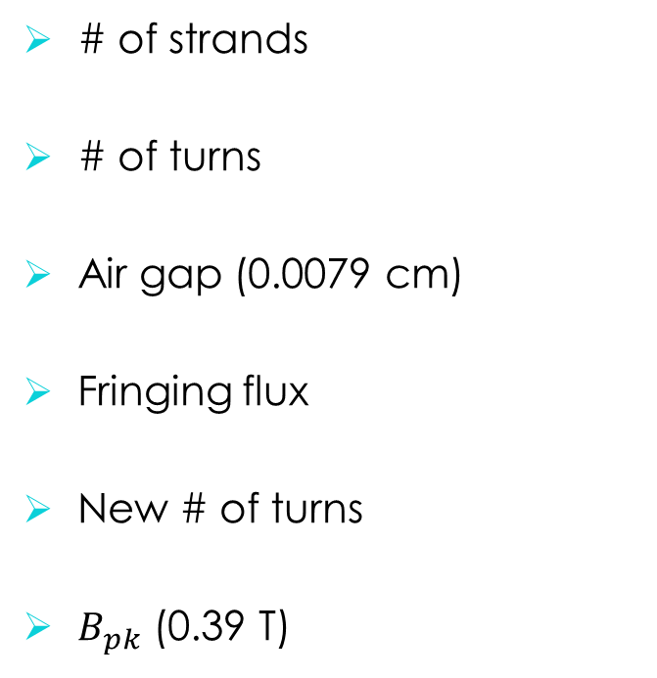
Magnetic Design
$K_{g}$ Method
$L_{pri}$ (80µH)
Energy handling capability (1.2 mJ)
$K_{g}$, core geometry (0.0148)
Select core (EE-21)
Current density
Window area
# of strands
# of turns
Air gap (0.0079 cm)
Fringing flux
New # of turns
$B_{pk}$ (0.39 T)

Slide 7
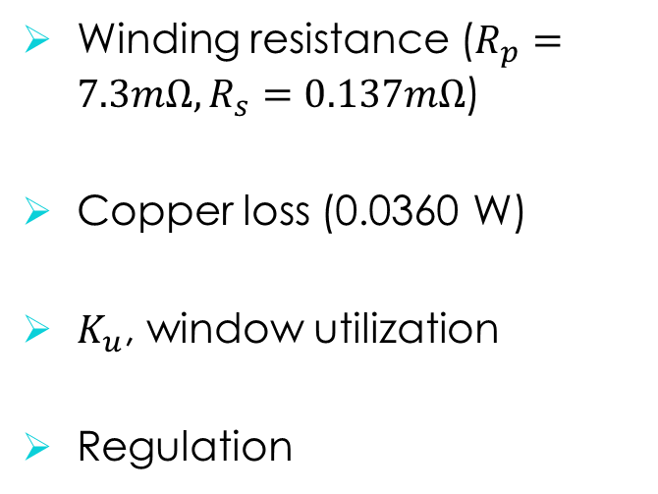
Magnetic Design
$K_{g}$ Method cont’
Winding resistance ($R_{p}=7.3mΩ, R_{s}=0.137mΩ$)
Copper loss (0.0360 W)
$K_{u}$, window utilization
Regulation
Flux density
Core loss (5.38 W)
Temperature rise (61 ºC)

Slide 8
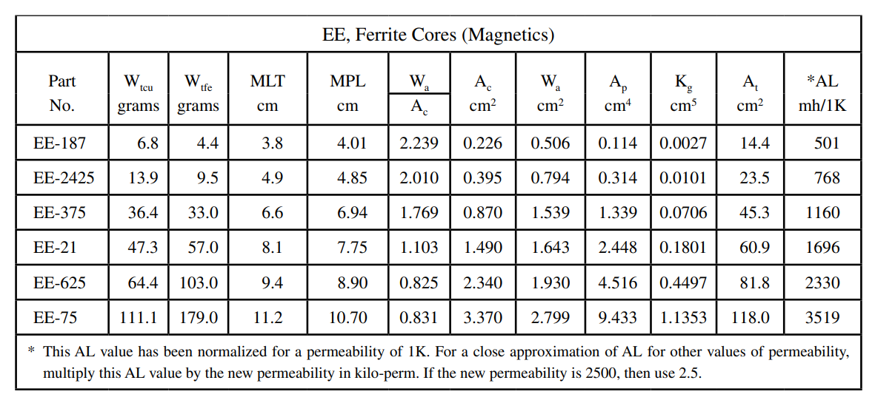

Slide 9
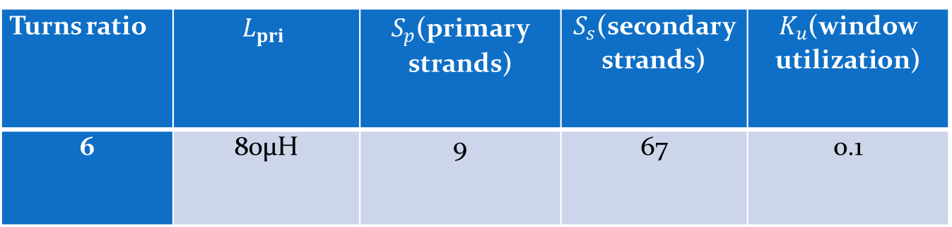
Turns ratio | $$L_{pri}$$ | $S_{p}$(primary strands) | $S_{s}$(secondary strands) | $K_{u}$(window utilization)
6 | 80µH | 9 | 67 | 0.1

Slide 10
Component Selection and Simulations

Slide 11
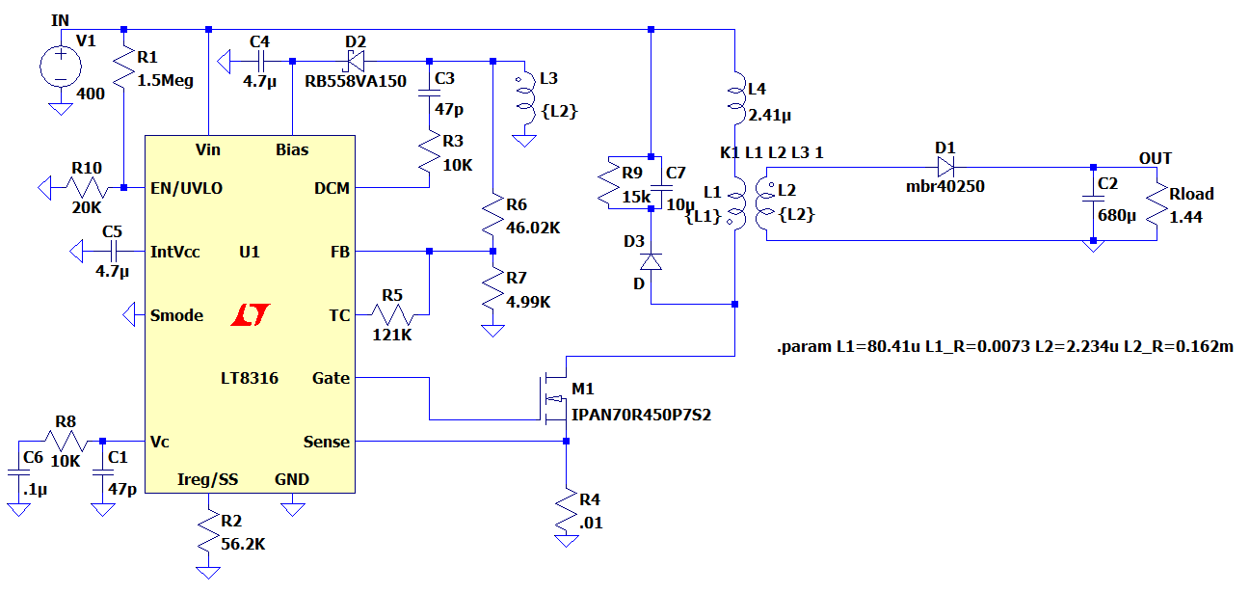
Controller
Parameter | Value - Description
V_{in} | 16V – 600V
F_{SW(Min)} | 3 kHz
F_{SW(Max)} | 140 kHz
Operating Junction Temperature | -40 – 125ºC
Price | $2.18 (1000+ order)

Slide 12
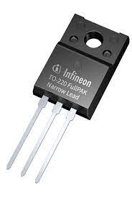
Mosfet (IPAN70R450P7S)
Parameter | Value - Description
V_{DS} , Breakdown voltage | 700V
I_{D}, Continuous current | 10A at T_{C} =20 ºC
I_{D,pulse} Pulsed Drain current | 25.9 A
R_{DS,ON} | 450mΩ
Q_{g} | 13.1nC
Price | $1.05

Slide 13
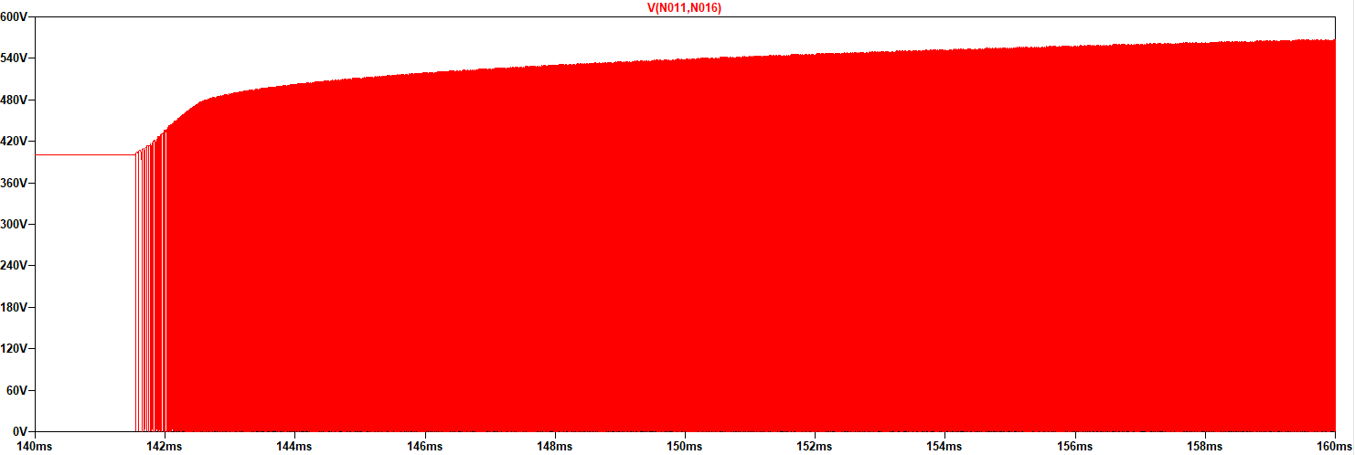
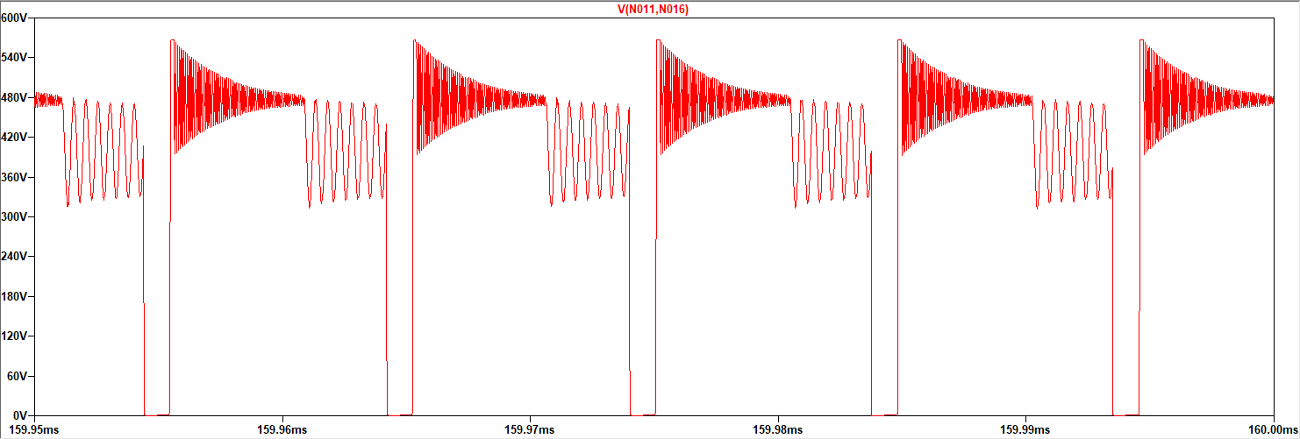
Mosfet Voltage Waveform

Slide 14
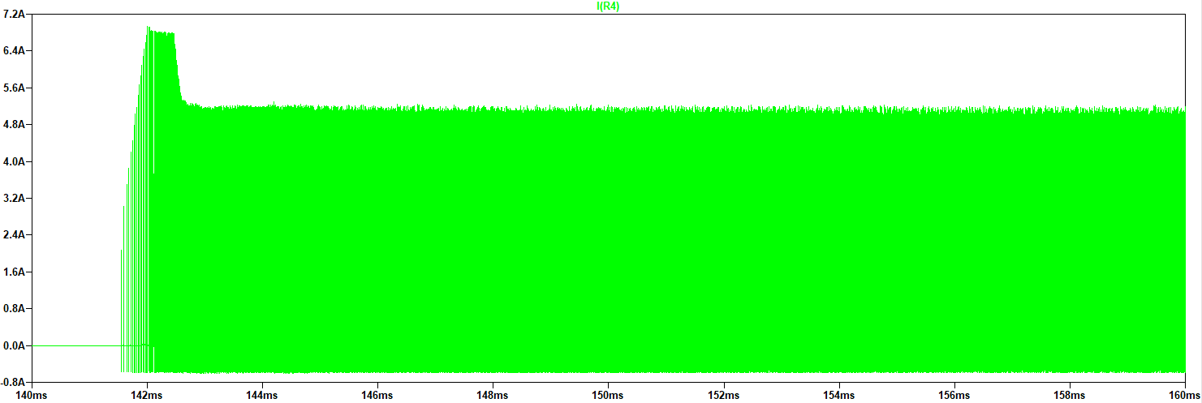
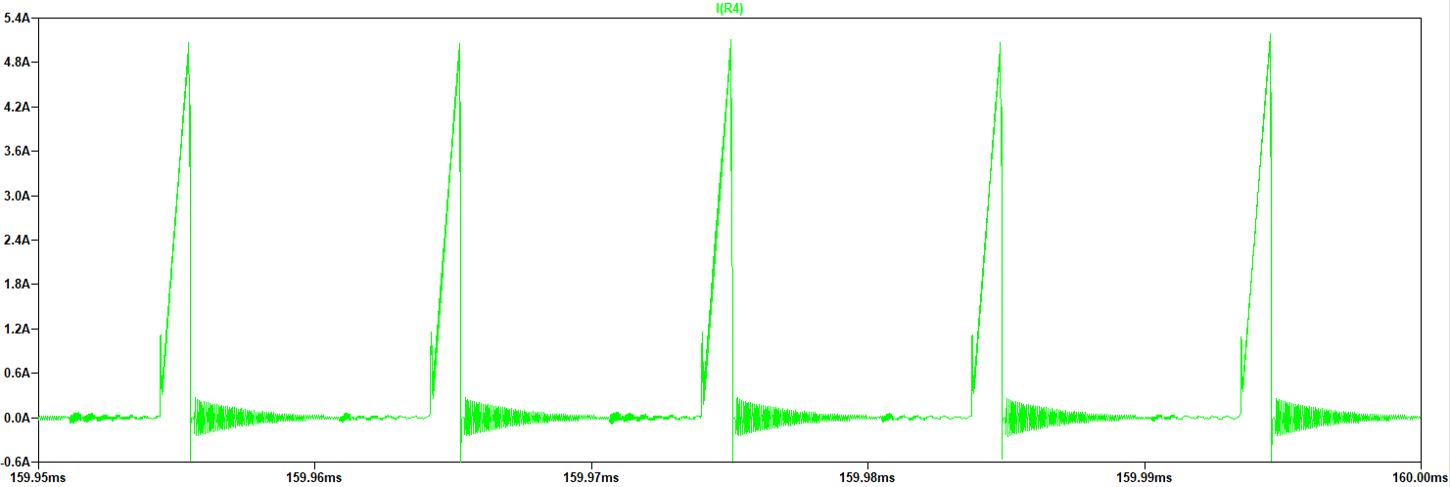
Mosfet Current Waveform

Slide 15
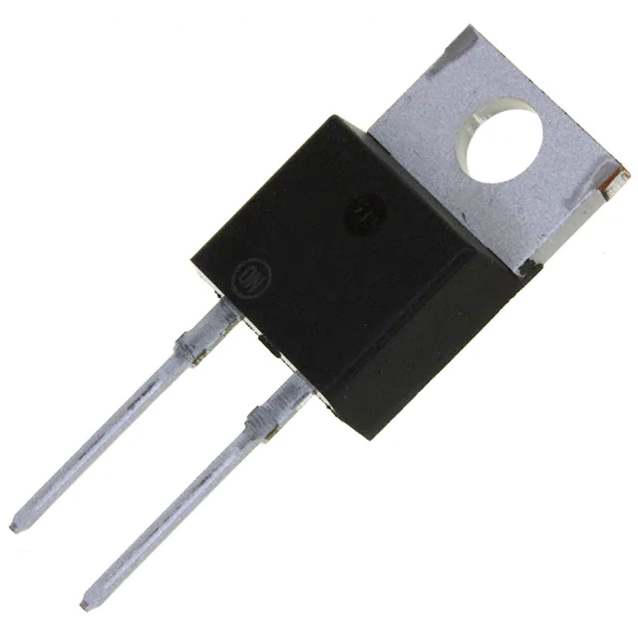
Diode(MBR40250G)
Parameter | Value - Description
V_{R} , Blocking voltage | 250V
I_{RMS}, Continuous current | 40A
I_{FRM}, Peak Repetitive Forward Current | 80A
V_{F} | 0.86V
Price | $1.82000

Slide 16
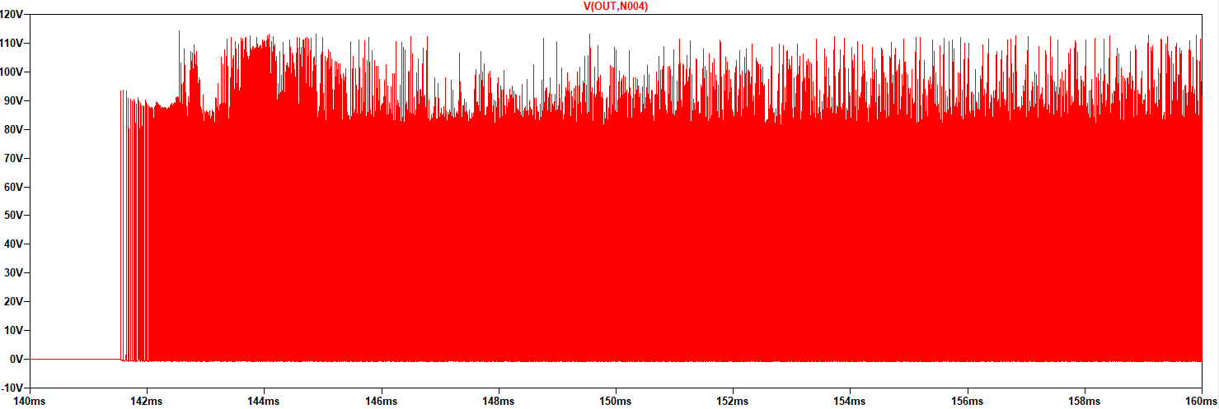
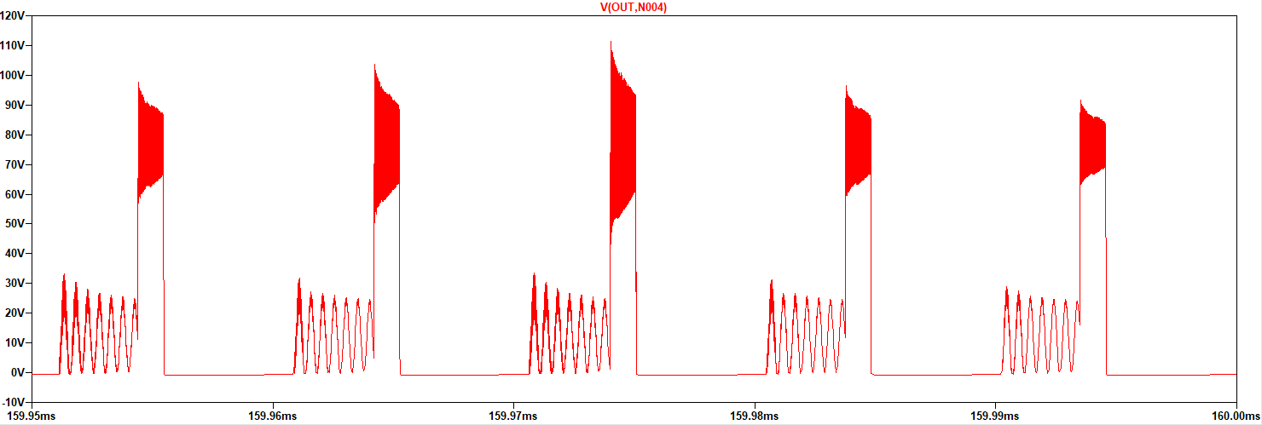
Diode Voltage Waveform

Slide 17
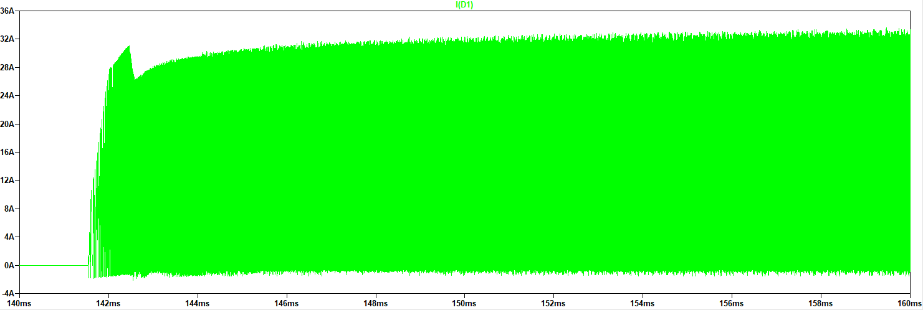
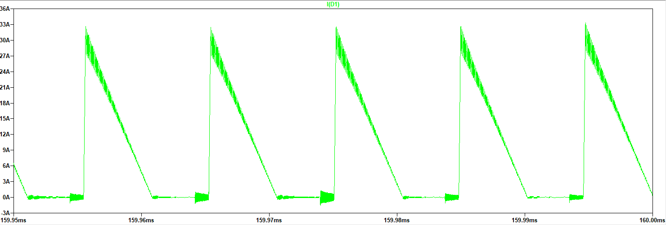
Diode Current Waveform

Slide 18
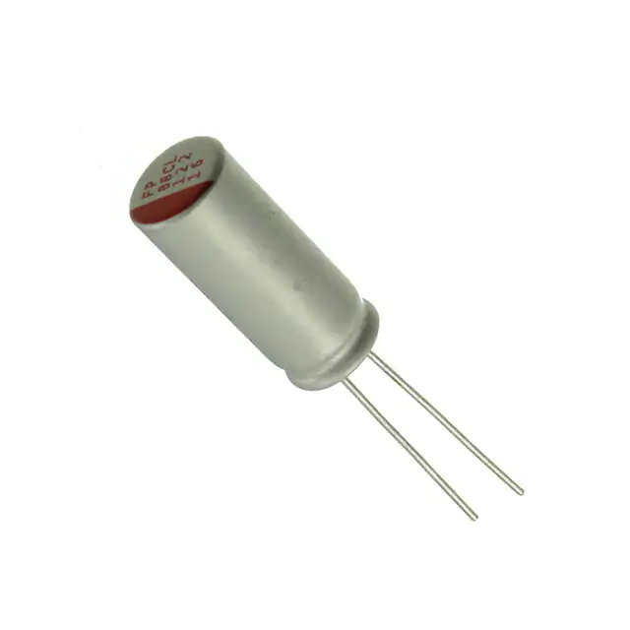
Output Capacitor(RNL1C681MDS1)
Parameter | Value - Description
C, Capacitance | 680 uF
V_{C,MAX} Rating | 25V
I_{C,ripple} | 7A
ESR | 8mΩ
Price | 1.50$

Slide 19
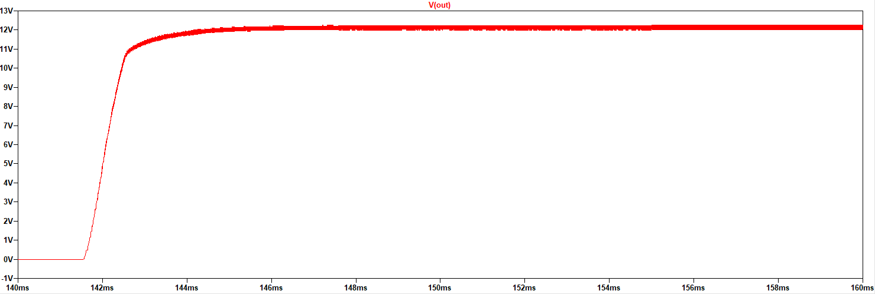
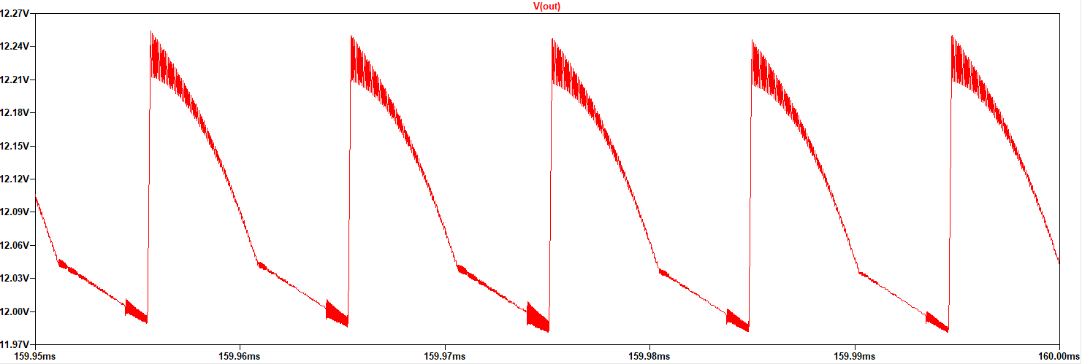
Output Voltage Waveform

Slide 20
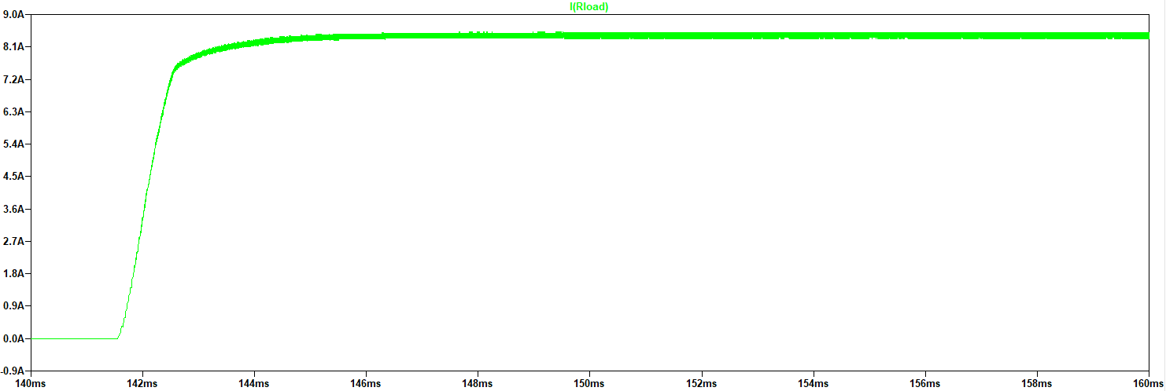
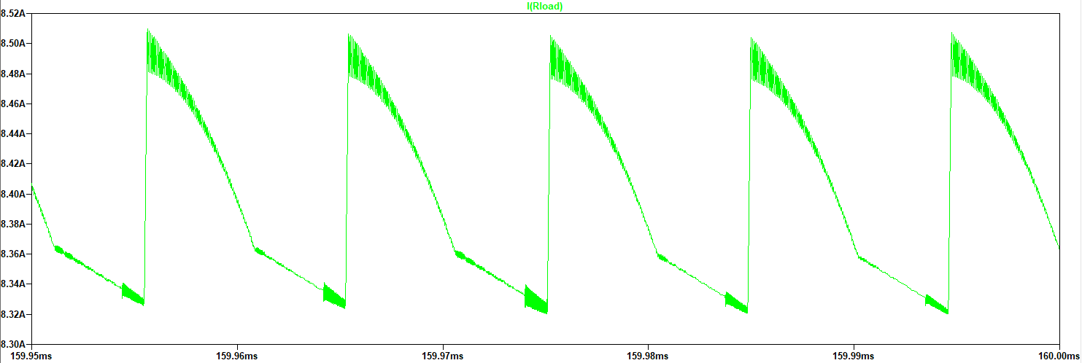
Output Current Waveform

Slide 21
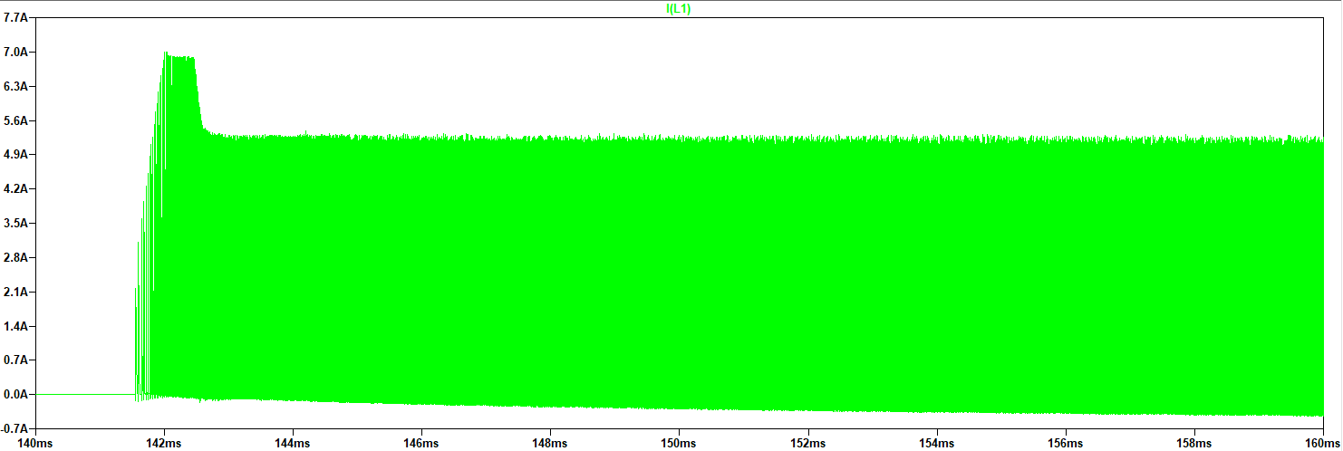
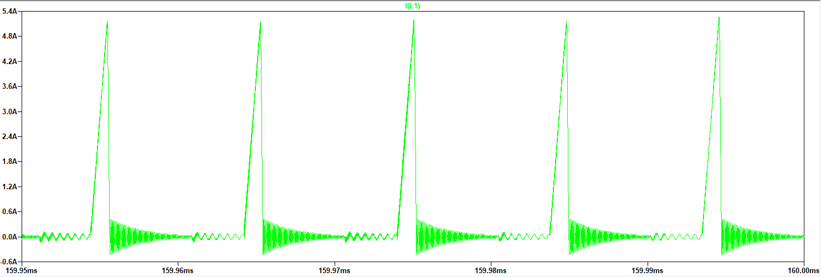
Primary Inductor Current Waveform

