Slide 1
Component Selection and Simulations

Slide 2
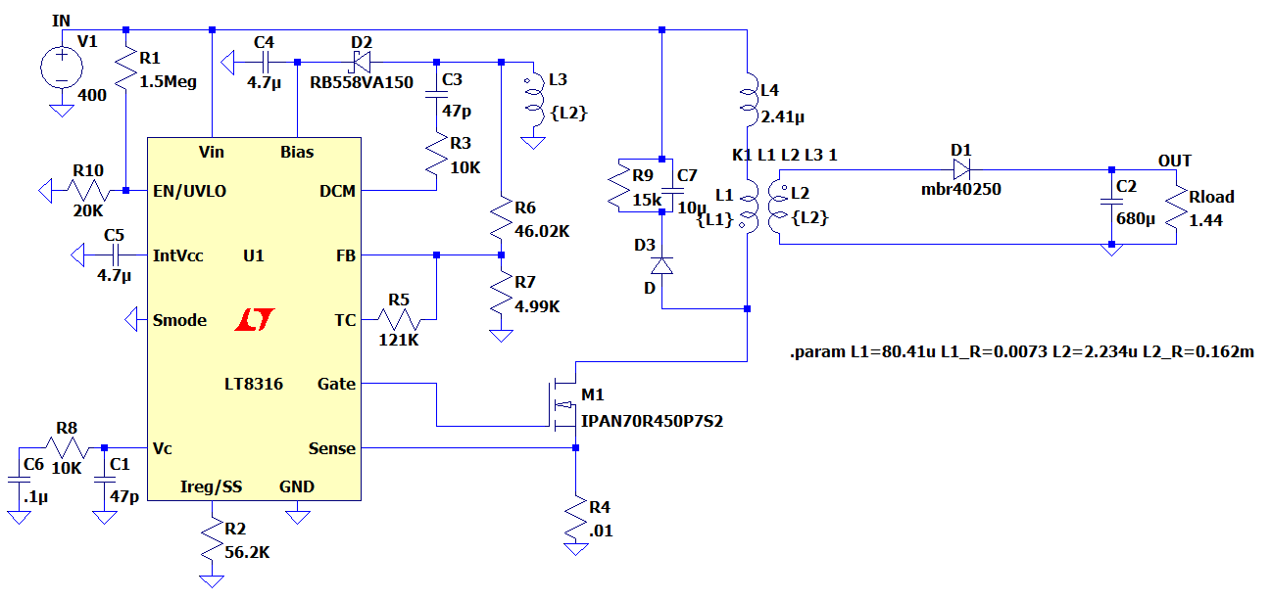
Controller
Parameter | Value - Description
V_{in} | 16V – 600V
F_{SW(Min)} | 3 kHz
F_{SW(Max)} | 140 kHz
Operating Junction Temperature | -40 – 125ºC
Price | $2.18 (1000+ order)

Slide 3
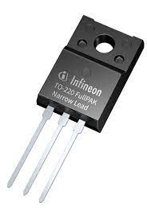
Mosfet (IPAN70R450P7S)
Parameter | Value - Description
V_{DS} , Breakdown voltage | 700V
I_{D}, Continuous current | 10A at T_{C} =20 ºC
I_{D,pulse} Pulsed Drain current | 25.9 A
R_{DS,ON} | 450mΩ
Q_{g} | 13.1nC
Price | $1.05

Slide 4
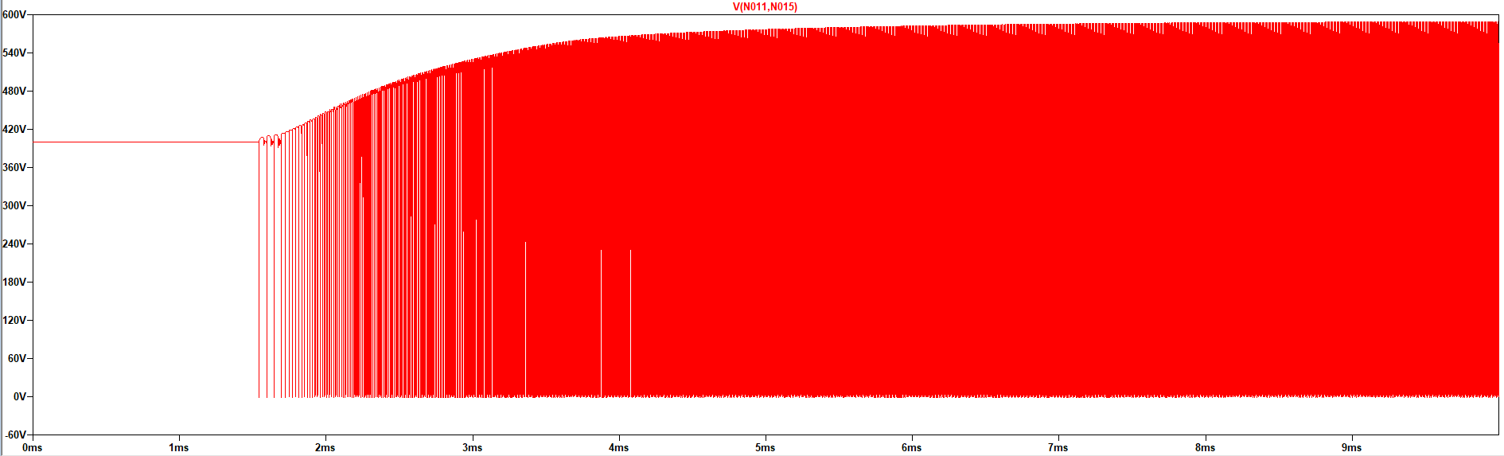
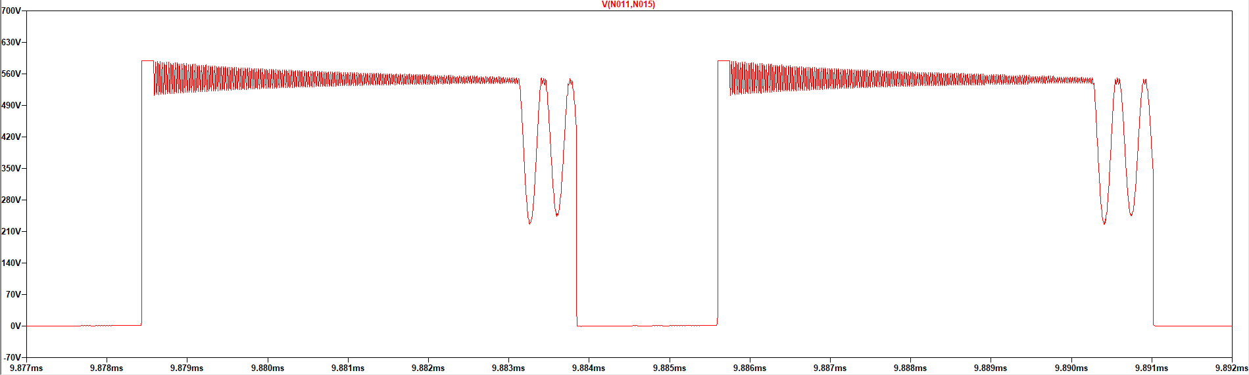
Mosfet Voltage Waveform

Slide 5
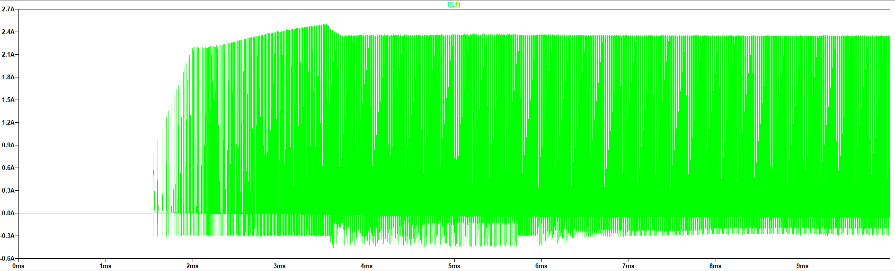
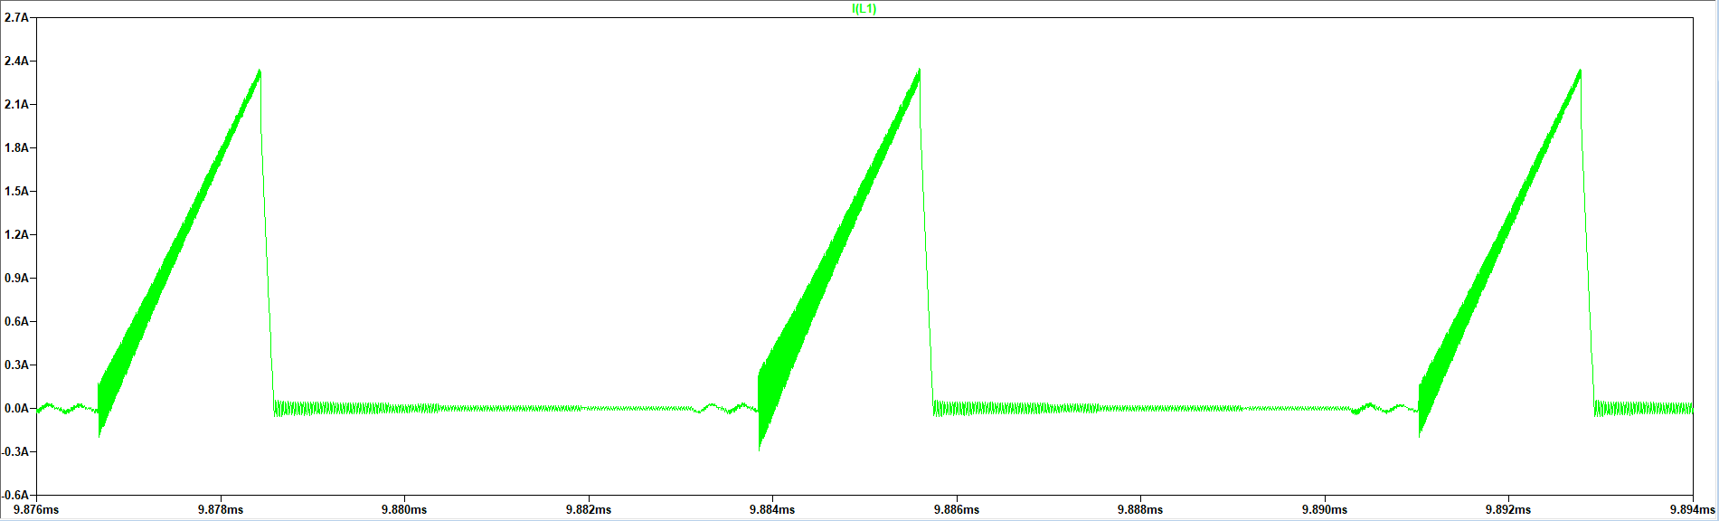
Mosfet Current Waveform

Slide 6
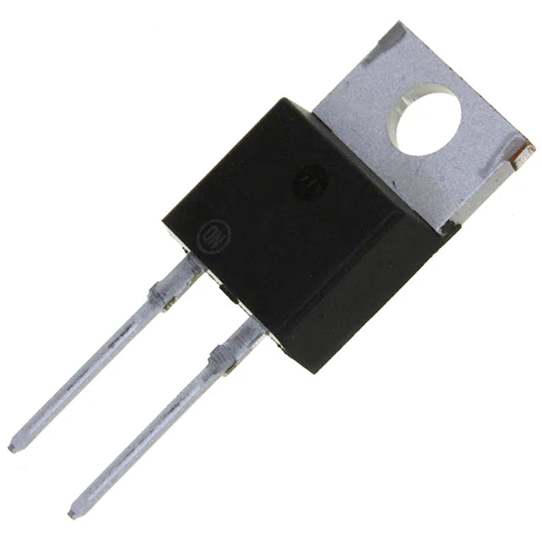
Diode(MBR40250G)
Parameter | Value - Description
V_{R} , Blocking voltage | 250V
I_{RMS}, Continuous current | 40A
I_{FRM}, Peak Repetitive Forward Current | 80A
V_{F} | 0.86V
Price | $1.82000

Slide 7
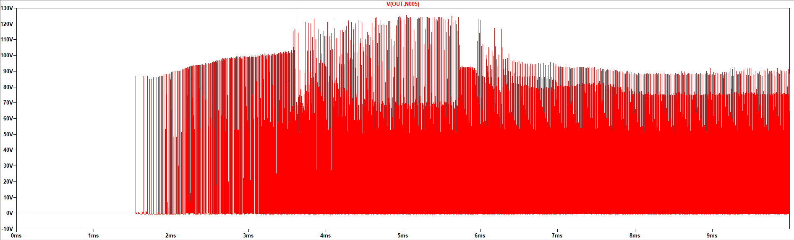
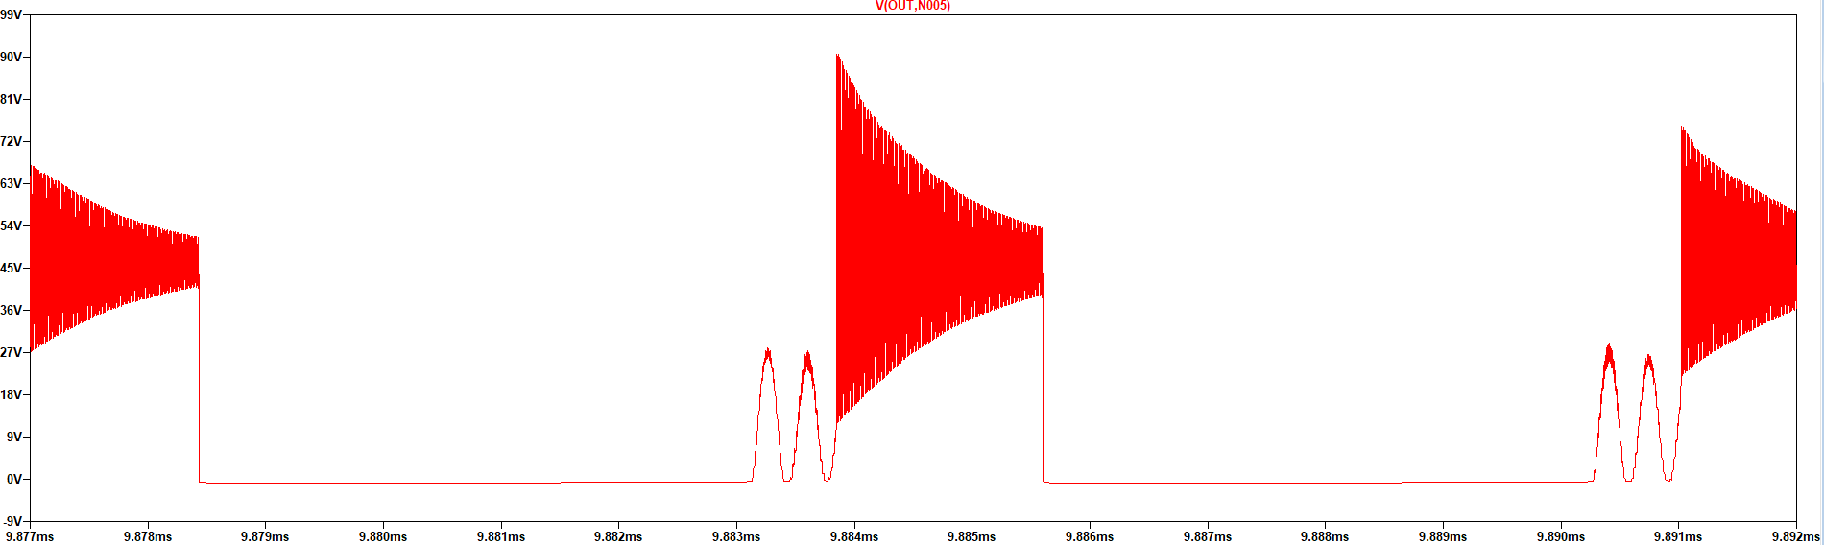
Diode Voltage Waveform

Slide 8
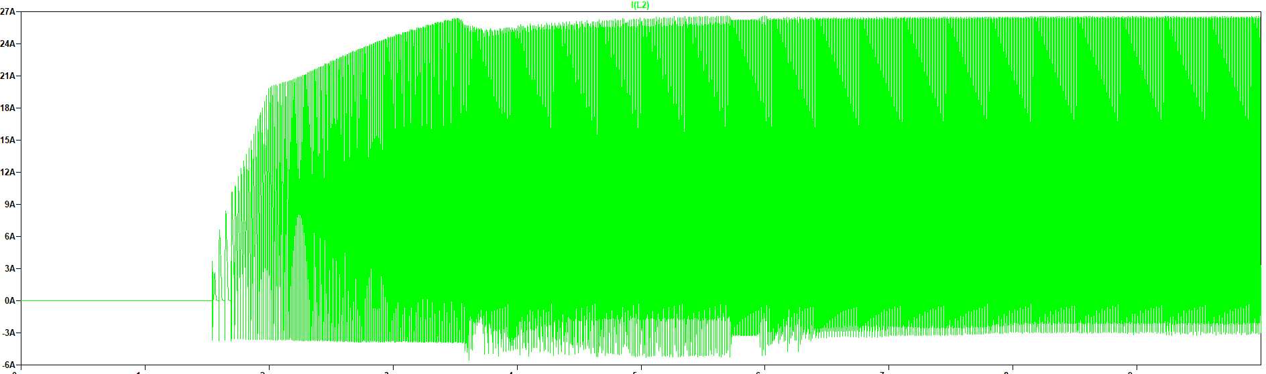
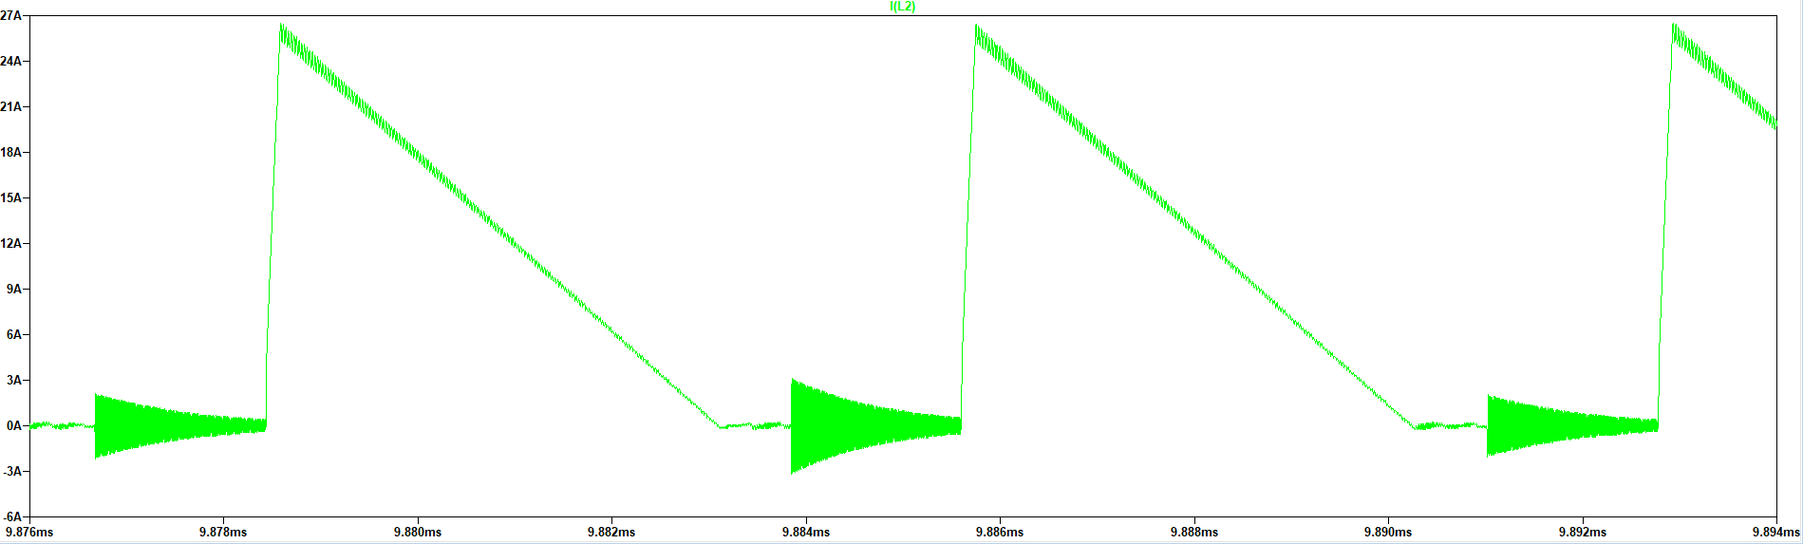
Diode Current Waveform

Slide 9
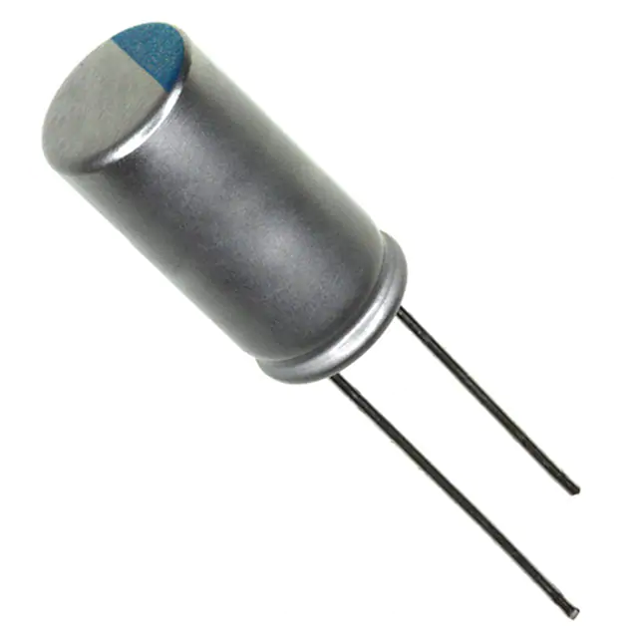
Output Capacitor(337ULR016MFF)
Parameter | Value - Description
C, Capacitance | 330 uF
V_{C,MAX} Rating | 16V
I_{C,ripple} | 4.3A
ESR | 13mΩ
Price | 0.2925$ x2

Slide 10
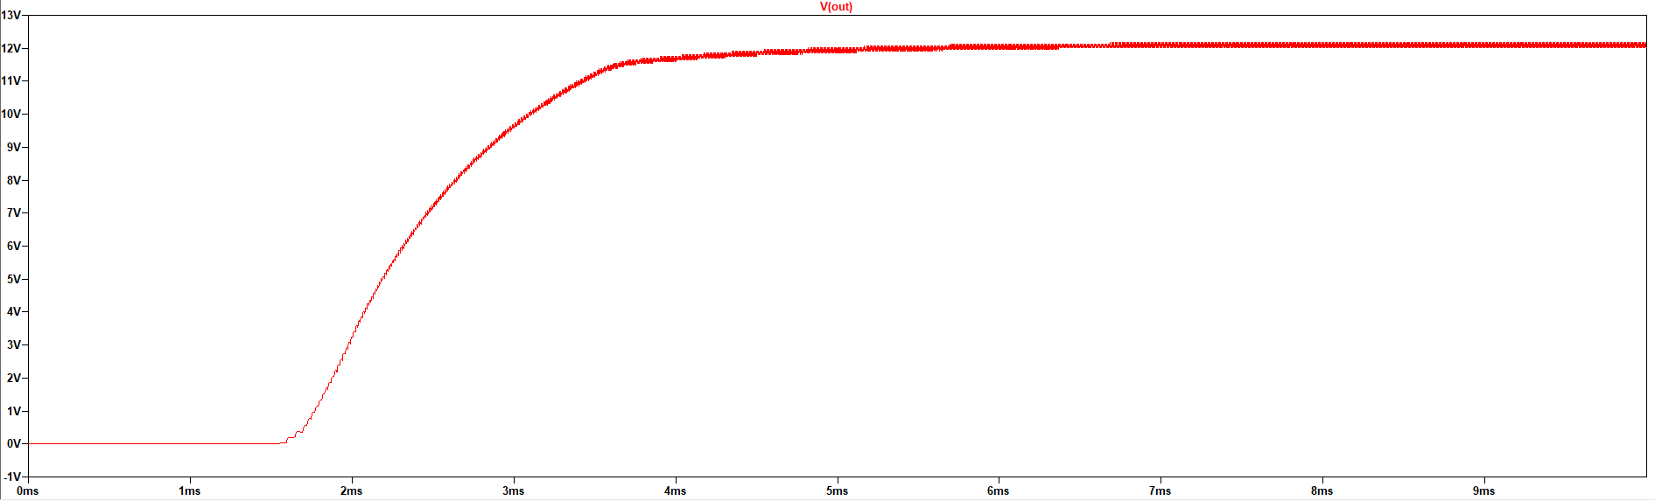
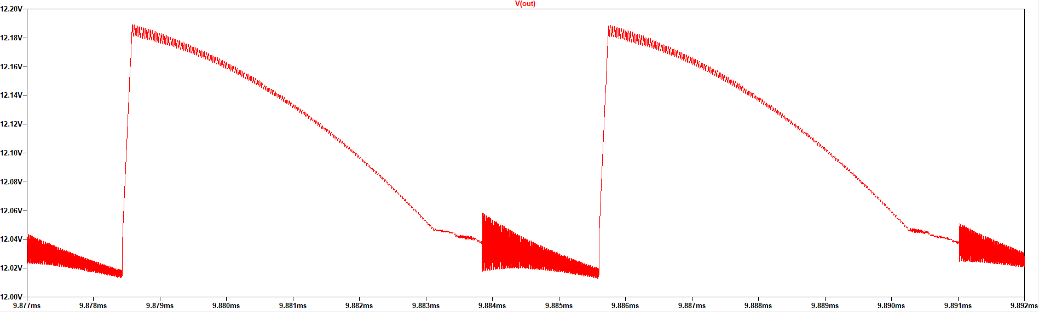
Output Voltage Waveform

Slide 11
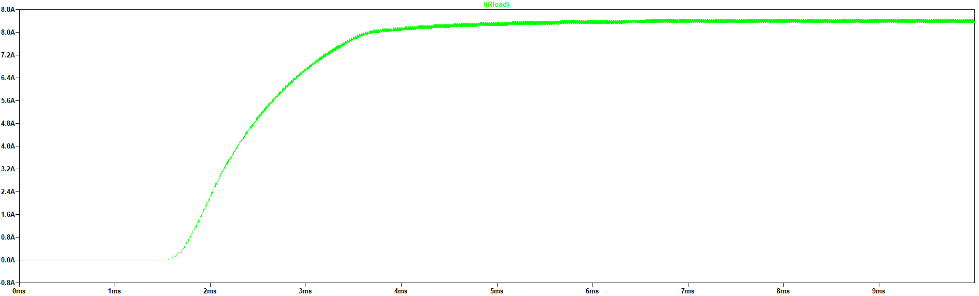
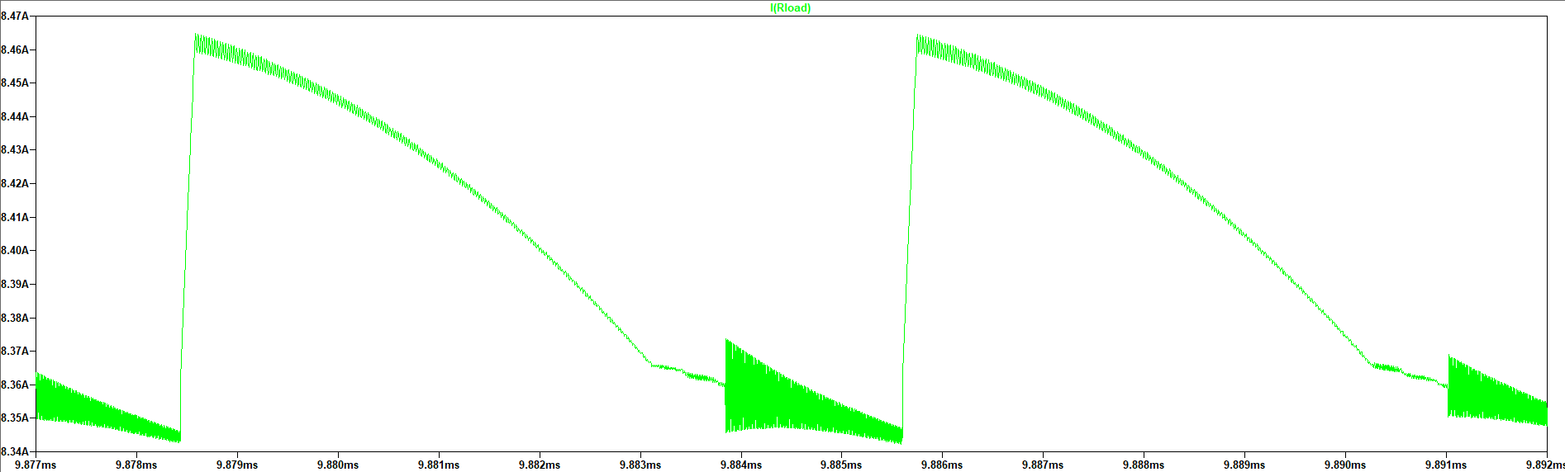
Output Current Waveform

Slide 12
Efficiency = 88.98 %
Losses
Type | Value
Mosfet Switching Loss | 0.8285 W
Mosfet Conduction Loss | 0.0157 W
Mosfet Total Loss | 0.8442 W
Diode Switching Loss | 0.0032 W
Diode Conduction Loss | 7.167 W
Diode Total Loss | 7.1702 W
Snubber Loss | 4 W
Transformer Core Loss | 0.124 W
Transformer Copper Losses | 0.2431 W
Transformer Total Loss | 0.3671 W
Total Loss | 12.3815 W

