Slide 1


Slide 2
EE464- TERM PROJECT
Büşra Nur Koçak
Defne Nur Korkmaz
Mustafa Mert Sarıkaya
May 9, 2021

Slide 3
What should the presentation include?
Topology selection
Project design
How we selected critical components
Our plan for the design and manufacturing
Magnetic design
Controller selection
Our ideas about the design even if it is not completed
PCB design

Slide 4
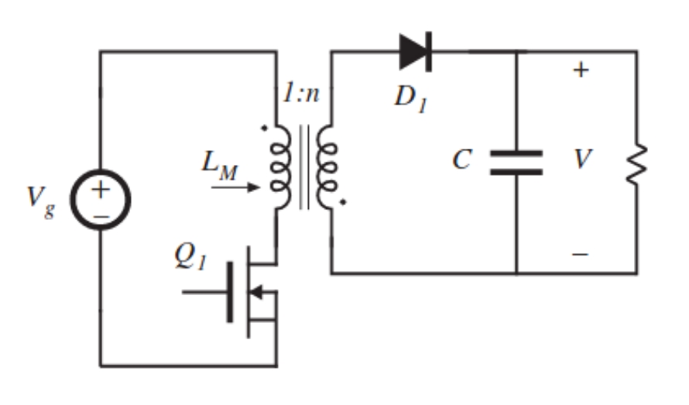
TOPOLOGY SELECTION
FLYBACK CONVERTER
Better utilization of transformer
Continuous output current
Easier to control
DCM operation
Smaller transformer
Reduce switching losses

Slide 8
EE464- TERM PROJECT
Büşra Nur Koçak
Defne Nur Korkmaz
Mustafa Mert Sarıkaya
May 9, 2021

Slide 9
Topology selection
Component selection
Simulation results
PCB design
Magnetic design

Slide 10
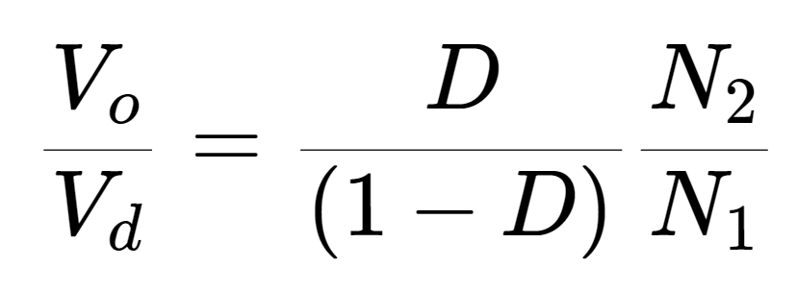
TOPOLOGY SELECTION
FLYBACK CONVERTER
Better utilization of transformer
Easier to control
DCM operation

Slide 11

Operating Values
$D_{max}=0.2$
$D_{dweel}=0.1$
$f_{s} ≅100 kHz$
AWG #26 (skin effect)
DCM operation:
Limits flux density
Smaller core
Reduce switching losses
Smooth start

Slide 12
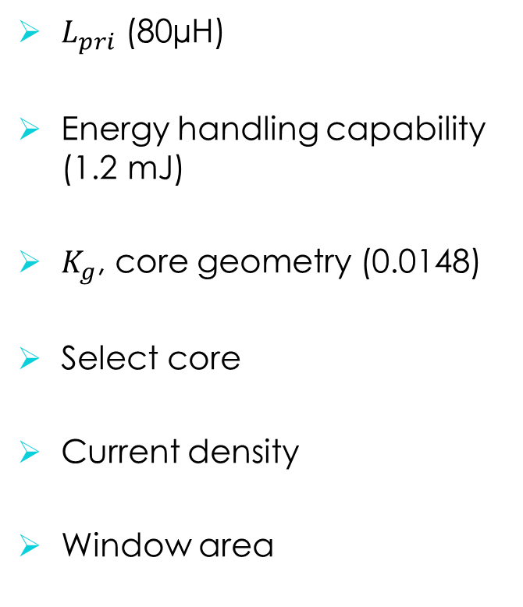

Magnetic Design
$K_{g}$ Method
$L_{pri}$ (80µH)
Energy handling capability (1.2 mJ)
$K_{g}$, core geometry (0.0148)
Select core
Current density
Window area
# of strands
# of turns
Air gap
Fringing flux
New # of turns
$B_{pk}$

Slide 13
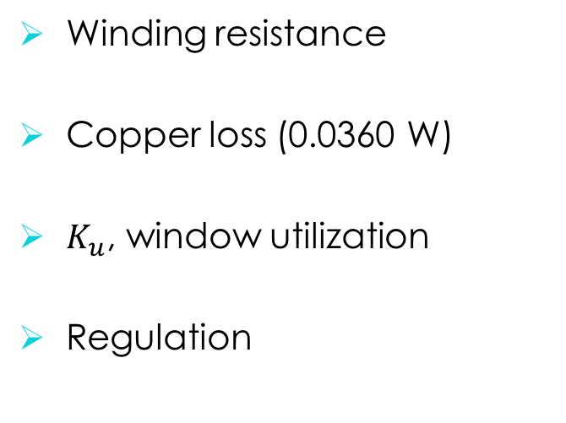
Magnetic Design
$K_{g}$ Method cont’
Winding resistance
Copper loss (0.0360 W)
$K_{u}$, window utilization
Regulation
Flux density
Core loss (5.38 W)
Temperature rise (61 ºC)

Slide 14
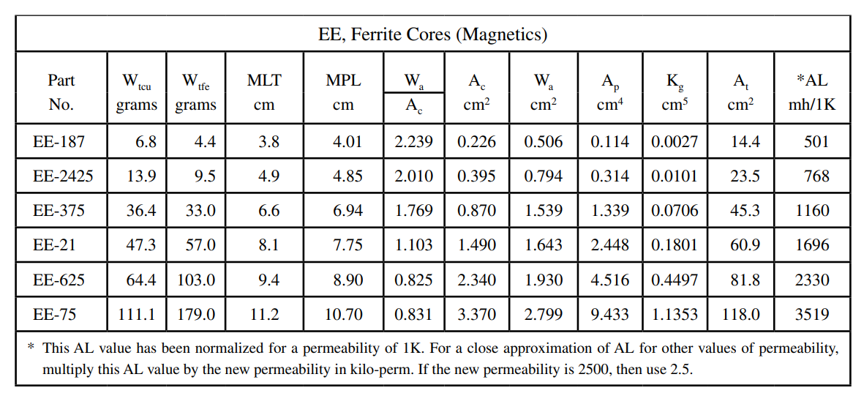

Slide 15
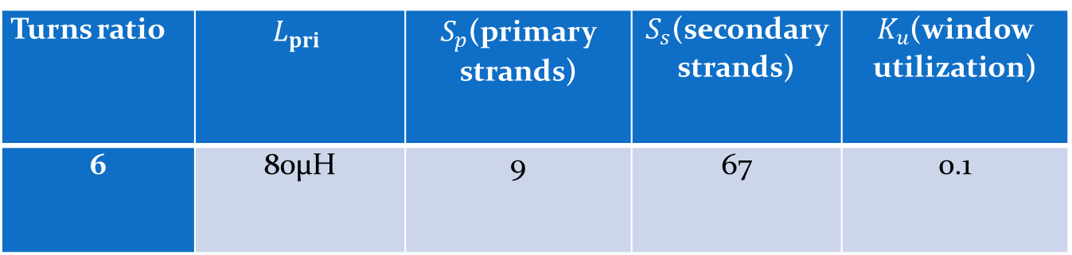
Turns ratio | $$L_{pri}$$ | $S_{p}$(primary strands) | $S_{s}$(secondary strands) | $K_{u}$(window utilization)
6 | 80µH | 9 | 67 | 0.1

Slide 16
Component Selection and Simulations

Slide 17
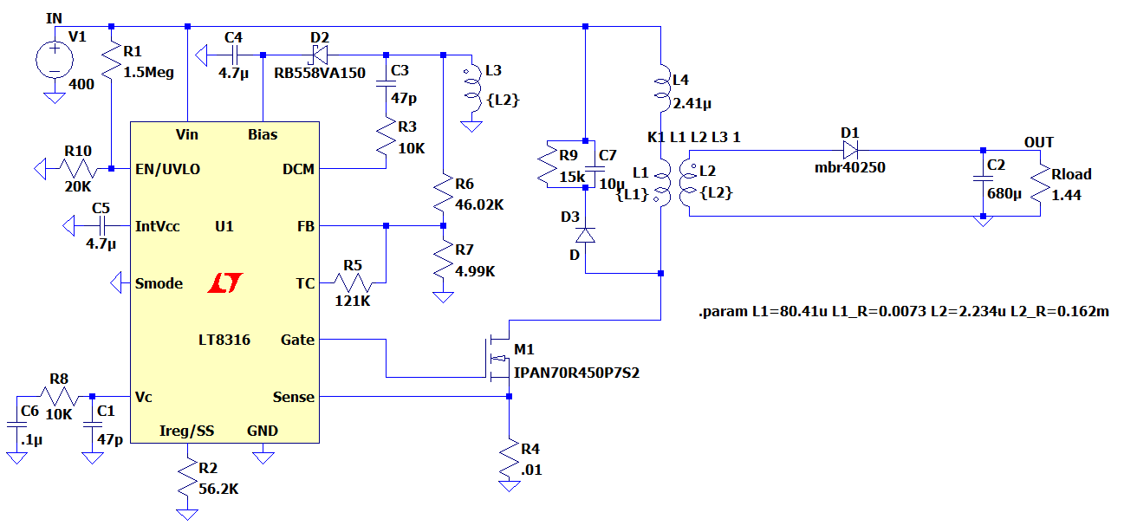
Controller
Parameter | Value - Description
V_{in} | 16V – 600V
F_{SW(Min)} | 3 kHz
F_{SW(Max)} | 140 kHz
Operating Junction Temperature | -40 – 125ºC
Price | $2.18 (1000+ order)

Slide 18
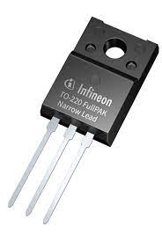
Mosfet (IPAN70R450P7S)
Parameter | Value - Description
V_{DS} , Breakdown voltage | 700V
I_{D}, Continuous current | 10A at T_{C} =20 ºC
I_{D,pulse} Pulsed Drain current | 25.9 A
R_{DS,ON} | 450mΩ
Q_{g} | 13.1nC
Price | $1.05

Slide 19
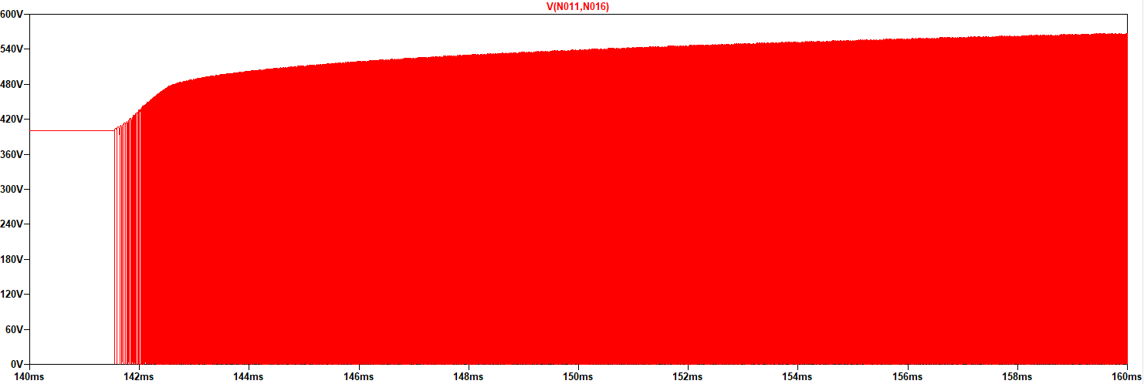
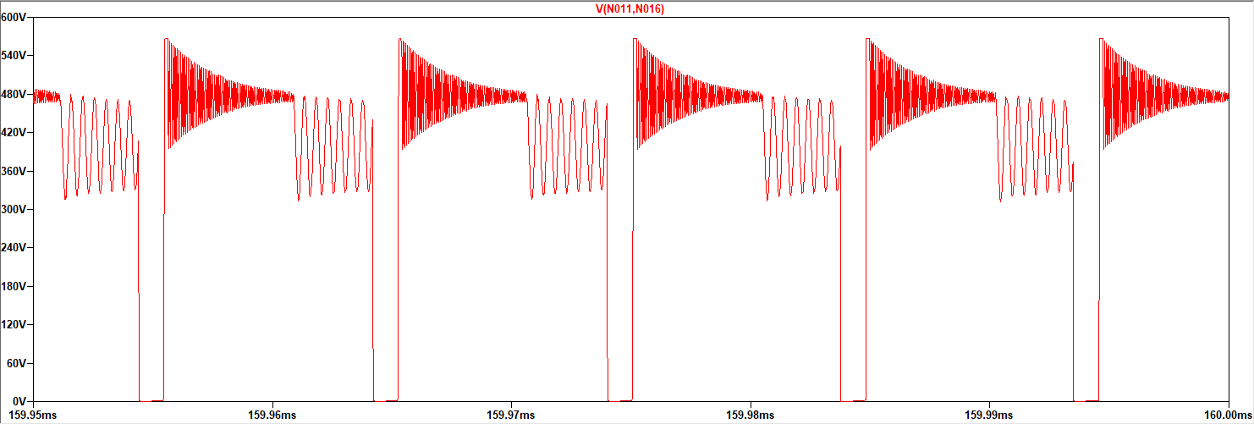
Mosfet Voltage Waveform

Slide 20
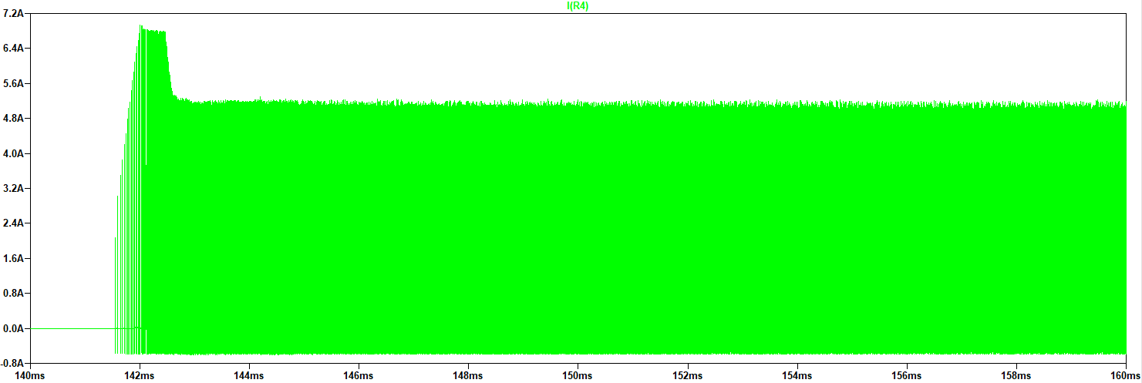
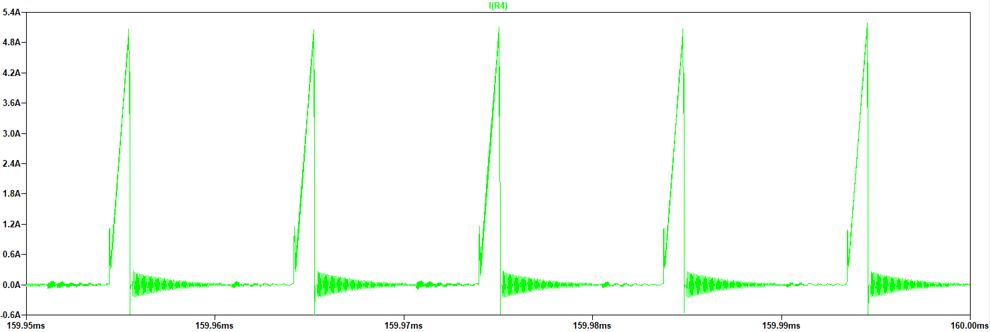
Mosfet Current Waveform

Slide 21
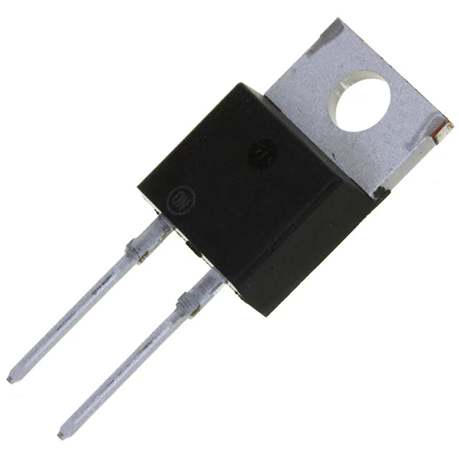
Diode(MBR40250G)
Parameter | Value - Description
V_{R} , Blocking voltage | 250V
I_{RMS}, Continuous current | 40A
I_{FRM}, Peak Repetitive Forward Current | 80A
V_{F} | 0.86V
Price | $1.82000

Slide 22
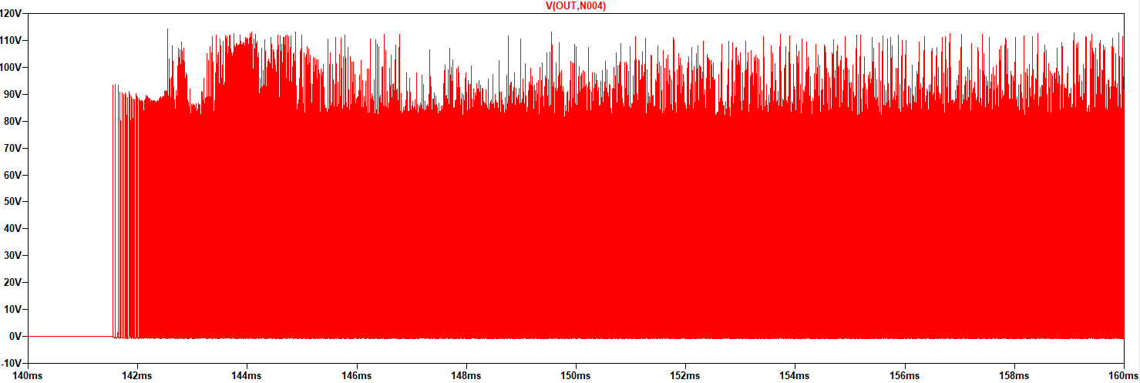
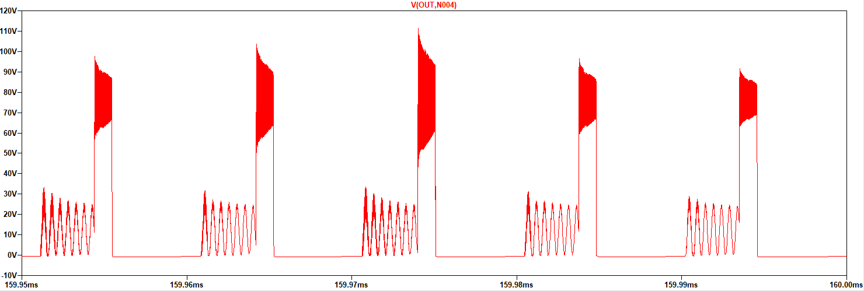
Diode Voltage Waveform

Slide 23
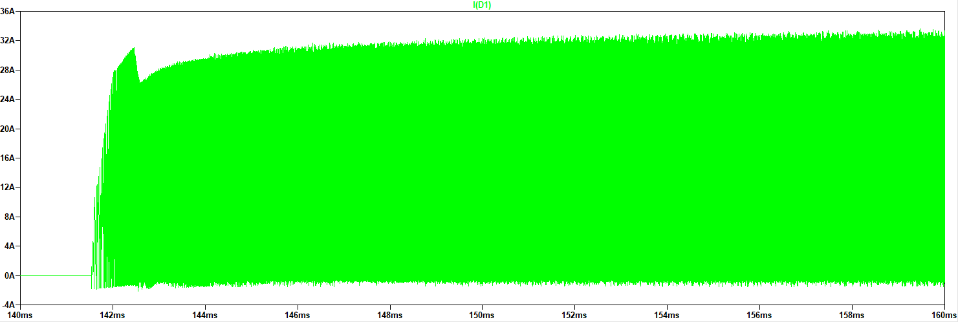
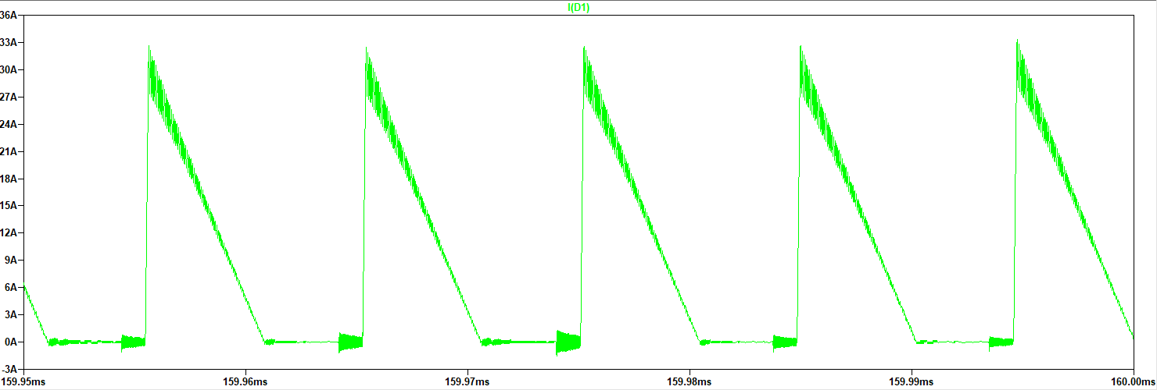
Diode Current Waveform

Slide 24
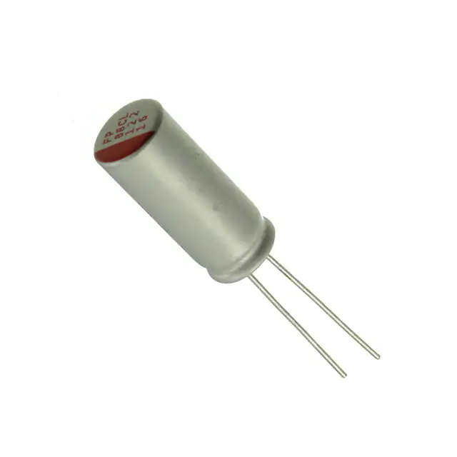
Output Capacitor(RNL1C681MDS1)
Parameter | Value - Description
C, Capacitance | 680 uF
V_{C,MAX} Rating | 25V
I_{C,ripple} | 7A
ESR | 8mΩ
Price | 1.50$

Slide 25
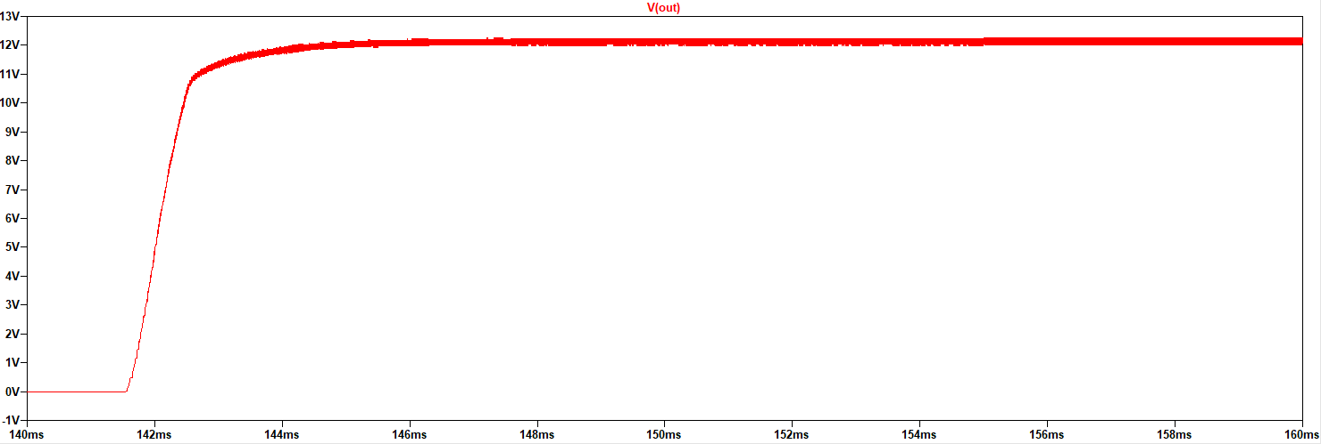
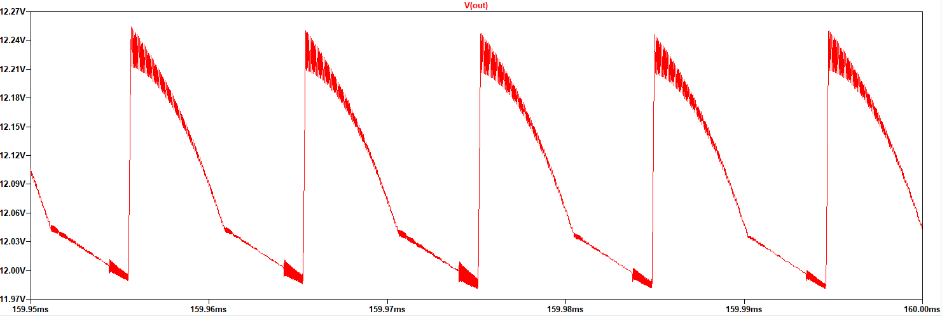
Output Voltage Waveform

Slide 26
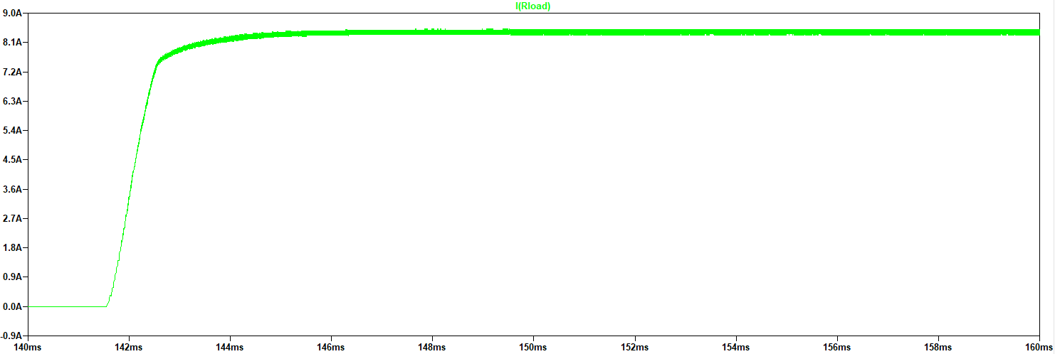
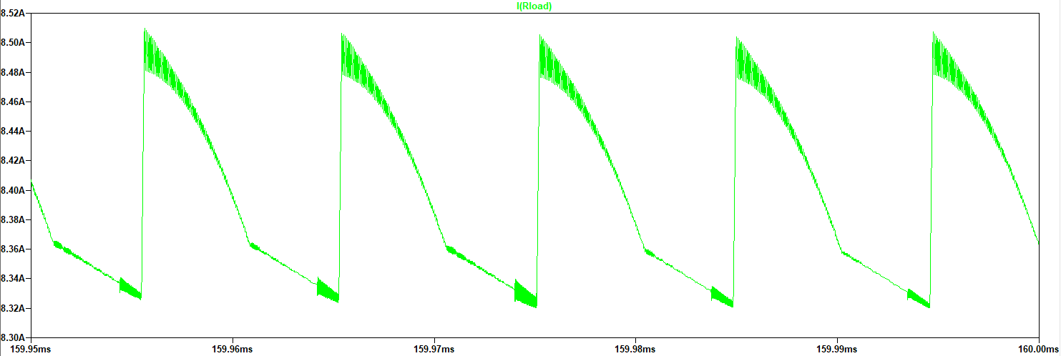
Output Current Waveform

Slide 27
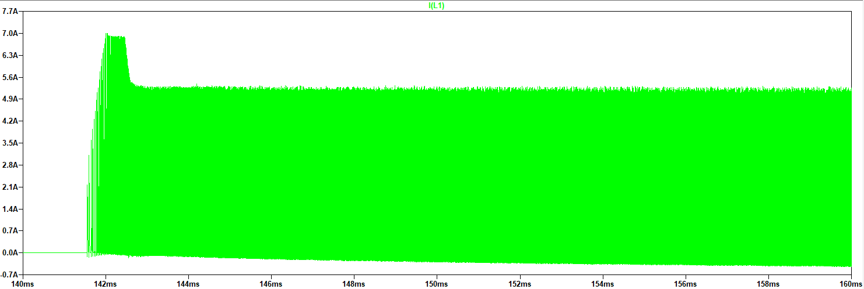
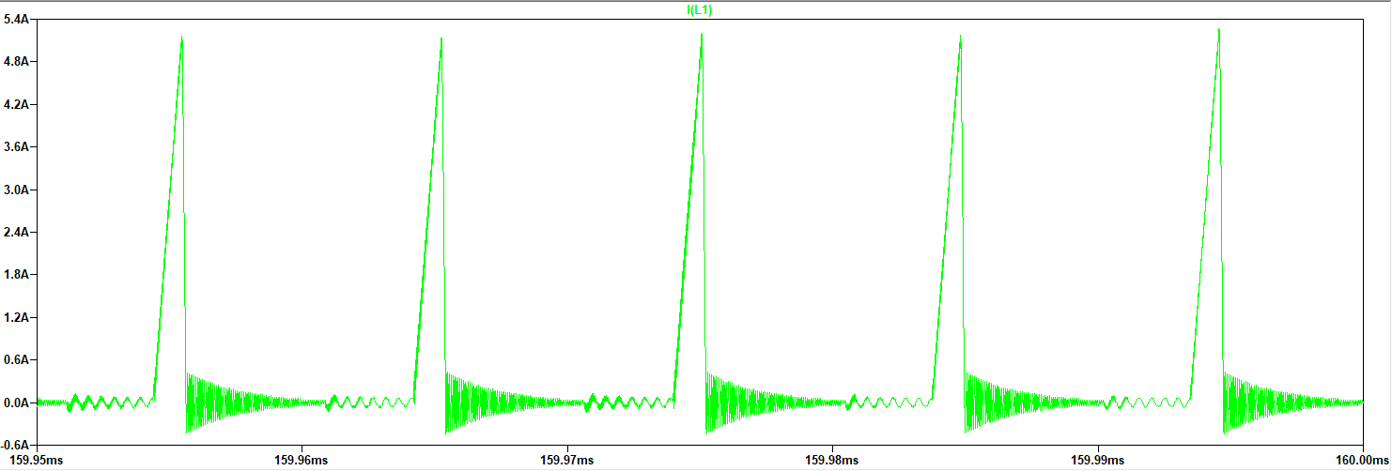
Primary Inductor Current Waveform

