Slide 1
NoSQL Databases
Non-Relational Databases

Slide 2
HBASE –> Hadoop Üzerinde çalışan NoSQL Database
Paralel Processing
On
BigData
Hadoop
NoSQL
RDBMS
UnStructured
Structured
Semi-Structured
Processing
Semi-Structured
Structured
No-relational
Structured
Relational

Slide 3
Write, Write ,Update , Delete
Write Once ,Read Multiple Times. --> NoSQL

Slide 4
Vertical scaling ( Scaling In,Up ) – Better Machines
Horizontal scaling ( Scaling out) – More Machines

Slide 5
Relational –Constraints - Data Integrity
Non-Relational – No Constraints – No Integrity

Slide 6
Types of NoSQL
Key-Value Stores (Redis) for Simple Data
Document Based (MongoDB, CouchDB,ElasticSearch) for More Complex Data
Column Based (Cassandra)
Graph Databses (Neo4j)

Slide 7
How It Works
Keys – Hash - Partition

Slide 8
When ? Examples
Hadoop → Sensor Data
MongoDB → Write Once, Read Many

Slide 9
Example
Courses
Exams
Questions
Answers

Slide 10
Basic / Intermediate SQL
Basics
Select, From , Where,
Limit, Order by, Asc, Desc ,
Like, In, Between And, Or
Intermediate
Aggragate Functions (Count, Sum, Avg, Min, Max)
Group By ,Having
Case When Then Else
Joins ( Inner, Outer, Left ,Right)
Union

Slide 11
Advanced SQL
Change Column Type
String Operations ( Left ,Right , Length , Trim , Position, StrPos ,SubStr, Concat, Upper, Lower)
Extract, Date_Trunc
Coalesce (replace null values)
Subqueries
Conditions
Window Functions
Row_number, Rank,Dense_Rank, Ntitle
Lag, Lead

Slide 12
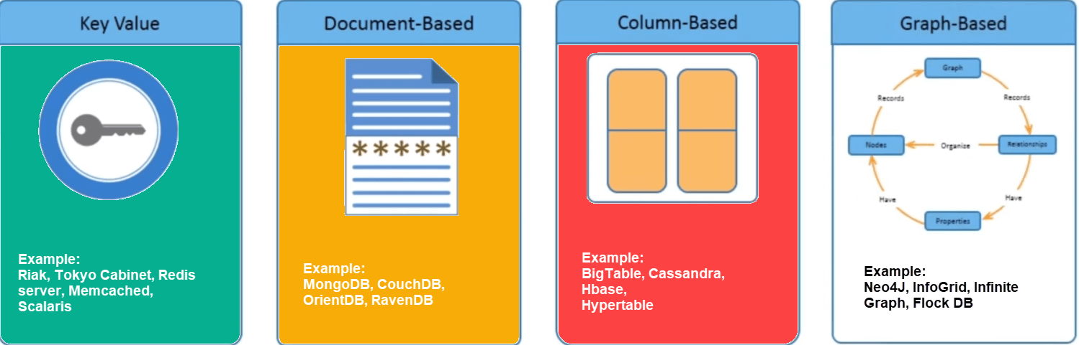

Slide 13
Bina
Bina
Bina
Bina
Bina
Bina
Bina
Horizontal Scaling
( Scale Out)
No-SQL Database lerin en avantajlı olduğu konu
Vertical Scaling
(Scale up, In)
SQL Database Problemi

Slide 14
Row Based Database
ID
ürünad
Tipi
fiyat
stok
ID
ürünad
Tipi
fiyat
stok

Slide 15
Column Based Database
ID
ID
ürünad
ürünad
Tipi
Tipi
fiyat
fiyat
stok
stok

Slide 16
Key-Valu Based
Document Based
Column Based
Key
Value
cassandra231
cassandra233
abc1231
Ahmet
mongo12313
Ahmet
Demirelli
Öğretim Görevlsisi
Ahmet
Demirelli
Öğretim Görevlisi
abc324234
Demirelli
Mehmet
Alioğlu
CTO
def324234
Öğretim Görevlisi
abc1231
Mehmet
mongo12312
Mehmet
Alioğlu
CTO
abc324234
Alioğlu
def324234
CTO

Slide 17
hash
34.3
Ahmet
Demirelli
Öğretim Görevlsisi
0-25
NoSQL DB 1
hash
55.8
Mehmet
Alioğlu
CTO
NoSQL DB 2
25-50
NoSQL DB 3
50-75
NoSQL DB 3
75-100

Slide 18




Master
Slave
Slave
hash
34.3
Ahmet
Demirelli
Öğretim Görevlsisi
https://blog.kloia.com/distributed-computing-in-microservices-cap-theorem-253c16017a99

Slide 19
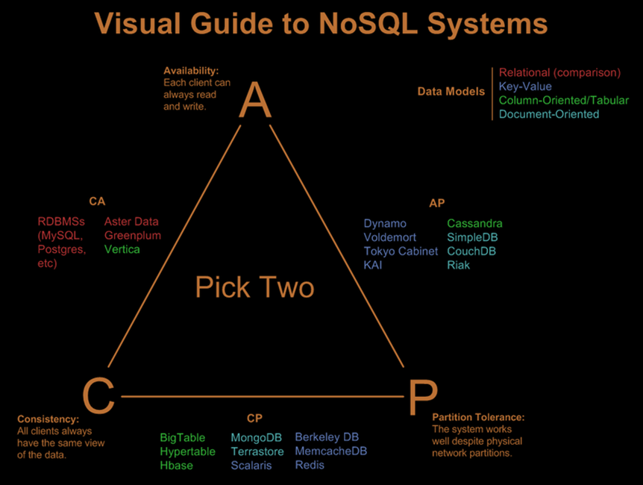
https://blog.kloia.com/distributed-computing-in-microservices-cap-theorem-253c16017a99

