Slide 1
Function
Input
Output
F(x,y) = 2*x + 3*y + 5
?
F(istanbul,3,1)
8
F(1,0)
?
7
F(1,1)
?
10

Slide 2

Function
Input
Output
F(x,y) = ???
F(0,1)
8
F(1,0)
7
F(1,1)
10
F(x,y) = ax + by + c
Calculating Function
b + c = 8
a + c = 7
Yerine koyma
a + b + c = 10
F(5,5) = ??
30
Calculated Function
a = 2
c = 5
b = 3
F(x,y) = 2x + 3 y + 5

Slide 3

Model
Feature
Label
F(x,y) = ???
F(2,0,1)
8
F(0,1,0)
7
F(1,1,1)
10
F(x,y) = ax + by + c
Model Training
b + c = 8
a + c = 7
Prediction
a + b + c = 10
F(5,5) = ??
30
Model
a = 2
c = 5
b = 3
F(x,y) = 2x + 3 y + 5

Slide 4


F(x) = ?
Linear Function
F(x) = ax + b
y = F(x) = 2x+2
Iteration
RMSE
85
Iteration
RMSE
65
Iteration
RMSE
60
40
48
Y = 0.1 x + 0.1
Linear Regression

Slide 5
Model (Function)
Features (Evin Özellikleri)
Lablel (Ev Fiyatı)
F(x,y) = ???
F(3,1,180,5)
450.000
F(2,1,110,10)
330.000
F(3,1,200,0)
600.000
F(3,1,170,0)
800.000
F(oda,salon,alan,yas) = ?? (a * oda + b * salon + c * alan + d * yas + e)
Katsayılar ( coefficients ) = a, b,c,d
Sabit Sayı ( Intercept ) = e

Slide 6
70
30
8000
2000
Train Data
Test Data
80
20
F = ??
99

Slide 7
Artifial Intelligence
Machine Learning
Deep Learning
(ANN)

Slide 8
Machine Learning
Label Var mı?
Supervised Learning
UnSupervised Learning
Continous
Label Tipi
Categorical
Regression
Classification
Clustering
Örnek : Ev Fiyat Tahmini
Örnek : Kredi Verelim mi ?
Örnek : Müşteri Segmentasyonu

Slide 9
Big Data
Storage
Processing
Hadoop
Spark
+

Slide 10
sayilar
sayilarRDD
sc.parallelize(liste)
12
12
43
43
3
3
2
2
51
42
51
59
rdd.collect()
42
14
59
14
Python List
RDD

Slide 11

For döngüsü
CPU
sayilar
12
Core 1
Core 2
43
3
2
51
Core 3
Core 4
42
59
14

Slide 12







SIMD
x : x* x
CPU
12
43
x : x* x
Core 1
Core 2
3
2
51
x : x* x
Core 3
Core 4
42
Lambda
59
14
x : x* x
RDD

Slide 13
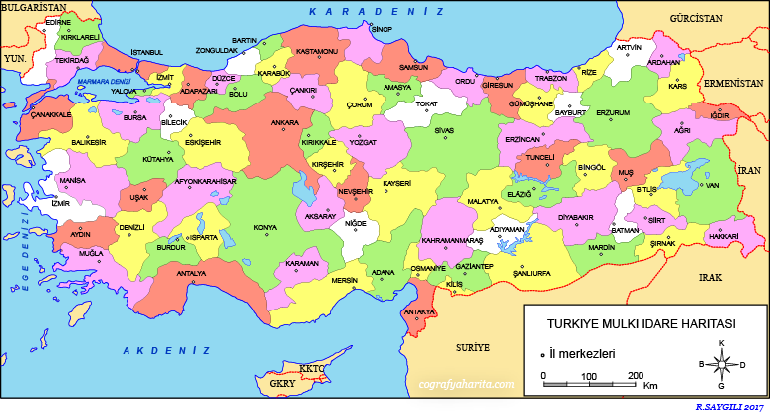





26
31
36
41
46
42
39
36

Slide 14
ReduceByKey ( x+y)
(Ahmet,1)
(Ali,1)
(Zeynep,1)
(Ali,1)
(Ahmet,1)
(Ali, 2)
(Zeynep,1)
Ahmet,1
Ahmet,1,
Ali,2
Ali,1
Ali,1
Ali,1
Ahmet,2
Ali,2
Ahmet,2
(Mehmet,1)
(Ali,1)
(Zeynep,1)
(Mehmet,1)
(Mehmet,2)
(Ali,1)
(Zeynep,1)
Ali,2
Ali,3
Ali,3
(Zeynep,1)
(Ali,1)
(Zeynep,1)
(Zeynep,1)
(Zeynep,3)
(Ali,1)
(Mehmet,2)
(Mehmet,2)
(Zeynep,1)
(Zeynep,1)
(Zeynep,3)
Mehmet,4
Mehmet,4
(Mehmet,2)
(Ali,1)
(Ahmet,1)
(Mehmet,1)
(Ali,1)
(Mehmet,1)
(Ahmet,1)
Zeynep,5
Zeynep,5

Slide 15

lambda x,y : x+y
1
x
3
2
y
X+y
x
10
10
x
21
3
x
7
11
4
y
y
y
45
5
x
11
11
6
y
24
7
x
15
24
8
y
9
9
İşlem Paralel olduğu için Toplam 3 veya 4 sanyede biter

Slide 16




Toplam = 0
1
2
3
6
3
4
10
5
15
6
21
7
28
8
36
9
45
Eğer bir toplama 1 saaniye sürerse
For ile döngü yaparsak
Toplam 9 saniye sürer

Slide 17
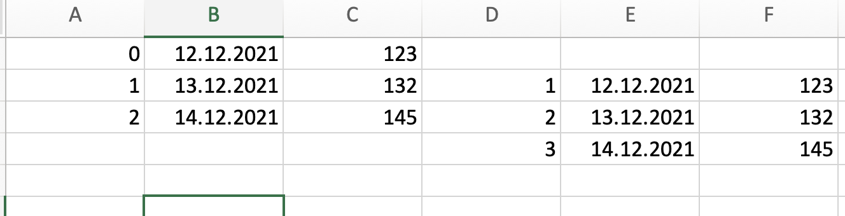

Slide 18
Iris dataset
Model
Bu model ne kadar başarılı ?

Slide 19
70-80%
20-30%
Train dataset
Test
Dataset
Model

