Slide 1

NGS Data Processing and Analysis
BLG348E TERM PROJECT
Büşra Özdemir, 150200036 Aslı Yel, 150200054

Slide 2
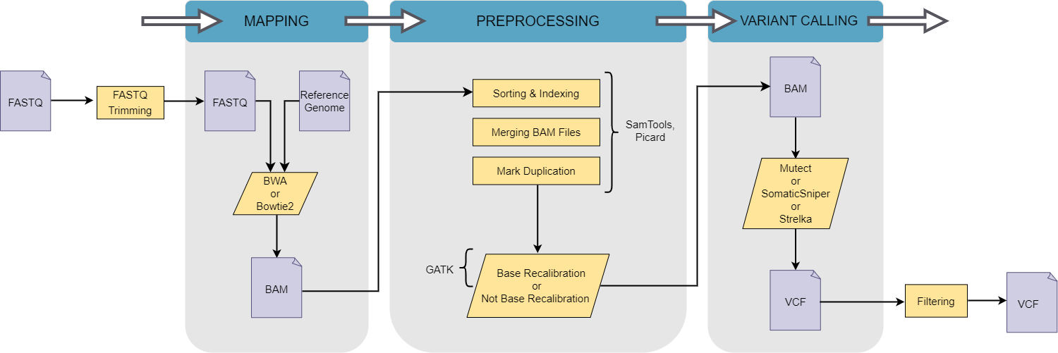
Pipeline Structure

Slide 3
Principle Component Analysis (PCA)

Slide 4
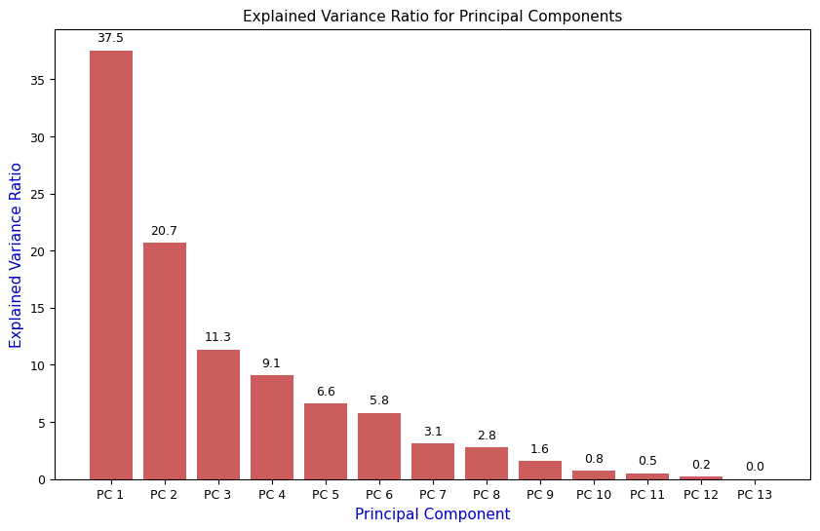
Principle Component Analysis (PCA)
For an n-dimensional dataset, n principal components can be obtained and PCA aims to compress the maximum information into the first component, followed by the maximum remaining information in the second component, and so forth. For the case, n is 13 and the scree plot that shows explained variability by each principal component is shown in charts. In order to visualize the data, a scatter plot of the first and second principal components which carry the most of the variance in the original data is plotted as in next page.

Slide 5
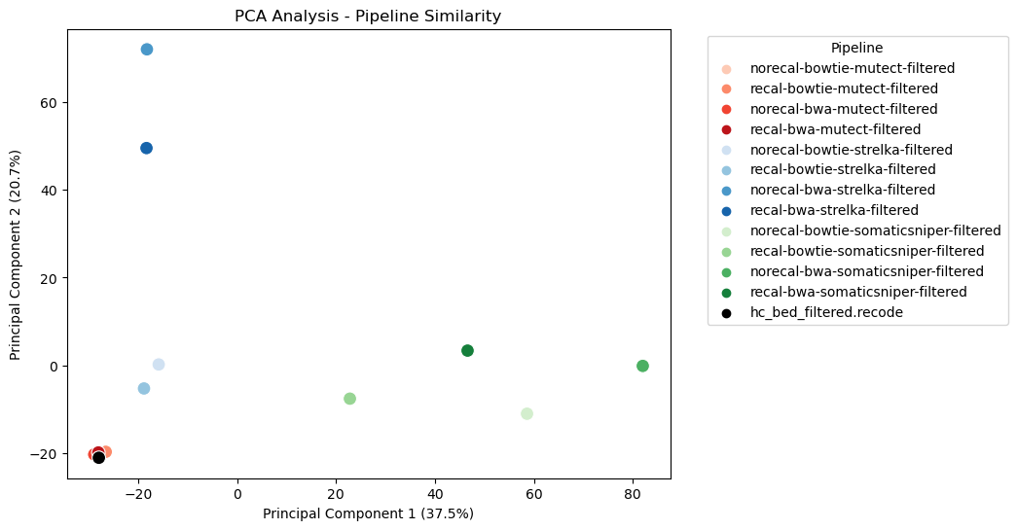
Principle Component Analysis (PCA)
Each point in this plot represents a variant list(12 for pipelines and one for ground truth). The closer the points are, the more similar the variant lists are, the plot indicates.
It can clearly be seen from graph that there is a clustering between the pipelines with same variant caller, indicating pipelines with same variant caller shows similarity. This demonstrates that the effect of the variant caller choice on the result is considerably higher than the choices for mapper and base recalibration.
The data frame constructed on which PCA is applied consists of information about not only pipelines to be tested but also ground truth variant list(hc bed filtered.vcf). Therefore, there are 13 data points on the scatter plot, instead of 12. This allows one to see the similarity of each pipeline’s variant list with ground truth list. When the chart is examined in this sense, it is easily noticed that Mutect gives the most proper results independent of the other parameters like mapper and base calibration.

Slide 6
Heatmap and Clustering

Slide 7
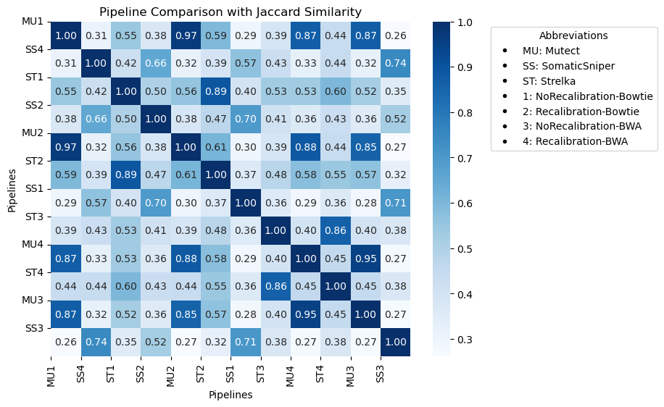
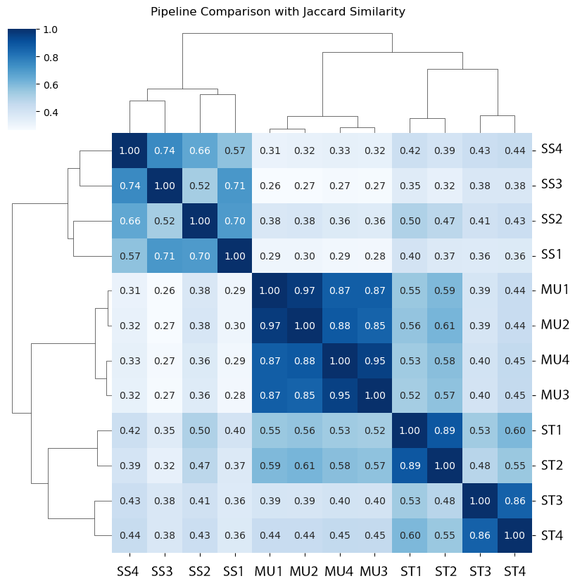
Similarity Matrix
Comparing the pipelines in terms of the similarity matrix heatmap provided in charts, one can observe the similarity between the different pipeline configurations based on the variants detected. The heatmap shows the Jaccard similarity score between the pipelines, with darker colors indicating higher similarity.

Slide 8
Similarity Matrix
The symmetry observed in the heatmap is a result of the construction of the Jaccard similarity matrix before generating the heatmap. The Jaccard similarity matrix is symmetric by definition because the Jaccard similarity between pipeline A and pipeline B is the same as the similarity between pipeline B and pipeline.

Slide 9
Similarity Matrix
Also, the diagonal represents the self-similarity of each pipeline, meaning each pipeline is compared with itself. As a result, the diagonal values are all equal to 1, indicating a perfect match when a pipeline is compared to itself. This is a natural outcome of the Jaccard similarity metric, where the intersection of a set with itself is the set itself, leading to a similarity score of 1.

Slide 10
Similarity Matrix
1. The pipelines "Norecal-Bowtie-Mutect" and "Recal-Bowtie-Mutect" are the most similar, with a similarity score of 0.97. This indicates that these pipelines detected a similar set of variants.
2. The pipelines "Norecal-Bwa-Mutect" and "Recal-Bwa-Mutect" are also highly similar, with a similarity score of 0.95. This suggests that these pipelines detected a similar set of variants.

Slide 11
Similarity Matrix
3. The pipelines "Norecal-Bowtie-Strelka" and "Recal-Bowtie-Strelka" are similar, with a similarity score of 0.89. This indicates that these pipelines detected a similar set of variants.
4. The pipelines "Norecal-Bwa-SomaticSniper" and "Recal-Bwa-SmoticSniper" are also similar, with a similarity score of 0.74. This suggests that these pipelines detected a similar set of variants.
5. The pipelines "Norecal-Bwa-SomaticSniper" and "Norecal-Bowtie-Mutect" are the least similar, with a similarity score of 0.26. This indicates that these pipelines detected a different set of variants.

Slide 12
Similarity Matrix
Overall, the similarity matrix heatmap highlights the importance of selecting the appropriate pipeline configuration based on the specific research question and dataset. It also suggests that the choice of mapper and variant caller has a greater impact on the similarity of the detected variants than the choice of base recalibration.

Slide 13
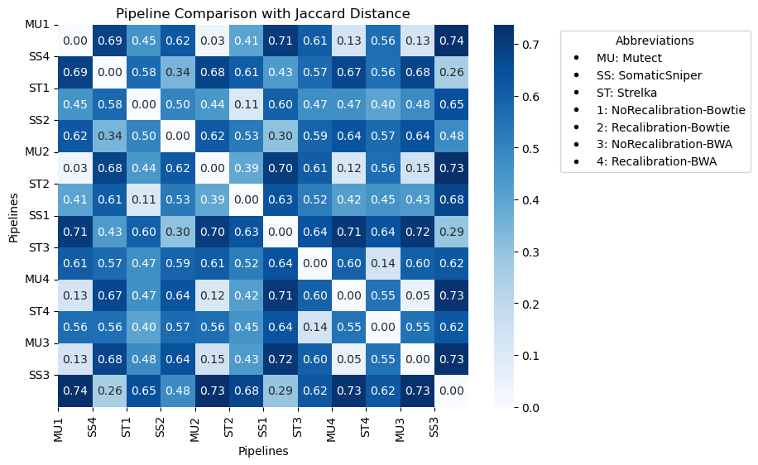
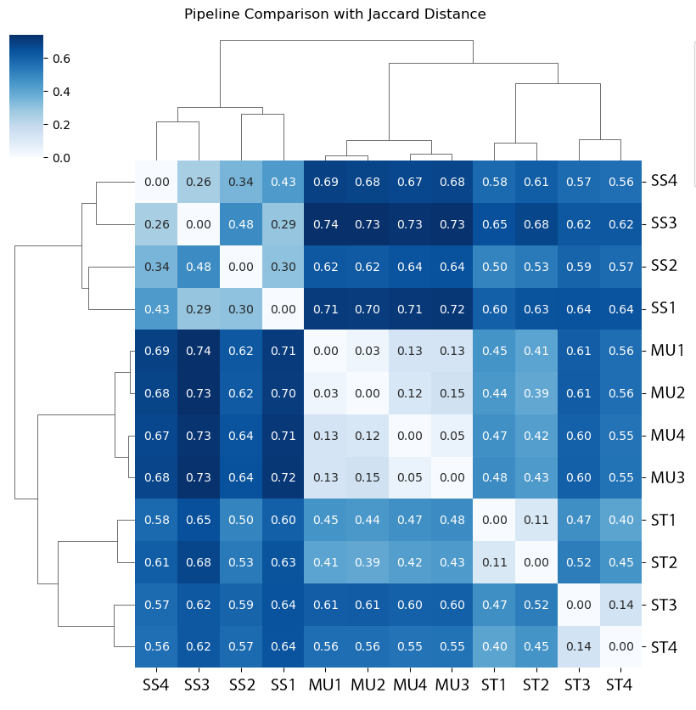
Distance Matrix
Comparing the pipelines in terms of the distance matrix heatmap provided in charts, one can observe the distance between the different pipeline configurations based on the variants detected. The darker the color, the higher the distance between the pipelines.

Slide 14
Distance Matrix
Based on the heatmap, the following observations can be made:
1. The pipelines "Norecal-Bowtie-Mutect" and "Recal-Bwa-Strelka" are the closest, with a distance score of 0.03, indicating that these pipelines detected a similar set of variants.
2. The pipelines "Norecal-Bwa-Mutect" and "Recal-Bwa-Mutect" are also very close, with a distance score of 0.05, indicating that these pipelines detected a similar set of variants.

Slide 15
Distance Matrix
3. The pipelines "Norecal-Bowtie-Strelka" and "Recal-Bowtie-Strelka" are also very close, with a distance score of 0.11, indicating that these pipelines detected a similar set of variants.
4. The pipelines "Norecal-Bwa-SomaticSniper" and "Recal-Bwa-SmoticSniper" are close, with a distance score of 0.26, indicating that these pipelines detected a similar set of variants
5. The pipelines "Norecal-Bwa-SomaticSniper" and "Norecal-Bowtie-Mutect" are the furthest apart, with a distance score of 0.74, indicating that these pipelines detected a different set of variants.

Slide 16
Distance Matrix
Overall, the distance matrix heatmap suggests that the choice of mapper and variant caller has a greater impact on the similarity of the detected variants than the choice of base recalibration. The heatmap also highlights the importance of selecting the appropriate pipeline configuration based on the specific research question and dataset.

Slide 17
Accuracy-Presicion-Recall-F1 Metrics
True Positive (TP): It is a variant that was detected by the pipeline configured and is one that exists in the high-confidence list of variants.
False Positive (FP): It is a variant that was detected by the pipeline configured but is one that does not exist in the high-confidence list of variants.
True Negative (TN): It is a variant that was not detected by the pipeline configured and is one that does not exist in the high confidence list of variants.
False Negative (FN): It is a variant that was not detected by the pipeline configured but is one that does exist in the high confidence list of variants.

Slide 18
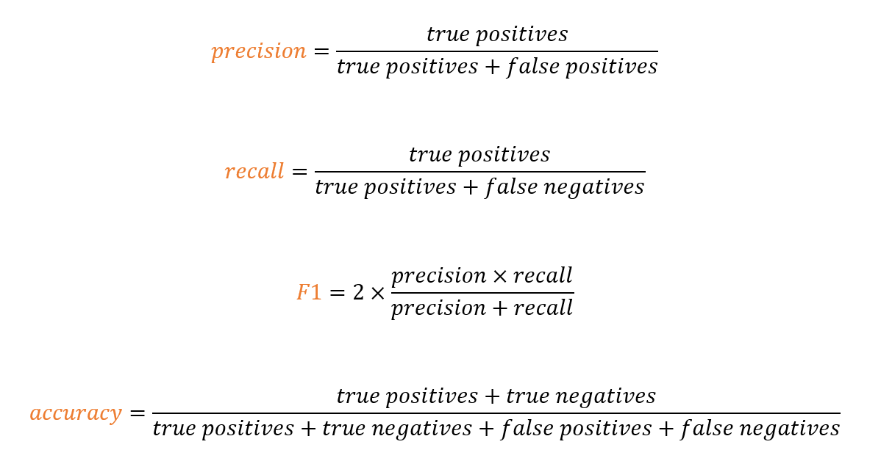
Accuracy-Presicion-Recall-F1 Metrics
Precision: Indicates the proportion of true positive predictions out of all positive predictions. It measures the accuracy of the positive predictions.
Recall: Represents the proportion of true positive predictions out of all actual positives. It measures the ability of the model to identify all relevant instances.
F1 Score: The harmonic mean of precision and recall, provides a balance between the two metrics.
Accuracy: Measures the overall correctness of the predictions.

Slide 19
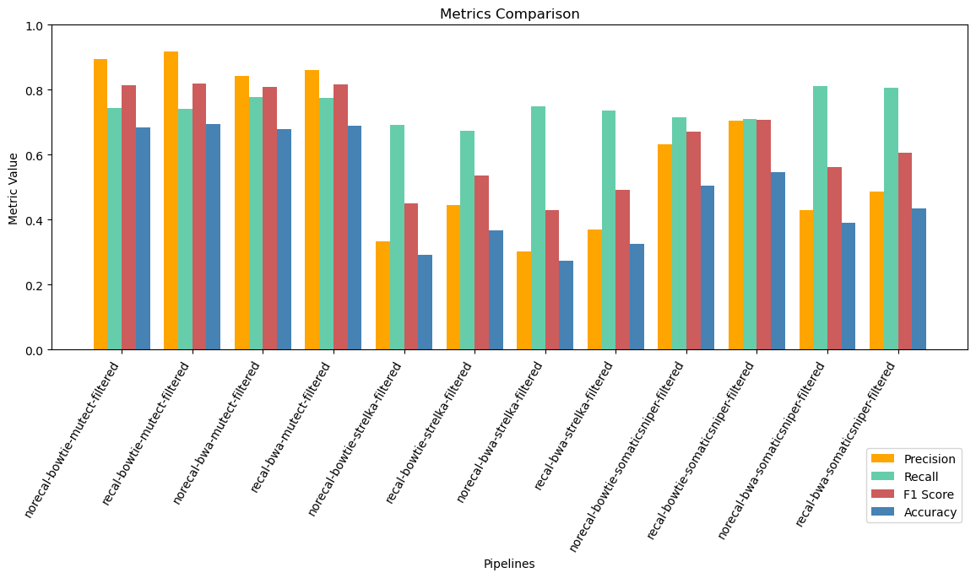
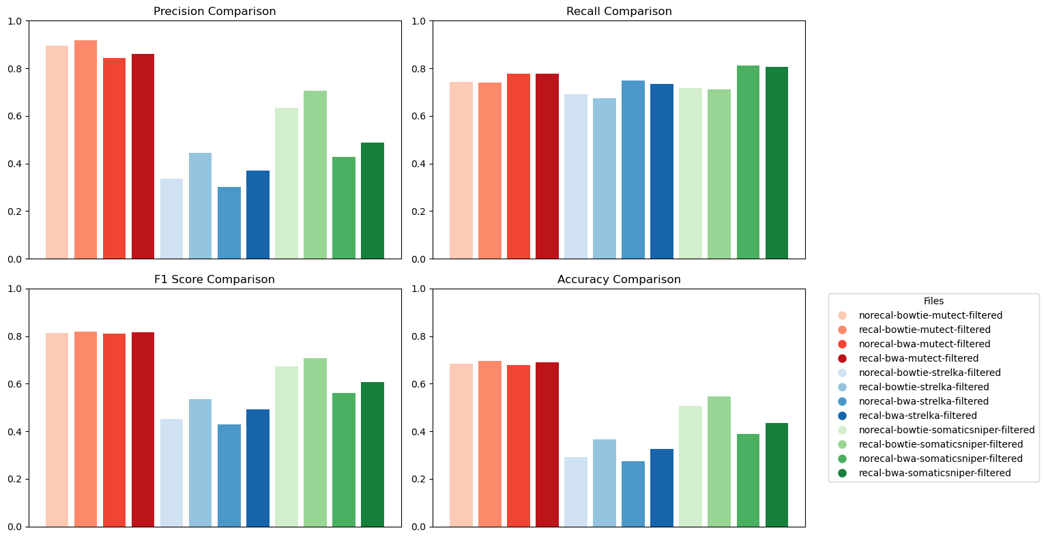
Accuracy-Presicion-Recall-F1 Metrics
Comparing the pipelines in terms of metrics such as precision, recall, accuracy, and F1 score, the following observationscan be made:
1. Precision: • The pipeline ”Recal-Bowtie Mutect” achieved the highest precision of 0.92, followed closely by ”Norecal-Bowtie- Mutect” with a precision of 0.89. These pipelines demonstrated the highest precision among all the configurations tested. • The pipeline ”Norecal-Bwa SomaticSniper” had the lowest precision of 0.30, indicating a higher rate of false positives in variant calling.
2. Recall: • The pipelines ”Norecal-Bwa-Strelka” and ”Recal-Bwa- Strelka” achieved the highest recall of 0.81, followed closely by ”Norecal-Bwa SomaticSniper” with a precision of 0.75, indicating a lower rate of false negatives in variant calling. • The pipeline ”Recal-Bowtie-SomaticSniper” had the lowest recall of 0.67, suggesting a higher rate of false negatives in variant calling.

Slide 20
Accuracy-Presicion-Recall-F1 Metrics
3. F1 Score: • The pipelines ”Recal-Bowtie-Mutect” and ”Recal-Bwa-Mutect” achieved the highest F1 score of 0.82, indicating a good balance between precision and recall. • The pipeline ”Norecal-Bwa-SomaticSniper” had the lowest F1 score of 0.43, indicating a lower balance between precision and recall.
4. Accuracy: • The pipelines ”Recal-Bowtie-Mutect” and ”Recal Bwa-Mutect” achieved the highest accuracy of 0.69, followed closely by ”Norecal-Bowtie-Mutect” and ”Norecal-Bwa- Mutect” with accuracies of 0.68 and 0.67, respectively. • The pipeline ”Norecal-Bwa-SomaticSniper” had the lowest accuracy of 0.27, indicating lower overall correctness in variant calling.

Slide 21
Accuracy-Presicion-Recall-F1 Metrics
These comparisons highlight the varying performance of the pipelines in terms of precision, recall, F1 score, and accuracy, emphasizing the importance of selecting the appropriate pipeline configuration for NGS data analysis.

Slide 22
Execution Times

Slide 23
Execution Times
Bowtie mapper for normal: 535 minutes Bowtie mapper for tumor: 439 minutes
BWA mapper for normal: 410 minutes BWA mapper for tumor: 382 minutes
Mark Duplication after BWA mapper: 430 minutes Mark Duplication after Bowtie mapper: 439 minutes
(After NoRecalibration and Bowtie mapper) SomaticSniper variant caller: 20 minutes Strelka variant caller: 17.5 minutes Mutect variant caller: 27 minutes, 30 minutes
(After Recalibration and Bowtie mapper) SomaticSniper variant caller: 16 minutes Strelka variant caller: 13.5 minutes Mutect variant caller: 42 minutes
(After NoRecalibration and BWA mapper) SomaticSniper variant caller: 14 minutes Strelka variant caller: 13.5 minutes Mutect variant caller: 49 minutes
(After Recalibration and BWA mapper) SomaticSniper variant caller: 17 minutes Strelka variant caller: 15 minutes Mutect variant caller: 31 minutes
BWA mapper tooks less time than Bowtie mapper.
Both BWA and Bowtie aligns normal sample in a longer time than tumor sample.
Mark Duplication is performed in approximately the same time both after BWA and Bowtie.
Independent of the Base Calibration and Mapper choices, the execution time of variant callers have an descending order for Mutect, SomaticSniper and Strelka respectively.

