Slide 1
The Great Umbraco Search Shake-Up
Examine, Algolia and Azure AI Search compared
Umbraco UK Festival · 16 October 2026

Slide 2



About me
Busra Sengul
Senior developer, true digital
LinkedIn
GitHub

Slide 3
Should you stay on Examine, or move?

Slide 4
Seventeen years of Examine
2009
Around 2010
2021
August 2026
Today
Examine created by Shannon Deminick
Standard search from Umbraco 4.5
Examine 2: modern .NET and Lucene.NET 4.8, for Umbraco 9
Examine 4: faceting built in
The default provider in Umbraco Search
23 million+
17 years
downloads of Examine on NuGet
of active development, still maintained by Shannon
Why this matters

Slide 5
What Umbraco Search is
Examine
Umbraco Search
one standard way to ask
Your website code
asks for text, filters, facets and a sort order
Algolia
Azure AI Search
Anything else you build
Add-on for Umbraco 17 and 18 today
Planned for the core of Umbraco 19, due 10 December 2026
Examine stays the default
Why this matters

Slide 6
A provider is just two pieces
Indexer
Searcher
writes content into the index · 4 jobs
answers searches · 1 job
1 Add or update a document
2 Delete documents
3 Reset: empty the index
4 Report: document count, health, provider
1 Search
One method receives the text, filters, facets, sort order, language and paging
Index name → indexer + searcher. That's the whole contract.
Why this matters

Slide 7
The whole contract, in code
Umbraco.Cms.Search.Core 17.2.0
C#
1
Indexer: four methods
1
2
3
4
5
6
7
8
9
10
11
12
13
14
15
16
17
public interface IIndexer
{
Task AddOrUpdateAsync(string indexAlias, Guid id,
UmbracoObjectTypes objectType, IEnumerable<Variation> variations,
IEnumerable<IndexField> fields, ContentProtection? protection);
Task DeleteAsync(string indexAlias, IEnumerable<Guid> ids);
Task ResetAsync(string indexAlias);
Task<IndexMetadata> GetMetadataAsync(string indexAlias);
}
public interface ISearcher
{
Task<SearchResult> SearchAsync(string indexAlias, string? query,
IEnumerable<Filter>? filters, IEnumerable<Facet>? facets,
IEnumerable<Sorter>? sorters, string? culture, string? segment,
AccessContext? accessContext, int skip, int take,
int maxSuggestions);
}
Add or update, delete, reset, and report how the index is doing.
1
2
Searcher: one method
Text, filters, facets, sorting, language, access and paging, all in one call.
2
Signatures as implemented by the demo's Azure provider; parameter defaults left out
Why this matters

Slide 8
Asking a question: your website code
ShowdownSearchService.cs
C#
1
Ask by index name
1
2
3
4
5
6
7
8
9
10
11
12
13
14
ISearcher searcher = _searcherResolver
.GetRequiredSearcher("Showdown_Algolia");
SearchResult result = await searcher.SearchAsync(
indexAlias: "Showdown_Algolia",
query: "chair",
filters: [new DecimalRangeFilter("price",
[new DecimalRangeFilterRange(50m, 200m)], false)],
facets: [new KeywordFacet("category"),
new IntegerExactFacet("rating")],
sorters: [new DecimalSorter("price", Direction.Ascending)],
culture: null, segment: null, accessContext: null,
skip: 0,
take: 12);
long total = result.Total;
1
The page never names an engine. Change the alias, change the engine.
2
Neutral filters and facets
2
A price range, a keyword facet. Each provider translates them.
3
Same answer shape
Total, documents and facet counts look the same from every provider.
3
Simplified from the demo's ShowdownSearchService.cs
Why this matters

Slide 9
Prepared once, shared with everyone
Content saved or published
Turned into search fields once
umbracoIndexDocument
database cache
Examine
Algolia
Azure AI Search
Demo database: 5,035 published rows and 5,072 draft rows
Only on Umbraco Search 17 or later. Rebuilding an index does not refresh this cache; re-publishing or clearing it does.
Why this matters

Slide 10
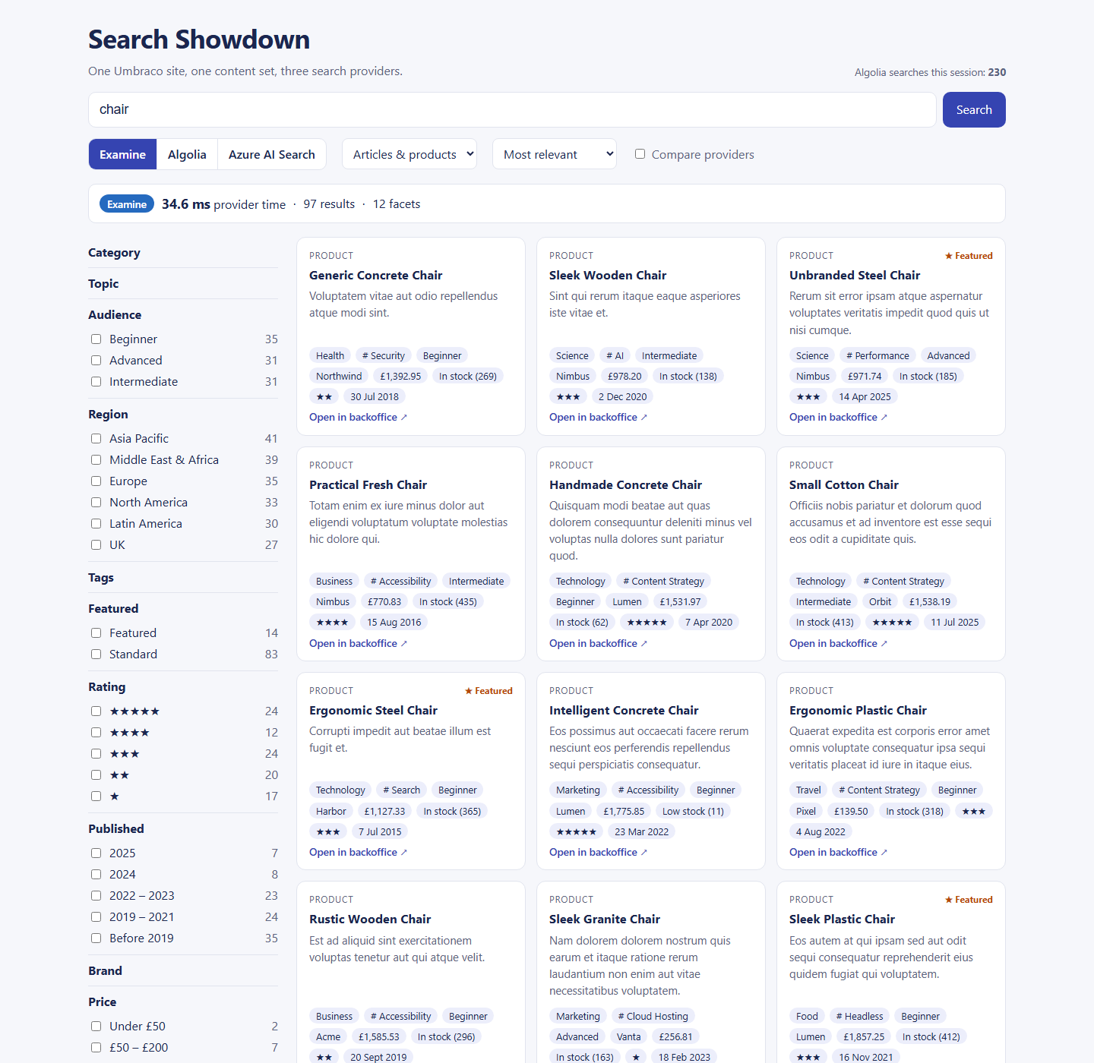
Meet the demo
5,000
16
items
fields
13
12
property editors
facets
5
3
sort options
providers
The demo and what it reveals

Slide 11
One search, three providers
What you'll see
1
Search for "chair" on Examine
2
Switch to Algolia, then Azure AI Search: same page, same code
DEMO 1
3
Tick "Compare providers" and read the times
4
Make a typo: "chiar"
localhost:22518/showdown?q=chair
▶ Recording if/when demo fails ☺
The demo and what it reveals

Slide 12
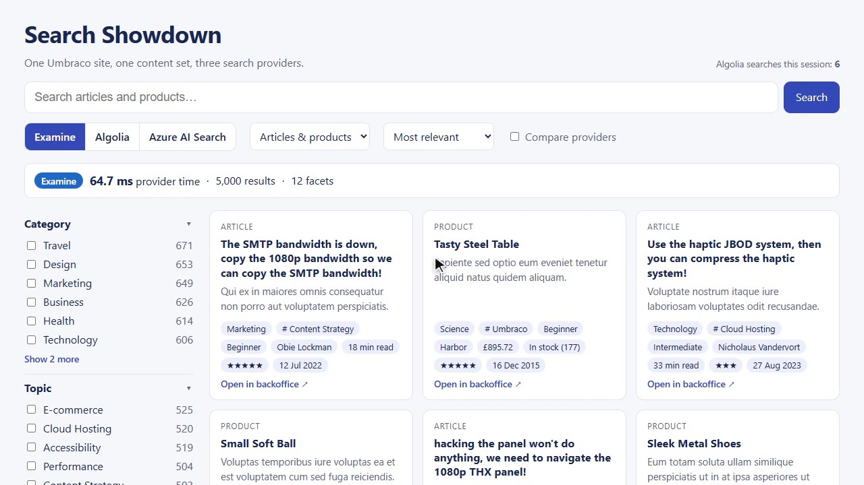
Backup: demo 1 recording

Slide 13
What we just saw
Same page, same code, three engines. "chair" gave 97, 101 and 98 results. Then the typo:
"chiar"
Examine
Algolia
Azure AI Search
0
101
97
results
results
results
Only two forgive the typo. That's extra work, so remember it when we compare speed.
The demo and what it reveals

Slide 14
The two-line swap
SiteComposer.cs
C#
1
Swap: one line
1
2
3
4
5
6
7
8
9
10
11
12
13
14
15
builder.AddSearchCore();
if (providers.Algolia)
builder.AddAlgoliaSearchProvider();
builder.AddExamineSearchProvider()
.AddDeliveryApiSearch()
.AddBackOfficeSearch();
builder.Services.Configure<IndexOptions>(options =>
{
options.RegisterContentIndex<IExamineIndexer,
IExamineSearcher, IPublishedContentChangeStrategy>(
"Showdown_Examine", UmbracoObjectTypes.Document);
options.RegisterAlgoliaContentIndex<
IPublishedContentChangeStrategy>("Showdown_Algolia", ...);
});
Use this line instead of the Examine one, and the whole site searches with Algolia.
1
2
2
The last one wins
Registered second, Examine takes the default indexes back, including backoffice search.
3
3
Side by side
Then each provider gets its own named index. The demo adds Azure the same way.
Simplified from the demo's SiteComposer.cs
The demo and what it reveals

Slide 15
Content modelling is now search modelling
Category and Brand started as Textstrings.
Their facets came back empty on every provider.
Changed to dropdowns: everything worked.
Out of the box, only keywords, numbers and dates can be facets.
Property editor | Becomes | Facet?
Textstring, Textarea, Rich text | Searchable text | No
Dropdown, Radio, Checkbox, Tags | Keywords | Yes
Content picker | Keyword: the picked page's key | Yes
True/false, Integer | Whole number | Yes
Decimal, Slider | Decimal number | Yes
Date picker | Date | Yes
The demo and what it reveals

Slide 16
Declare your fields
 | Examine | Algolia | Azure AI Search
What you declare | Fields to facet or sort on | Fields to facet, or filter on by text | The whole index structure
If you forget | Faceting on it fails | You can't facet on it | The upload is rejected
The demo and what it reveals

Slide 17
Declaring fields, in code
SiteComposer.cs
C#
1
Examine: facet and sort fields
1
2
3
4
5
6
7
8
9
10
11
12
13
14
builder.Services.Configure<FieldOptions>(options =>
options.Fields =
[
new() { PropertyName = "price",
FieldValues = FieldValues.Decimals,
Facetable = true, Sortable = true },
new() { PropertyName = "category",
FieldValues = FieldValues.Keywords,
Facetable = true },
// ...ten more
]);
builder.Services.Configure<AzureSearchFieldOptions>(options =>
options.Fields = ShowdownFields.ForAzure());
Forget one and that search fails with a configuration error.
1
2
Same list, Azure's format
One shared list in the demo, converted for each provider. Azure also needs the full index structure up front.
2
Simplified: the demo builds both lists from one ShowdownFields definition
The demo and what it reveals

Slide 18
Shopping: price ranges and sorting
What you'll see
1
Products only, priced £50 to £200
2
Sort by price, cheapest first
DEMO 2
3
Add "Published in 2024": the same 13 items everywhere
localhost:22518/showdown?compare=true
▶ Backup recording
The demo and what it reveals

Slide 19
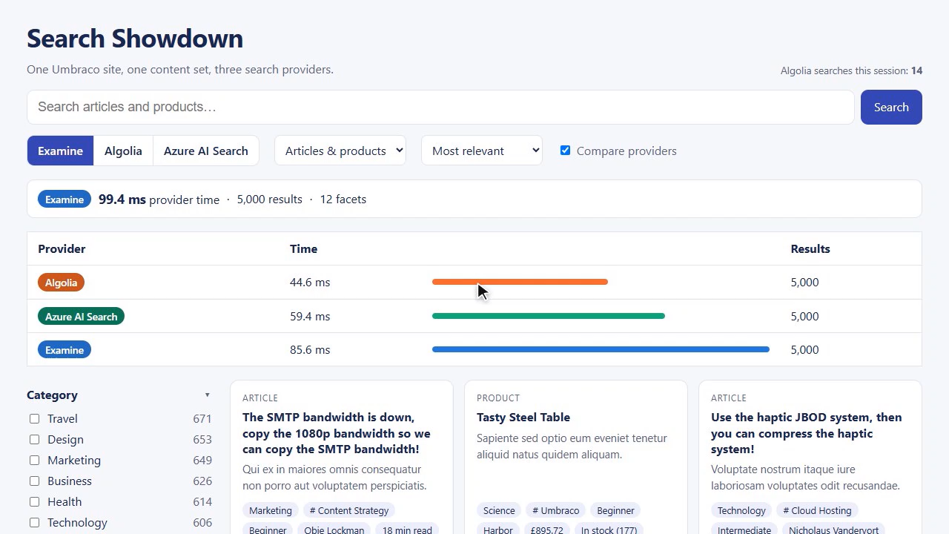
Backup: demo 2 recording

Slide 20
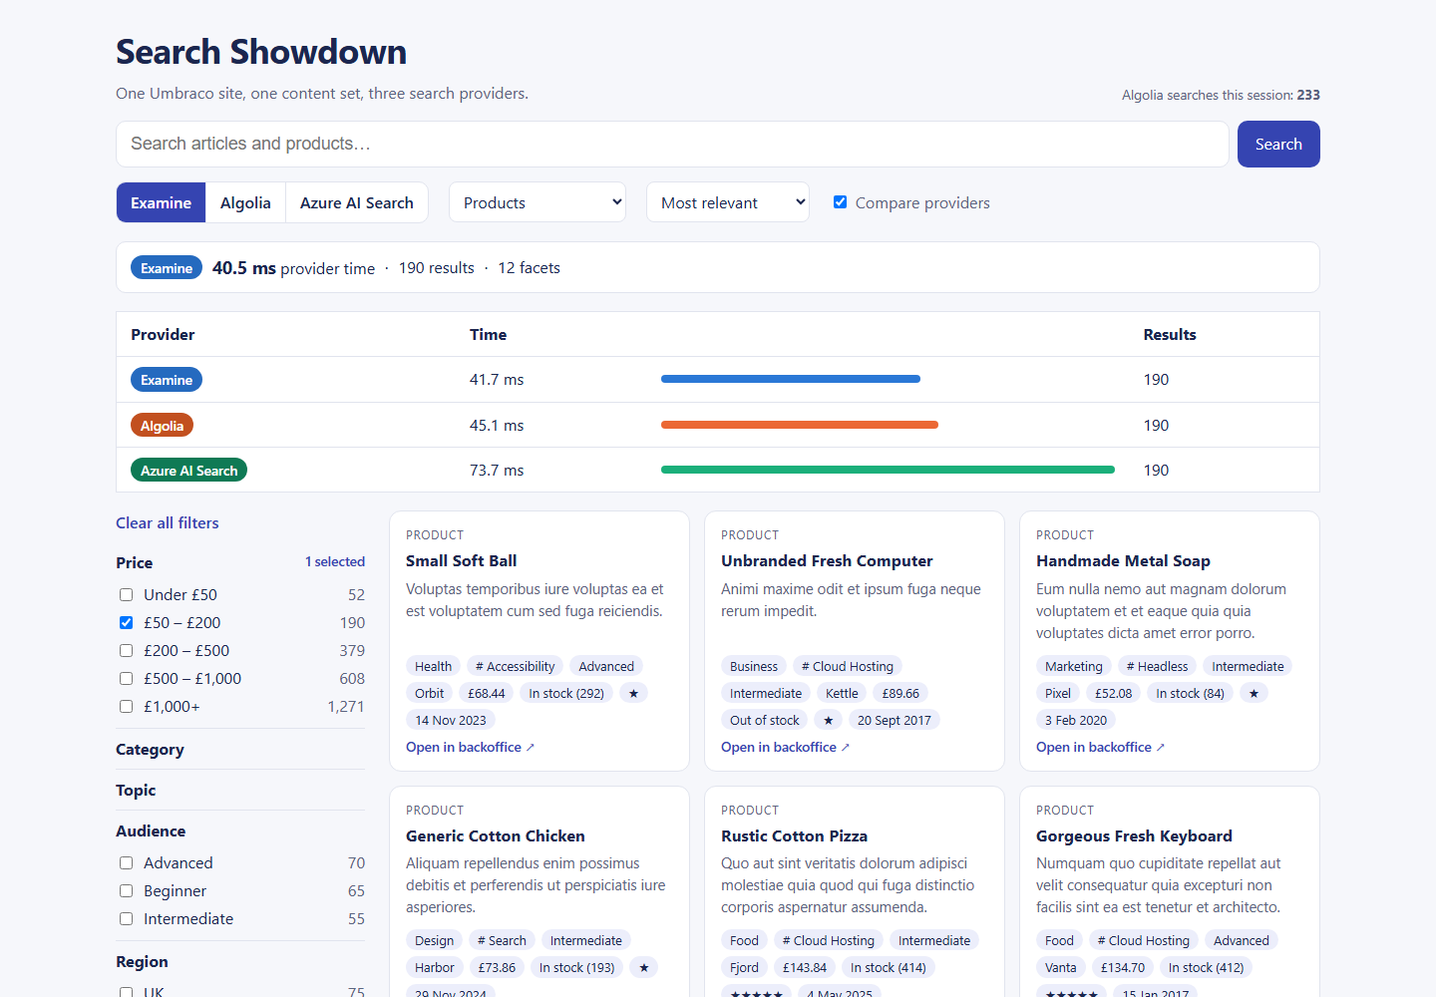
What we just saw
190
products between £50 and £200, on all three
Same order
when sorted by price, cheapest first
13
items for £50 to £200 and published in 2024, identical everywhere
Identical on the surface. Underneath, three very different jobs.
The demo and what it reveals

Slide 21
Where providers really differ
One line of code on the website. Three very different amounts of work underneath.
Examine
Azure AI Search
Algolia
Sorting
Works out the price ranges at the moment you search.
Also works them out at search time, from the boundaries 50 | 200 | 500 | 1,000.
Counts exact values only, so each product's price band is worked out when it is indexed.
On Algolia, every sort order needs its own copy of the index, called a replica. On Examine it's one line of configuration.
The demo and what it reveals

Slide 22
Algolia: work out the band when indexing
RangeBucketContentIndexer.cs
C#
1
An extra content indexer
1
2
3
4
5
6
7
8
9
10
11
12
13
14
15
16
public sealed class RangeBucketContentIndexer : IContentIndexer
{
public Task<IEnumerable<IndexField>> GetIndexFieldsAsync(
IContentBase content, string?[] cultures,
bool published, CancellationToken cancellationToken)
{
IndexField[] fields = RangeFacets
.Select(facet => (facet.Field, Bucket: facet.BucketFor(
content.GetValue(facet.Field, published: published))))
.Where(bucket => bucket.Bucket is not null)
.Select(bucket => RangeIndexFieldHelper.Create(
bucket.Field, bucket.Bucket!))
.ToArray();
return Task.FromResult<IEnumerable<IndexField>>(fields);
}
}
1
Umbraco Search lets you add your own fields to every document.
2
Find the band
2
A price of £454.96 becomes the band "200-500".
3
3
Store it as a keyword
A helper from the Algolia package. Change the bands and you rebuild.
Simplified from the demo's RangeBucketContentIndexer.cs, registered with AddTransient<IContentIndexer, ...>
The demo and what it reveals

Slide 23
Azure: translating the question
AzureSearchSearcher.cs · about 650 lines in 10 files
C#
1
Range facets
1
2
3
4
5
6
7
8
9
10
11
12
// Range facet -> "d_price,values:50|200|500|1000|1000000"
DecimalRangeFacet range => Boundaries(range.Ranges
.SelectMany(r => new[] { r.MinValue, r.MaxValue }), ...),
return $"{field.Name},values:{string.Join('|', boundaries)}";
// Range filter -> "d_price ge 50 and d_price lt 200"
DecimalRangeFilter range => AnyOf(field, range.Ranges
.Select(r => Between(Number(r.MinValue), Number(r.MaxValue)))),
// Typo tolerance -> "chiar~1"
query.Split(' ', StringSplitOptions.RemoveEmptyEntries)
.Select(term => term.Length >= 4 ? $"{term}~1" : term);
Umbraco's ranges become Azure's boundary list.
1
2
Filters
Every filter becomes Azure's own filter language.
2
3
Typos
3
One wrong letter allowed in words of four letters or more.
Simplified from the demo's AzureSearchSearcher.cs
The demo and what it reveals

Slide 24
AI and personalisation
Can it show the most relevant results for this particular visitor?
Algolia
Azure AI Search
Umbraco
Where it stops
Personalisation per visitor (paid plans)
AI re-ranking and NeuralSearch (paid)
Agent Studio on every plan
No built-in per-visitor personalisation
Tag boosting is the documented approach
Vector and hybrid search on every tier
Semantic ranker: 1,000 free requests a month
Umbraco.AI.Search: official AI search package built on Umbraco Search
Umbraco Search has no "this visitor" concept. Extend the provider, or call it directly.
The verdict

Slide 25
How we measured
1
2
3
4
5
Same 5,035 documents for every provider
5 warm-up runs first
50 measured runs, provider order rotated
Median and 95th percentile reported
Free tiers named, different work called out
Release build · Umbraco debug mode off · benchmark script in the GitHub repository
The verdict

Slide 26
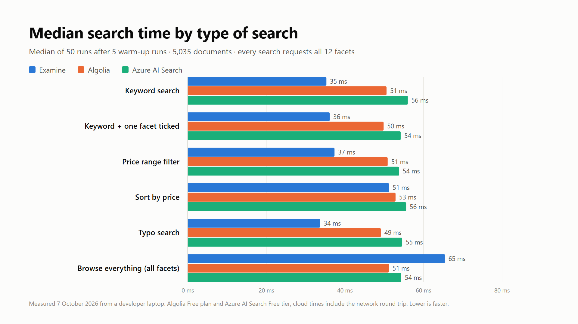
The results
Median of 50 runs, milliseconds · every search requests all 12 facets · Algolia Free plan, Azure AI Search Free tier · 7 October 2026
The verdict

Slide 27
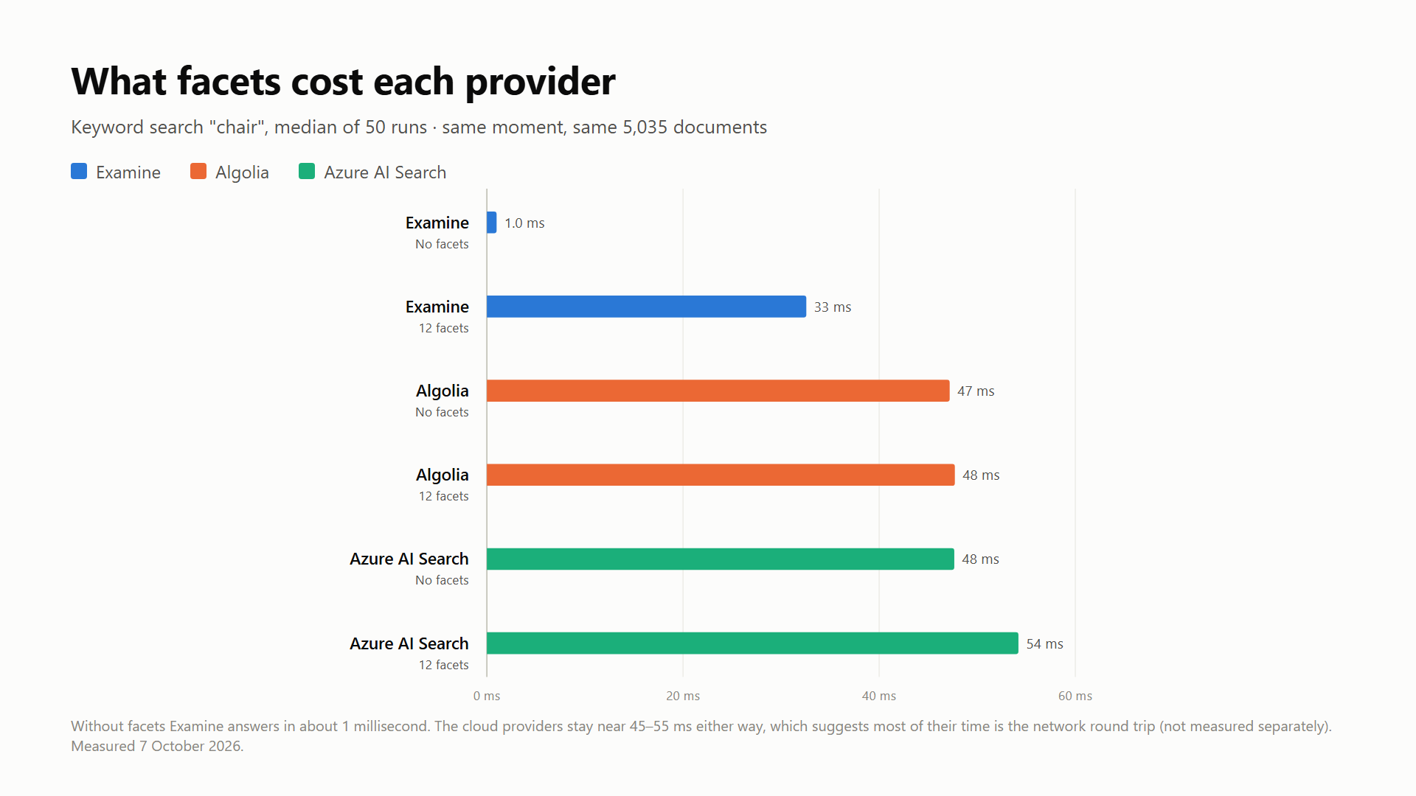
The facet surprise
1 ms
Examine keyword search without facets
About 33 ms with 12 facets
Algolia and Azure: about 47–54 ms either way
Keyword search "chair", median of 50 runs, run at the same moment · most cloud time is likely the network round trip (not measured separately)
The verdict

Slide 28
Cost and free tiers
 | Examine | Algolia (Free plan) | Azure AI Search (Free tier)
Price | Free | Free | Free
Search limit | None | 10,000 requests a month | None documented, but throttled when busy
Size limit | Your server | 50,000 records, 10 KB each | 50 MB, 3 indexes
Catch | Uses your server | Many AI features are paid | Shared servers, speed varies
Prices and free plans change often, so check the pricing pages. This benchmark used 550 of my 10,000 Algolia searches.
The verdict

Slide 29
Which provider when?
Based on what we measured.
Examine
Algolia
Azure AI Search
Most sites
Free, and the default
About 1 ms for a plain search box
Keep the number of facets sensible
No typo tolerance
Typo tolerance out of the box
Many facets at a steady speed
Business users tune results
Budget for paid plans for AI features
Already on Microsoft Azure
Strong filtering
Vector and hybrid search
Send documents in batches
The verdict

Slide 30
Should you adopt it now?
1
Runs alongside what you have
Try it without ripping anything out.
Yes, carefully.
2
Upgrades Examine to version 4
On Umbraco 17 (long-term support) or 18, today.
The provider needs Examine 4.0; Umbraco 17 ships with 3.10. Test any custom Examine code before you ship.
The verdict

Slide 31

Thank you
[QR code]
github.com/busrasengul/SearchShowdown
Demo site · content generator · Azure provider · benchmark scripts

