Slide 1
Cachena
Build a sleek GPS module to locate items
Product should fit into wallets without excess bulk
Clean UI for single or multiple device use

Slide 2
Team
Keegan Hood - bussekj@mail.uc.edu
Corey Sloan - sloancb@mail.uc.edu
Nihaal Sidhu - sidhuns@mail.uc.edu
Advisor
Brian Loudin - loudinbk@mail.uc.edu

Slide 3
Project Abstract
This project focuses on designing a sleek and durable GPS tracking card for personal object monitoring. The device prioritizes usability, offering reliable location data with reasonable certainty and battery life across most environments. Crucially, the system integrates advanced hardware and software security, featuring two-way encryption and mandatory device registration to protect user data from attackers. To address the ethical implications of tracking, a mechanism for device discoverability will be implemented. The project is committed to minimizing environmental impact and using ethically sourced parts, ensuring a responsible and secure solution.

Slide 4
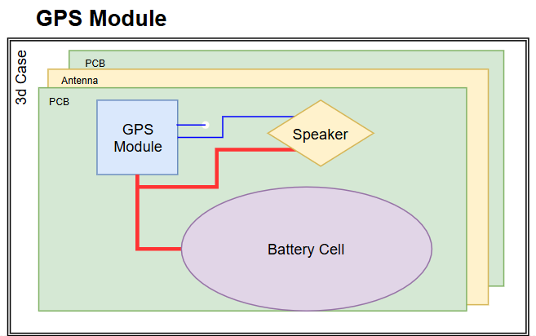
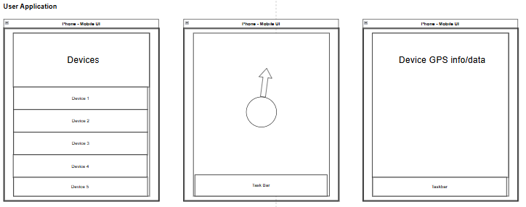
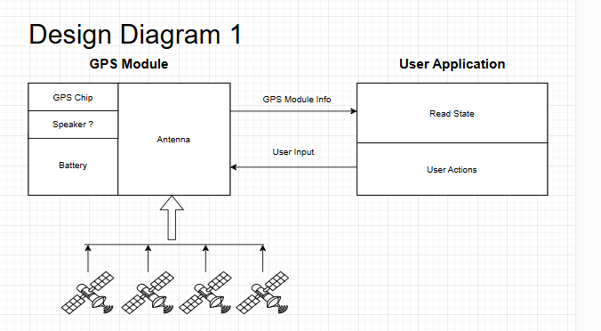
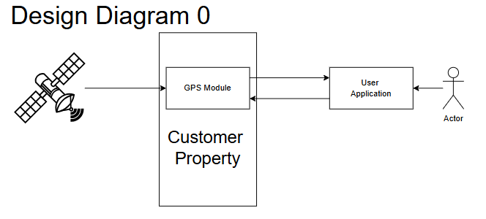
Design Diagrams

Slide 5
Project Constraints
GPS modules are useful to people throughout society. Currently, these systems are implemented in phones, smartwatches, cars and other technology. Implementing a sleek GPS card requires a developer to understand all aspects of the device and its potential uses. A user must be able to monitor their own objects while also following the environmental, ethical, security implications the technology has. If a user wants to track a product, they must be able to find their devices easily and quickly. Our GPS modules must withstand the everyday wear and tear, and receive a GPS signal with reasonable certainty. The GPS module should have a reasonable battery life to communicate with the application/server. Ethically, these devices can be used to unethically track people and/or objects. This encourages the team to develop a way for people to discover the GPS device. Similarly, security becomes an important aspect because users do not want their data easily captured. Both of these cases require the team to be aware of fraudulent behaviors from both the end user and attackers. The team will need to develop ways to have 2-way encryption and device registration to ensure a GPS module only reports to the correct user. As we develop our project, we fill focus on the usability of the product while minimizing environmental impact and prioritize ethically sourced parts.
A user must be able to reach their product given most environments while still being protected from other users. Additionally, the application/server must use standard encryption software. Our module must be durable yet light, hardware/software security, and built ethically.

Slide 6
Project Progress
Finished ideation and research
Currently designing GPU prototype
  CAD
  PCB design
Decided on framework programming principles

Slide 7
Expected Accomplishments
Have designed a prototype of GPS module
  Prototype reports data to a backend
  GPS constraints are honed
  Self-designed PCB is fabricated
Developed skeleton front-end UI

Slide 8
Division of Work
Keegan Hood - Primary Hardware
Corey Sloan - Develop Front-End
Nihaal Sidhu - Connect Software to Hardware / Documentation

Slide 9
Expected Demo at Expo
Have a working GPS module with a live demo
User friendly front end that allows for fleet management
Proper optimized back-end for current small scale set-up

Slide 10

Presentation Video

