Slide 1

Identify Friend or Enemy
Introduction and Instructions

Slide 2
Identify Friend or Enemy
Background
You have been assigned to guard the gate of a military base. Intelligence tells us that enemy soldiers are trying to sneak into the base, and some of them may be disguised. It is also possible that some of your friends may be wearing pieces of enemy garb. Unfortunately, you do not know what anyone is supposed to be wearing.
For each soldier that shows up you must decide to identify him as a friend and permit him into the base, or declare him an enemy and shoot him.

Slide 3
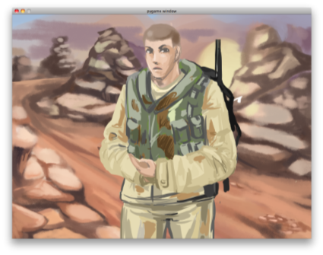
This is an unadorned Soldier
  Different items will appear on the soldier one at a time.

Slide 4
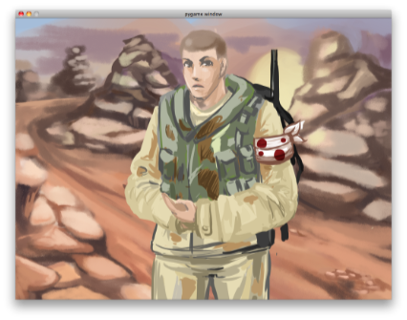
Here is the Soldier with 1 cue
  Each item is either friendly or hostile.

Slide 5
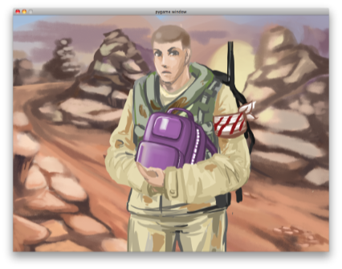
Here is the Soldier with 2 cues
  F to identify as a Friend
  J to identify as an Enemy

Slide 6
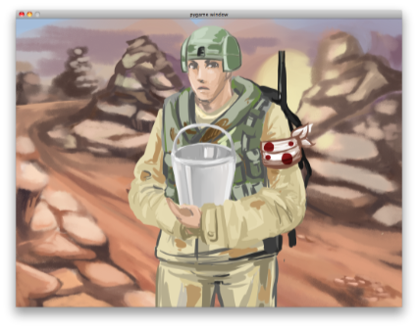
Here is the Soldier with
3 Cues
  A total of 3 cues will be displayed for each soldier
  There are three types of cues: Armbands, Helmets, and Carried Items

Slide 7
Soldier with 3 cues
  Feedback will be given after your response
  If feedback displays “Out of Time”, try to respond faster.

Slide 8
The safety of the base and the health of your fellow soldiers depends upon you. Please be as accurate as possible in your judgments.
The first block is a practice block and does not count against your overall score.

Slide 9
Caution:
Enemies are dangerous and may shoot you if not identified quickly.

