Slide 1

Identify Friend or Enemy
Introduction and Instructions

Slide 2
Identify Friend or Enemy
Background
You have been assigned to guard the gate of a military base. Intelligence tells us that enemy soldiers are trying to sneak into the base, and some of them may be disguised. It is also possible that some of your friends may wear an enemy item. Unfortunately, you do not know what anyone is supposed to be wearing.
For each soldier that shows up you must decide to identify him as a friend and permit him into the base, or declare him an enemy and shoot him.

Slide 3
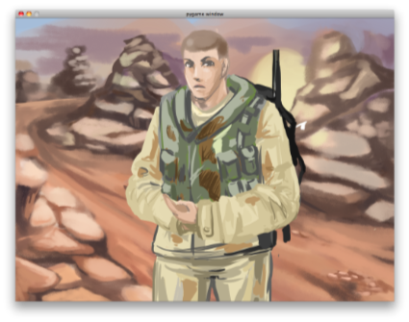
This is an unadorned Soldier
  Different items will appear on the soldier one at a time.

Slide 4
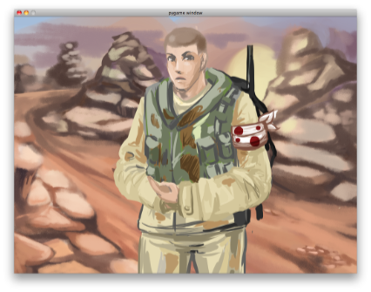
A Soldier with 1 item
  Each item is either friendly or hostile.
  Object’s status as friendly or hostile never changes

Slide 5
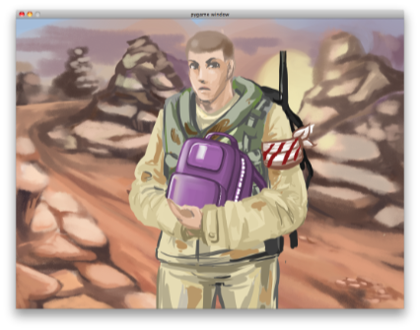
A Soldier with 2 items
  F to identify as a Friend
  J to identify as an Enemy

Slide 6
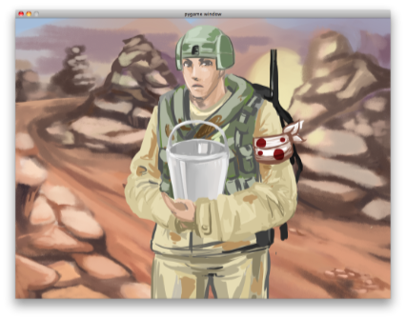
A Soldier with 3 items
  Each soldier has 3 items.
  The soldier's status as a friend or enemy is determined by the majority of items.

Slide 7
The safety of the base and the health of your fellow soldiers depends upon you. Please be as accurate as possible in your judgments.
The first block is a practice block and does not count against your overall score.

Slide 8
Caution:
Enemies are dangerous and may shoot you if not identified quickly.

