Slide 1
Dashboards

Slide 2
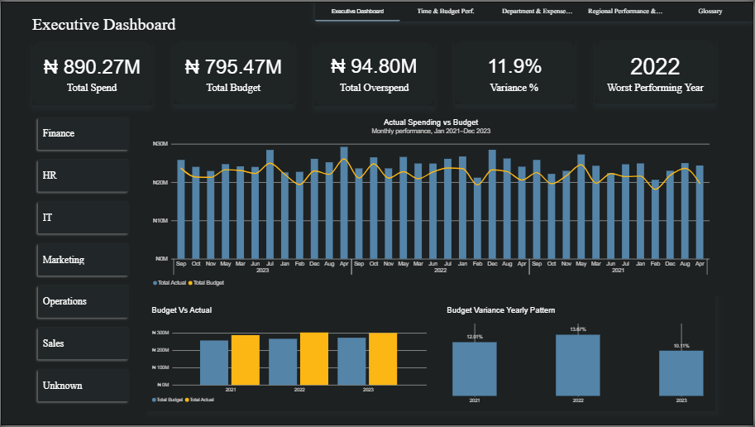

Slide 3
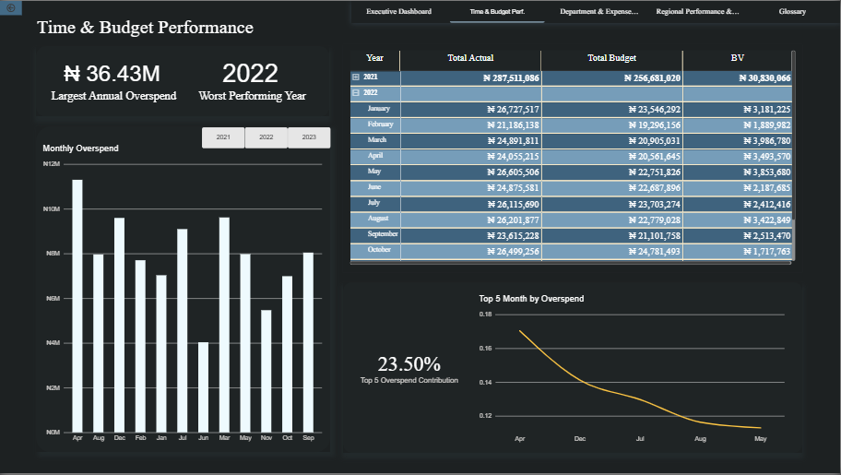

Slide 4
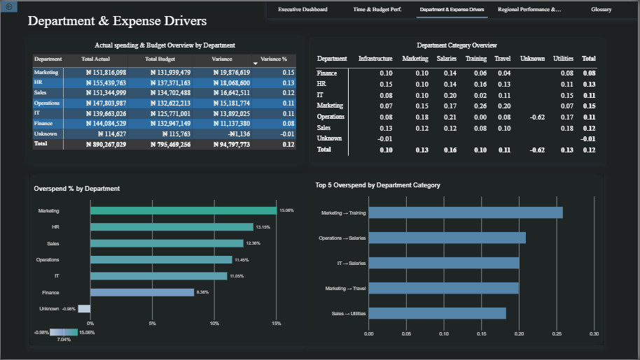

Slide 5
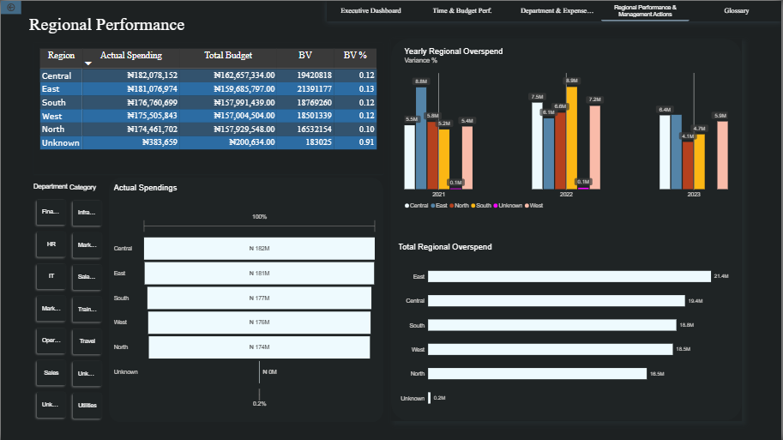

Slide 6
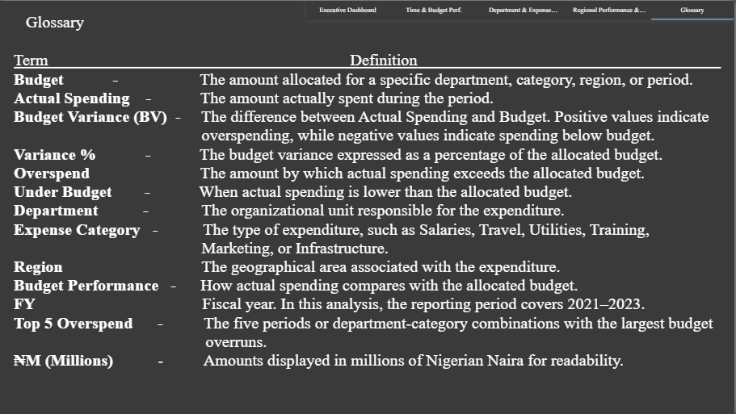

Slide 7
Business Value
The analysis transforms raw financial transactions into a structured view of where, when and why budget overruns are occurring.
Rather than focusing only on total spending, the analysis provides management with multiple levels of visibility, from overall performance to specific department-category combinations and regional drivers.
This supports more targeted budget monitoring, cost control and future budget planning.

Slide 8
Conclusion
The company exceeded its allocated budget by ₦94.8M across the three-year period. Overspending was widespread, with Marketing, Salaries and the East region emerging as key areas requiring attention.
The analysis indicates that improving budget performance will require both stronger expenditure monitoring and a review of whether current budget allocations accurately reflect operational spending requirements.

