Slide 1
Solving Differential Equations in Parallel on a Grid
Chad Bustard
ME 759 Final Project

Slide 2


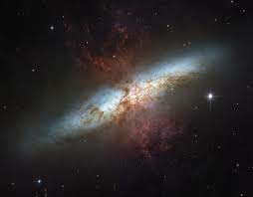
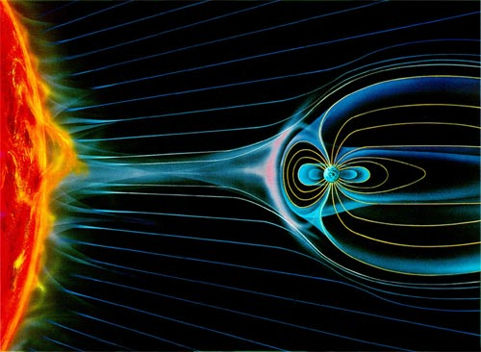
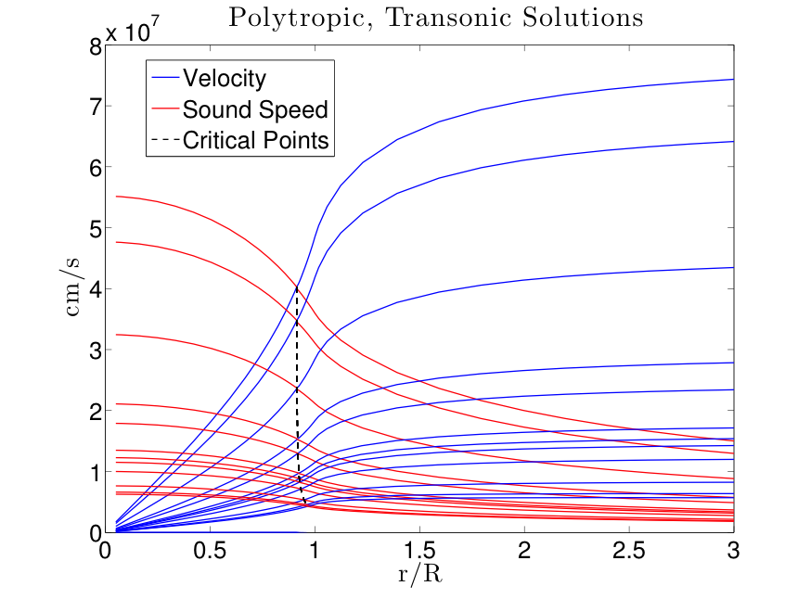
Motivation

Slide 3
Project Goals
Use the Gauss-Seidel method with various algorithms to solve the Poisson equation on a grid using OpenMP
Test result determinacy and speedup of parallel algorithms compared to sequential algorithm
References:
http://www.idi.ntnu.no/~elster/master-studs/larsgaard/larsgaard-master.pdf
http://www.hpcc.unn.ru/mskurs/ENG/DOC/pp12.pdf
http://www.compunity.org/training/tutorials/openmp_Boston.pdf

Slide 4
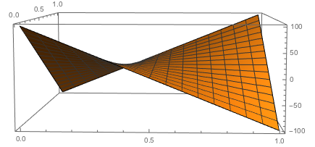


Solving the Poisson Equation
Process:
Discretize the domain x = {0,1}, y = {0,1}
x = i/N, y = j/N
Input boundary conditions
Initially set u(x,y) = 1 inside the boundary
Update u(x,y) until max(u^{k}_{ij} – u^{k-1}_{ij}) < tol
Updating each u(x,y):

Slide 5
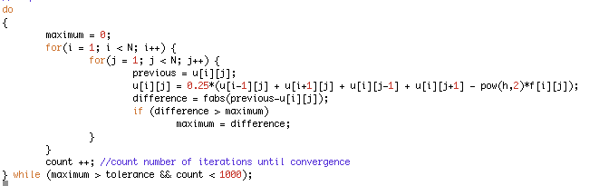
Sequential

Slide 6
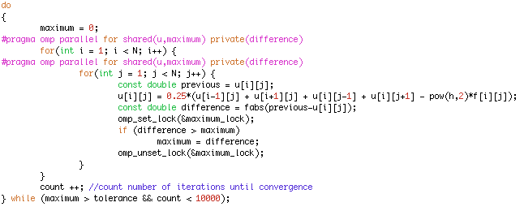
First (Naive) Parallel Algorithm

Slide 7
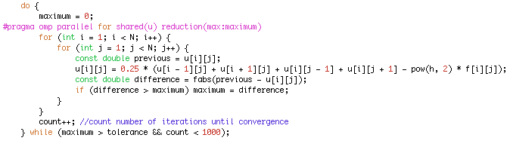
Second Parallel Algorithm
Parallelize only outer loop
Parallelizing only the outermost for loop leads to significant speedup
Locking ‘maximum’ added extra time and also caused many issues → use the built-in OpenMP reduction to find the maximum, instead

Slide 8
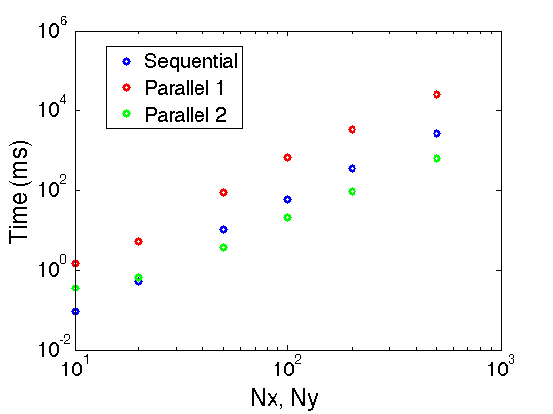
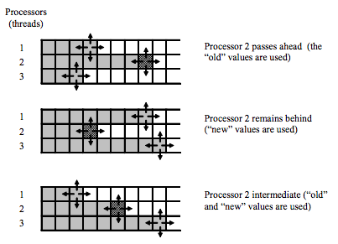
Issues with these algorithms:
Race conditions
Solution indeterminacy – solution isn’t the same each time I run the code

Slide 9
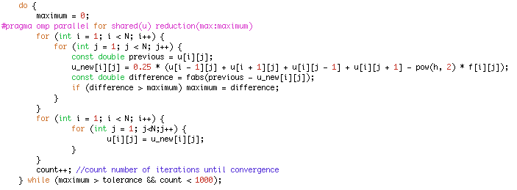
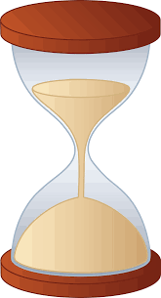
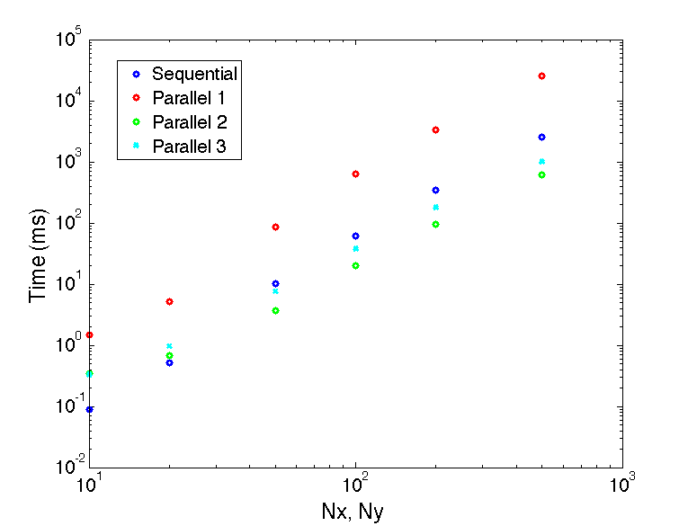
Third Parallel Algorithm
Overhead
Solves the solution indeterminacy issue, but there is significant overhead with writing to u_new many times

Slide 10
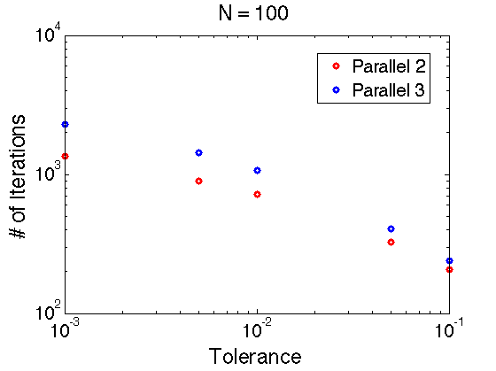
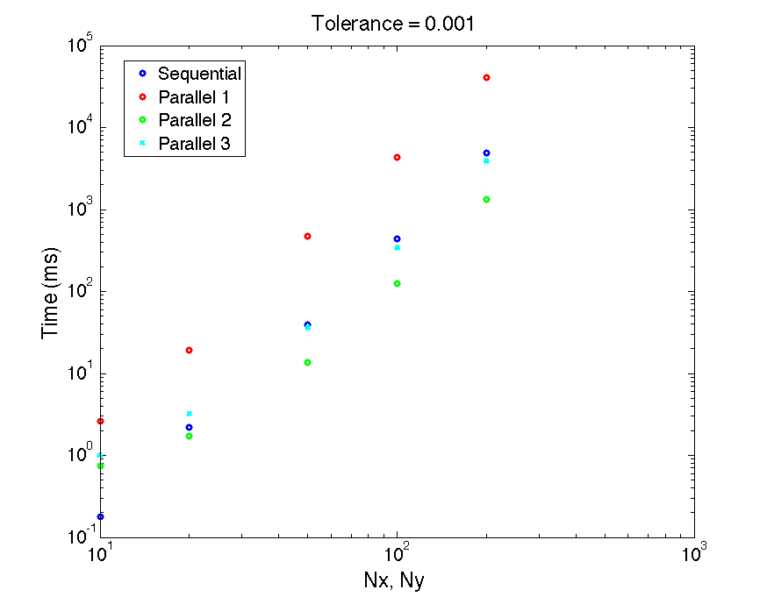
Convergence
Parallel #3: Sacrificing both overall time and convergence for solution consistency

Slide 11
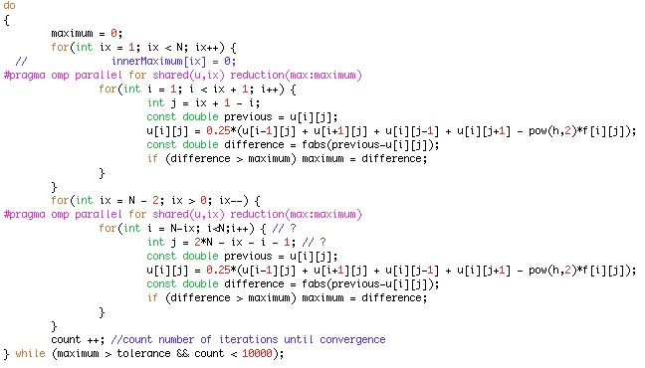
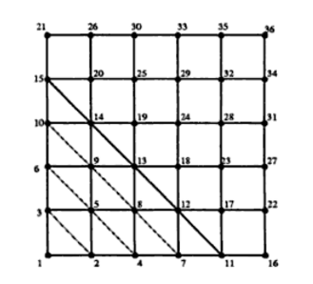
Fourth Parallel Algorithm (using wave front method)
Wave is growing
Wave is decaying

Slide 12
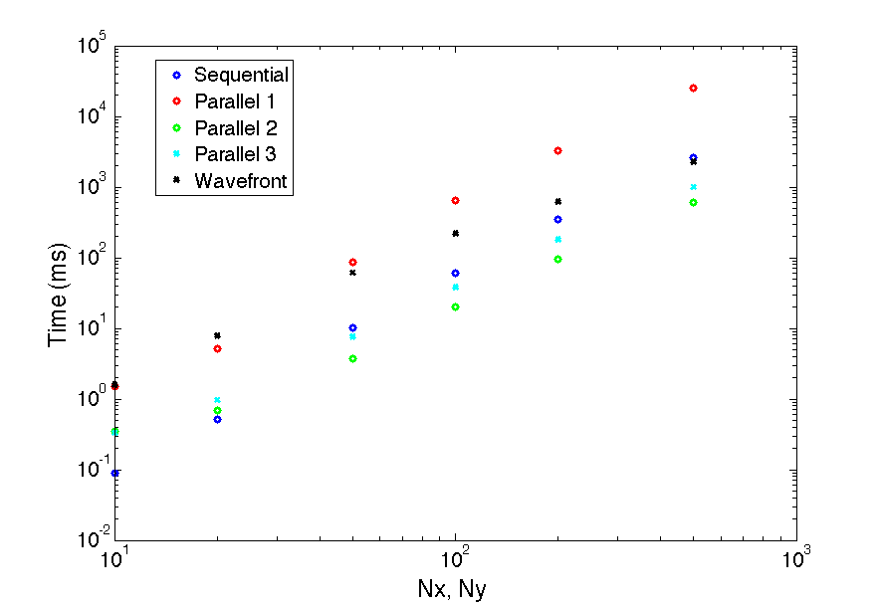

Slide 13
What I Learned
Wavefront method gives same solution each run
But it isn’t as fast as other parallel algorithms tested
Parallelizing outer-most loop leads to significant speedup over parallelizing nested loops
As expected, memory accesses can increase computation time significantly
When using a grid, need to watch for race conditions and computation indeterminacy
Future work: test “red and black” tiling method
Apply these methods to future research solving MHD (magnetohydrodynamics) equations on a grid

