Slide 1
Marvel Comics by the Numbers
by: Bruno Ustariz

Slide 2
Summary
Goals, Questions, Findings.

Slide 3
Summary: Goals
This project is to uncover any trends in the content created by marvel comics with respect to all its characters. The goals are:
To analyze and draw conclusions about the popularity of characters based on the amount of material created for each.
To analyze the amount of content created for the most popular characters vs characters in general.
To determine if the amount of comic books created for each character determines their appearance in events(universe changing story lines)

Slide 4
Summary: Questions
How much content does Marvel create for all of its characters?
Which Marvel characters are the most popular?
Does the amount of content created for each character determine appearance in Marvel events?

Slide 5
Summary: Findings
How much content does Marvel create for all of its characters?
The data shows that the majority of marvels characters have very low amounts of content. In fact, the most popular characters are outliers.
Which Marvel characters are the most popular?
For those who are Marvel fans and have either read comics, or watched the cartoons or movies, the most popular characters are expected.
Does the amount of content created for each character determine appearance in Marvel events and series?
The data shows that there is a strong positive correlation between the amount of content created for each character and the amount of appearances in marvels events and series.

Slide 6
Data Set
Marvels API

Slide 7
Data Set
The data required was the amount of content created for each marvel character in regards to comic books, events and series.
Data was pulled from Marvel API and stored into a Pandas DataFrame.
Key assumption: The amount of content created per character represents a measure of character popularity.

Slide 8
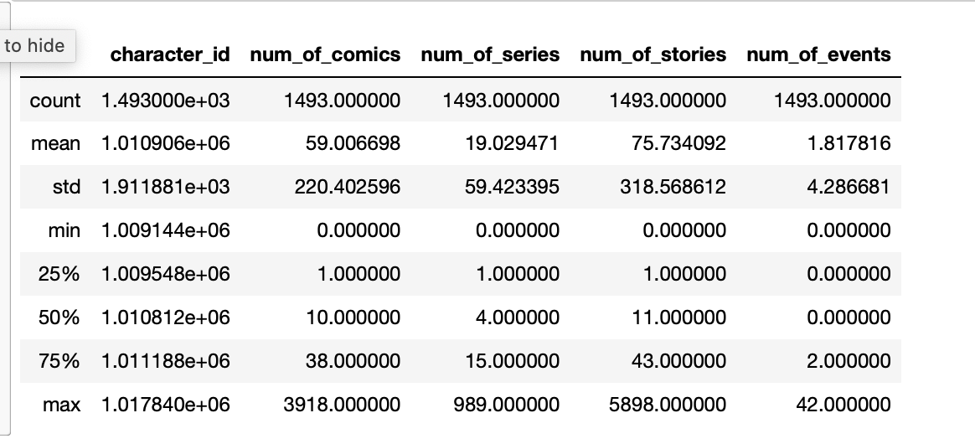
DataFrame Statistics
Data shows that 75% of the data has less than 40 comic books made compared to a max of 3,918.
In addition, 75% of the data shows up to 2 event appearances.
"Data provided by Marvel. © 2014 Marvel"

Slide 9
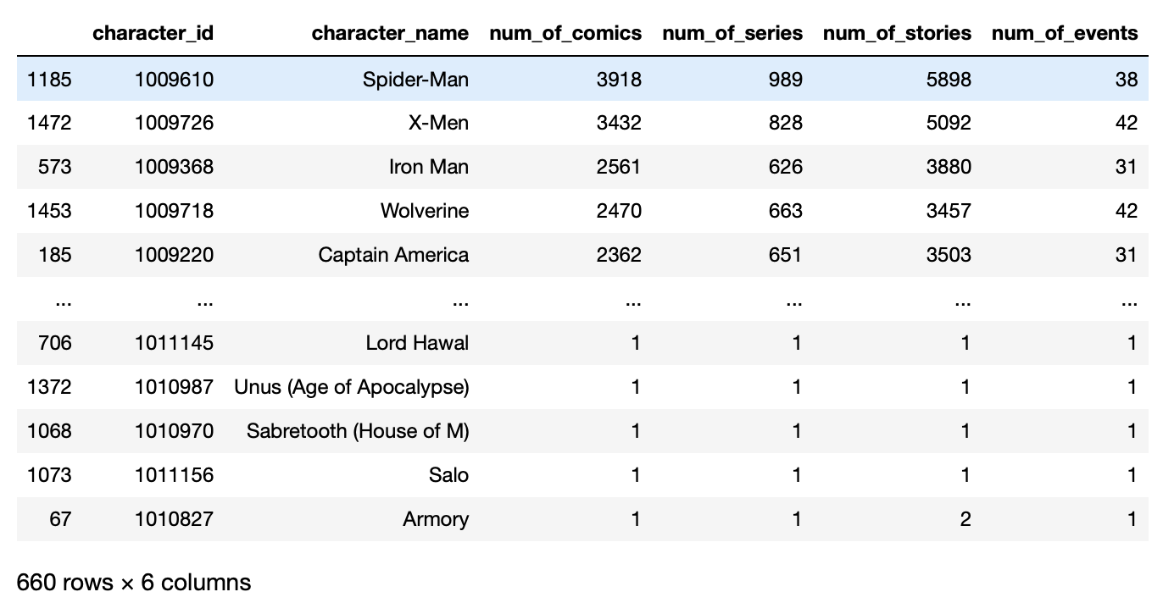
DataFrame Filtering
DataFrame was filtered to show only characters with at least 1 comic book and one event.
Characters with 0 comic books were determined to be supporting characters in comics of other characters.
The result was a reduction of characters from 1493 to 660.
"Data provided by Marvel. © 2014 Marvel"

Slide 10
Content per Character?
How much content has marvel created for each character?

Slide 11
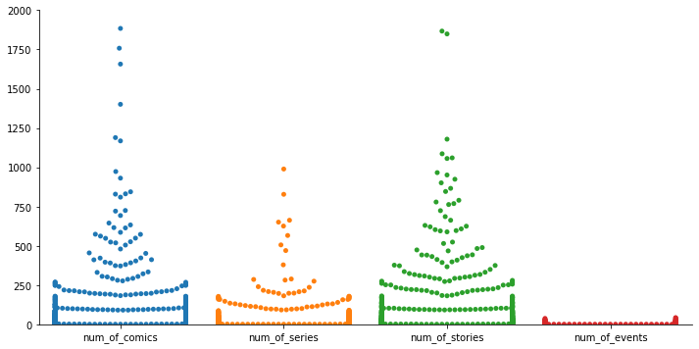
Content per character
Data Distribution
The majority of characters have a very low amount of content.
Note: this representation is based on our reduced DataFrame.
"Data provided by Marvel. © 2014 Marvel"

Slide 12
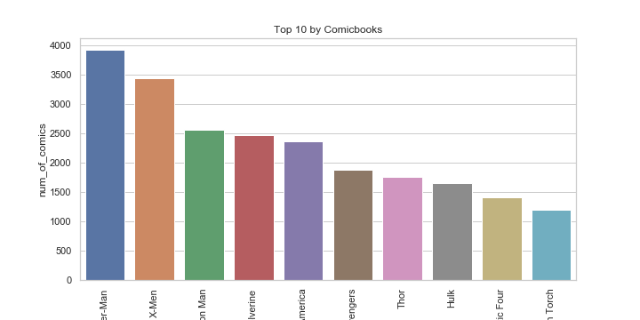
Top 10 Characters by Comic books
The top 10 characters have over 1,000 comic books.
In comparison to our data, the most popular characters have significantly more content vs the rest of the characters.
"Data provided by Marvel. © 2014 Marvel"

Slide 13
Characters by Series
Top characters by amount of series and correlation vs comic books.

Slide 14
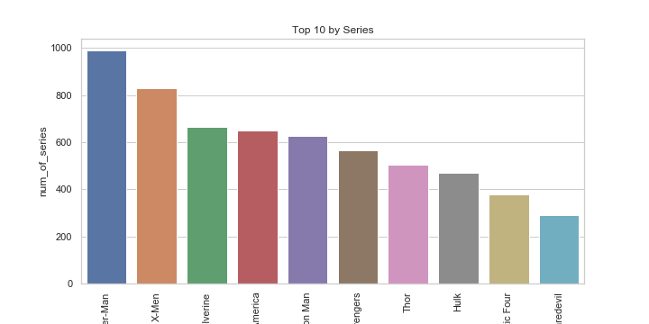
Top 10 Characters by Series
Top 10 are very similar to our previous bar chart of top 10 characters by comic book count.
An assumption can be made that the amount of comics made for each character is positively correlated to the amount of series they are in.
"Data provided by Marvel. © 2014 Marvel"

Slide 15
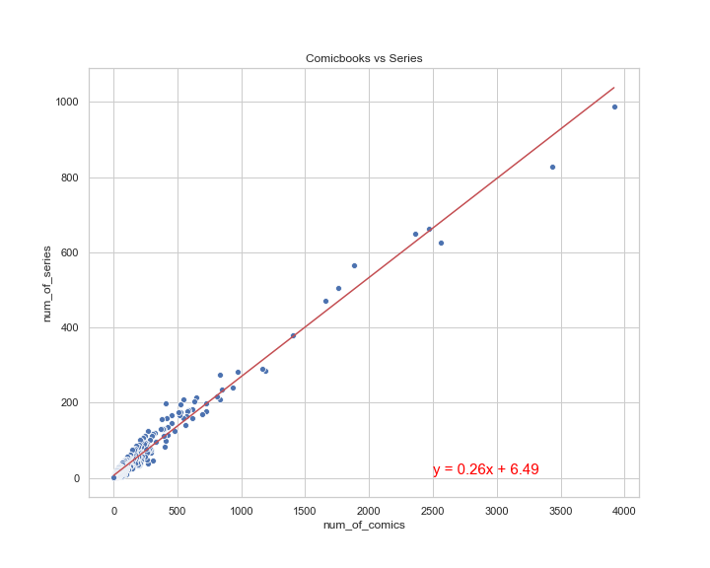
Character Comic books vs Series
The data shows that our previous assumption is correct. In fact, there is a nearly perfect correlation between both data points.
The r-squared is: 0.9887123917887364
"Data provided by Marvel. © 2014 Marvel"

Slide 16
Characters by Events
Top characters by amount of events and correlation vs comic books.

Slide 17
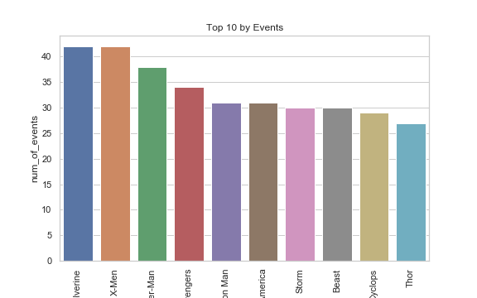
Top 10 characters by Events
Top 10 are also very similar to our previous bar chart of top 10 characters by comic book count, although less so than series top 10.
An assumption can be made that the amount of comics made for each character is positively correlated to the amount of events they are in.
"Data provided by Marvel. © 2014 Marvel"

Slide 18
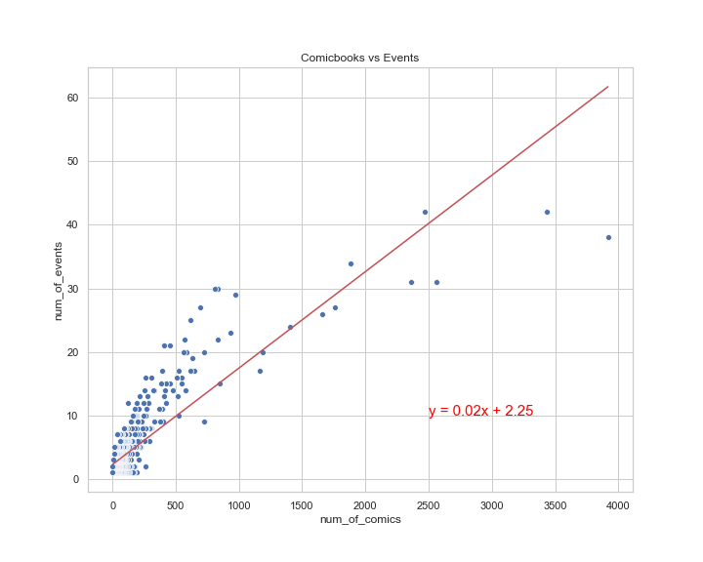
Characters Comic books vs Events
The data shows that In there is a positive correlation between both data points. Although less so than series vs comic books.
The r-squared is: 0.8568303798251373
"Data provided by Marvel. © 2014 Marvel"

Slide 19
Conclusion
Discoveries:
There are very few popular characters who are popular. In fact, they are outliers of the data.
The proportion of investment in content is very high for few characters.
Data Shortcomings:
Quantity sold per comic book was not available.
Some characters are part of a group (x-men, avengers, etc) and could not be separated.
Time component of comic books was not available.

Slide 20
Conclusion contd.
Additional questions:
Popularity of characters over time(by year/month)?
Total comics marvel creates per year?
How many creators worked on each character?

Slide 21
Thanks!

