Slide 1
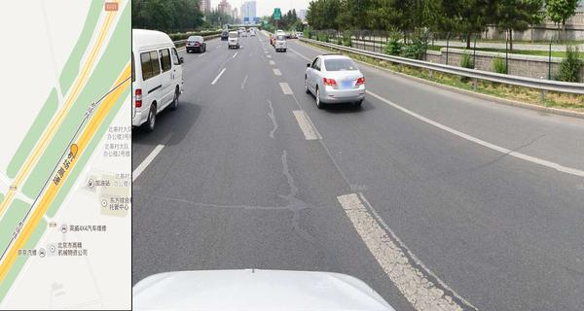
[City]
Comment:
[URL]
[Baidu-Version]
[GPS-data]
[serial-number]

