Slide 1
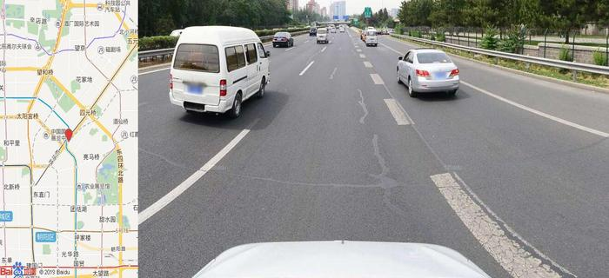
[City]
Comment:
[URL]
[GPS-data]

