Slide 1
Predicting Pitches in Baseball
STA 531
Sarah Normoyle
Drew Jordan
Gonzalo Bustos

Slide 2
Motivation and Data
prediction rather than performance metrics is a less explored area of baseball
valuable for a batter to know what pitch to expect before a pitch is thrown
data set is available publically on mlb.com
3 years, from 2013 to 2015
2 million observations
39 variables

Slide 3
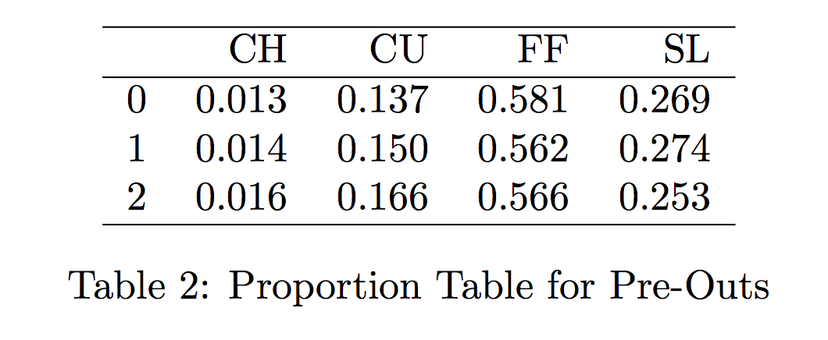
Exploratory Data Analysis
tables for proportions of pitches across different covariates
looking at changes across the columns
focusing on one pitcher: Clayton Kershaw (4 different types of pitches)

Slide 4
First: Naïve Sampling and Markov model
Naïve sampling
Calculating sample probability vector
Predictions from sampling according to these probabilities
Not based on previous pitch or any covariates
Markov model
Creating sample transition matrix
Creating sample initial probability matrix
Predictions from sampling according to probabilities taken from transition matrix
Only based on previous pitch

Slide 5
Hidden Markov Model
Hidden states: not as interpretable, status of game
Observations: different types of pitches
Baum Welch
Get estimates of parameters for hidden Markov model fit to pitching sequence
Tried different numbers of hidden states
Forward Algorithm
Can calculate probability of

Slide 6
Multinomial Logistic Regression
Easy to understand as a combination of regular logistic regression
from fit of model can calculate a probability for each category j:
Simple attempts with variable selection
Reporting results for 3 models:
LR1: count
LR2: count, pre outs, inning
LR3: pre outs, count, pitch number, runners count, pitch count, top of inning, bat side, inning number, previous pitch type

Slide 7
Cross Validation Results
5-fold cross validation was applied to each of the techniques
Percent accuracies of prediction were used as a comparison metric

Slide 8
Conclusions
some results in ability to predict baseball pitches
multinomial logistic regression was the most successful
cross validation was shown to be useful
Further investigation
Looking into the success of simply binary logistic regression
examining multiple pitchers and the differences in predicting pitches by different pitchers
More sophisticated techniques at variable selection

