Slide 1






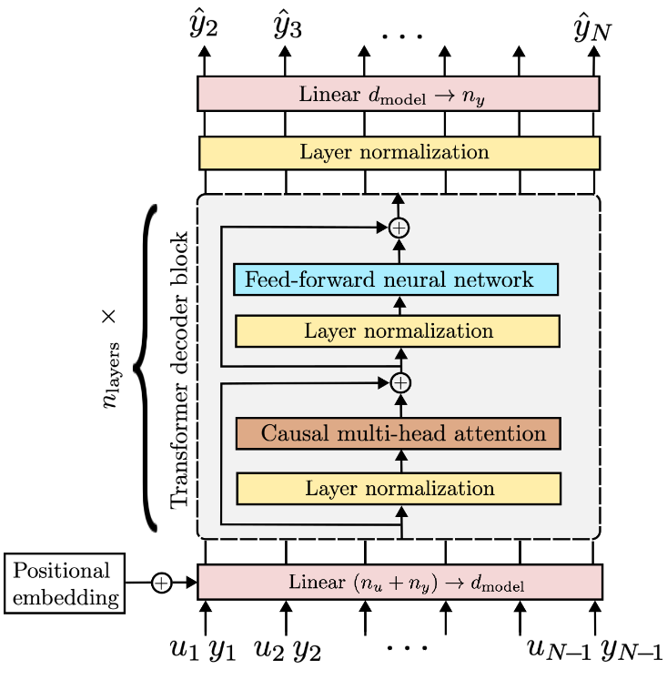
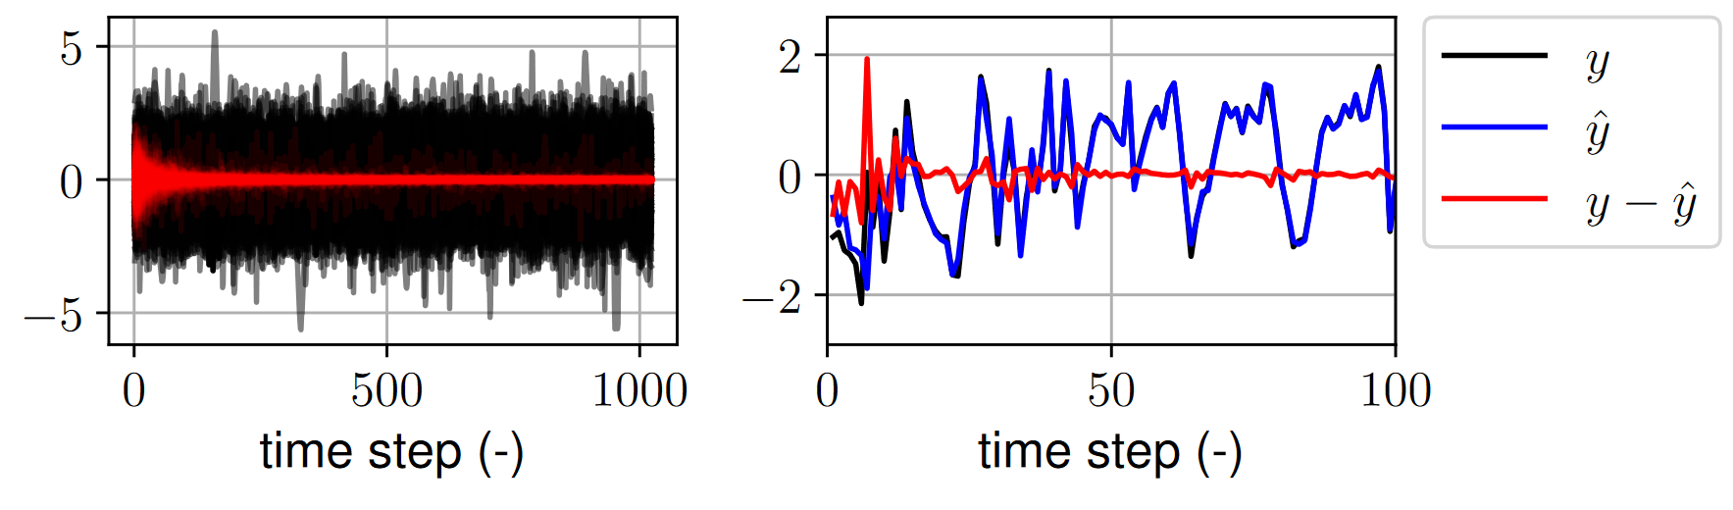
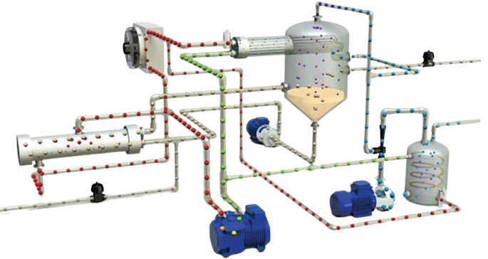


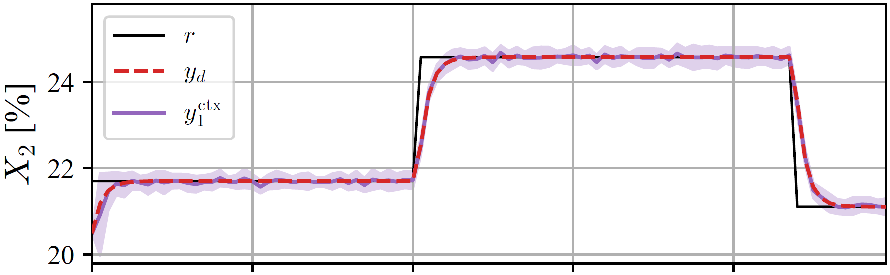
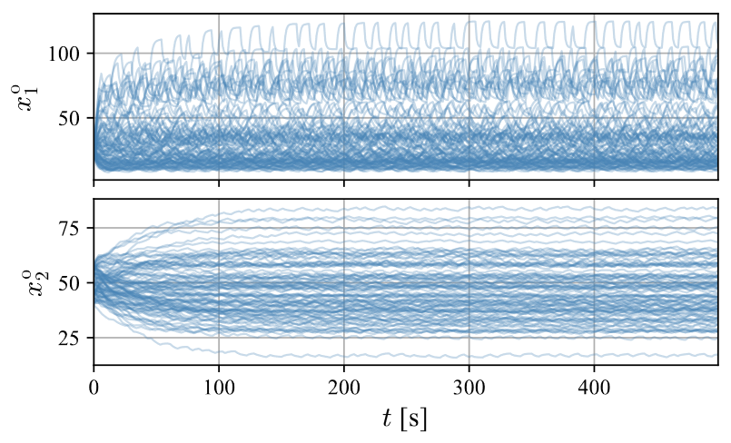
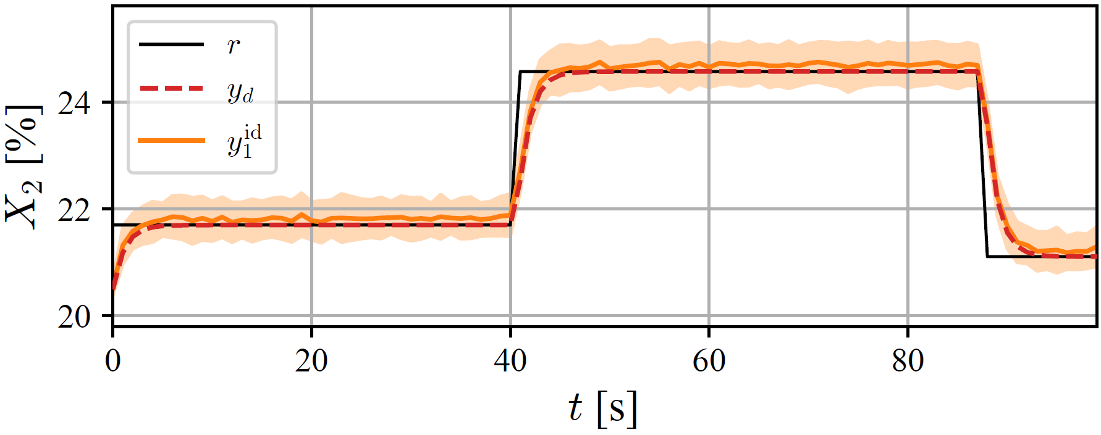
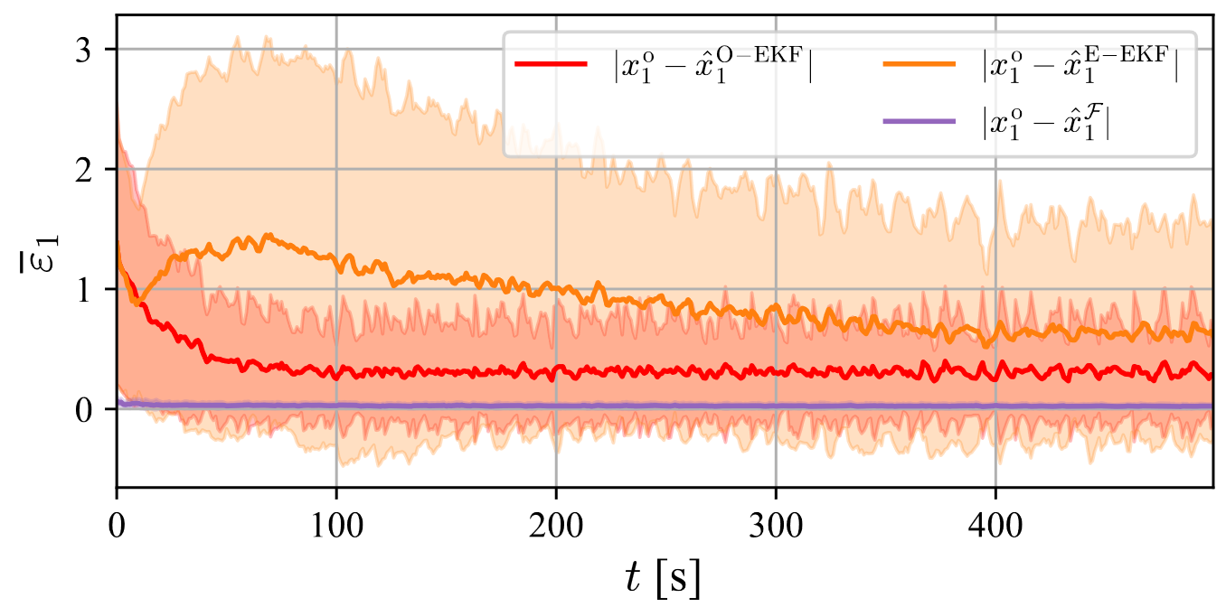
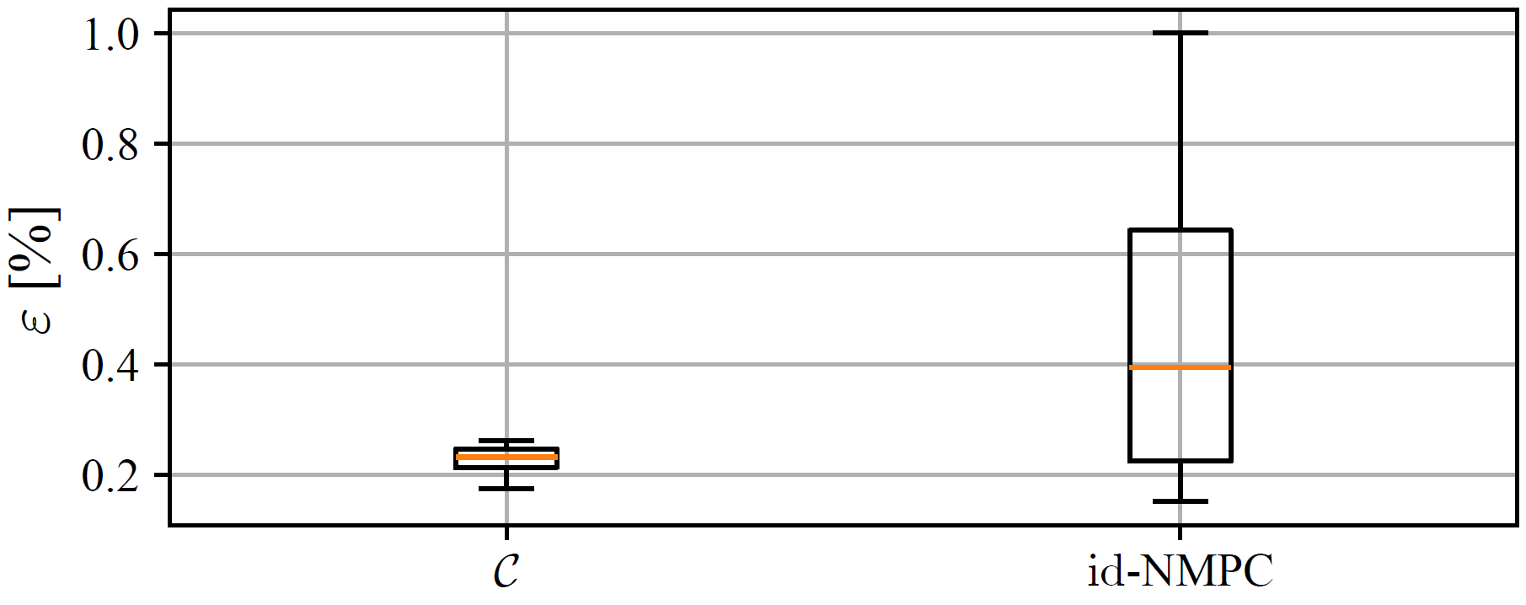
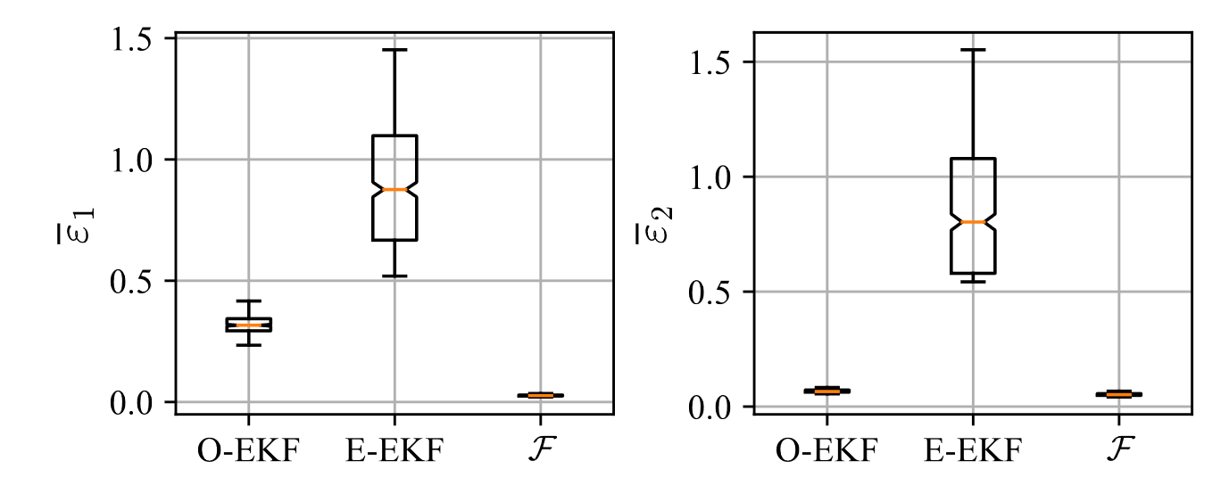
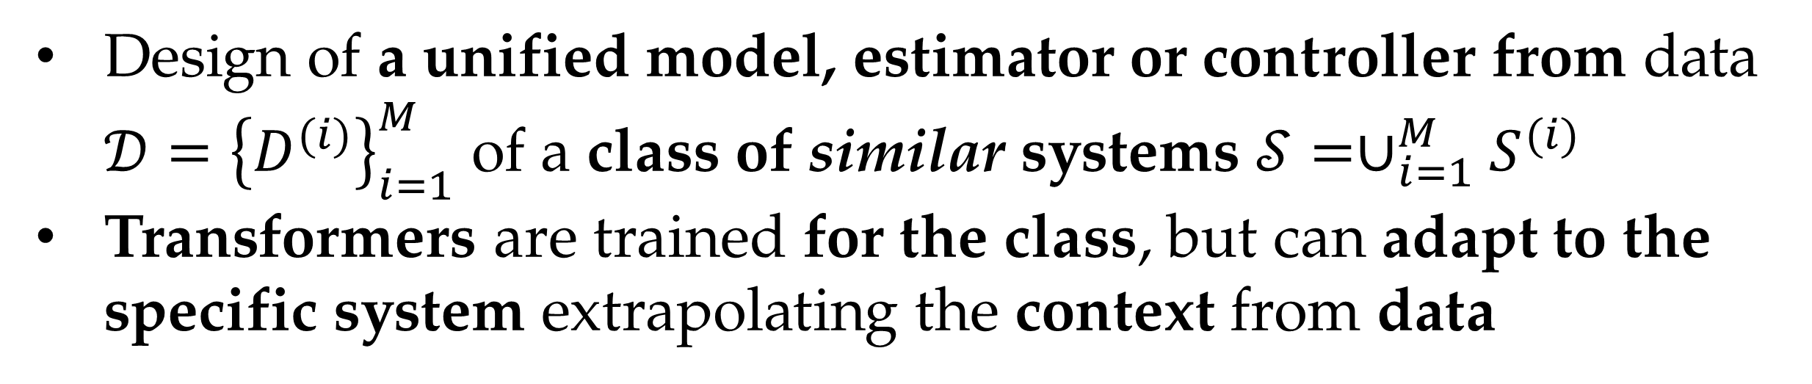
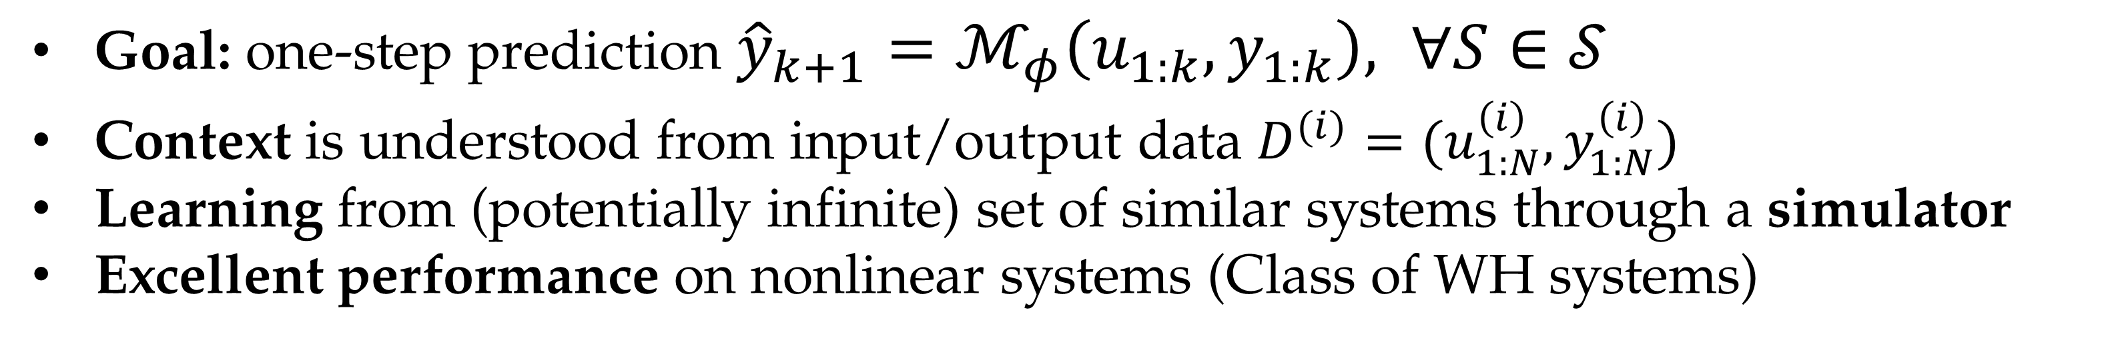
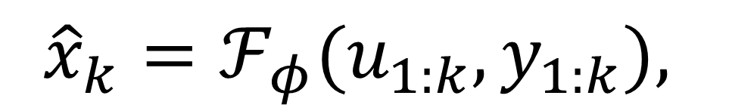


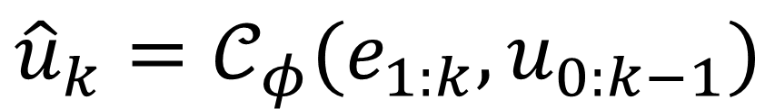
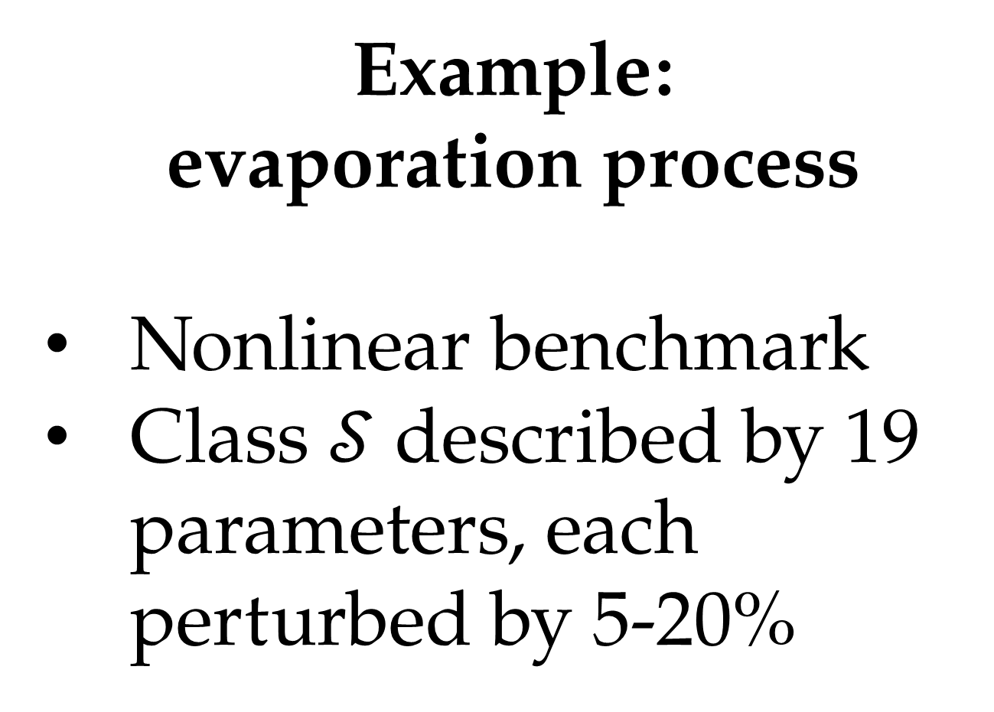
An in-context learning framework for control
Contact us
Riccardo Busetto^{1,3}, Valentina Breschi², Marco Forgione¹, Dario Piga¹, Simone Formentin³
¹IDSIA Dalle Molle Institute for Artificial Intelligence
²Department of Electrical Engineering, Eindhoven University of Technology
³Dipartimento di Elettronica, Bioingegneria e Informazione, Politecnico di Milano
In-context learning approach
Design of a unified model, estimator or controller from data $𝒟={\left\{D^{(i)}\right\}}_{i=1}^{M}$ of a class of similar systems $𝒮=∪_{i=1}^{M}S^{(i)}$
Transformers are trained for the class, but can adapt to the specific system extrapolating the context from data
One system
One model
One model
All systems!
Paper link
System Identification
Goal: one-step prediction ${\hat{y}}_{k+1}=ℳ_{φ}\left(u_{1:k},y_{1:k}\right), ∀S∈𝒮$
Context is understood from input/output data $D^{(i)}=(u_{1:N}^{\left(i\right)},y_{1:N}^{\left(i\right)})$
Learning from (potentially infinite) set of similar systems through a simulator
Excellent performance on nonlinear systems (Class of WH systems)
Original work of Marco Forgione, Filippo Pura, and Dario Piga. "From system models to class models: An in-context learning paradigm." IEEE Control Systems Letters (2023).
Paper in preparation.. stay tuned
Paper link
Control
State Estimation
$${\hat{u}}_{k}=𝒞_{φ}(e_{1:k},u_{0:k−1})$$
$${\hat{x}}_{k}=ℱ_{φ}(u_{1:k},y_{1:k}),$$
Goal: model reference control
$$\min_{φ}{𝔼_{p(𝒟)}\left[\sum_{k=1}^{N−1}{{\left\|u_{k}^{⋆}−𝒞_{φ}\left(e_{1:k},u_{0:k−1}\right)\right\|}_{2}^{2}}\right]}$$
Context is understood from errors $e_{1:k}$ and inputs $u_{0:k−1}$
Matching error is reduced with respect to NMPC
Goal: state estimation
$$\min_{φ}{𝔼_{p(𝒟)}\left[\sum_{k=1}^{N−1}{{\left\|x_{k}^{o}−ℱ_{φ}\left(u_{1:k},y_{1:k}\right)\right\|}_{2}^{2}}\right]}$$
Context is undestood from inputs $u_{1:k}$ and outputs $y_{1:k}$
Estimation error is reduced with respect to EKF
Example:
evaporation process
Nonlinear benchmark
Class $𝒮$ described by 19 parameters, each perturbed by 5-20%
Future works
Experimental validation on applications
Architectural modifications to speed up learning
Formal results on properties of the approach (stability, effect of noise)

