Slide 1
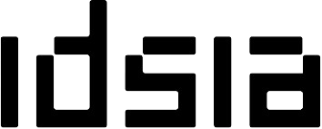


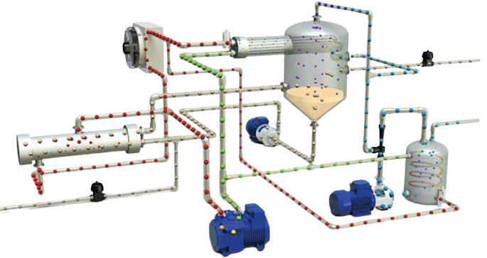
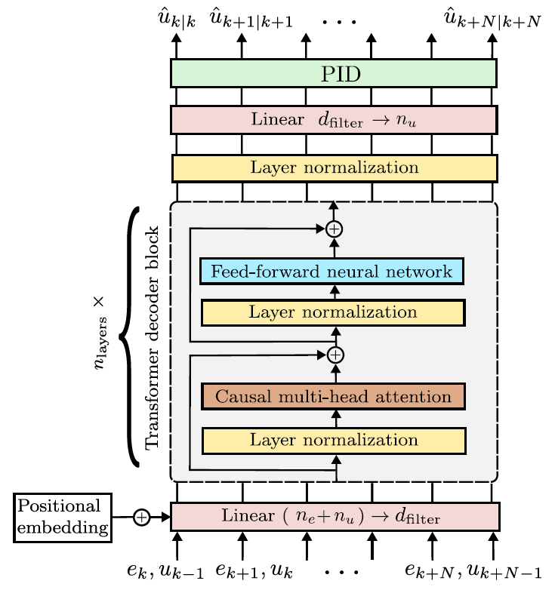
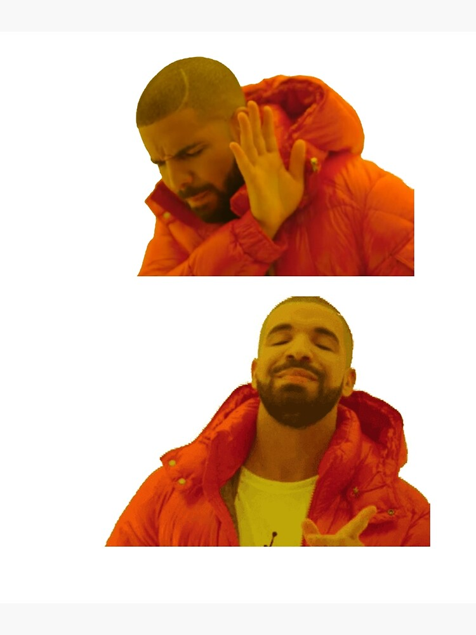





An in-context learning framework for control
Riccardo Busetto, Valentina Breschi, Marco Forgione, Dario Piga, Simone Formentin
.
.
.
Unique model, estimator or controller
Context: adaptation to the specific system
$$D^{(1)}$$
$$∀S∈𝒮$$
.
.
.
Class of systems $𝒮$
.
.
.
$$D^{(i)}$$
.
.
.
$$D^{(M)}$$
One system
One model
One model
All systems!

