Slide 1
Data Analysis of Avocado Sales in the US (2015-2018)
Gina Cameras, Abby Ko, Jacob Bellagio, Ray King
Notes:
jacob

Slide 2
Motivation & Summary
Notes:
jacob

Slide 3
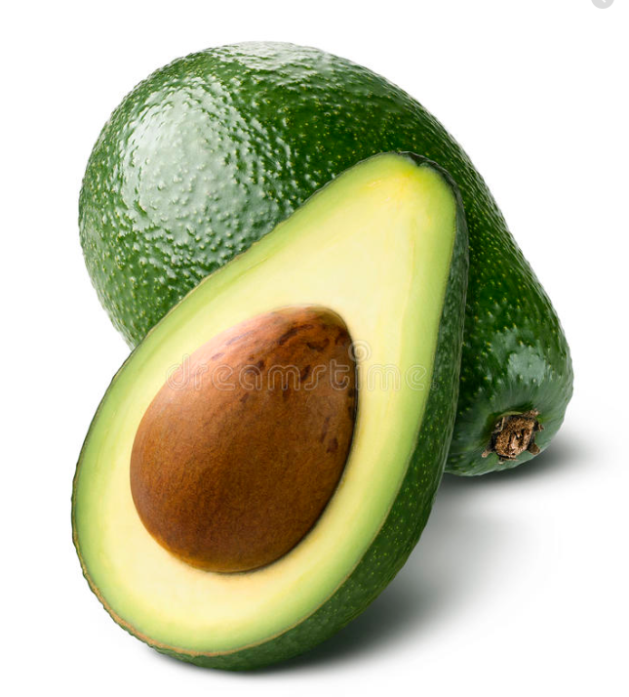
Hass Avocado Information
Availability: Year-round harvesting
The Hass brand is the standard for commercial use (restaurants, guacamole production, etc.)
Counts for around 80% of avocados consumed worldwide
When discovered in 1935, they were granted the 1st US patent on a tree
References: 1) https://www.foodrepublic.com/2012/10/18/know-your-avocado-varieties-and-when-theyre-in-season/ 2) https://specialtyproduce.com/produce/Hass_Avocados_949.php
Notes:
jacob
https://www.foodrepublic.com/2012/10/18/know-your-avocado-varieties-and-when-theyre-in-season/
https://specialtyproduce.com/produce/Hass_Avocados_949.php

Slide 4
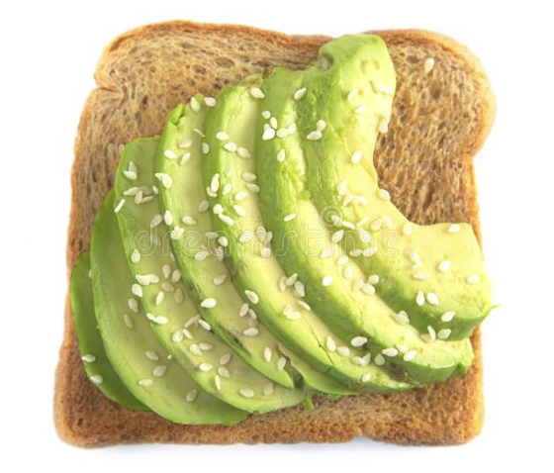
Hypothesis:
Avocado sales went up as avocados became more popular in the USA.
“With social media, the popularization of the food grew and after Paltrow's book food bloggers recreated the dish and merchandise being created. - wikipedia
Bon Appétit magazine published a recipe for “Your New Avocado Toast” in its January 2015 issue.” - wikipedia
References: 1) https://en.wikipedia.org/wiki/Avocado_toast
Notes:
jacob
https://en.wikipedia.org/wiki/Avocado_toast

Slide 5
Questions Asked & Why
Is there seasonality for avocado sales (MoM, YoY)?
Understand when people are buying and if the consumption is related to the time of year.
What regions sold the most avocados?
Understand where in the USA people are buying and if the consumption is concentrated in particular areas.
What’s the breakout of avocado sales are conventional compared to organic?
Understand what type is being consumed in the USA and if there’s a preference.
What size avocado is the most popular (by bag, by PLU)?
Understand if people are buying multiple or single avocados.
Notes:
ray

Slide 6
Summary of Findings
Overall, we found that avocado sales growth did increase YOY and that certain regions account for most of the consumption.
Notes:
ray

Slide 7
Questions & Data
Notes:
abby

Slide 8
About our data
Source of data is Kaggle for Hass avocados and the Census Bureau for population:
Link:
https://www.kaggle.com/neuromusic/avocado-prices
https://factfinder.census.gov/faces/nav/jsf/pages/index.xhtml
Historical data (weekly) on avocado prices and sales volume in multiple US markets
This data was downloaded from the Hass Avocado Board website in May of 2018
Notes:
Abby.
Our data is from Kaggle and Census Bureau,which has a huge variety of datasets. For our avocado data, it originally came from the Hass Avocado Board website. We have the avocado sales from 2015 to the first quarter of 2018. The census bureau data is for population.

Slide 9
Data structure
Relevant columns in the dataset:
Date - The date of the observation
AveragePrice - the average price of a single avocado
type - conventional or organic
year - the year
Region - the city or region of the observation
Total Volume - Total number of avocados sold
4046 - Total number of avocados with PLU 4046 sold
4225 - Total number of avocados with PLU 4225 sold
4770 - Total number of avocados with PLU 4770 sold
Notes:
Abby
The original columns are like this. There is a redundant col. As you can see from the slide. There is Date and Year. For the columns: 4046.4225 and 4770 represents the size of avocados, such as, small, large, and Extra large. Later on, you will see how the data is organized thought out our jupyter notebook.
https://www.kaggle.com/neuromusic/avocado-prices

Slide 10
Data Exploration & Cleanup
Notes:
Gina - got to j notebook

Slide 11
Data Exploration: Clean Up & Exploration
Exploration
Reviewed data types
Values counts for avocado types
Values counts for years
Values counts for region
See high level stats data (.describe)
Seaborn corr plots and coefficients to see relationships
Clean Up
Renamed columns
PLUs: more descriptive
Counted rows of data to ensure none was missing
Removed USTotal row to avoid duplication in data
Added total sales column
Notes:
gina

Slide 12
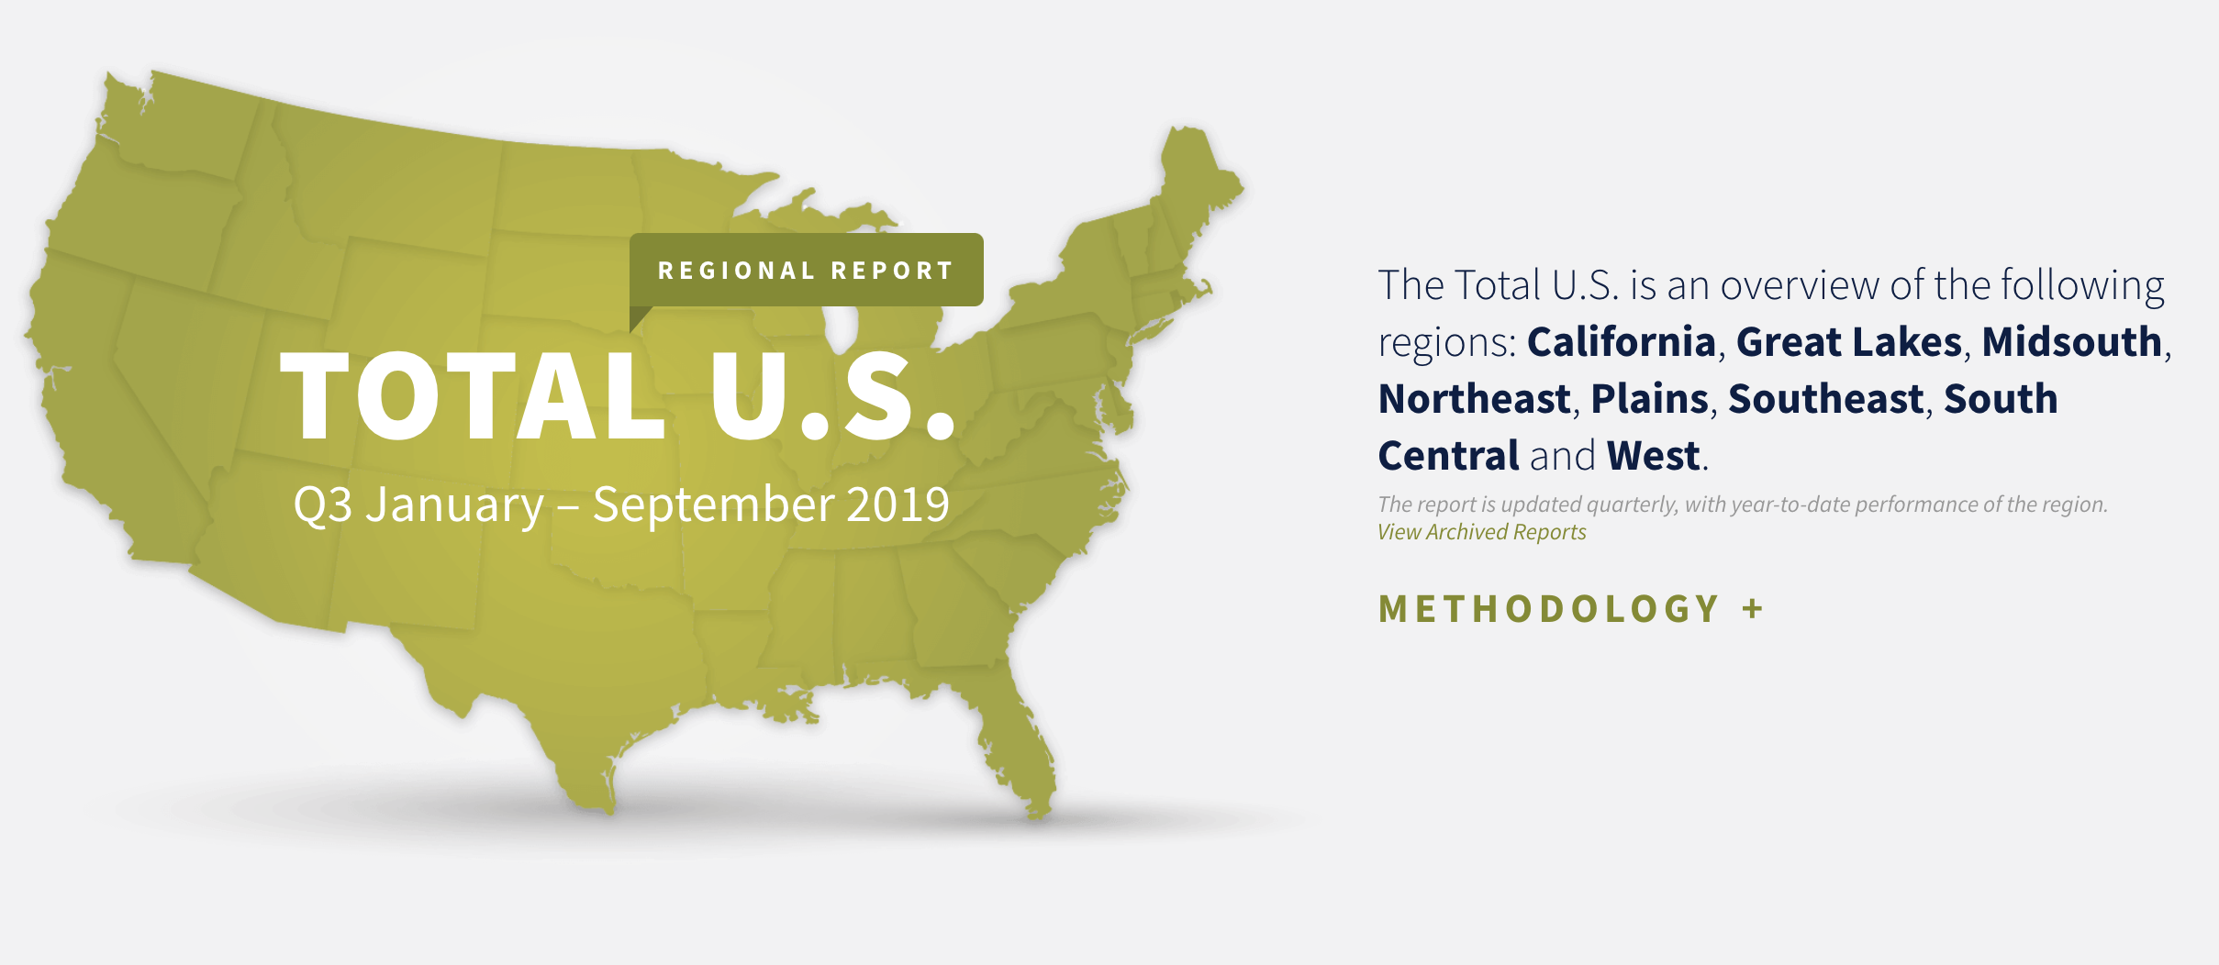
Data Exploration: Gotchas
Total US column: Was its own row under region column and had to decide to remove it or not.
Regions: Broken out in odd ways (cities, bulked regions, etc) causing perceived overlap in the data.
Size of Avocados: are represented twice in the data
The bag size is based on the size of the avocado inside
Ex. small bags only include small avocados
Notes:
gina

Slide 13
Data Analysis
Notes:
Gina - j notebook data analysis

Slide 14
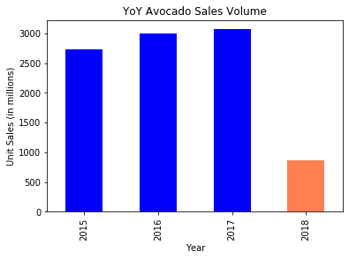
Are the sales of avocados increasing each year?
Year over year from 2015 to 2018, avocado sales have grown in total volume.
Notes:
gina

Slide 15
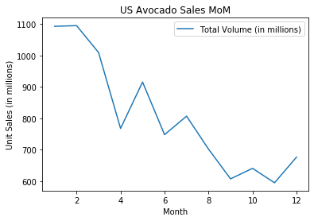
Is there seasonality for avocado sales MoM?
There's a general decline in avocado sales throughout the the calendar year with the first quarter of the year showing the most volume.
Notes:
gina

Slide 16
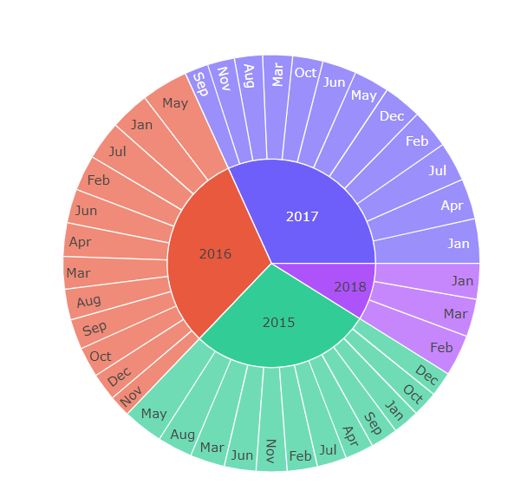
What’s the seasonality of avocado consumption?
May was the highest selling month for 2015 & 2016, while January was the highest for 2017.
Notes:
gina
Sorts volume of avocado sales by month, each year starts with lowest selling month, ends with most (moves clockwise)

Slide 17
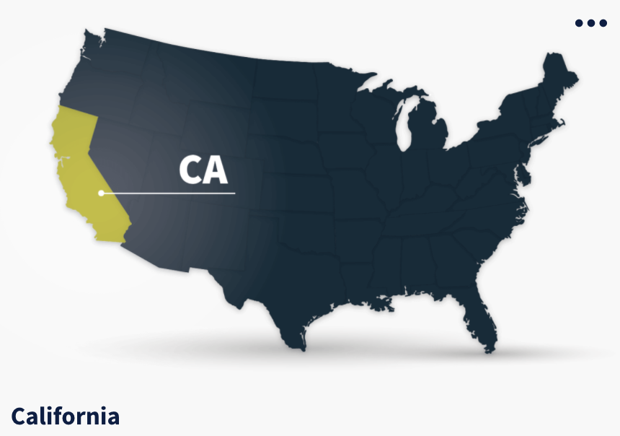
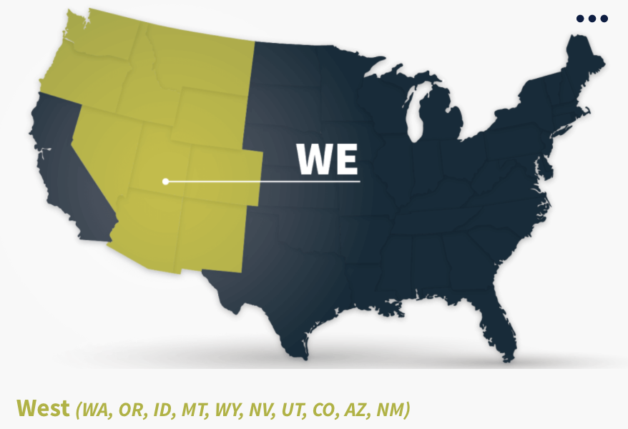
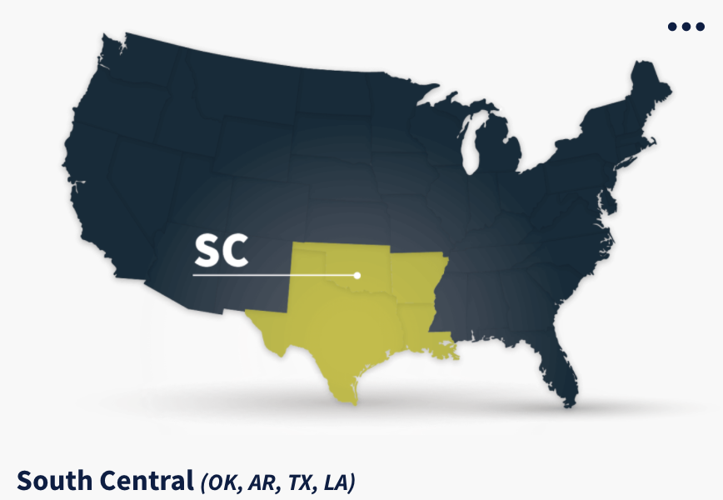
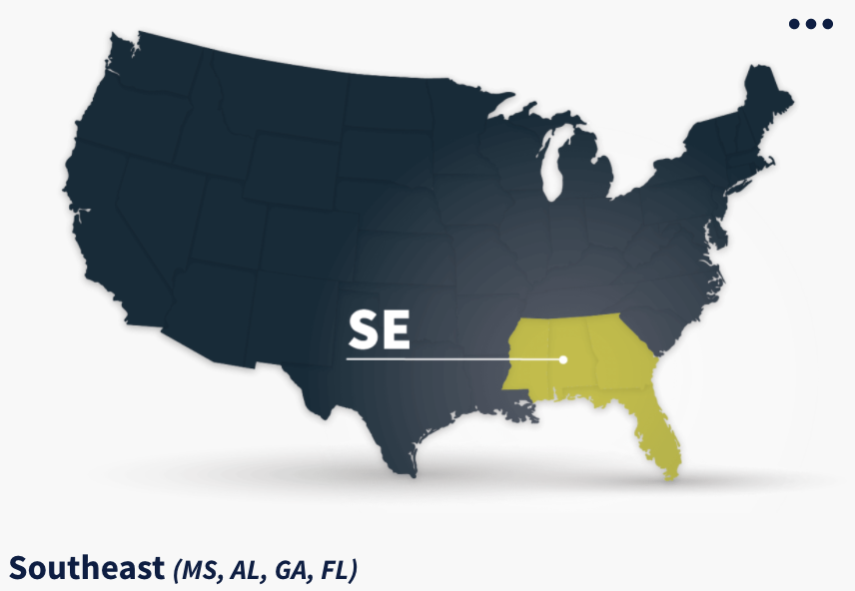
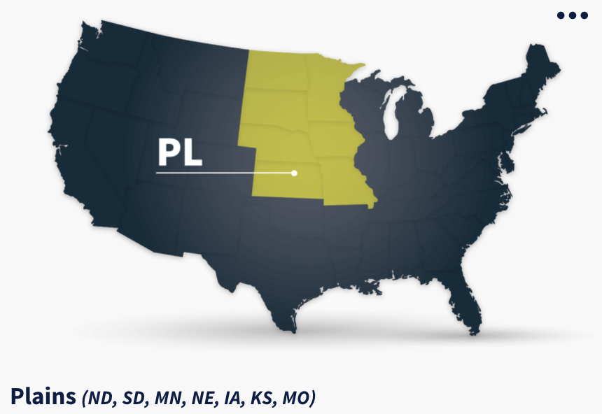
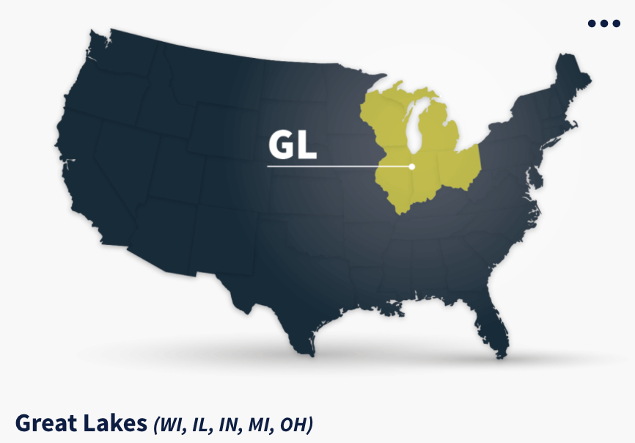
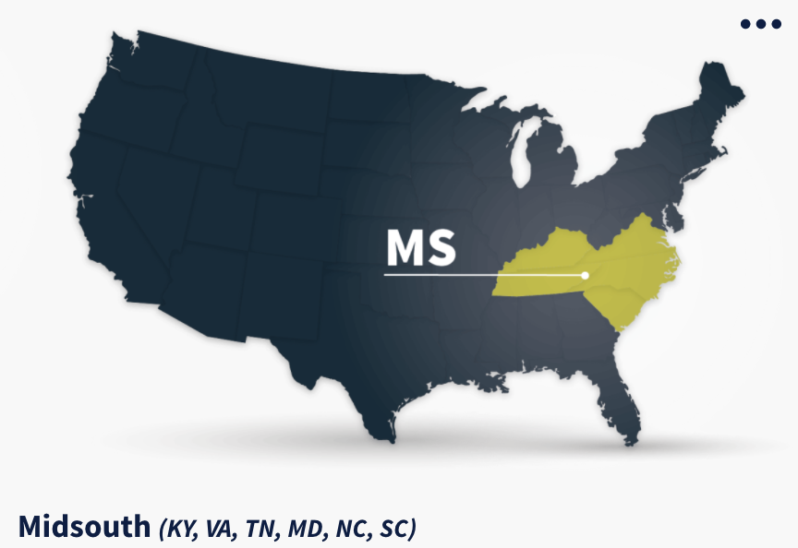
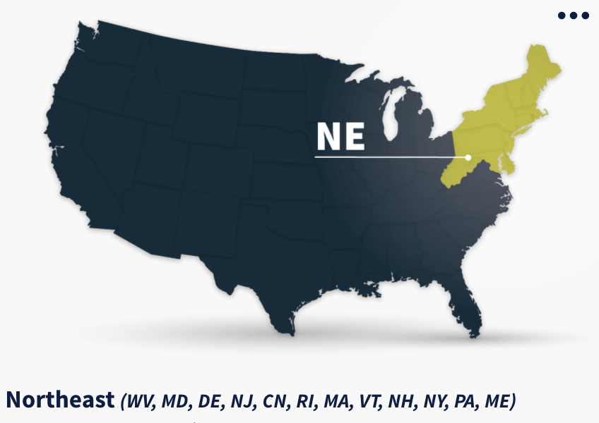
The 8 Regions
Notes:
Abby
My question is What regions sold the most avocados? The dataset includes avocado prices by city and region. Some of the cities have unclear boundaries, so I use the regions for the analysis. Here are the regions use in the data.

Slide 18
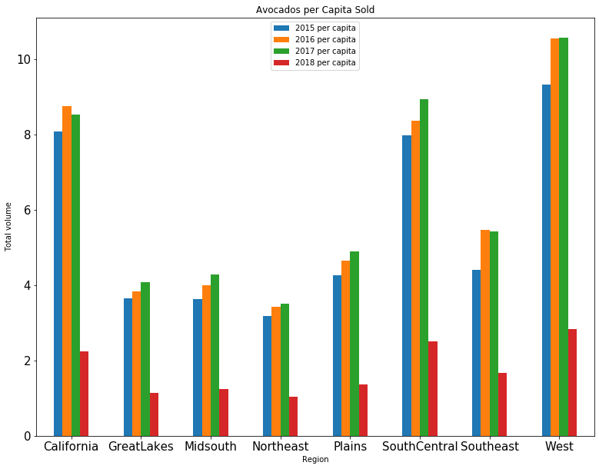
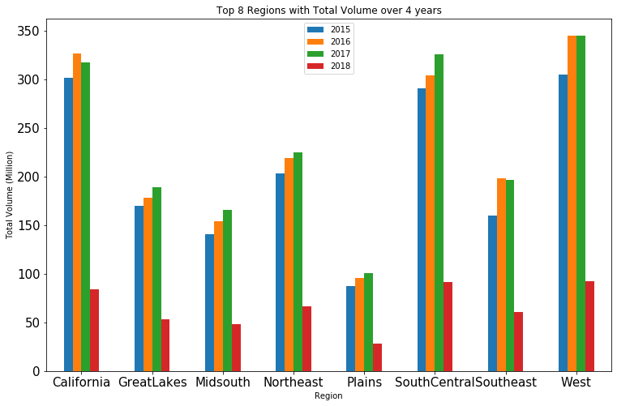
What regions sold the most avocados?
Comparing total volume to sales volume per capita in the U.S regions. The region that sold most avocados is West.
Notes:
Abby
It’s obvious that West, CA, and southcentral are top 3 regions for selling avocados. In the beginning, I wasn’t thinking of using cesus population data at all, but I did. It turned out it didn’t affect the top 3 regions, but it did change bottom few a lot, such as, plains and northeast.

Slide 19
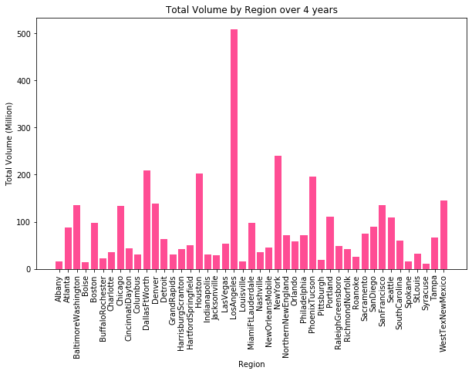
What are the regional sales of avocados?
The most popular places for avocados are LA, NY, Houston, and Dallas.
Notes:
Abby
For this one, I just want to share everyone that many of the cities in the data isn’t really clearly defined, like…...Westtexnewmaxcio is listed as a single city. So here I can do it’s combined the all years data and compared which one place bought the most avocado.

Slide 20
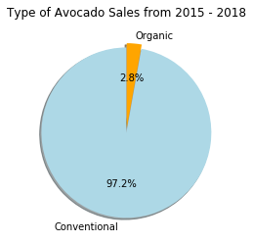
What’s the breakout of avocado sales: Conventional versus Organic?
Conventional avocado sales are the vast majority of the market, with only 3% of the avocados sold from 2015 - 2018 in the US have been grown organically.
Notes:
jacob

Slide 21
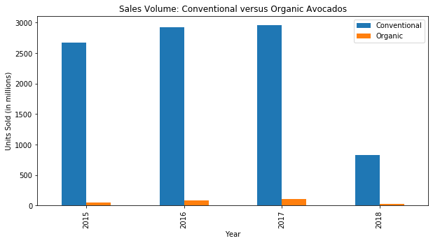
What’s the breakout of avocado sales: Conventional versus Organic?
Each year organic sales have stayed relatively low, however it has been increasing steadily since the first recorded year.
Notes:
jacob

Slide 22
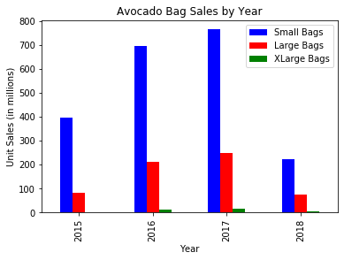
Bag: What size avocado is most popular?
Year by year assessment of sales of bags of Hass avocados. Small bags were by far the most popular.
Notes:
ray

Slide 23
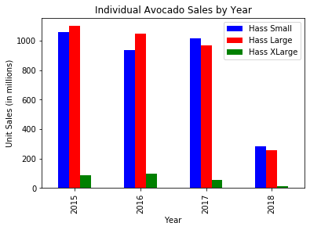
Individual: What size avocado is most popular?
Year by year assessment of sales of individual Hass avocado sizes. Small and large avocados were significantly more popular. Extra large avocados were a rarity.
Notes:
ray

Slide 24
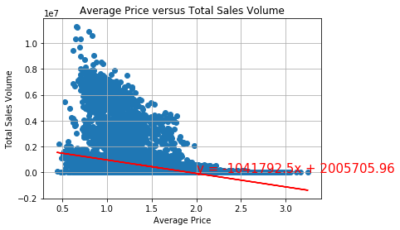
Extra: How does the price of an avocado impact sales?
A visual representation of how price impacts sales, using linear regression we see at roughly $2 the sales drop off significantly.
Notes:
ray
Possible correlation for low xl avocado sales - higher price = less demand

Slide 25
Discussion
Notes:
ray

Slide 26
Conclusion
YoY, avocados have increased in sales volume across the US in line with our hypothesis
Conventional avocados drive most of the sales volume versus organic avocados.
8 regions in the US drive most of the sales volume (accounting for 61% of total volume)
US consumers are are primarily buying small and large sizes, in addition to small bags.
Notes:
ray

Slide 27
Post Mortem
Notes:
abby

Slide 28
Difficulties
Working with a partial year of data (2018)
Merging our branches using github
Deciding to remove ‘totalUS’ row and working with overlapping regional data.
We had limited data ending in May 2018 so couldn’t see the growth since then.
Notes:
Abby
-1.We kept 2018, but ensured to highlight in YoY data
-2.We manually copy/pasted code into master
-3.We ended up removing the row after digging deeper.
-4.We didn’t find recent data.

Slide 29
If we had more time….
Find recent data post May 2018
Figure out lat,longs to use Google places to heatmap avocado sales
Find millenial home sales and correlated the relationship
Figure out how they define the regions and if they already removed the overlapping data
Adding population data to determine how this affects growth in sales versus popularity of the product (US census data)
Notes:
gina

Slide 30
Questions?
Notes:
gina

