Slide 1


2022
ZkPayroll
Double Security

Slide 2
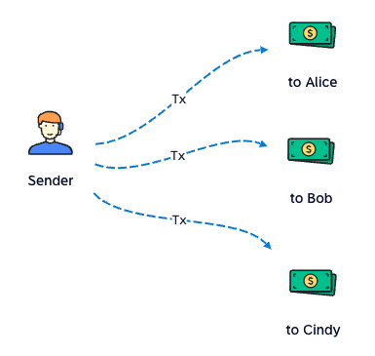
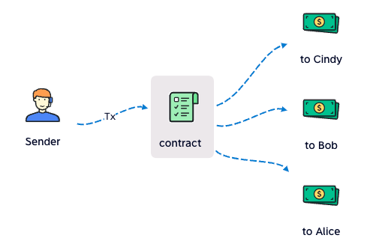
Batch Pay
Usual Pay
one tx one payment
gas: high
time: long
Batch Pay
one tx multi payments
gas: low
time: quick

Slide 3
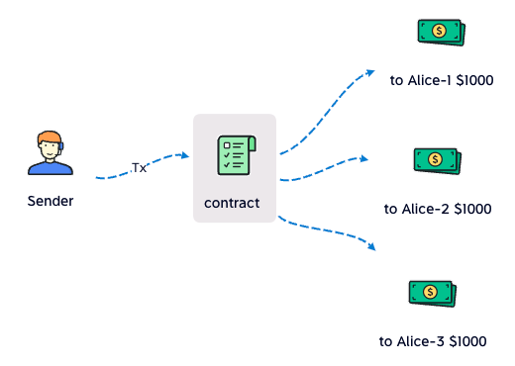
Batch Pay
Hide the high salary
split $3000 into 3 payment (address)

Slide 4
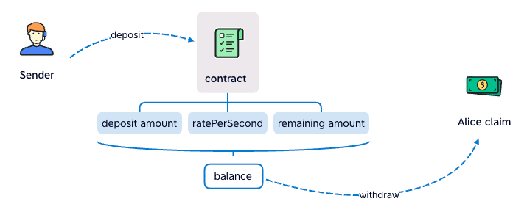
Streaming Pay
Claim salary every sec
sender deposit to contract
recipient withdraw from contract
contract calculats how much (balance) the recipient can claim

Slide 5
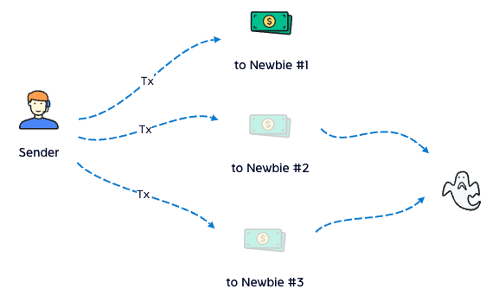
Safe Box
Is private key safe enough?
we recognize that the newbie's first salary is much easier to be stolen
In fact, there're many traps (e.g. Phishing) to take our private key
so we build safebox, to save assets

Slide 6
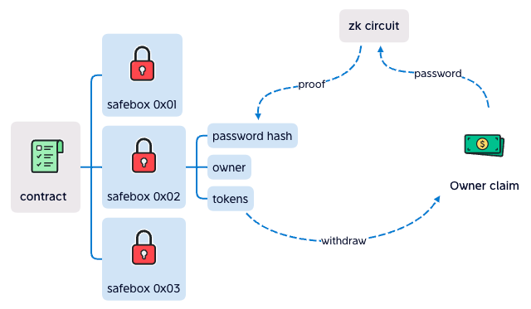
Safe Box
It hides password
owner input password to zk circuit at frontend
zk circuit calculate the proof to contract
contract verify success, withdraw to owner

Slide 7
Safe Box
Double Security
private key is taken, safebox is still safe
password is taken, safebox is still safe
both private key and password are taken, that's so bad

Slide 8
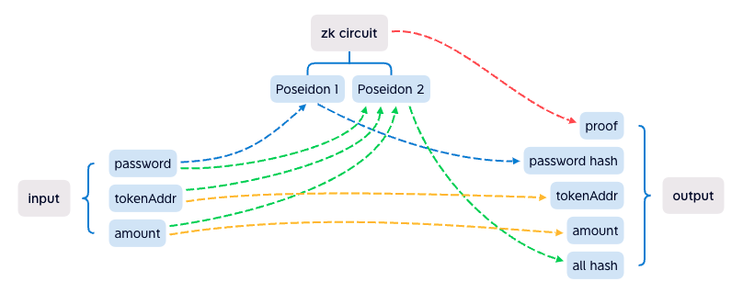
Safe Box
zk circuit
it's complex, but it's done, and works well
we're going to upgrade it, make calculation harder
to anti brute force cracking

Slide 9


Team
George
10+ years full stack develop
4 years solidity develop
a boring coder
BlackRabbit
10+ years full stack develop
2 years web3 develop
another boring coder

Slide 10
2022
It's show time
zkpayroll.xyz
https://github.com/busyapedao/zkpayroll-contract

