Slide 1


2022
ZkPayroll
Double security
Notes:
大家好，我来介绍一下METAPO。一个Web3社交网络，通过公平的曝光量算法，建立SocialFI。
Hello everyone, let me introduce METAPO. A Web3 social network, with a fair exposure algorithm, to build SocialFI.

Slide 2
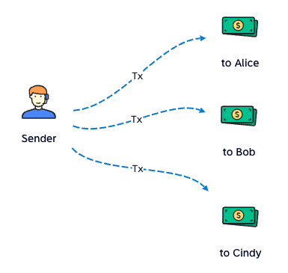
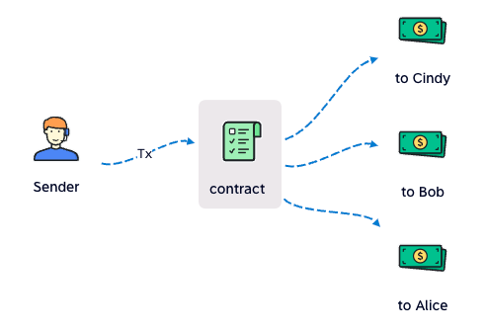
Batch Pay
Usually Pay
one tx one payment
gas: high
time: long
Batch Pay
one tx multi payments
gas: low
time: short
Notes:
这是Metapo的预览，首页有点像google，用来搜索帖子。每个帖子是一个NFT，由用户铸造，Mirror把这样的帖子叫做Entry，好吧，那我们也这么叫。排名是按照热度值排的，热度即曝光量。由于热度值是在智能合约里计算出来的，所以唯一能改变热度值的办法就是用户点击喜欢按钮，下面我将详细介绍这种算法。
This is a preview of Metapo,
the homepage looks like google for searching posts.
Each post is an NFT, minted by user, Mirror calls such a post an Entry, well, then we call it that too.
The ranking sorts by the Hot value,
Hot is exposure, which is calculated in the smart contract,
so the only way to change the Hot is pressing the Like button.
I will introduce this algorithm in detail below.

Slide 3
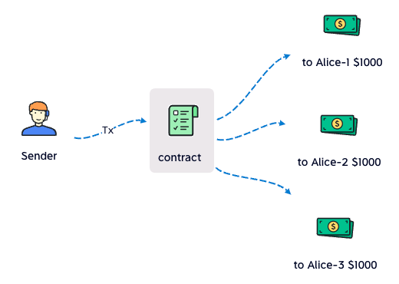
Batch Pay
Hide the high salary
split $3000 into 3 payment(address)
Notes:
这是Metapo的预览，首页有点像google，用来搜索帖子。每个帖子是一个NFT，由用户铸造，Mirror把这样的帖子叫做Entry，好吧，那我们也这么叫。排名是按照热度值排的，热度即曝光量。由于热度值是在智能合约里计算出来的，所以唯一能改变热度值的办法就是用户点击喜欢按钮，下面我将详细介绍这种算法。
This is a preview of Metapo,
the homepage looks like google for searching posts.
Each post is an NFT, minted by user, Mirror calls such a post an Entry, well, then we call it that too.
The ranking sorts by the Hot value,
Hot is exposure, which is calculated in the smart contract,
so the only way to change the Hot is pressing the Like button.
I will introduce this algorithm in detail below.

Slide 4
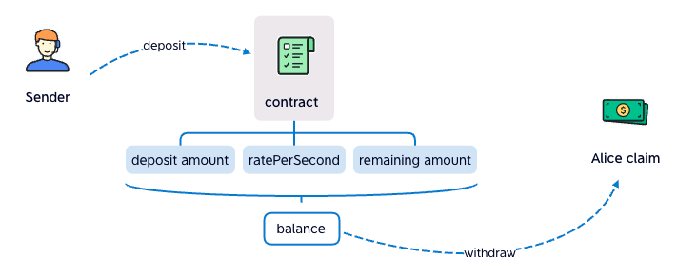
Streaming Pay
Claim salary every sec
sender deposit to contract
recipient withdraw from contract
contract calculats how much (balance) the recipient can claim
Notes:
这是Metapo的预览，首页有点像google，用来搜索帖子。每个帖子是一个NFT，由用户铸造，Mirror把这样的帖子叫做Entry，好吧，那我们也这么叫。排名是按照热度值排的，热度即曝光量。由于热度值是在智能合约里计算出来的，所以唯一能改变热度值的办法就是用户点击喜欢按钮，下面我将详细介绍这种算法。
This is a preview of Metapo,
the homepage looks like google for searching posts.
Each post is an NFT, minted by user, Mirror calls such a post an Entry, well, then we call it that too.
The ranking sorts by the Hot value,
Hot is exposure, which is calculated in the smart contract,
so the only way to change the Hot is pressing the Like button.
I will introduce this algorithm in detail below.

Slide 5
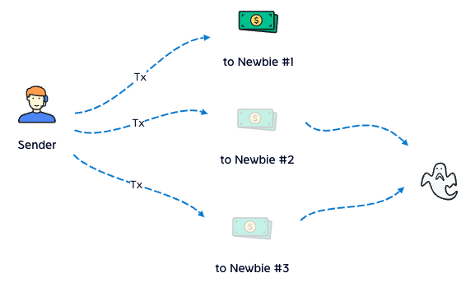
Safe Box
Is your wallet safe enough?
We recognize that the newbie's first salary is much easier to be stole
In fact, there're many ways to take our private key
Notes:
这是Metapo的预览，首页有点像google，用来搜索帖子。每个帖子是一个NFT，由用户铸造，Mirror把这样的帖子叫做Entry，好吧，那我们也这么叫。排名是按照热度值排的，热度即曝光量。由于热度值是在智能合约里计算出来的，所以唯一能改变热度值的办法就是用户点击喜欢按钮，下面我将详细介绍这种算法。
This is a preview of Metapo,
the homepage looks like google for searching posts.
Each post is an NFT, minted by user, Mirror calls such a post an Entry, well, then we call it that too.
The ranking sorts by the Hot value,
Hot is exposure, which is calculated in the smart contract,
so the only way to change the Hot is pressing the Like button.
I will introduce this algorithm in detail below.

Slide 6
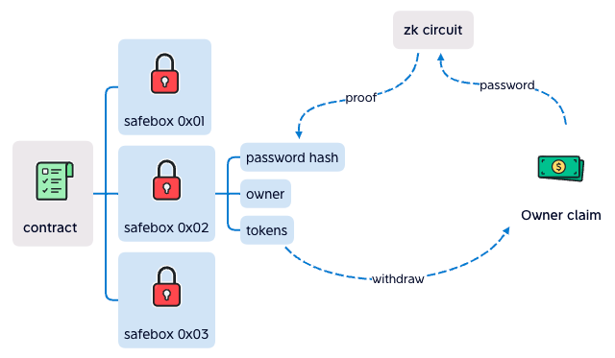
Safe Box
It hides password
user input password to zk circuit at frontend
zk circuit calculate the proof to contract
contract verify success, withdraw to user
Notes:
这是Metapo的预览，首页有点像google，用来搜索帖子。每个帖子是一个NFT，由用户铸造，Mirror把这样的帖子叫做Entry，好吧，那我们也这么叫。排名是按照热度值排的，热度即曝光量。由于热度值是在智能合约里计算出来的，所以唯一能改变热度值的办法就是用户点击喜欢按钮，下面我将详细介绍这种算法。
This is a preview of Metapo,
the homepage looks like google for searching posts.
Each post is an NFT, minted by user, Mirror calls such a post an Entry, well, then we call it that too.
The ranking sorts by the Hot value,
Hot is exposure, which is calculated in the smart contract,
so the only way to change the Hot is pressing the Like button.
I will introduce this algorithm in detail below.

Slide 7
Safe Box
Double Security
private key is taken, safebox is still safe
password is taken, safebox is still safe
both private key and password are taken, that's so bad
Notes:
这是Metapo的预览，首页有点像google，用来搜索帖子。每个帖子是一个NFT，由用户铸造，Mirror把这样的帖子叫做Entry，好吧，那我们也这么叫。排名是按照热度值排的，热度即曝光量。由于热度值是在智能合约里计算出来的，所以唯一能改变热度值的办法就是用户点击喜欢按钮，下面我将详细介绍这种算法。
This is a preview of Metapo,
the homepage looks like google for searching posts.
Each post is an NFT, minted by user, Mirror calls such a post an Entry, well, then we call it that too.
The ranking sorts by the Hot value,
Hot is exposure, which is calculated in the smart contract,
so the only way to change the Hot is pressing the Like button.
I will introduce this algorithm in detail below.

Slide 8
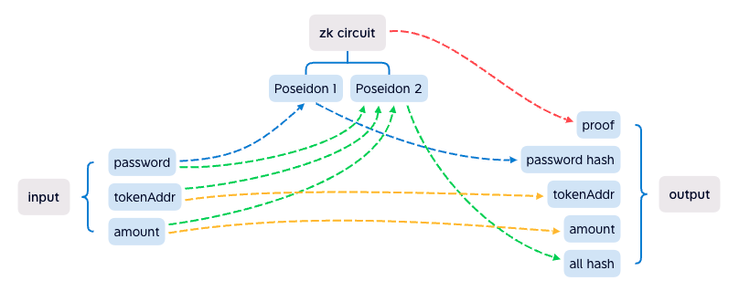
Safe Box
zk circuit
it's complex, but it's done, and works well
we'll try to upgrade it, make it harder to calculate
anti brute force cracking
Notes:
这是Metapo的预览，首页有点像google，用来搜索帖子。每个帖子是一个NFT，由用户铸造，Mirror把这样的帖子叫做Entry，好吧，那我们也这么叫。排名是按照热度值排的，热度即曝光量。由于热度值是在智能合约里计算出来的，所以唯一能改变热度值的办法就是用户点击喜欢按钮，下面我将详细介绍这种算法。
This is a preview of Metapo,
the homepage looks like google for searching posts.
Each post is an NFT, minted by user, Mirror calls such a post an Entry, well, then we call it that too.
The ranking sorts by the Hot value,
Hot is exposure, which is calculated in the smart contract,
so the only way to change the Hot is pressing the Like button.
I will introduce this algorithm in detail below.

Slide 9


Team
George
10+ years full stack develop
4 years solidity develop
boring coder
BlackRabbit
10+ years full stack develop
2 years web3 develop
another boring coder
Notes:
我们计划在今年上线，第一季也就是现在，是POC阶段，概念证明；第二季是开发测试阶段，需要更多的开发者；第三季度上线，希望一切顺利！
We plan to launch this year,
season 1, now it is, the POC stage, proof of concept;
season 2, the development stage, and more developers are needed;
season 3, launch! Hopes everything goes well!

Slide 10
2022
谢谢观看
THANK YOU
https://github.com/busyapedao/zkpayroll-contract
Notes:
就这样，谢谢大家！
That's it, thank you!

