Slide 1


2022
zkSafebox
Double Security

Slide 2
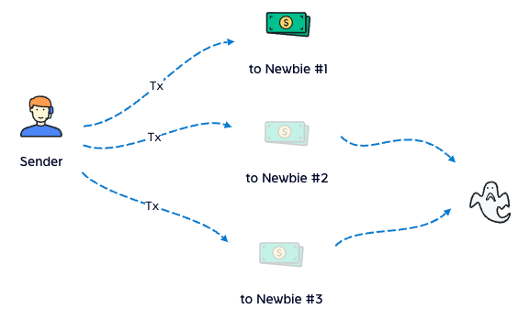
Story
Is private key safe enough?
we recognize that the newbie's first tx is much easier to be stolen
even me, I often worry about my wallet
so we build safebox, to save assets

Slide 3
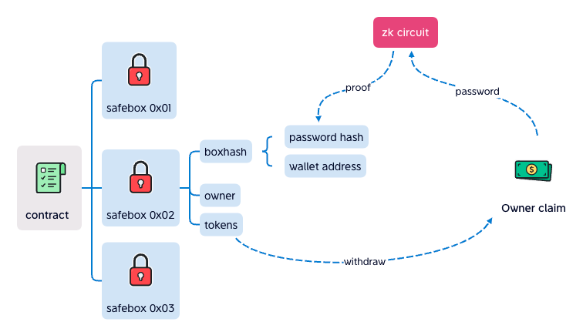
ZK-SNARK
It hides password
owner input password to zk circuit at frontend
zk circuit calculate the proof to contract
contract verify success, withdraw to owner

Slide 4
ZK-SNARK
Double Security
private key is stolen, safebox is still safe
password is stolen, safebox is still safe
both private key and password are stolen, that's so bad

Slide 5
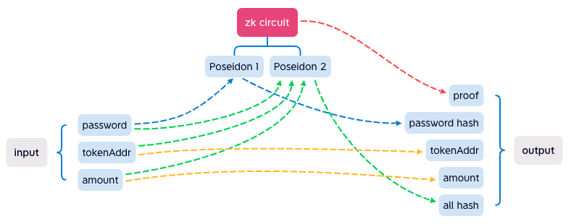
ZK-SNARK
zk circuit
it's complex, but it's done, and works well

Slide 6
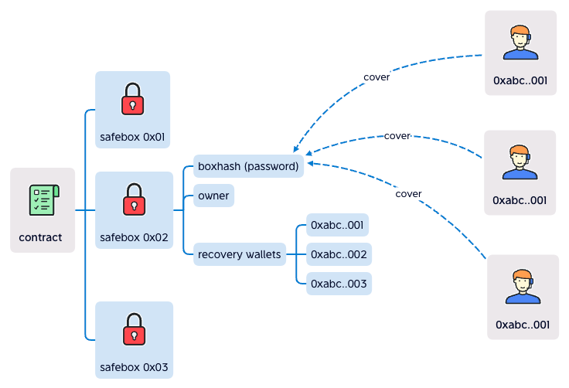
Social Recover
Social Recover
if you forget your password, your friends can help you to cover it

Slide 7


Team
George
10+ years full stack develop
4 years solidity develop
a boring coder
BlackRabbit
10+ years full stack develop
2 years web3 develop
another boring coder

Slide 8
2022
It's show time
zksafebox.vercel.app
https://github.com/busyapedao/zksafebox-contract

