Slide 1
Model Context Protocol
By Dev J. Shah
Notes:
Hello everyone! This is Dev and today I am going to talk about Model Context Protocol. First of all, how many of you here have heard about Model Context Protocol?

Slide 2
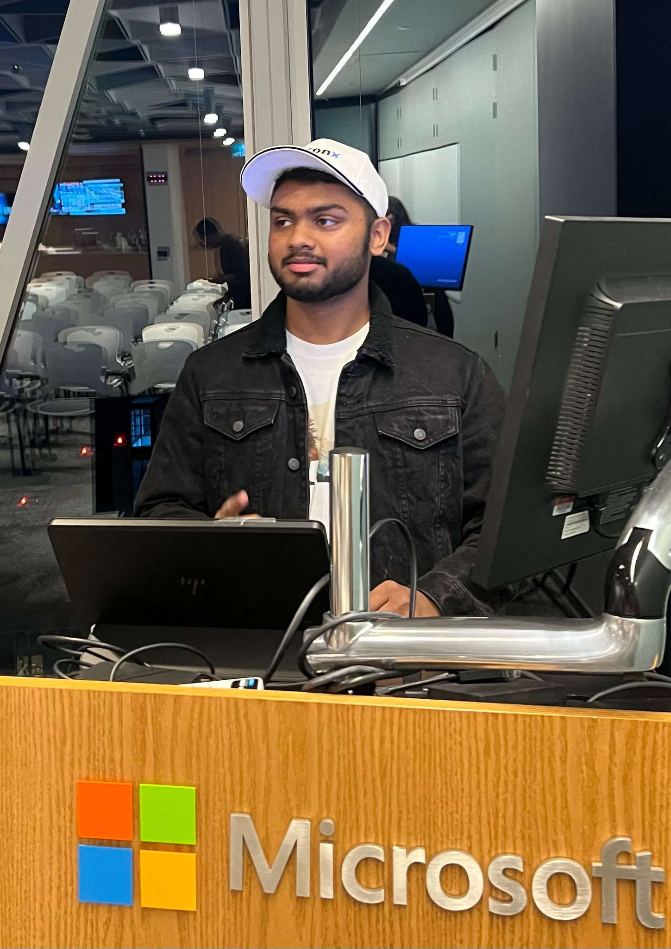
Introduction
Name: Dev J. Shah
Full Stack Developer, AI Evangelist
Blogger | YouTuber | GenAI Enthusiast
Username: busycaesar
I create content to help developers explore Generative AI concepts and bring AI into real-world applications.
Notes:
Alright, let me first introduce myself.
My name is Dev and I am a Full Stack Developer.
I also write tech blogs, create tech videos on YouTube and actively learn and share things in the field of Generative AI.
I go by this username on almost all the platforms. Hence, its easy to find me on any platform.

Slide 3
RAG to MCP
Retrieval-Augmented Generation
Store Data in Vector Database into chunks
Retrieve relevant data based on user's prompt
Pass the prompt along with the relevant data to the LLM to generate the response
MCP
Gets access to various sources of data in real time through tools.
AI Agents can fetch the publicly available content from the internet related to the user's query, but cannot access the data from data sources.
Possible to build the functionality without using MCP, but MCP standardize this logic.
Notes:
So where did it come from?
Before MCP, everyone was and is talking about Retrieval-Augment Generation, that is a technique in which you store your data first in Vector Database into chunks and then based on the user's prompt, you retrieve the most relevant chunks of data, augment it with the user's prompt and pass it to the LLM to generate the response.
MCP is a similar concept but it goes one step further. MCP get the access to various sources of data in real time. Although traditional AI Agents like ChatGPT, can search for the content related to the user's query from the internet in real time, it wont be able to fetch the content from the place where your data lives. For example, if you ask ChatGPT, to help you summarize your last 3 commits on a specific GitHub Repository, it wont be able to serve you as it does not have access to your GitHub account or repository.
However, it is completely possible to build such functionality without using MCP, but MCP standardize this logic because of which makes it easy to plug and play with various MCP server through various AI Agents and even build your custom MCP server that can work with existing AI agents.

Slide 4
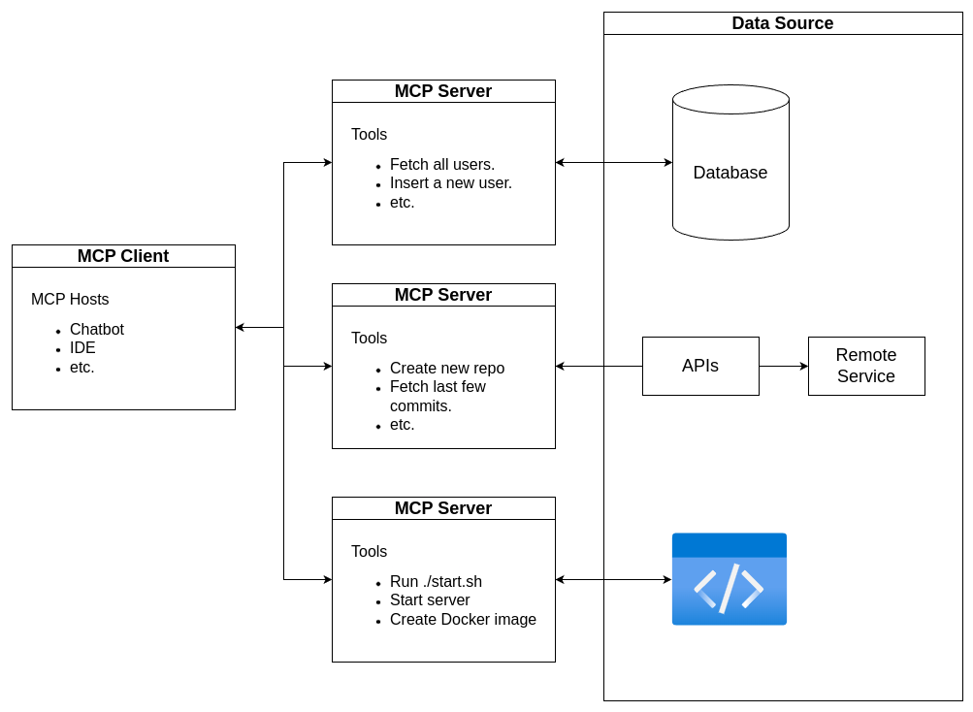
Model Context Protocol (MCP) Architecture
Notes:
Alright. Now, lets start with first understand the basic architecture of Model Context Protocol before delving deep into the workflow.
Overall, MCP consists of these three components: one is MCP Hosts, the other is MCP Client and the third one is MCP server.
Lets disucss these components one by one.
MCP Hosts is the AI Agent like a chatbot or copilot that directly interacts with the user.
MCP Client maintains a 1 to 1 relationship with one or more MCP servers. MCP Client is the components that does most of the work in MCP workflow.
Lastly, there are MCP Servers. MCP Server consists of the list of tools which provide a variety of data. In simple words, tools are functions that can be called by the MCP client to fetch the data as required by the user query.
These tools listed in MCP can be connected with the database, remote service through APIs or run some code or script.
This is the basic architecture of the MCP

Slide 5
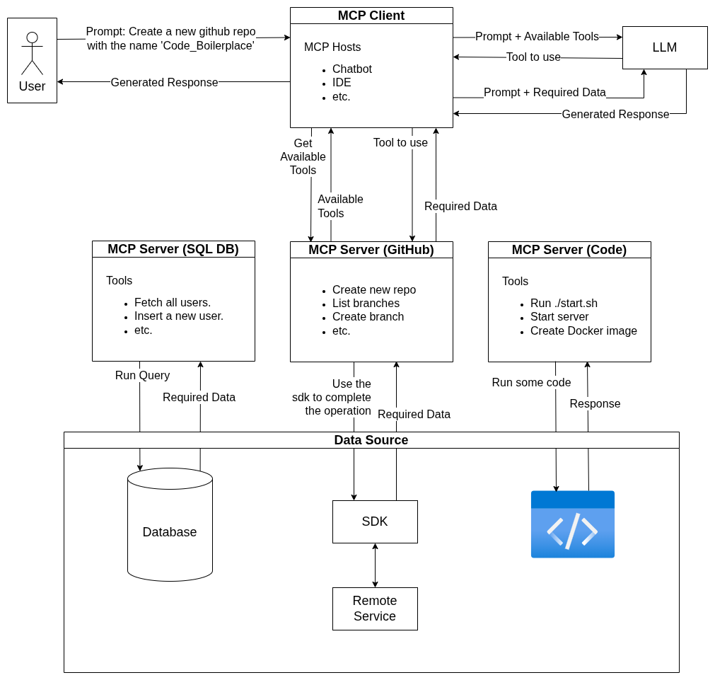
Workflow
Notes:
Moving forward to the MCP workflow.
First, the user writes some prompt in a chatbot. Assuming the prompt is "Create a new github repo with the name 'Code_Boilerplate'".
This prompt is received by the MCP Host which is further handeled by the MCP Client. The MCP client first calls the MCP server that serves the requests related to GitHub and asks the send the list of all the tools available. The MCP server in return passes the list of tools available to the MCP Client.
In the next step, the MCP Client passes the prompt along with the list of tools to the LLM and asks if there is any specific tool/s to be used to answer the prompt. As a response, the LLM returns the tool/s to be executed to get the relevant data to answer the prompt.
Now, the MCP client passes the tool/s to be executed to the MCP server. The MCP server then runs the tools and gets the required data. This data is then passed to the MCP client.
The MCP client finally sends the relevant data received along with the prompt to the LLM and now the LLM generates the response based on the data and returns it to the MCP Client.
Last but not the least, the MCP Client sends this response to the User through the MCP Host.
This is the whole workflow of how MCP works.
Here one thing to understand is that the MCP server's tools are not only used to fetch the information, it can also be used to do some operations, like creating some resource using the information from the user's query.
You will understand it more clearly, once you see the code.

Slide 6
Code and Demonstration
Code Walkthrough
Project Demonstration
Notes:
Time to get hands on.

Slide 7
More Use Cases
Companies launching their own MCP servers.
AI Agents providing the facility to using your custom MCP server.
Notes:
A large number of companies are adapting this protocol; hence they are publishing their own MCP server, just like SDKs and APIs. Moreover, AI Agents like copilot are providing the facilities to integrate your own, custom MCP server.

Slide 8
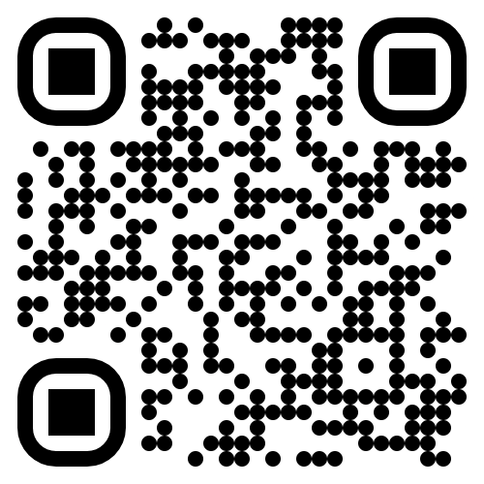
Final Words
#OpenToOpportunities Thank you for attending.
Notes:
Thank you for attending this session.
Scan this QR Code to connect with me on LinkedIn and let me know if you have any questions.

