Slide 1
Notes on FoxDot
Assembled Information from several documentation sources

Slide 2
https://www.youtube.com/watch?v=d8XP7zT-lBo
Start supercollider
Strg + b
FoxDot.start()
Enter „FoxDot“ in (Pycharm) Terminal
Enter python -m FoxDot in Terminal

Slide 3
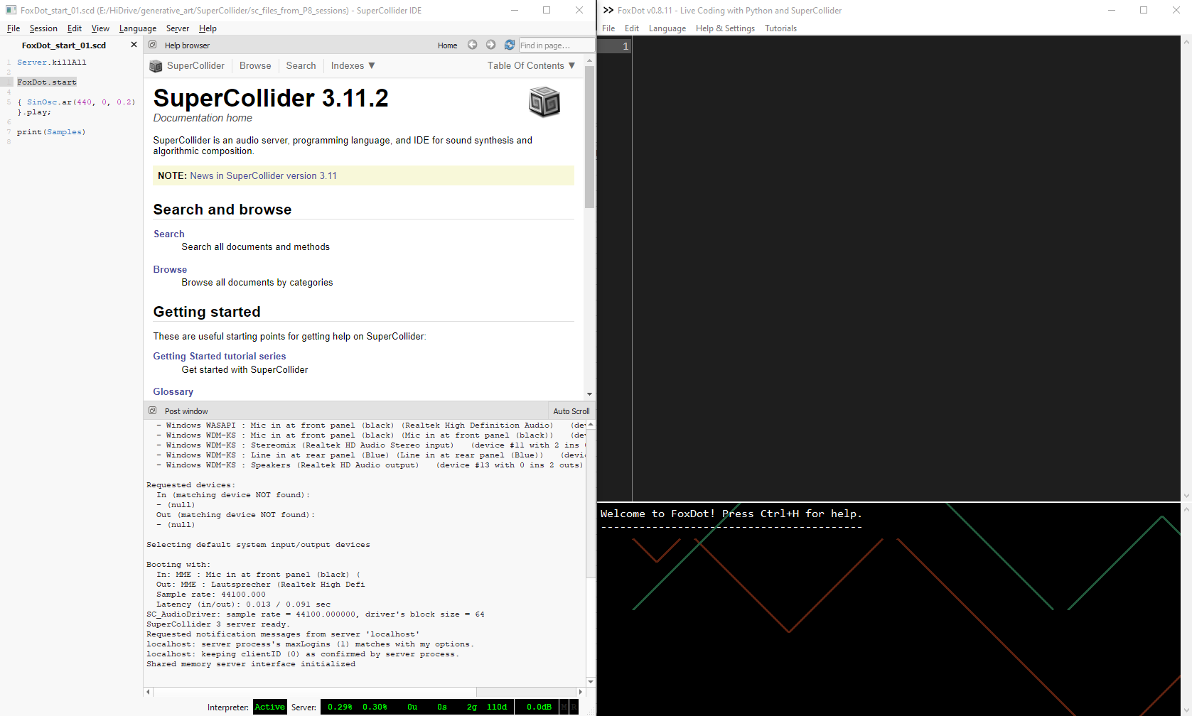
Start Screen

Slide 4
Meaning of Arguments and lists
First argument is pitch
  p1 » pluck(1)
  Pitch could be in a list
  p1 » pluck([0, 2, 4, 5, 7, 9, 11])
Pitch could be in a chord (in round brackets)
  p1 » pluck([0, 2, 4, 5, 7, 9, 11,(0, 2, 4, 5, 7, 9, 11)])
nested lists: each pitch of the second list is appended to the end of the first list in turn.
  p1 >> pluck([0, 2, 4, 5, 7, 9, 11,[0, 2, 4, 5, 7, 9, 11]])
  Plays 0, 2, 4, 5, 7, 9, 11, 0 0, 2, 4, 5, 7, 9, 11, 2 0, 2, 4, 5, 7, 9, 11, 4 ....

Slide 5
Player Object
# create a new player objetc
  foo = Player()
  foo >> pluck((3,5,8))

Slide 6
Octave - Durations
Default octave is 5
  p2 >> blip(oct=2)
Durations
  p2 >> blip(oct=2,dur=[1/2,0.5,1,2])
Stop all playaer objects:
  Strg + . or Clock.clear()
Sop a single player Object:
  P1.stop()

Slide 7
Sceduling of musical events
print(Clock) shows the next event
Tempo is defined in bpm (default 120) with
  Clock.bpm=100

Slide 8
Trigger audio files with play()
Multiple events in a duration period with []
Nested lists with () like with pitches:
  each sound element of the second list is appended to the end of the elements of the first list in turn.
Play item from the subsequence list at random within {...}:
Each character is mapped to the first file in a folder
  Next file with sample=n (n = 0,1,2,...)

Slide 9
Infos about methods and modules

Slide 10
Display all SynthDefs
>>> print(SynthDefs)
['loop', 'stretch', 'play1', 'play2', 'audioin', 'noise', 'dab', 'varsaw', 'lazer', 'growl', 'bass', 'dirt', 'crunch', 'rave', 'scatter', 'charm', 'bell', 'gong', 'soprano', 'dub', 'viola', 'scratch', 'klank', 'feel', 'glass', 'soft', 'quin', 'pluck', 'spark', 'blip', 'ripple', 'creep', 'orient', 'zap', 'marimba', 'fuzz', 'bug', 'pulse', 'saw', 'snick', 'twang', 'karp', 'arpy', 'nylon', 'donk', 'squish', 'swell', 'razz', 'sitar', 'star', 'jbass', 'piano', 'sawbass', 'prophet', 'pads', 'pasha', 'ambi', 'space', 'keys', 'dbass', 'sinepad']

Slide 11
Keyword Arguments
print(Player.Attributes())
  ('degree', 'oct', 'freq', 'dur', 'delay', 'buf', 'blur', 'amplify', 'scale', 'bpm', 'sample', 'env', 'sus', 'fmod', 'pan', 'rate', 'amp', 'midinote', 'channel', 'vib', 'vibdepth', 'slide', 'sus', 'slidedelay', 'slidefrom', 'glide', 'glidedelay', 'bend', 'benddelay', 'coarse', 'striate', 'buf', 'rate', 'pshift', 'hpf', 'hpr', 'lpf', 'lpr', 'swell', 'bpf', 'bpr', 'bpnoise', 'bits', 'amp', 'crush', 'dist', 'tmp', 'chop', 'tremolo', 'beat_dur', 'echo', 'echotime', 'spin', 'cut', 'room', 'mix', 'formant', 'shape', 'drive')

Slide 12
Scales
Print Scale.names()
  ['aeolian', 'altered', 'bebopDom', 'bebopDorian', 'bebopMaj', 'bebopMelMin', 'blues', 'chinese', 'chromatic', 'custom', 'default', 'diminished', 'dorian', 'dorian2', 'egyptian', 'freq', 'halfDim', 'halfWhole', 'harmonicMajor', 'harmonicMinor', 'hungarianMinor', 'indian', 'justMajor', 'justMinor', 'locrian', 'locrianMajor', 'lydian', 'lydianAug', 'lydianDom', 'lydianMinor', 'major', 'majorPentatonic', 'melMin5th', 'melodicMajor', 'melodicMinor', 'minMaj', 'minor', 'minorPentatonic', 'mixolydian', 'phrygian', 'prometheus', 'romanianMinor', 'susb9', 'wholeHalf', 'wholeTone', 'yu', 'zhi']

Slide 13
Keyword Argument chop
pluck([Chop=[1,2,4,8,32]
  chops each pitch in parts within a measure duration

Slide 14
Patterns
Pattern Class
  Pattern([0,1,2)]
  Shorthand: P[0,1,2,3:9] series possible
  Mathematical Operations: Each Element of the Pattern List is calculated according to the mathematical function like in a list comprehension
  Append Patterns with pipe operator | : b = P[0,1,2,3] | [99,100]
  Results in P[0,1,2,3,99,100]
help(Pattern) for further information

Slide 15
Pattern stretch
>>> print( P[1,2,3,4].stretch(10))
  P[1, 2, 3, 4, 1, 2, 3, 4, 1, 2]

Slide 16
Patterns.Sequences
help(Patterns.Sequences)
>>> print(PEuclid2(3,8,'-','X'))
  P['X', '-', '-', 'X', '-', '-', 'X', '-']
Eucledian rythm:
  P1 » pluck(0, dur=PDur(3,8))
https://www.youtube.com/watch?v=_5LJftFuQFs 7:09

Slide 17
https://www.youtube.com/watch?v=_5LJftFuQFs 12:04
Time var
  p1 >> pluck(P[0,2,5,6, [(0, 2, 5), 9, 11, 12,(2, 4, 5, 8)]] + var([0,3],8), dur=PDur([5,2,3],8), oct=4)
Chord progressions
  var.chords = var([0,4,7,3],4)
  var.chords = var([0,1,5,3],4)
  var.chords = var([0],1)
  p1 >> pluck(var.chords + [0, 2, 4], dur=PDur([3,5,7],8))
  b1 >> bass(var.chords, dur=[1/2,1/2,1/4])

Slide 18
https://www.youtube.com/watch?v=_5LJftFuQFs 15:50
Patterns that change over time
  p1 >> pluck(dur=PDur(var([3,5],4),8))

Slide 19
https://www.youtube.com/watch?v=v8niuWEHUiw 0:00
Clock
  p1 >> pluck(var.chords + [0, 2, 4], dur=PDur([3,5,7],8))
  p1.every(8, "reverse")
  p1.stop_calling("reverse")
  p1.every(4, "stutter", oct=4, pan=[-0.5, 0.5])
Tutorial 3 5:27

Slide 20
Tutorial 3 5:27
Clock.schedule(lambda: p1.solo())
p1 >> pluck(var.chords + [0, 2, 4], dur=PDur([3,5,7],8))
b1 >> bass(var.chords, dur=[1/2,1/2,1/4])
Tutorial 3 13:00

Slide 21
Tutorial 3 13:05
Recursion
  def add(a, b):
  print(a + b)
  a = a* 2
  b = b / 2
  Clock.schedule(add, beat=Clock.now() + 2, args=(a,b))
  add(10,10)

Slide 22
Tutorial 4 play SynthDef
play()
  p1 >> play("x-o{(xx-z)(-xx)(z0o)(-o-)}(1,z,2,z,3,!,t,z)", sample=[0,1,2,3,4,6,7,8])
Combine several Patterns (all Permutations)
  >>> print(P[0,1,2] & P[3,4])
  P[P(0, 3), P(1, 4), P(2, 3), P(0, 4), P(1, 3), P(2, 4)]
Tutorial 4 5:22

Slide 23
Tutorial 4 5:25
Chords out of multiple Patterns
  Not further explained
p1 >> play(P["x-o-x-=(-o3), -!zz"] & P[" *[**][*][o-]"], sample=[0,1], room=0.9, verb=0.2, hpf=20, chop=2)

Slide 24
Tutorial 4 8:26
Different playback rates and separate them in left and right channels
  p1 >> play("x-o[--]", rate=(.9,1),pan=(-1,1))
  p1 >> play("x-o[--]", rate=((.9,1),),pan=((-1,1),), delay=(0,0.25))
  p1 >> play("x-o[--]", rate=((0.9,1),),pan=((-0.5,0.5),), delay=(0,0.25))

Slide 25
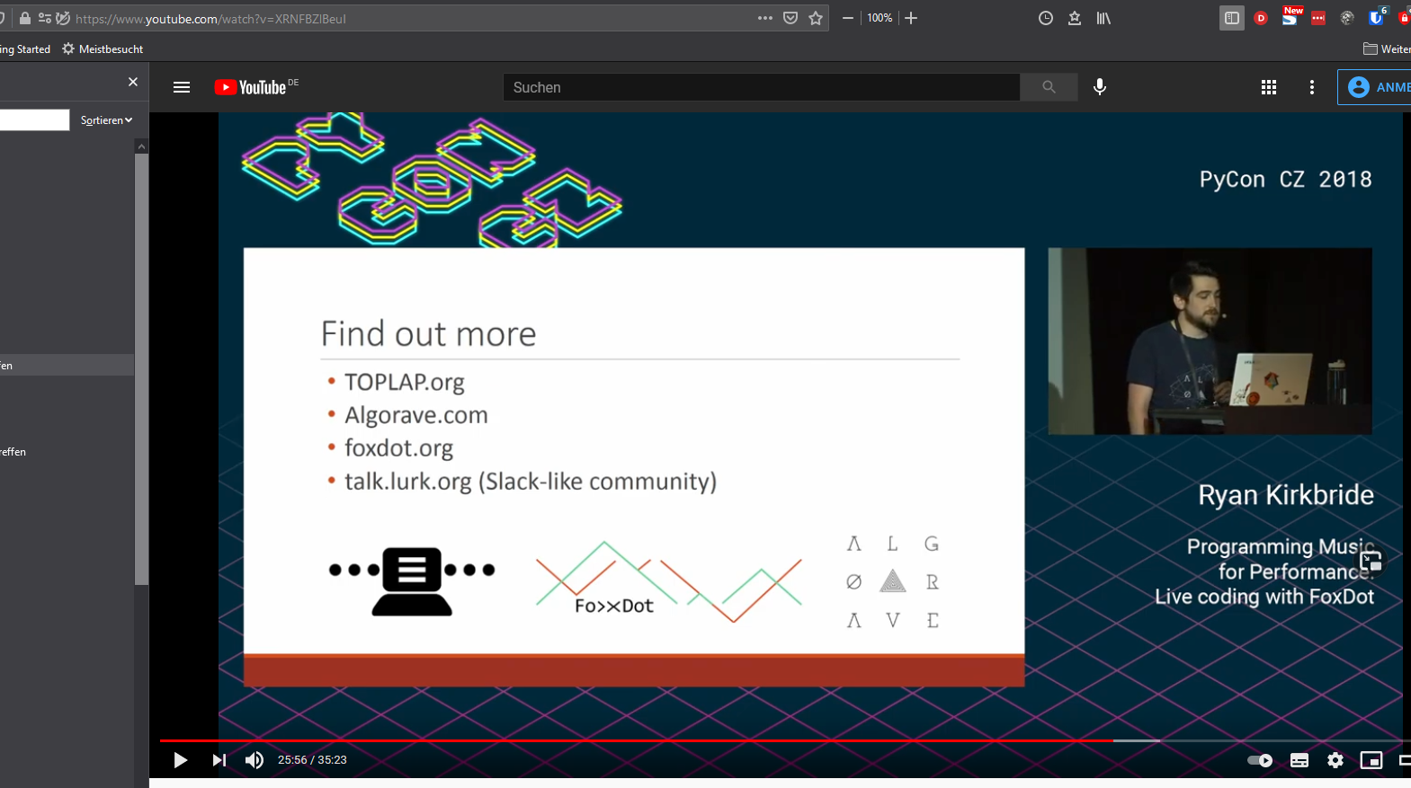
https://www.youtube.com/watch?v=XRNFBZlBeuI

Slide 26
Login: Yetigo42
https://foxdot.org/docs/player-effects/
https://foxdot.org/docs/playing-samples/

Slide 27
echoes
piano_group = piano_rhythm()
piano_group.pan = [0.25]
piano_group.fmod = 0
piano_group.vib=0
piano_group.vibdepth=0.5
piano_group.slide=0
piano_group.bend=0
piano_group.chop=0
piano_group.coarse=0
piano_group.dist=0.5
piano_group.shape=0.8
piano_group.drive=0.1
piano_group.echo=0.4
piano_group.echotime=4
piano_group.room=0.8
piano_group.cut=0
piano_group.formant=2
piano_group.tremolo=0
piano_group.pshift=[2]
piano_group.glide=[2]

Slide 28
Record random generated patterns for reuse
Is it possible to store a log file with pattern informations of a live session?

