Slide 1
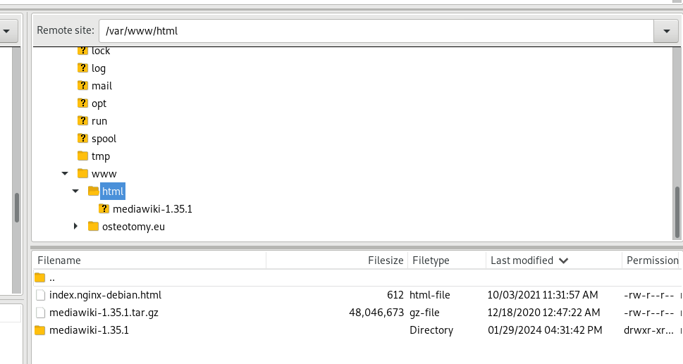
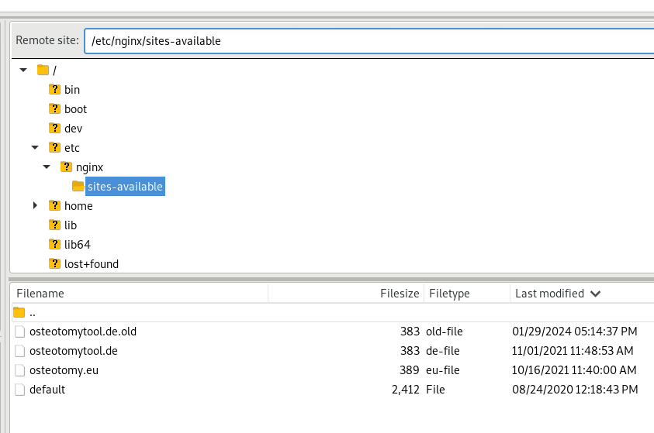

Slide 2
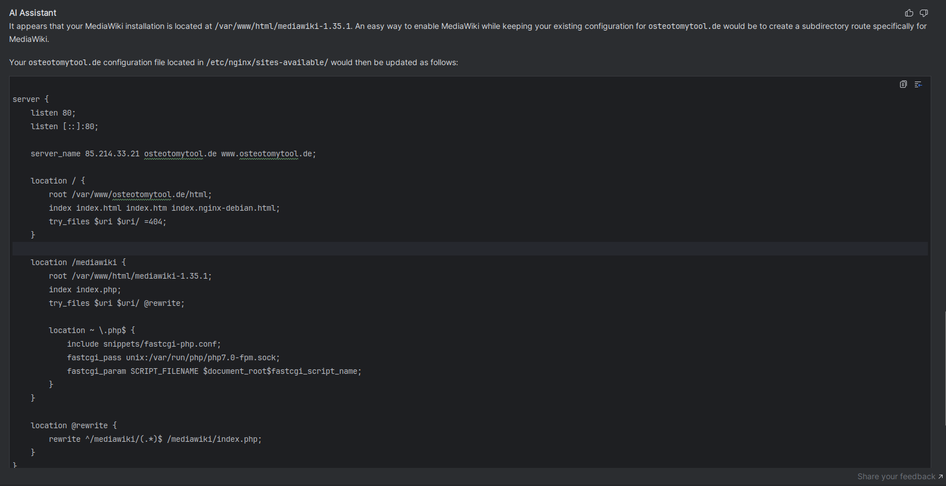
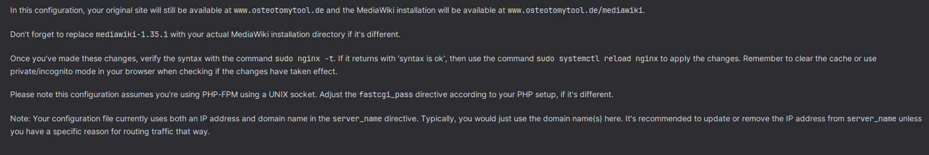

Slide 3
In this configuration, your original site will still be available at www.osteotomytool.de and the MediaWiki installation will be available at www.osteotomytool.de/mediawiki.
Don't forget to replace mediawiki-1.35.1 with your actual MediaWiki installation directory if it's different.
Once you've made these changes, verify the syntax with the command
sudo nginx -t
If it returns with 'syntax is ok', then use the command
sudo systemctl reload nginx
to apply the changes.
Remember to clear the cache or use private/incognito mode in your browser when checking if the changes have taken effect.
Please note this configuration assumes you're using PHP-FPM using a UNIX socket. Adjust the fastcgi_pass directive according to your PHP setup, if it's different.

Slide 4
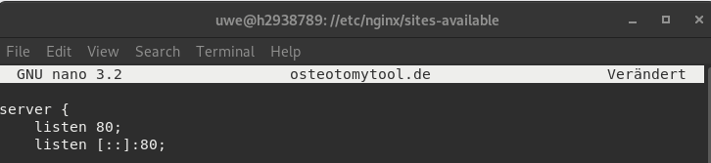
server {
listen 80;
listen [::]:80;
server_name osteotomytool.de www.osteotomytool.de;
location / {
root /var/www/osteotomytool.de/html;
index index.html index.htm index.nginx-debian.html;
try_files $uri $uri/ =404;
}
location /mediawiki {
alias /var/www/html/mediawiki-1.35.1;
index index.php;
location ~ \.php$ {
include snippets/fastcgi-php.conf;
fastcgi_param SCRIPT_FILENAME $request_filename;
fastcgi_pass unix:/var/run/php/php7.0-fpm.sock;
}
location ~ /mediawiki/.*\.php$ {
rewrite ^/mediawiki/(.*)$ /mediawiki/index.php;
}
location /mediawiki {
try_files $uri $uri/ @mediawiki;
}
location @mediawiki {
rewrite ^/mediawiki/(.*)$ /mediawiki/index.php;
}
}
}

Slide 5
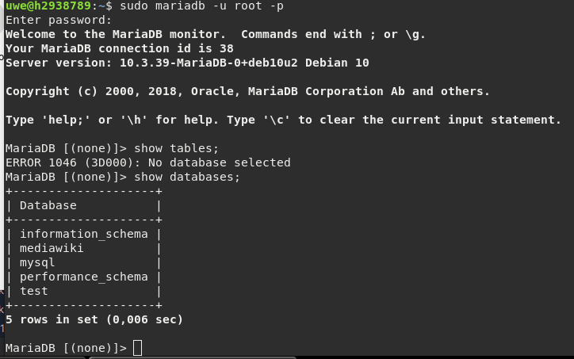

Slide 6
root@h2938789:/home/uwe/.acme.sh# acme.sh --issue -d osteotomytool.de -d www.osteotomytool.de -w /var/www/html
[Wed 31 Jan 2024 08:09:25 PM CET] Using CA: https://acme.zerossl.com/v2/DV90
[Wed 31 Jan 2024 08:09:26 PM CET] Multi domain='DNS:osteotomytool.de,DNS:www.osteotomytool.de'
[Wed 31 Jan 2024 08:09:26 PM CET] Getting domain auth token for each domain
[Wed 31 Jan 2024 08:09:38 PM CET] Getting webroot for domain='osteotomytool.de'
[Wed 31 Jan 2024 08:09:38 PM CET] Getting webroot for domain='www.osteotomytool.de'
[Wed 31 Jan 2024 08:09:39 PM CET] Verifying: osteotomytool.de
[Wed 31 Jan 2024 08:09:42 PM CET] Processing, The CA is processing your order, please just wait. (1/30)
[Wed 31 Jan 2024 08:09:45 PM CET] Success
[Wed 31 Jan 2024 08:09:45 PM CET] Verifying: www.osteotomytool.de
[Wed 31 Jan 2024 08:09:48 PM CET] Processing, The CA is processing your order, please just wait. (1/30)
[Wed 31 Jan 2024 08:09:54 PM CET] Success
[Wed 31 Jan 2024 08:09:54 PM CET] Verify finished, start to sign.
[Wed 31 Jan 2024 08:09:54 PM CET] Lets finalize the order.
[Wed 31 Jan 2024 08:09:54 PM CET] Le_OrderFinalize='https://acme.zerossl.com/v2/DV90/order/adjrj-ZNp_1QdmYojDxn2Q/finalize'
[Wed 31 Jan 2024 08:09:57 PM CET] Order status is processing, lets sleep and retry.
[Wed 31 Jan 2024 08:09:57 PM CET] Retry after: 15
[Wed 31 Jan 2024 08:10:13 PM CET] Polling order status: https://acme.zerossl.com/v2/DV90/order/adjrj-ZNp_1QdmYojDxn2Q
[Wed 31 Jan 2024 08:10:14 PM CET] Downloading cert.
[Wed 31 Jan 2024 08:10:14 PM CET] Le_LinkCert='https://acme.zerossl.com/v2/DV90/cert/AEBn1SBB4Fp71DHzDO_yog'
[Wed 31 Jan 2024 08:10:16 PM CET] Cert success.
-----BEGIN CERTIFICATE-----
MIIEGjCCA5+gAwIBAgIQY+13kW9r609qSlm3lmmgtDAKBggqhkjOPQQDAzBLMQsw
CQYDVQQGEwJBVDEQMA4GA1UEChMHWmVyb1NTTDEqMCgGA1UEAxMhWmVyb1NTTCBF
Q0MgRG9tYWluIFNlY3VyZSBTaXRlIENBMB4XDTI0MDEzMTAwMDAwMFoXDTI0MDQz
MDIzNTk1OVowGzEZMBcGA1UEAxMQb3N0ZW90b215dG9vbC5kZTBZMBMGByqGSM49
AgEGCCqGSM49AwEHA0IABGQorCjZ52BRYgr1dXPE6yRrBT7rgXI1FZLqsNjlnRIe
4Q1u6y4R5jTe82beo7aIhioeEMC17/Zi4HEQ/FMXIi6jggKTMIICjzAfBgNVHSME
GDAWgBQPa+ZLzjlHrvZ+kB558DCRkshfozAdBgNVHQ4EFgQUDbCcCQfNnyLxaVm4
bRFr7qUrt2AwDgYDVR0PAQH/BAQDAgeAMAwGA1UdEwEB/wQCMAAwHQYDVR0lBBYw
FAYIKwYBBQUHAwEGCCsGAQUFBwMCMEkGA1UdIARCMEAwNAYLKwYBBAGyMQECAk4w
JTAjBggrBgEFBQcCARYXaHR0cHM6Ly9zZWN0aWdvLmNvbS9DUFMwCAYGZ4EMAQIB
MIGIBggrBgEFBQcBAQR8MHowSwYIKwYBBQUHMAKGP2h0dHA6Ly96ZXJvc3NsLmNy
dC5zZWN0aWdvLmNvbS9aZXJvU1NMRUNDRG9tYWluU2VjdXJlU2l0ZUNBLmNydDAr
BggrBgEFBQcwAYYfaHR0cDovL3plcm9zc2wub2NzcC5zZWN0aWdvLmNvbTCCAQUG
CisGAQQB1nkCBAIEgfYEgfMA8QB3AHb/iD8KtvuVUcJhzPWHujS0pM27KdxoQgqf
5mdMWjp0AAABjWDtrgMAAAQDAEgwRgIhAOMs3s0VwD1WaI6F1TZR2DIRC8vqjqnV
HhPVw1QpmaIjAiEAt7Dd+JOWW9GueVopxhHb6/cJOGBfqPr9N+qu+vLG6IUAdgA7
U3d1Pi25gE6LMFsG/kA7Z9hPw/THvQANLXJv4frUFwAAAY1g7a63AAAEAwBHMEUC
IGztW0ONbO946TikNPO6GBcV3F0wkL5BxTJpdMIdXc3eAiEA28ufgAw6eQsi8Oey
oys9YgKNMk8cNMsrQWyZwZ7gZbMwMQYDVR0RBCowKIIQb3N0ZW90b215dG9vbC5k
ZYIUd3d3Lm9zdGVvdG9teXRvb2wuZGUwCgYIKoZIzj0EAwMDaQAwZgIxALXKLq63
hfzPYsdWs+d65xD6lqYt9oemiD4lyfJng0mVOq2dSpxdH/lqu8U9tkSxMwIxAMBN
iukLq8b+D0U2t0sg0VDK7JQmMV651J6P4rVPU2kAbfZof4eVln+zmv8pfZd9/g==
-----END CERTIFICATE-----
[Wed 31 Jan 2024 08:10:16 PM CET] Your cert is in: /home/uwe/.acme.sh/osteotomytool.de_ecc/osteotomytool.de.cer
[Wed 31 Jan 2024 08:10:16 PM CET] Your cert key is in: /home/uwe/.acme.sh/osteotomytool.de_ecc/osteotomytool.de.key
[Wed 31 Jan 2024 08:10:16 PM CET] The intermediate CA cert is in: /home/uwe/.acme.sh/osteotomytool.de_ecc/ca.cer
[Wed 31 Jan 2024 08:10:16 PM CET] And the full chain certs is there: /home/uwe/.acme.sh/osteotomytool.de_ecc/fullchain.cer
root@h2938789:/home/uwe/.acme.sh#

Slide 7
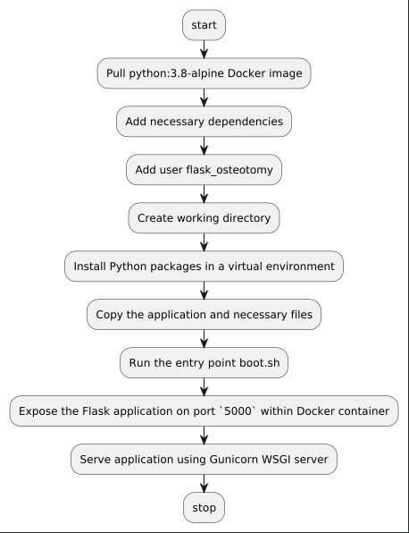

Slide 9
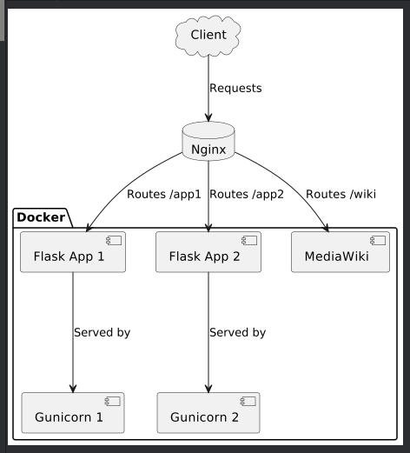

Slide 10
You can use the official Docker images for Flask via the Python image, MediaWiki and Nginx for this setup. The following steps assume that you have Docker and Docker Compose installed on your server.
In terms of Docker images:
For the Flask applications, you can use the official Python image from Docker.
You will create a Dockerfile for each of your Flask applications and use the Python image as the base.
For MediaWiki, use the official MediaWiki image from Docker.
For Nginx, use the official Nginx image from Docker.
Here's what your docker-compose.yml file might look like:
Flask Docker setup Here's a basic Dockerfile for a Flask app:
FROM python:3.12.1-buster WORKDIR /app COPY . /app RUN pip install --no-cache-dir -r requirements.txt CMD ["gunicorn", "app:app", "-c", "./gunicorn.conf.py"]
version: "3"
services:
nginx:
image: nginx:latest
ports:
- 80:80
- 443:443
volumes:
- ./nginx:/etc/nginx/conf.d
- ./certs:/etc/ssl/certs:ro
depends_on:
- wiki
- app1
- app2
wiki:
image: mediawiki
ports:
- 8080:80
volumes:
- ./mediawiki:/var/www/html
app1:
build: ./app1
volumes:
- ./app1:/app
app2:
build: ./app2
volumes:
- ./app2:/app
MediaWiki Docker setup
The official MediaWiki Docker image is configured to serve MediaWiki over port 80 by default. It might be a bit trickier with MediaWiki, though, because they might require some configuration steps that go beyond just instantiating a Docker container.
Nginix Docker setup
You need to configure the Nginx Docker container to use your SSL certificate and route incoming traffic to the correct location.
You will have a local directory structure where each app has its own directory (app1 and app2

Slide 13
SSL Certificates Setup
Ensure you place your certificates for osteotomytool.de, test.osteotomytool.de, and wiki.osteotomytool.de in the certs directory.
Finally, create configuration files for Nginx that utilize the SSL certificates and define the reverse proxy settings for the Flask apps and MediaWiki. Here's a sample Nginx configuration file to give you an idea. This listens in https, creates an upstream to your servers and defines the proxy_pass:
upstream osteotomy_flask {
server app1:5000;
server app2:5001;
}
server {
listen 80;
listen [::]:80;
server_name osteotomytool.de www.osteotomytool.de;
location / {
return 301 https://$host$request_uri;
}
}
server {
listen 443 ssl;
server_name osteotomytool.de www.osteotomytool.de;
ssl_certificate /etc/ssl/certs/osteotomytool.crt;
ssl_certificate_key /etc/ssl/osteotomytool.key;
location / {
proxy_pass http://osteotomy_flask;
proxy_set_header Host $host;
proxy_set_header X-Real-IP $remote_addr;
proxy_set_header X-Forwarded-For $proxy_add_x_forwarded_for;
proxy_set_header X-Forwarded-Proto $scheme;
}
}

