Slide 1
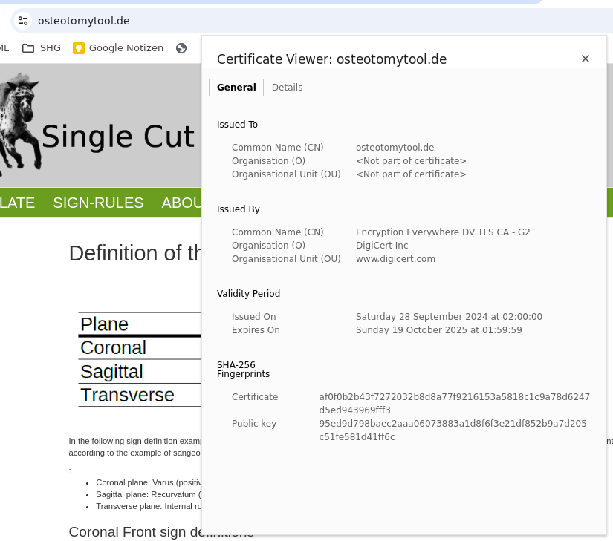
Strato Zertifikaterneuerung am 15.11.24 gemäß Beschreibung in dieser Datei
uwe@hpi5-p8:~/Documents/Osteotomytool$ cat cert_osteotomytool.de.crt root_osteotomytool.de.crt intermediate_osteotomytool.de.crt > osteotomytool_chain.crt
uwe@hpi5-p8:~/Documents/Osteotomytool$ ssh uwe@85.214.33.21
uwe@85.214.33.21's password:
Last login: Mon Nov 11 19:09:13 2024 from 79.209.33.227
uwe@h2938789:~$ su
Passwort:
root@h2938789:/home/uwe# mv /tmp/osteotomytool_chain.crt /etc/ssl/certs/osteotomytool_chain.crt
root@h2938789:/home/uwe# chmod 644 /etc/ssl/certs/osteotomytool_chain.crt
root@h2938789:/home/uwe# systemctl restart nginx
root@h2938789:/home/uwe# exit
exit
uwe@h2938789:~$ exit
Abgemeldet
Connection to 85.214.33.21 closed.
uwe@hpi5-p8:~/Documents/Osteotomytool$ openssl s_client -connect 85.214.33.21:443 -servername 85.214.33.21
CONNECTED(00000003)
depth=2 C = US, O = DigiCert Inc, OU = www.digicert.com, CN = DigiCert Global Root G2
verify return:1
depth=1 C = US, O = DigiCert Inc, OU = www.digicert.com, CN = Encryption Everywhere DV TLS CA - G2
verify return:1
depth=0 CN = osteotomytool.de
verify return:1
---
Certificate chain
0 s:CN = osteotomytool.de
…..
Die Zertifikatdetails werden angezeigt!

Slide 2
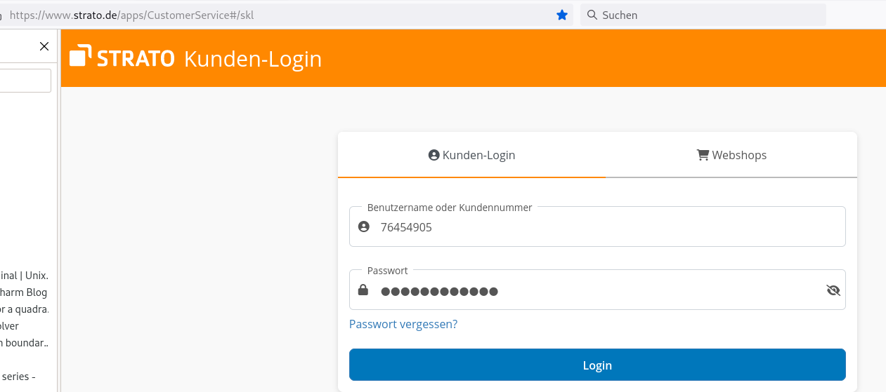
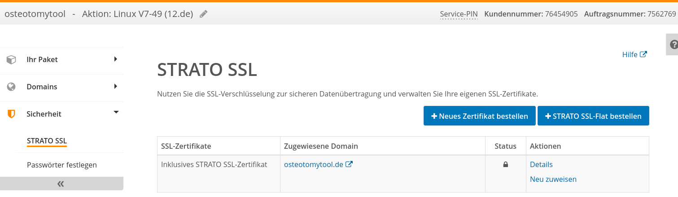
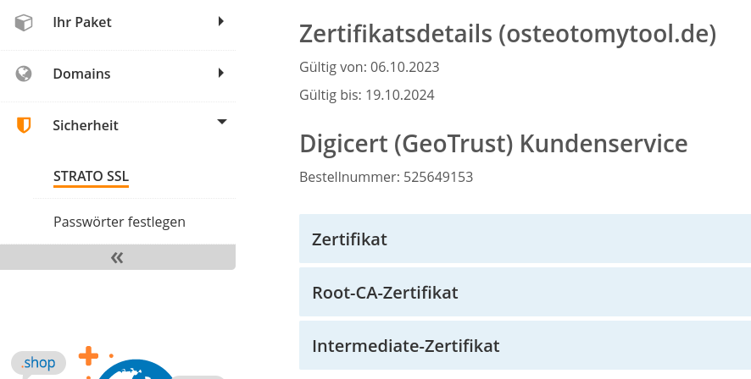

Certificat_renew_Strato.odp
herunterladen

Slide 3
Concatenate the certificate (server's certificate), the Intermediate Certificate and the Root Certificate into one file. The concatenation should be in this order:
cat Zertifikat.pem Intermediate-Zertifikat.pem Root-CA-Zertifikat.pem > chained.pem
Consolbefehl mit den Strato Dateien:
uwe@hpi5-p8:~/Downloads$ cat cert_osteotomytool.de.crt root_osteotomytool.de.crt intermediate_osteotomytool.de.crt > osteotomytool_chain.crt

Slide 4
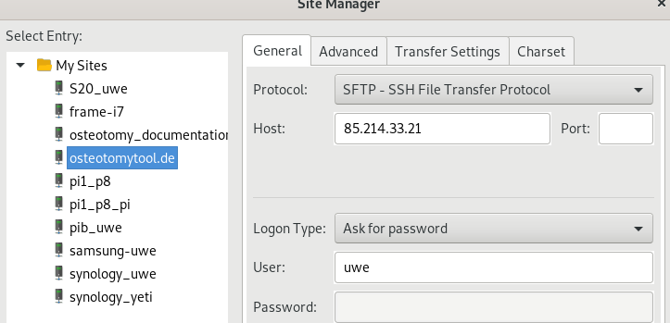
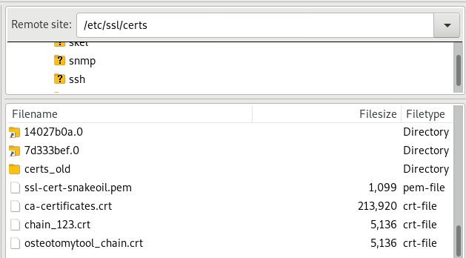
Mit FileZilla die Zusammengesetzte Zertifikatsdatei in das richtige Verzeichnis kopieren:
ssl_certificate /etc/ssl/certs/osteotomytool_chain.crt;
FileZilla

Slide 5
uwe@h2938789://etc/nginx/conf.d/project.conf
uwe@h2938789://etc/nginx/conf.d$ ls
project.conf project.conf.old_1 project.conf.old_211114_a project.conf.save project.conf.test_80
project.conf.old project.conf.old_211114 project.conf.osteo_01 project.conf.save.1
uwe@h2938789://etc/nginx/conf.d$ cat project.conf
server {
listen 443 ssl;
server_name 85.214.33.21;
ssl_certificate /etc/ssl/certs/osteotomytool_chain.crt;
ssl_certificate_key /etc/ssl/private/osteotomytool_de.key;
location / {
proxy_pass http://85.214.33.21:8000/;
# Do not change this
proxy_set_header Host $host;
proxy_set_header X-Real-IP $remote_addr;
proxy_set_header X-Forwarded-For $proxy_add_x_forwarded_for;
}
# location / {
# if ($host = http.osteotomytool.de) {
# return 301 https://server_name$request_uri;
# }
# }
# location /static {
# rewrite ^/static(.*) /$1 break;
# root /static;
# }
}
server {
listen 80;
server_name osteotomytool.de www.osteotomytool.de osteotomy.eu www.osteotomy.eu;
location / {
return 301 https://$host$request_uri;
}
}

Slide 6
Test if your configuration is correct:
uwe@h2938789://etc/nginx/conf.d$ cd ~
uwe@h2938789:~$ sudo nginx -t
[sudo] Passwort für uwe:
nginx: the configuration file /etc/nginx/nginx.conf syntax is ok
nginx: configuration file /etc/nginx/nginx.conf test is successful
uwe@h2938789:~$
If all is well, reload the nginx:
sudo systemctl reload nginx
Alternativ:
Server neu starten mit:
uwe@h2938789:~$ sudo reboot now

Slide 7
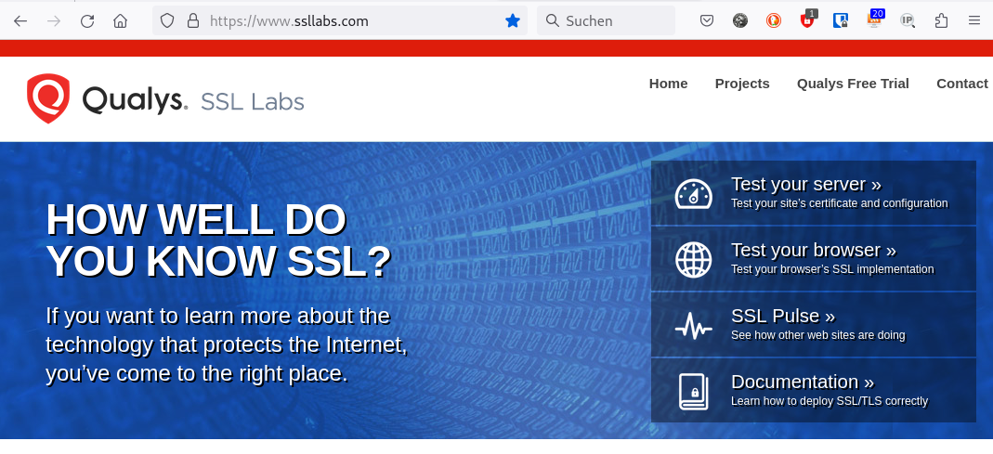
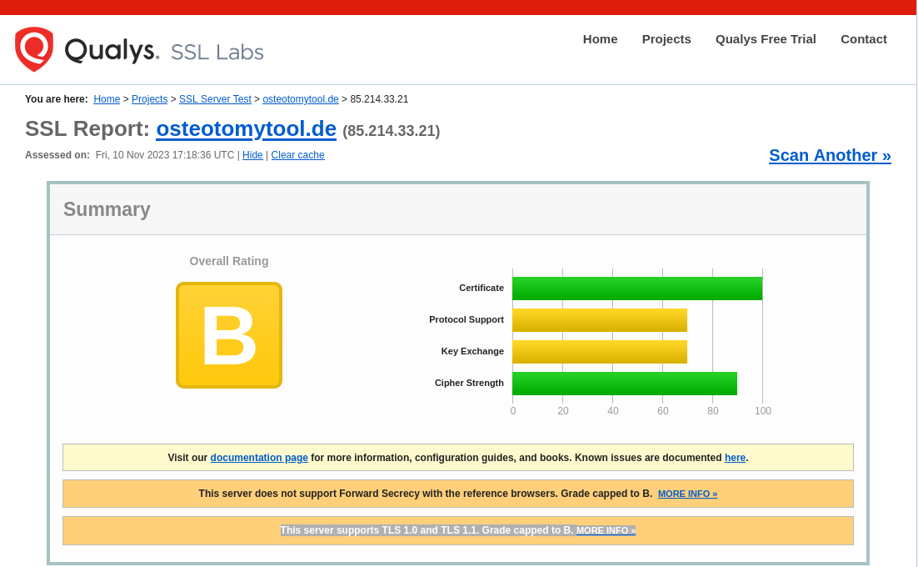
Testen des Certifikats:
https://www.ssllabs.com/

Slide 8
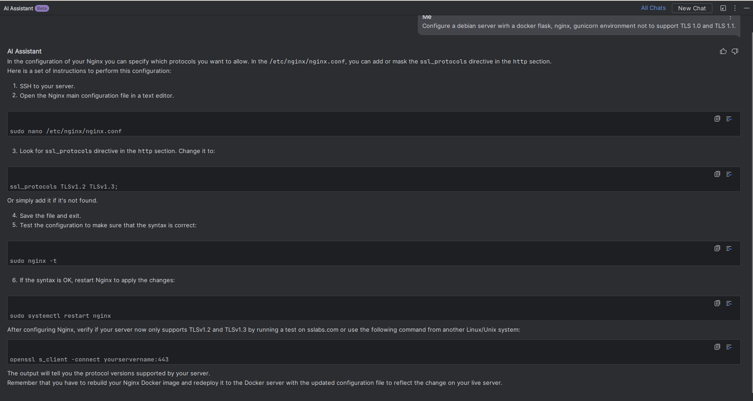
Configure a debian server wirh a docker flask, nginx, gunicorn environment not to support TLS 1.0 and TLS 1.1.
uwe@h2938789://etc/nginx/conf.d$ cat project.conf
server {
listen 443 ssl;
server_name 85.214.33.21;
ssl_protocols TLSv1.2 TLSv1.3;
ssl_certificate /etc/ssl/certs/osteotomytool_chain.crt;
ssl_certificate_key /etc/ssl/private/osteotomytool_de.key;
location / {
proxy_pass http://85.214.33.21:8000/;
# Do not change this
proxy_set_header Host $host;
proxy_set_header X-Real-IP $remote_addr;
proxy_set_header X-Forwarded-For $proxy_add_x_forwarded_for;
}
# location / {
# if ($host = http.osteotomytool.de) {
# return 301 https://server_name$request_uri;
# }
# }
# location /static {
# rewrite ^/static(.*) /$1 break;
# root /static;
# }
}
server {
listen 80;
server_name osteotomytool.de www.osteotomytool.de osteotomy.eu www.osteotomy.eu;
location / {
return 301 https://$host$request_uri;
}
}

Slide 9
uwe@h2938789://etc/nginx$ cd conf.d/
uwe@h2938789://etc/nginx/conf.d$ ls
project.conf project.conf.old_1 project.conf.old_211114_a project.conf.save project.conf.test_80
project.conf.old project.conf.old_211114 project.conf.osteo_01 project.conf.save.1
uwe@h2938789://etc/nginx/conf.d$ cp project.conf project.conf.old_231110
cp: reguläre Datei 'project.conf.old_231110' kann nicht angelegt werden: Keine Berechtigung
uwe@h2938789://etc/nginx/conf.d$ sudo cp project.conf project.conf.old_231110
[sudo] Passwort für uwe:
uwe@h2938789://etc/nginx/conf.d$ sudo nano project.conf
uwe@h2938789://etc/nginx/conf.d$ sudo nginx -t
nginx: the configuration file /etc/nginx/nginx.conf syntax is ok
nginx: configuration file /etc/nginx/nginx.conf test is successful
uwe@h2938789://etc/nginx/conf.d$ sudo systemctl restart nginx
uwe@h2938789://etc/nginx/conf.d$ openssl s_client -connect osteotomytool.de:443
CONNECTED(00000003)
depth=2 C = US, O = DigiCert Inc, OU = www.digicert.com, CN = DigiCert Global Root G2
verify return:1
depth=1 C = US, O = DigiCert Inc, OU = www.digicert.com, CN = Encryption Everywhere DV TLS CA - G2
verify return:1
depth=0 CN = osteotomytool.de
verify return:1
---
Certificate chain
0 s:CN = osteotomytool.de
i:C = US, O = DigiCert Inc, OU = www.digicert.com, CN = Encryption Everywhere DV TLS CA - G2
1 s:C = US, O = DigiCert Inc, OU = www.digicert.com, CN = Encryption Everywhere DV TLS CA - G2
i:C = US, O = DigiCert Inc, OU = www.digicert.com, CN = DigiCert Global Root G2
2 s:C = US, O = DigiCert Inc, OU = www.digicert.com, CN = DigiCert Global Root G2
i:C = US, O = DigiCert Inc, OU = www.digicert.com, CN = DigiCert Global Root G2
---
Server certificate
-----BEGIN CERTIFICATE-----
MIIGDzCCBPegAwIBAgIQBeRFw1dCJAL7SGqYfxrvfzANBgkqhkiG9w0BAQsFADBu
...
.
MvyWe5m0Hg0/rRSIWmXN+Vrnfw==
-----END CERTIFICATE-----
subject=CN = osteotomytool.de
issuer=C = US, O = DigiCert Inc, OU = www.digicert.com, CN = Encryption Everywhere DV TLS CA - G2
---
No client certificate CA names sent
Peer signing digest: SHA256
Peer signature type: RSA-PSS
Server Temp Key: X25519, 253 bits
---
SSL handshake has read 4233 bytes and written 388 bytes
Verification: OK
---
New, TLSv1.3, Cipher is TLS_AES_256_GCM_SHA384
Server public key is 2048 bit
Secure Renegotiation IS NOT supported
Compression: NONE
Expansion: NONE
No ALPN negotiated
Early data was not sent
Verify return code: 0 (ok)
---
---
Post-Handshake New Session Ticket arrived:
SSL-Session:
Protocol : TLSv1.3
Cipher : TLS_AES_256_GCM_SHA384
Session-ID: F2CCFC36B74FFDB6C854EEE5A44C473730F7CAD7D12C7E40CC6A003779AD1A0F
Session-ID-ctx:
Resumption PSK: 1F2E5274C9E1CC636AE9ECCB9A66EDD51A10FCECC8749CED19255B39A45CC6A51F81BB1396175EF45E8058C5EEB55EEF
PSK identity: None
PSK identity hint: None
SRP username: None
TLS session ticket lifetime hint: 300 (seconds)
TLS session ticket:
0000 - 43 d3 7c 15 1d 32 3b 98-32 9a a1 89 f8 be 0a c2 C.|..2;.2.......
...
00d0 - 88 8a 0c 6d bb b8 47 29-53 dd 0d a1 cd e1 9e ea ...m..G)S.......
Start Time: 1699640192
Timeout : 7200 (sec)
Verify return code: 0 (ok)
Extended master secret: no
Max Early Data: 0
---
read R BLOCK
---
Post-Handshake New Session Ticket arrived:
SSL-Session:
Protocol : TLSv1.3
Cipher : TLS_AES_256_GCM_SHA384
Session-ID: 2FE61798503477268138E51B9459769FD0B9BB947946A5C99217130B7BAA7B4E
Session-ID-ctx:
Resumption PSK: D473B997F087F6EE1E84AA2BACD247B2517A3BA512FCEAB4481589FC6DF7E0D1E842566B3DB4FEDAE92BDF92C89742C4
PSK identity: None
PSK identity hint: None
SRP username: None
TLS session ticket lifetime hint: 300 (seconds)
TLS session ticket:
0000 - 43 d3 7c 15 1d 32 3b 98-32 9a a1 89 f8 be 0a c2 C.|..2;.2.......
...
00d0 - d9 a5 4a 49 b8 bb 0b b7-e8 cb ad b7 22 e2 b6 c6 ..JI........"...
Start Time: 1699640192
Timeout : 7200 (sec)
Verify return code: 0 (ok)
Extended master secret: no
Max Early Data: 0
---
read R BLOCK
closed

Slide 10
Configure a debian server wirh a docker flask, nginx, gunicorn environment to support Forward Secrecy with the browsers
uwe@h2938789://etc/nginx/conf.d$ cat project.conf
server {
listen 443 ssl;
server_name 85.214.33.21;
ssl_protocols TLSv1.2 TLSv1.3;
ssl_prefer_server_ciphers on;
ssl_dhparam /etc/nginx/ssl/dhparam.pem;
ssl_ciphers 'ECDHE-RSA-AES128-GCM-SHA256:ECDHE-ECDSA-AES128-GCM-SHA256:ECDHE-RSA-AES256-GCM-SHA384:ECDHE-ECDSA-AES256-GCM-SHA384:DHE-RSA-AES128-GCM-SHA256:DHE-DSS-AES128-GCM-SHA256:kEDH+AESGCM:ECDHE-RSA-AES128-SHA256:ECDHE-ECDSA-AES128-SHA256:ECDHE-RSA-AES128-SHA:ECDHE-ECDSA-AES128-SHA:ECDHE-RSA-AES256-SHA384:ECDHE-ECDSA-AES256-SHA384:ECDHE-RSA-AES256-SHA:ECDHE-ECDSA-AES256-SHA:DHE-RSA-AES128-SHA256:DHE-RSA-AES128-SHA:DHE-DSS-AES128-SHA256:DHE-RSA-AES256-SHA256:DHE-DSS-AES256-SHA:DHE-RSA-AES256-SHA:ECDHE-RSA-DES-CBC3-SHA:ECDHE-ECDSA-DES-CBC3-SHA:AES128-GCM-SHA256:AES256-GCM-SHA384:AES128-SHA256:AES256-SHA256:AES128-SHA:AES256-SHA:AES:CAMELLIA:DES-CBC3-SHA:!aNULL:!eNULL:!EXPORT:!DES:!RC4:!MD5:!PSK:!aECDH:!EDH-DSS-DES-CBC3-SHA:!EDH-RSA-DES-CBC3-SHA:!KRB5-DES-CBC3-SHA';
ssl_certificate /etc/ssl/certs/osteotomytool_chain.crt;
ssl_certificate_key /etc/ssl/private/osteotomytool_de.key;
location / {
proxy_pass http://85.214.33.21:8000/;
# Do not change this
proxy_set_header Host $host;
proxy_set_header X-Real-IP $remote_addr;
proxy_set_header X-Forwarded-For $proxy_add_x_forwarded_for;
}
# location / {
# if ($host = http.osteotomytool.de) {
# return 301 https://server_name$request_uri;
# }
# }
# location /static {
# rewrite ^/static(.*) /$1 break;
# root /static;
# }
}
server {
listen 80;
server_name osteotomytool.de www.osteotomytool.de osteotomy.eu www.osteotomy.eu;
location / {
return 301 https://$host$request_uri;
}
}
generate the dhparam.pem file
2038 sudo mkdir -p /etc/nginx/ssl/
2039 ll
2040 sudo openssl dhparam -out /etc/nginx/ssl/dhparam.pem 2048
2041 sudo nginx -t
2042 sudo systemctl restart nginx
2047 openssl s_client -connect osteotomytool.de:443
2048 sudo nginx -t
2049 systemctl status nginx
Korektur für Ipv6 siehe nächste Seite!

Slide 11
uwe@h2938789:~$ cd //etc/nginx
uwe@h2938789://etc/nginx$ cd conf.d/
uwe@h2938789://etc/nginx/conf.d$ ll
insgesamt 64
-rw-r--r-- 1 root root 3295 Nov 11 13:37 project.conf
server {
listen 443 ssl;
server_name 85.214.33.21;
ssl_protocols TLSv1.2 TLSv1.3;
ssl_prefer_server_ciphers on;
ssl_dhparam /etc/nginx/ssl/dhparam.pem;
ssl_ciphers 'ECDHE-RSA-AES128-GCM-SHA256:ECDHE-ECDSA-AES128-GCM-SHA256:ECDHE-RSA-AES256-GCM-SHA384:ECDHE-ECDSA-AES256-GCM-SHA384:DHE-RSA-AES128-GCM-SHA256:DHE-DSS-AES128-GCM-SHA256:kEDH+AESGCM:ECDHE-RSA-AES128-SHA256:ECDHE-ECDSA-AES128-SHA256:ECDHE-RSA-AES128-SHA:ECDHE-ECDSA-AES128-SHA:ECDHE-RSA-AES256-SHA384:ECDHE-ECDSA-AES256-SHA384:ECDHE-RSA-AES256-SHA:ECDHE-ECDSA-AES256-SHA:DHE-RSA-AES128-SHA256:DHE-RSA-AES128-SHA:DHE-DSS-AES128-SHA256:DHE-RSA-AES256-SHA256:DHE-DSS-AES256-SHA:DHE-RSA-AES256-SHA:ECDHE-RSA-DES-CBC3-SHA:ECDHE-ECDSA-DES-CBC3-SHA:AES128-GCM-SHA256:AES256-GCM-SHA384:AES128-SHA256:AES256-SHA256:AES128-SHA:AES256-SHA:AES:CAMELLIA:DES-CBC3-SHA:!aNULL:!eNULL:!EXPORT:!DES:!RC4:!MD5:!PSK:!aECDH:!EDH-DSS-DES-CBC3-SHA:!EDH-RSA-DES-CBC3-SHA:!KRB5-DES-CBC3-SHA';
ssl_certificate /etc/ssl/certs/osteotomytool_chain.crt;
ssl_certificate_key /etc/ssl/private/osteotomytool_de.key;
location / {
proxy_pass http://85.214.33.21:8000/;
# Do not change this
proxy_set_header Host $host;
proxy_set_header X-Real-IP $remote_addr;
proxy_set_header X-Forwarded-For $proxy_add_x_forwarded_for;
}
}
server {
listen [2a01:238:43de:3800:1b46:71d6:c0ea:eb03]:443 ssl;
server_name 2a01:238:43de:3800:1b46:71d6:c0ea:eb03; # domain here
ssl_protocols TLSv1.2 TLSv1.3;
ssl_prefer_server_ciphers on;
ssl_dhparam /etc/nginx/ssl/dhparam.pem;
ssl_ciphers 'ECDHE-RSA-AES128-GCM-SHA256:ECDHE-ECDSA-AES128-GCM-SHA256:ECDHE-RSA-AES256-GCM-SHA384:ECDHE-ECDSA-AES256-GCM-SHA384:DHE-RSA-AES128-GCM-SHA256:DHE-DSS-AES128-GCM-SHA256:kEDH+AESGCM:ECDHE-RSA-AES128-SHA256:ECDHE-ECDSA-AES128-SHA256:ECDHE-RSA-AES128-SHA:ECDHE-ECDSA-AES128-SHA:ECDHE-RSA-AES256-SHA384:ECDHE-ECDSA-AES256-SHA384:ECDHE-RSA-AES256-SHA:ECDHE-ECDSA-AES256-SHA:DHE-RSA-AES128-SHA256:DHE-RSA-AES128-SHA:DHE-DSS-AES128-SHA256:DHE-RSA-AES256-SHA256:DHE-DSS-AES256-SHA:DHE-RSA-AES256-SHA:ECDHE-RSA-DES-CBC3-SHA:ECDHE-ECDSA-DES-CBC3-SHA:AES128-GCM-SHA256:AES256-GCM-SHA384:AES128-SHA256:AES256-SHA256:AES128-SHA:AES256-SHA:AES:CAMELLIA:DES-CBC3-SHA:!aNULL:!eNULL:!EXPORT:!DES:!RC4:!MD5:!PSK:!aECDH:!EDH-DSS-DES-CBC3-SHA:!EDH-RSA-DES-CBC3-SHA:!KRB5-DES-CBC3-SHA';
ssl_certificate /etc/ssl/certs/osteotomytool_chain.crt;
ssl_certificate_key /etc/ssl/private/osteotomytool_de.key;
location / {
proxy_pass http://[2a01:238:43de:3800:1b46:71d6:c0ea:eb03]:8000/; # Server IPv6
proxy_set_header Host $host;
proxy_set_header X-Real-IP $remote_addr;
proxy_set_header X-Forwarded-For $proxy_add_x_forwarded_for;
proxy_set_header X-Forwarded-Proto $scheme;
}
}
server {
listen 80;
server_name osteotomytool.de www.osteotomytool.de osteotomy.eu www.osteotomy.eu;
location / {
return 301 https://$host$request_uri;
}
}
server {
listen [2a01:238:43de:3800:1b46:71d6:c0ea:eb03]:80;
server_name osteotomytool.de www.osteotomytool.de osteotomy.eu www.osteotomy.eu;
location / {
return 301 https://$host$request_uri;
}
}

Slide 12
